Slide 1

Continuum beliefs increase problem recognition among harmful drinkers without addiction experience
James Morris, PhD candidate, London South Bank University

Slide 2
Overview
Harmful drinkers are an overlooked population:
  Do not access treatment
  Unlikely to respond to brief interventions
  Characterised by ‘denial’ i.e. low problem recognition
Limited research exploring ways to increase problem recognition as a first step to behaviour change
One opportunity may be via promoting ‘continuum beliefs’
My PhD studies sought to explore this…

Slide 3
Harmful drinkers?
Defined as consuming alcohol at levels which are already causing negative psychological or physiological effects (e.g. ICD-11) ^{[1]}
In the UK, harmful drinkers also defined as either:
  35+ (women) or 50+ units (men) per week
  Score 16+ on the AUDIT*
Distinguished from ‘dependent drinkers’ (i.e.‘subthreshold’) i.e. score low on dependence measures (SADQ/LDQ)**
But outnumber dependent drinkers by more than 2:1 e.g. in England 1.3 million harmful drinkers versus 600k dependent**
*Alcohol Use Disorders Identification Test
**Based on a moderate/severe dependence criteria (Pryce et al. 2017) [2]

Slide 4
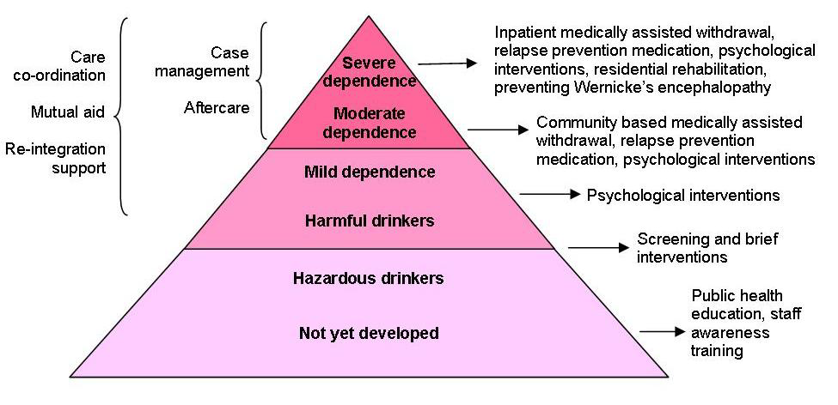
Stepped care model: missing steps?
The ‘treatment’ system
- % with mild dependence receiving treatment estimated at 1.13% (NICE) [3]
NICE alcohol guidance: CG115 (2011)

Slide 5
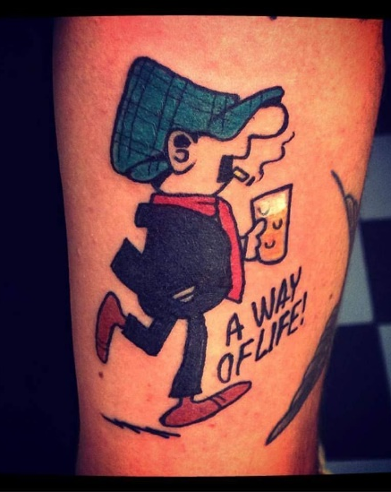
But…
Harmful drinkers have low ‘problem recognition’:
Do not describe their drinking as problematic ^{[4]} or recognise associated health problems ^{[5]}
Underestimate their drinking more than any other group ^{[6]}
Drinking often an important an part of their identity ^{[4,7]}
Rarely engage in treatment ^{[8]}
Point to ‘others’ as problem drinkers e.g ‘alcoholics’ ^{[9, 10, 11, 12]}

Slide 6

Problem recognition or denial?
‘Denial’ may be an common lay term, but ‘denial’ is complex, poorly defined etc. ^{[13]}
Valid reasons for low problem recognition may include:
  Still meeting responsibilities ^{[7]}
  Drinking pros seen as > cons ^{[11]}
  Normative misperception ^{[6]}
  Fear of stigma/labelling ^{[8, 15, 16]}
  ‘Binary thinking’: lack of an available language/framework to understand their drinking..? ^{[17, 18]}
The Nile:
“Not just a river in Egypt”?

Slide 7
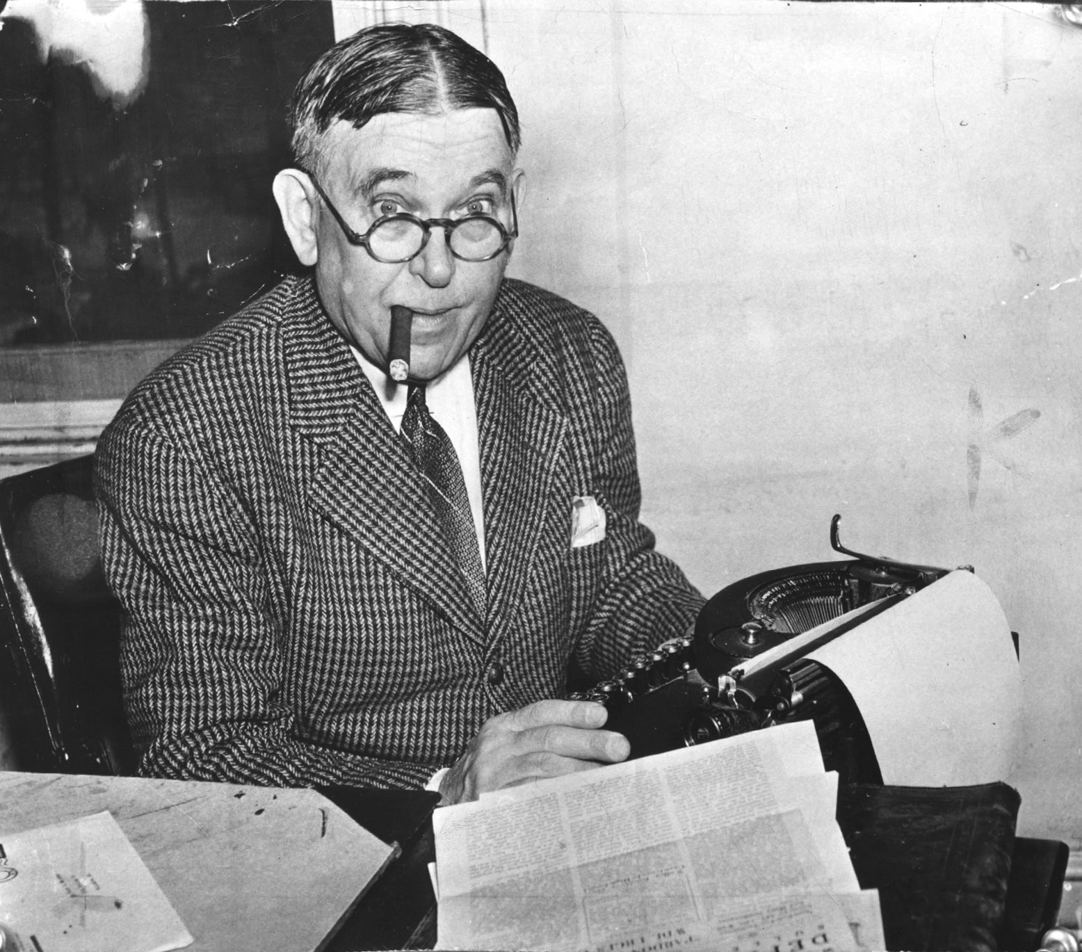
Binary thinking..?
Human tendency to categorise things i.e. to help simplify and makes sense of the world ^{[19]} & ease cognitive load ^{[20]}
The alcoholism false binary reflects lack of an adequate framework for harmful drinkers to assess their drinking ^{[18, 21]}
E.g. ‘Am I an alcoholic?’ ^{[22]}
  YES/NO?
“For every complex problem there is an answer that is clear, simple, and wrong.”
H. L. Mencken

Slide 8
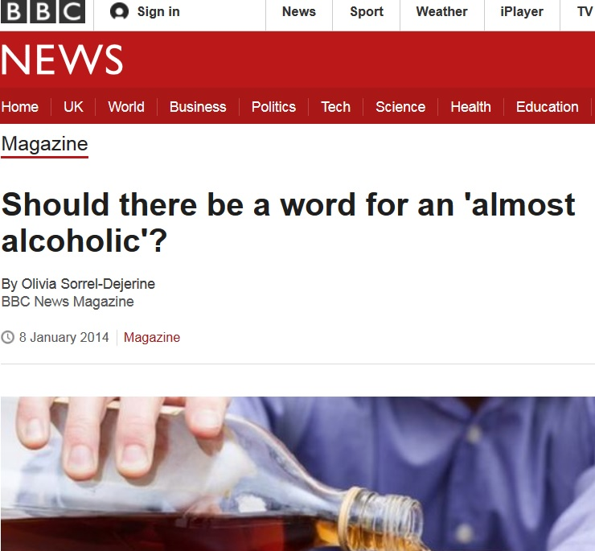
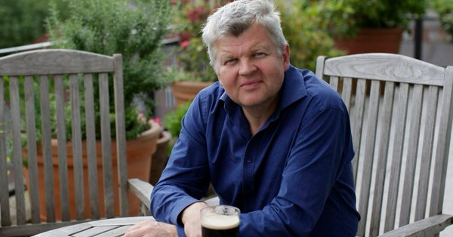
Navigating binary frames?
“My name’s Adrian Chiles, and I’m not an alcoholic… at least, I don’t think I am...?”
Adrian Chiles, ‘Drinkers Like Me’ 2018
How else can we frame alcohol problems to avoid the false binary?

Slide 9
The potential of ‘continuum beliefs’?
All drinking and problems can vary in severity
I.e. ‘anyone who drinks can experience alcohol problems’
DSM-V shift to AUDs by severity (rather than abuse vs dependence distinction)
Promoting continuum beliefs has been positive in the context of mental health help-seeking and stigma ^{[23]}
My PhD study 1 sought to test continuum vs binary beliefs amongst harmful drinkers..
‘Have a word’ version of the AUDIT-C

Slide 10
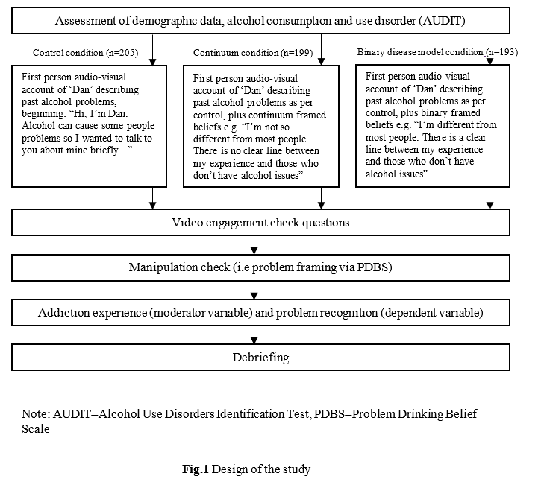
Study 1 design
Online experimental study recruitment via social media (n=579)
3 conditions (IV):
  Control
  Continuum
  Binary Disease Model (BDM)
Manipulation check adapted from the Addiction Belief Scale
Main Dependent Variable of Problem Recognition
Moderator variable of addiction experience

Slide 11
Primary hypotheses:
Continuum beliefs would increase problem recognition amongst harmful drinkers without addiction experience
Binary disease model beliefs would decrease problem recognition amongst harmful drinkers without addiction experience
No effect of condition on non-harmful drinkers or those with addiction experience

Slide 12
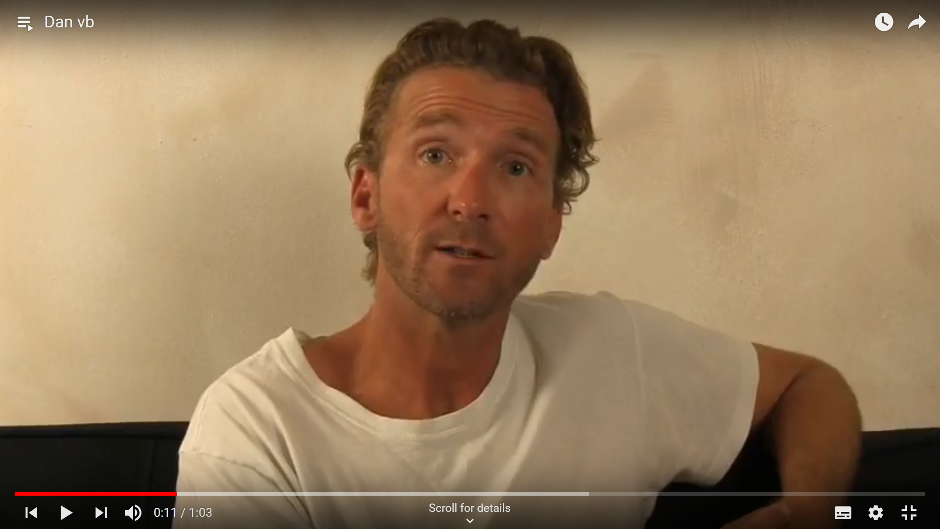
Study 1 design
Conditions used a first person audio-visual vignette based on narrative persuasion techniques
“Hi, I’m Dan. Alcohol can cause some people problems so I wanted to talk to you about mine briefly…
Continuum extract:
My drinking had become a problem but I’m not so different from most people. There is no clear line between my experience and those who don’t have alcohol issues - anyone could develop a problem with alcohol if they drink heavily...”
Manipulation check confirmed predicted differences in beliefs
Difference between Conditions on the continuum (F (2, 594) 8.91, p<.001, ηp2= .029) and BDM (F = (2, 594) 15.62, p<.001, ηp2= .050)

Slide 13
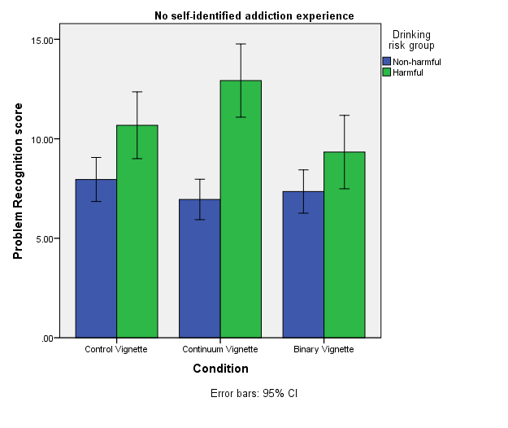
Study 1 results (accepted)
Main effects:
Harmful drinkers with no self-identified addiction experience had higher problem recognition in the continuum condition versus control (p=.007) and binary (p<.001) conditions
But no significant difference between binary and control
As predicted, no effect of condition on non-harmful drinkers or those with addiction experience

Slide 14
Continuum belief mechanisms?
Alcohol and addiction problems are highly stigmatised; people want to avoid the negative consequences of belonging to the stigmatised ‘out group’ ^{[8,10,11,12, 23]}
Thus protection from self-stigma may be a key motivation to ‘other’ e.g:
People state not wanting treatment because it will confirm their status as an ‘alcoholic’ and therefore become a target for prejudice and discrimination ^{[7]}
Or… continuum beliefs simply provide a more logical framework for self-evaluation…

Slide 15
Limitations & next steps
Harmful drinkers are a heterogeneous group with a range of drinking motives, behaviours and beliefs - including about addiction
Manipulations included different ‘recovery’ implications i.e. continuum vignette included behaviour change of drinking reduction Vs abstinence in the binary group
Continuum representation also has limitations e.g. doesn’t reflect abstinence (or periods of) and says ‘drinking problems’ which may still be considered a binary framework
What mechanisms may underlie belief effects
Implications for individual interventions or policy measures?

Slide 16
Conclusions
Whilst beliefs about alcohol problems are not purely binary or continuous, shifting beliefs towards a continuum model may have significant benefits for:
  Behaviour change / help-seeking amongst harmful drinkers
  Reducing the stigma of alcohol problems at large
  False perceptions of ‘non-problem drinking’ as risk-free
  Support for effective population policy measures
Researchers, policy-makers and individuals can help by:
  Retiring binary/stigmatising terms like ‘alcoholism’
  Promoting a diverse range of narratives about alcohol use, problems and routes to change/recovery

Slide 17

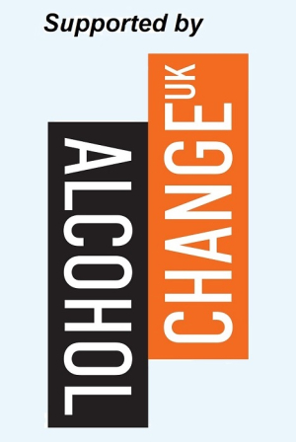
Contact & thanks
morrij17@lsbu.ac.uk
Twitter @jamesmorris24
With thanks to Alcohol Change UK and LSBU for support
Supervisors Prof Tony Moss, Prof Ian Albery, Prof Nick Heather

Slide 18
References
NICE. (2011). Alcohol-use disorders: diagnosis, assessment and management of harmful drinking and alcohol dependence [CG115]. The British Psychological Society and The Royal College of Psychiatrists. Retrieved from https://www.nice.org.uk/guidance/cg115/evidence
Pryce, R., Buykx, P., Gray, L., Stone, T., Drummond, C., & Brennan, A. (2017). Estimates of Alcohol Dependence in England based on APMS 2014, including Estimates of Children Living in a Household with an Adult with Alcohol Dependence Supplementary tables, (April). Retrieved from http://www.nta.nhs.uk/uploads/alcohol-estimates-supplementary-tables.xls
NICE. (2011a). Alcohol-use disorders: diagnosis, assessment and management of harmful drinking and alcohol dependence [CG115]. The British Psychological Society and The Royal College of Psychiatrists. Retrieved from https://www.nice.org.uk/guidance/cg115/evidence
Glass, J. E., Grant, J. D., Yoon, H. Y., & Bucholz, K. K. (2015). Alcohol problem recognition and help seeking in adolescents and young adults at varying genetic and environmental risk. Drug and Alcohol Dependence, 153, 250–257. https://doi.org/10.1016/j.drugalcdep.2015.05.006
Garnett, C., Crane, D., West, R., Michie, S., Brown, J., & Winstock, A. R. (2015). Normative misperceptions about alcohol use in the general population of drinkers: A cross-sectional survey. Addictive Behaviors (Vol. 42). https://doi.org/10.1016/j.addbeh.2014.11.010
Parke, H., Michalska, M., Russell, A., Moss, A. C., Holdsworth, C., Ling, J., & Larsen, J. (2018). Understanding drinking among midlife men in the United Kingdom: A systematic review of qualitative studies. Addictive Behaviors Reports, 8, 85–94. https://doi.org/10.1016/J.ABREP.2018.08.001
Wallhed Finn, S., Bakshi, A.-S., & Andréasson, S. (2014). Alcohol consumption, dependence, and treatment barriers: perceptions among nontreatment seekers with alcohol dependence. Substance Use & Misuse, 49(6), 762–769. https://doi.org/10.3109/10826084.2014.891616

Slide 19
Glass, J. E., Mowbray, O. P., Link, B. G., Kristjansson, S. D., & Bucholz, K. K. (2013). Alcohol stigma and persistence of alcohol and other psychiatric disorders: A modified labeling theory approach. Drug and Alcohol Dependence, 133(2), 685. https://doi.org/10.1016/j.drugalcdep.2013.08.016
Christmas, S., & Souter, A. (2016). Midlife Male Drinking | Findings from research with men aged 45 to 60. Retrieved from https://www.drinkaware.co.uk/research/our-research-and-evaluation-reports/midlife-male-drinking-report/
Khadjesari, Z., Stevenson, F., Toner, P., Linke, S., Milward, J., & Murray, E. (2018). ‘I’m not a real boozer’: a qualitative study of primary care patients’ views on drinking and its consequences. Journal of Public Health. https://doi.org/10.1093/pubmed/fdy067
Parke, H., Michalska, M., Russell, A., Moss, A. C., Holdsworth, C., Ling, J., & Larsen, J. (2018). Understanding drinking among midlife men in the United Kingdom: A systematic review of qualitative studies. Addictive Behaviors Reports, 8, 85–94. https://doi.org/10.1016/J.ABREP.2018.08.001
Thurnell-Read, T. (2017). ‘Did you ever hear of police being called to a beer festival?’ Discourses of merriment, moderation and ‘civilized’ drinking amongst real ale enthusiasts. The Sociological Review, 65(1), 83–99. https://doi.org/10.1111/1467-954X.12361
Pickard, H. (2016). Denial in Addiction. Mind & Language, 31(3), 277–299. https://doi.org/10.1111/mila.12106
Glass, 2013; Schomerus, Matschinger, & Angermeyer, 2014)Glass, J. E. (2013). Perceived alcohol stigma and treatment for alcohol use disorders. Dissertation Abstracts International Section A: Humanities and Social Sciences. https://doi.org/https://doi.org/10.7936/K7GQ6VW3
Schomerus, G., Matschinger, H., & Angermeyer, M. C. (2014). Attitudes towards alcohol dependence and affected individuals: persistence of negative stereotypes and illness beliefs between 1990 and 2011. European Addiction Research, 20(6), 293–299. https://doi.org/10.1159/000362407

Slide 20
Wilson, G. B., Kaner, E. F. S., Crosland, A., Ling, J., McCabe, K., & Haighton, C. A. (2013). A Qualitative Study of Alcohol, Health and Identities among UK Adults in Later Life. PLoS ONE, 8(8), e71792. https://doi.org/10.1371/journal.pone.0071792
Young, L. B. (2011). Joe Sixpack: Normality, deviance, and the disease model of alcoholism. Culture & Psychology, 17(3), 378–397. https://doi.org/10.1177/1354067X11408133
Link, B. G., Struening, E. L., Neese-Todd, S., Asmussen, S., & Phelan, J. C. (2001). Stigma as a Barrier to Recovery: The Consequences of Stigma for the Self-Esteem of People With Mental Illnesses. Psychiatric Services, 52(12), 1621–1626. https://doi.org/10.1176/appi.ps.52.12.1621
Macrae, C. N., Milne, A. B., & Bodenhausen, G. V. (1994). Stereotypes as Energy-Saving Devices: A Peek Inside the Cognitive Toolbox. Journal of Personality and Social Psychology, 66(1), 37–47. https://doi.org/10.1037/0022-3514.66.1.37
Christmas, S., & Souter, A. (2016). Midlife Male Drinking | Findings from research with men aged 45 to 60. Retrieved from https://www.drinkaware.co.uk/research/our-research-and-evaluation-reports/midlife-male-drinking-report/
Schomerus, G., Matschinger, H., & Angermeyer, M. C. (2013). Continuum beliefs and stigmatizing attitudes towards persons with schizophrenia, depression and alcohol dependence. Psychiatry Research, 209(3), 665–669. https://doi.org/10.1016/j.psychres.2013.02.006
Hill, J. V., & Leeming, D. (2014). Reconstructing “the Alcoholic”: Recovering from Alcohol Addiction and the Stigma this Entails. International Journal of Mental Health and Addiction, 12(6). https://doi.org/10.1007/s11469-014-9508-z

