Slide 1


The implementation of smokefree & e-cigarette policies in mental health & substance use services
Debbie Robson, RMN, PhD
Senior Research Fellow

Slide 2
Why tobacco smoking still matters……….
People who use mental health and/ or substance use services smoke more than the wider general population
More likely to die from a tobacco related illness than their mental illness or their primary substance use
Smoking gets in the way of their recovery
Stopping smoking may improve mental health & substance use outcomes

Slide 3
Overview
1] Smoking rates in people who use Mental Health and/or Drug & Alcohol services in England
2] Survey findings about smoking and vaping rates in the South London & Maudsley NHS Foundation Trust
3] Experience of introducing e-cigarettes into an integrated stop smoking service in a Drug & Alcohol Service in South London

Slide 4
Smoking prevalence in England
General population
15%
We don’t know how many people who use mental health inpatient and community services smoke
CQUIN* data (selected mental health trusts) – smoking prevalence among inpatients
49%
Commissioning for quality and innovation. CQUIN 9

Slide 5
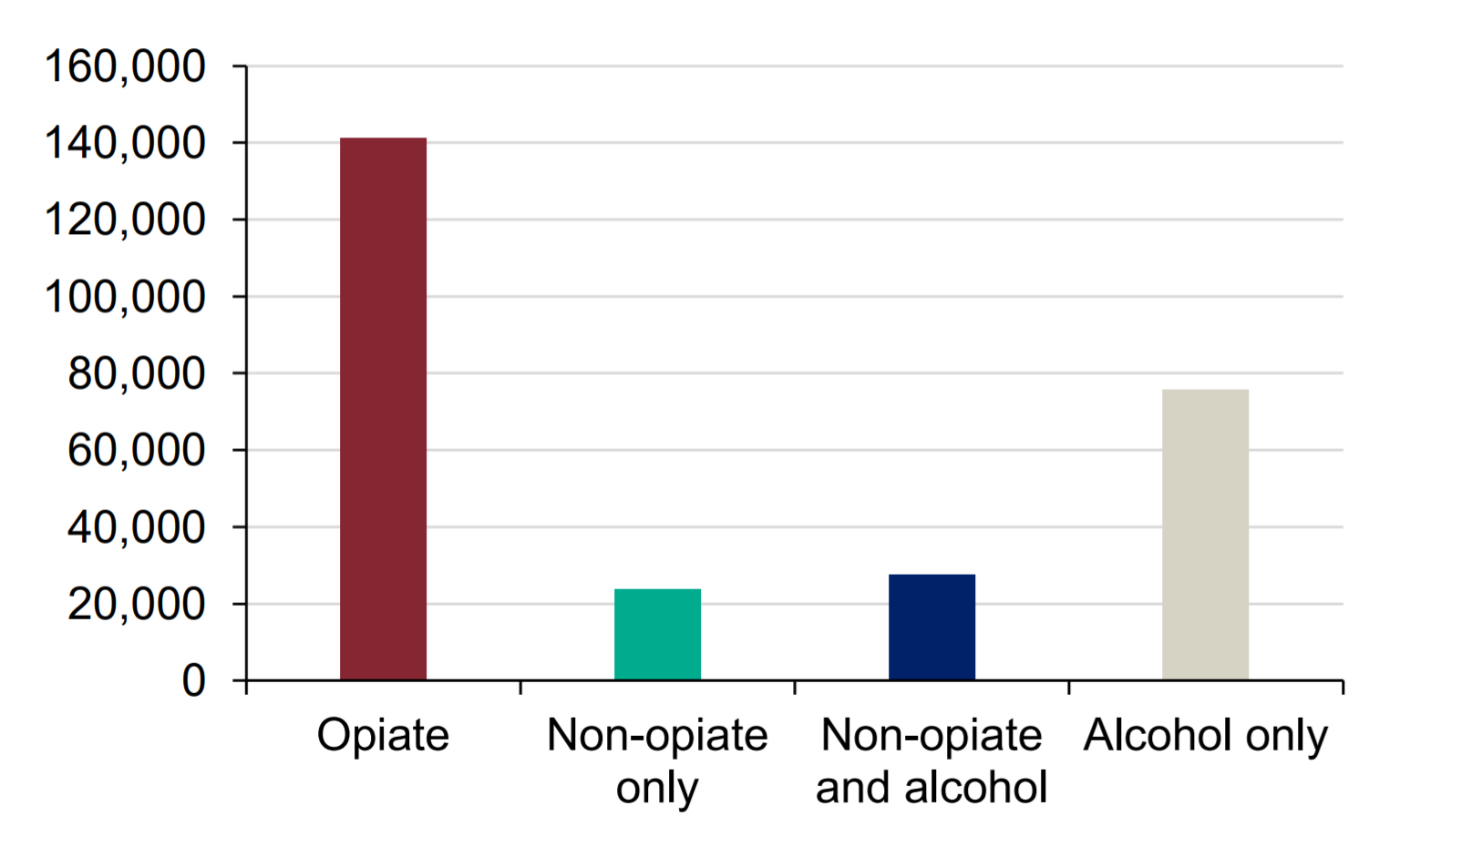
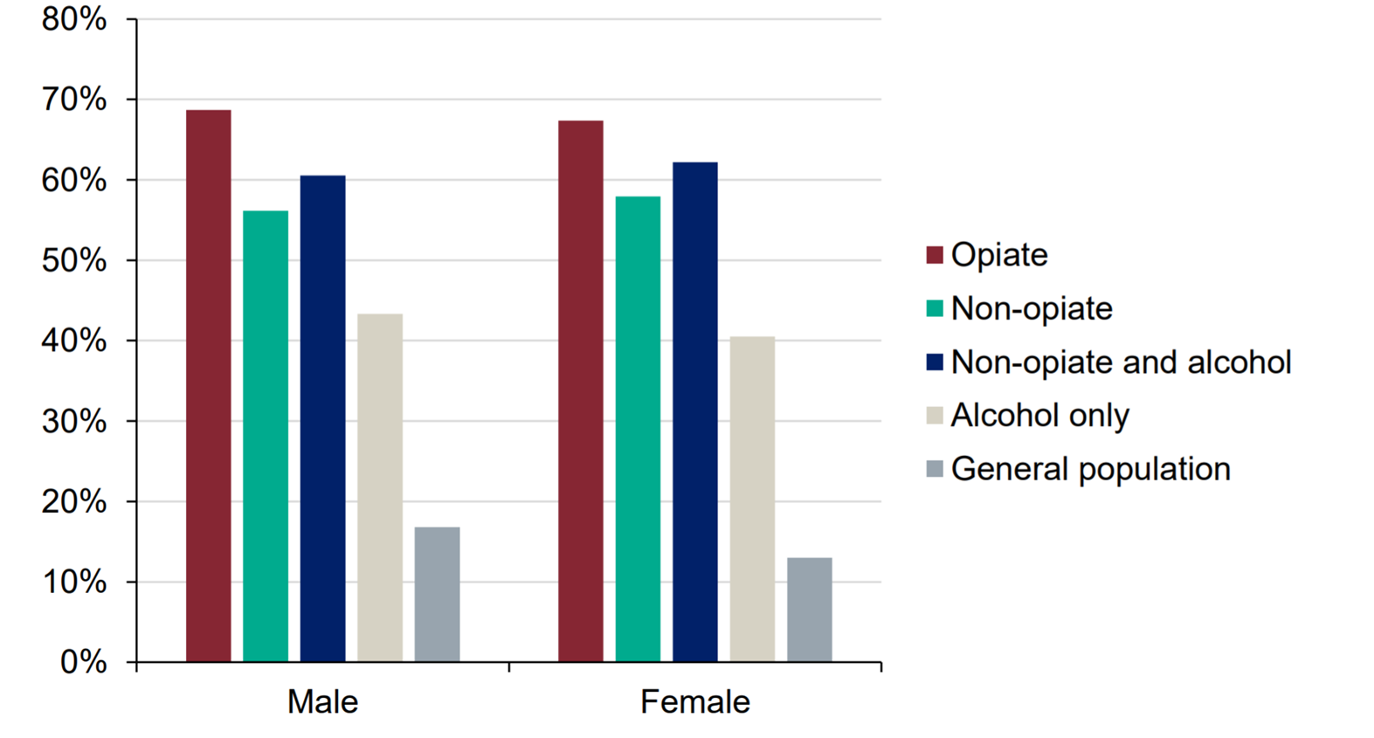
Smoking prevalence* in Drug & Alcohol services in England (2017-2018)
Numbers in treatment by main substance used
Smoking prevalence by substance used
3%
received smoking cessation support
* In the 28 days before the start of treatment
PHE (2018) Adult substance misuse statistics from the National Drug Treatment Monitoring System (NDTMS)
Notes:
People treated for opiates had the highest reported rates of smoking when starting treatment (68%). This was closely followed by people in treatment for non-opiates and alcohol, and non-opiates only (61% and 57% respectively). Those presenting with problematic alcohol use only had the lowest rates, with 42% smoking at the start of treatment.

Slide 6
Overview
1] Smoking rates in people who use Mental Health and/or Substance Use services in England
2] Survey findings about smoking and vaping rates in the South London & Maudsley NHS Foundation Trust
3] Experience of introducing e-cigarettes in a bespoke stop smoking service in a Drug & Alcohol Service in South London

Slide 7

South London and Maudsley NHS Foundation Trust
Mental health and substance use services
Smokefree since Oct 2014

Slide 8

Systems approach to support tobacco harm reduction
Improved infrastructure
Smokefree grounds & policy
Hospital tobacco dependence treatment service
Electronic referral system
Patient and staff audits
INFRASTRUCTURE
TREATMENT
Treatment pathway
Easy access to evidence based medicines
Behavioral & psychological support
Supportive policies to allow the use of
e-cigarettes
TRAINING
BARRIERS
Staff training pathway
E-Learning training about smoking
Classroom based advanced skills training
Understanding & addressing barriers to implementation
Eg fears violence will increase if service users could not smoke
Collaborations between SLaM & Addictions Dept, King’s College London

Slide 9
South London and Maudsley NHS Foundation Trust
Survey - 2018
Total sample n=360
Clients: Mental health n=102
Clients: Drug & Alcohol n=83
Staff: Mental health n-133
Staff: Drug & Alcohol n=42

Slide 10
Smoking & vaping prevalence among CLIENTS
Clients in D&A services have higher smoking rates, but lower vaping rates than MH clients

Slide 11
CLIENTS
STAFF
Staff in D&A services have higher smoking rates & vaping rates than MH staff

Slide 12



What type of e-cig devices did clients use?
Device type | Mental health | Drug & Alcohol
Disposable | 33% | 6%
Rechargable prefilled | 21% | 12%
Rechargable refillable (tank) | 21% | 41%
Rechargable refillable (mod) | 10% | 21%

Slide 13
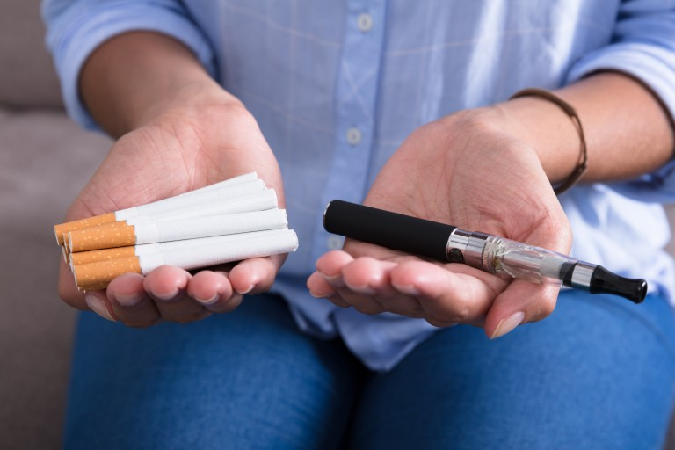
Relative harm perceptions (n=360)
E-cigarettes are LESS harmful than tobacco to a smoker’s health
CLIENTS – 53%
STAFF – 87%
Significant difference between the proportion of clients and staff who perceived that
e-cigarettes are less harmful or much less harmful than tobacco
More positive beliefs among
current vapers compared with smokers
staff who have had training
Notes:
The proportion who perceived that EC are lh or much less harmful than tobacco
Knowing nd believing are different things
Higher levels of knowledge doesn’t necessary mean you believe something to be true
The proportion who perceived that EC are lh or much less harmful than tobacco
Tested on a perceptual scale – knowledge – change in perceptions – increased confidence

Slide 14

Integrated tobacco dependence clinic within a Drug & Alcohol Service, South London

Slide 15
Integrated tobacco dependence treatment clinic
Aug ‘14 – Dec ‘18
½ day drop in
Free disposable e-cigarette from Oct ’16
Jan ‘19-Oct ‘19
5 days a week
Up to 12 sessions
Up to 6 sessions
NRT, varenicline, behavioural support
NRT, varenicline, behavioural support
Wider range of e-cigarettes
Substance use worker
Mental health occupational therapist
Funded by SLaM
Supported by a grant from Cancer Research UK

Slide 16
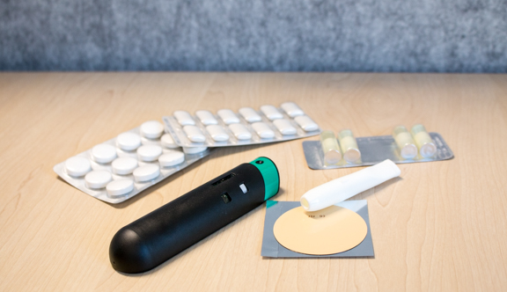
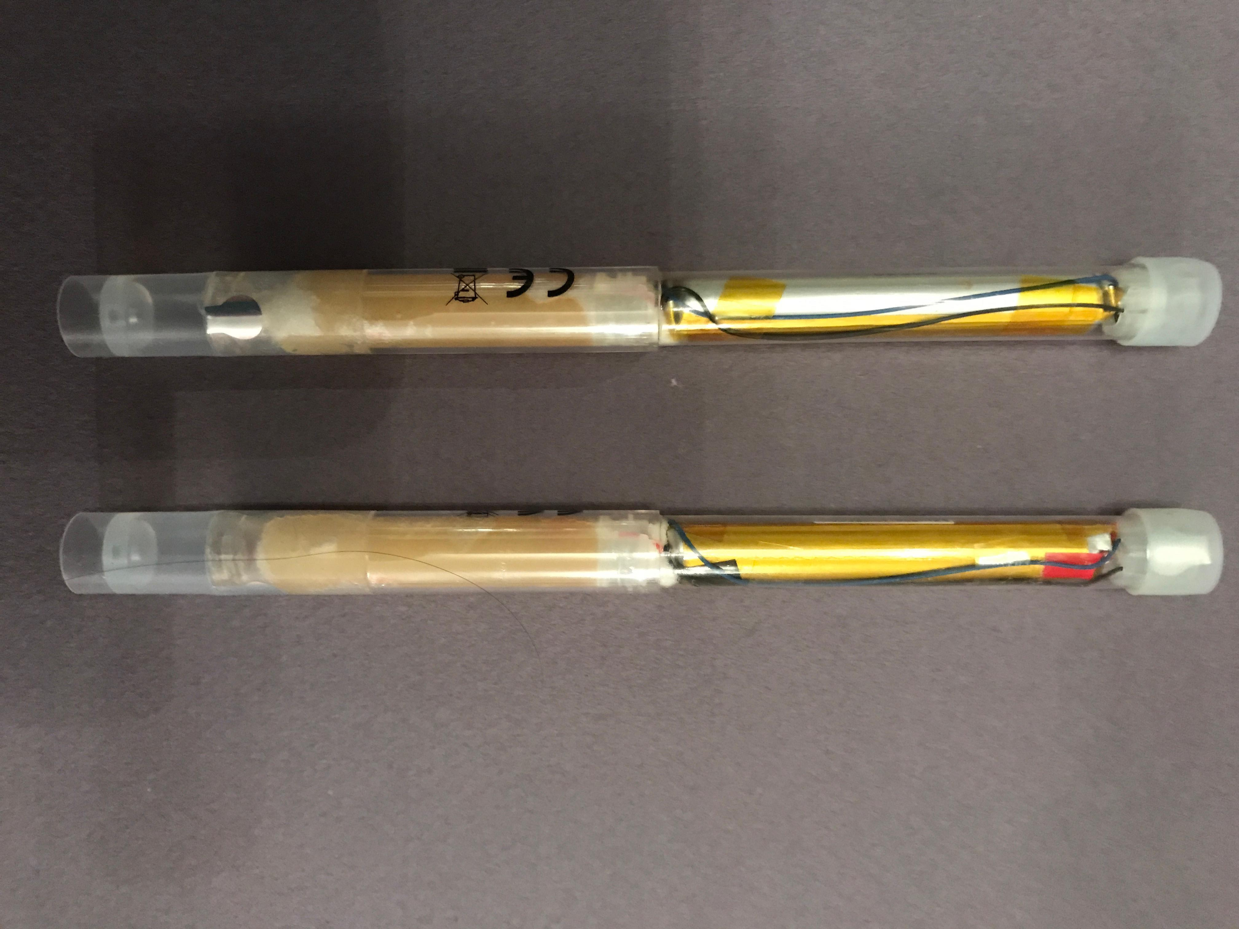
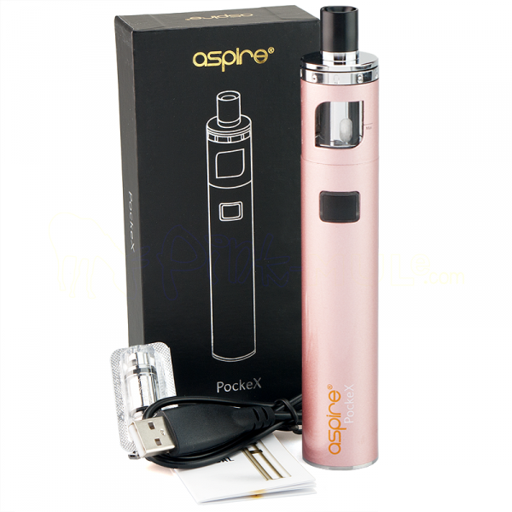
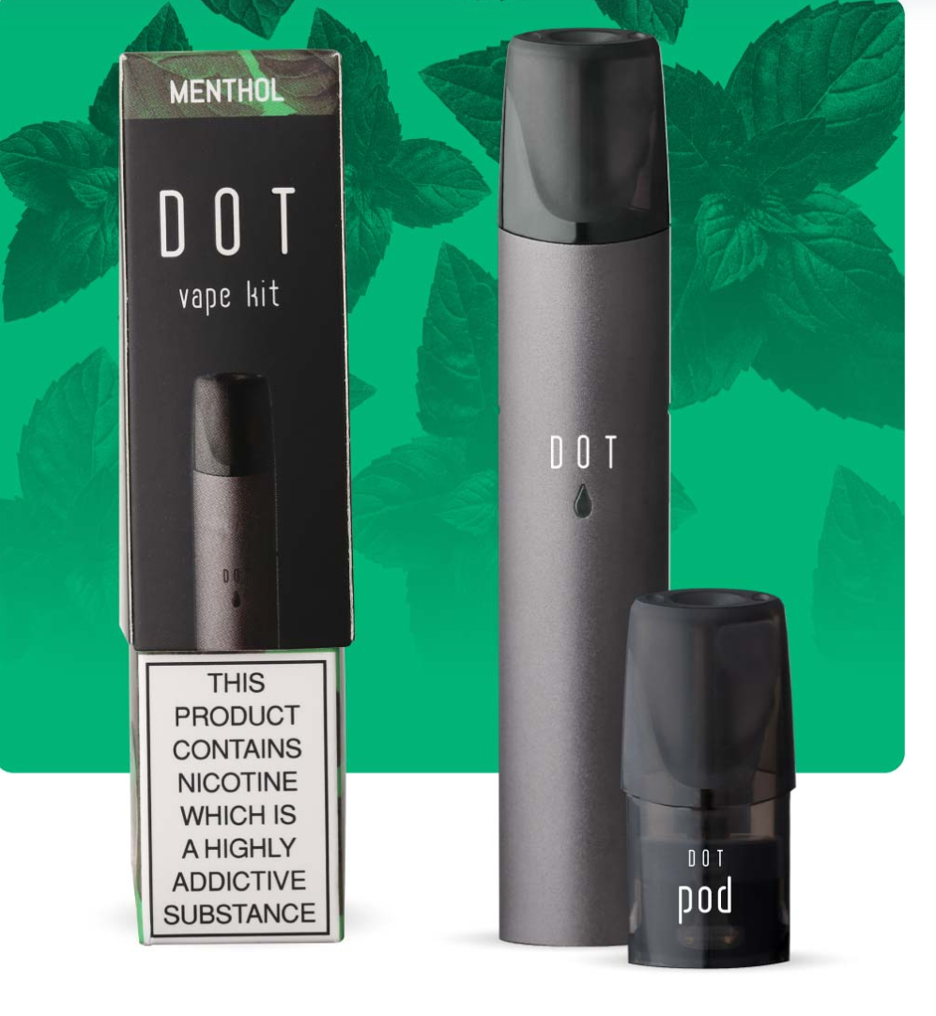
Nicotine products supplied (free of charge)
Patches, gum, lozenges, inhalator, mouth & nasal spray. All strengths
18mg/ml nicotine strength only; 2 flavours
Choice of e-liquid flavours & strengths
20mg/ml nicotine strength only; 4 flavours (nic salts)

Slide 17
New clinic increased access
Over a 3-year period
(August ‘14- July ‘17)
74 people accessed the service
Over 10-month period
(Jan ‘19- Oct ‘19)
124 people accessed the service

Slide 18
Baseline findings from new clinic (n=124)
Men 79%
Age 45.3 years (range 22-63)
27% homeless

Slide 19
Baseline findings (n=124)
Mean cigarettes per day
19.3 (max 90)
Type of cigarettes smoked
Manufactured 18%
Roll your own 54%
Both 28%
Intention to quit
Stop in one go 39%

Slide 20
Nicotine products chosen at 1st appt
Out of total sample 77% also chose NRT
1 –Eburn
3 – no EC
43%
54%

Slide 21
Additional observations…….
Majority finding devices easy to use
Concern about cost & access post treatment
Many clients smoke their main problem drug (heroin/crack)
Cannabis use is a common secondary/tertiary drug problem and undermines quitting tobacco completely

Slide 22

Summary
In a local service, higher smoking rates but lower vaping rates are observed among clients in D&A services vs Mental Health services
Offering e-cigarettes as part of an integrated tobacco dependence clinic within a D&A service attracts clients to engage with and use less harmful nicotine products
Nationally - Rates of smoking among people accessing D&A and/or Mental Health services remain very high –
Better data exist for clients accessing D&A services than Mental Health services
Only 3% of clients received treatment for their tobacco use
Tobacco smoking still matters…….

Slide 23

Acknowledgements
Georgia Whyte, Mike Kelleher, Luke Mitcheson, Emily Finch, Martin McCusker, Paul Lennon, Liz McDonnell, Mick Collins - South London & Maudsley NHS Foundation Trust
Gilda Spaducci, Mairtin McDermott, Leonie Brose, Ann McNeill- King’s College London
Cancer Research UK
Liberty Flights, E Burn, Lambeth Council
deborah.robson@kcl.ac.uk

