Slide 1

Reducing alcohol packaging size to reduce alcohol consumption
Inge Kersbergen
@Inge_Kersbergen
i.kersbergen@sheffield.ac.uk

Slide 2
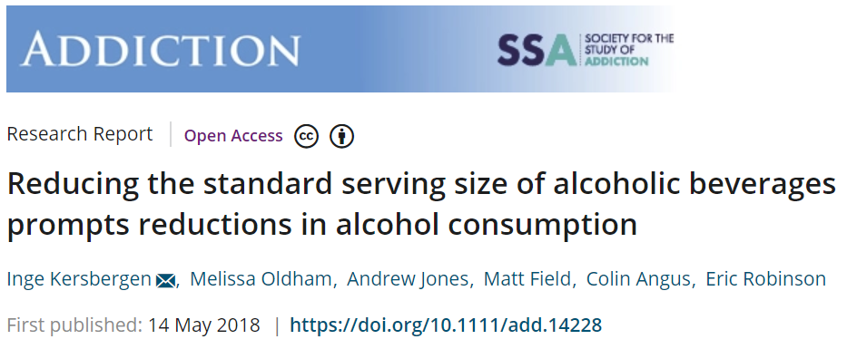
Serving size reductions

Slide 3
Where do people buy alcohol?

Slide 4
How can we use packaging size to reduce off-trade drinking?

Slide 5





Portion
Norm range
=
<
=
Intake

Slide 6
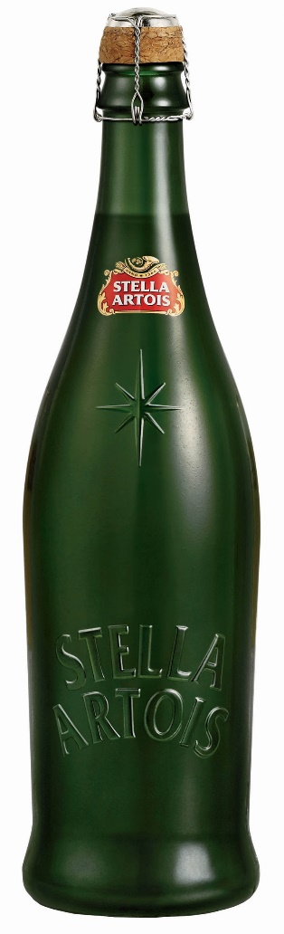
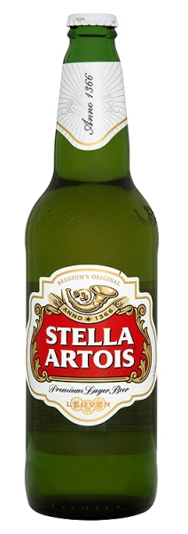
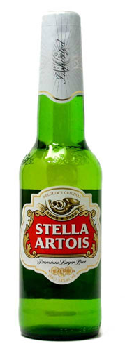
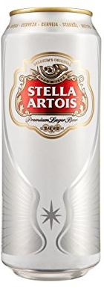
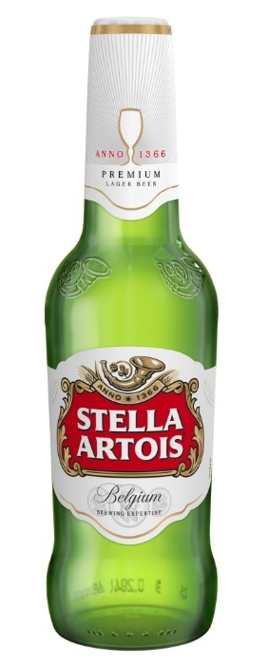
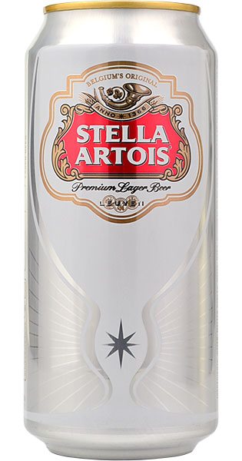
284ml
330ml
440ml
568ml
660ml
750ml

Slide 7
=
?
<
<
<
284ml
330ml
440ml
568ml
660ml
750ml

Slide 8
?
?
<
=
<
284ml
330ml
440ml
568ml
660ml
750ml

Slide 9
Current study
What packaging sizes contain a single drink?
How is packaging size associated with alcohol consumption?

Slide 10
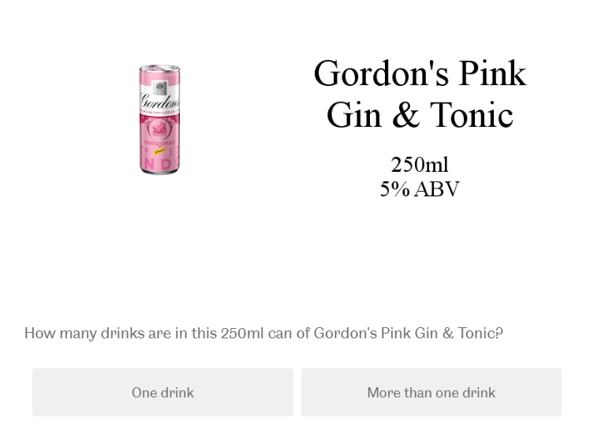
Finding size boundary

Slide 11
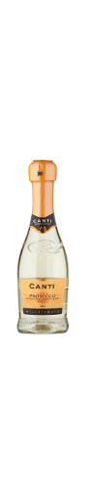
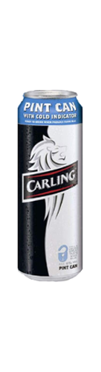
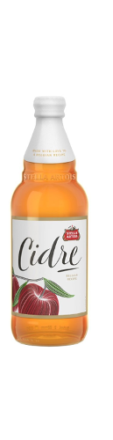
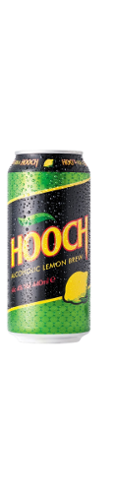
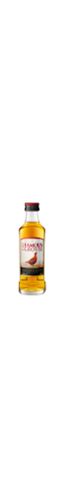
Largest ‘single drink’ packaging
2.8 units
2.5 units
1.8 units
2.4 units
2 units
568ml
500ml
440ml
200ml
50ml

Slide 12
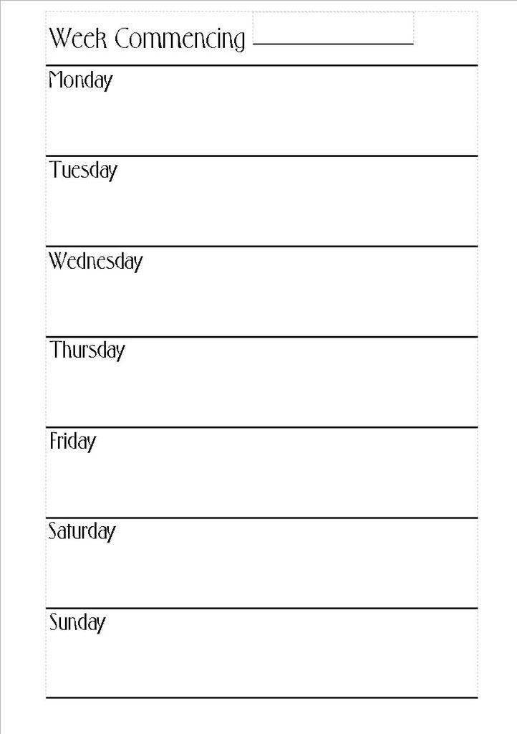
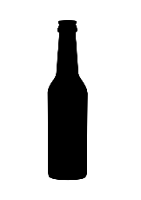
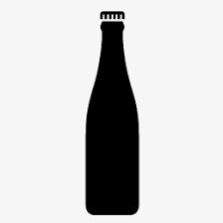
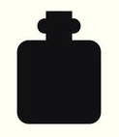

Kantar market research data
Detailed retrospective one-week diary
N = 142,164
Used boundaries to define drinks as
single/multi-drink packaging

Slide 13
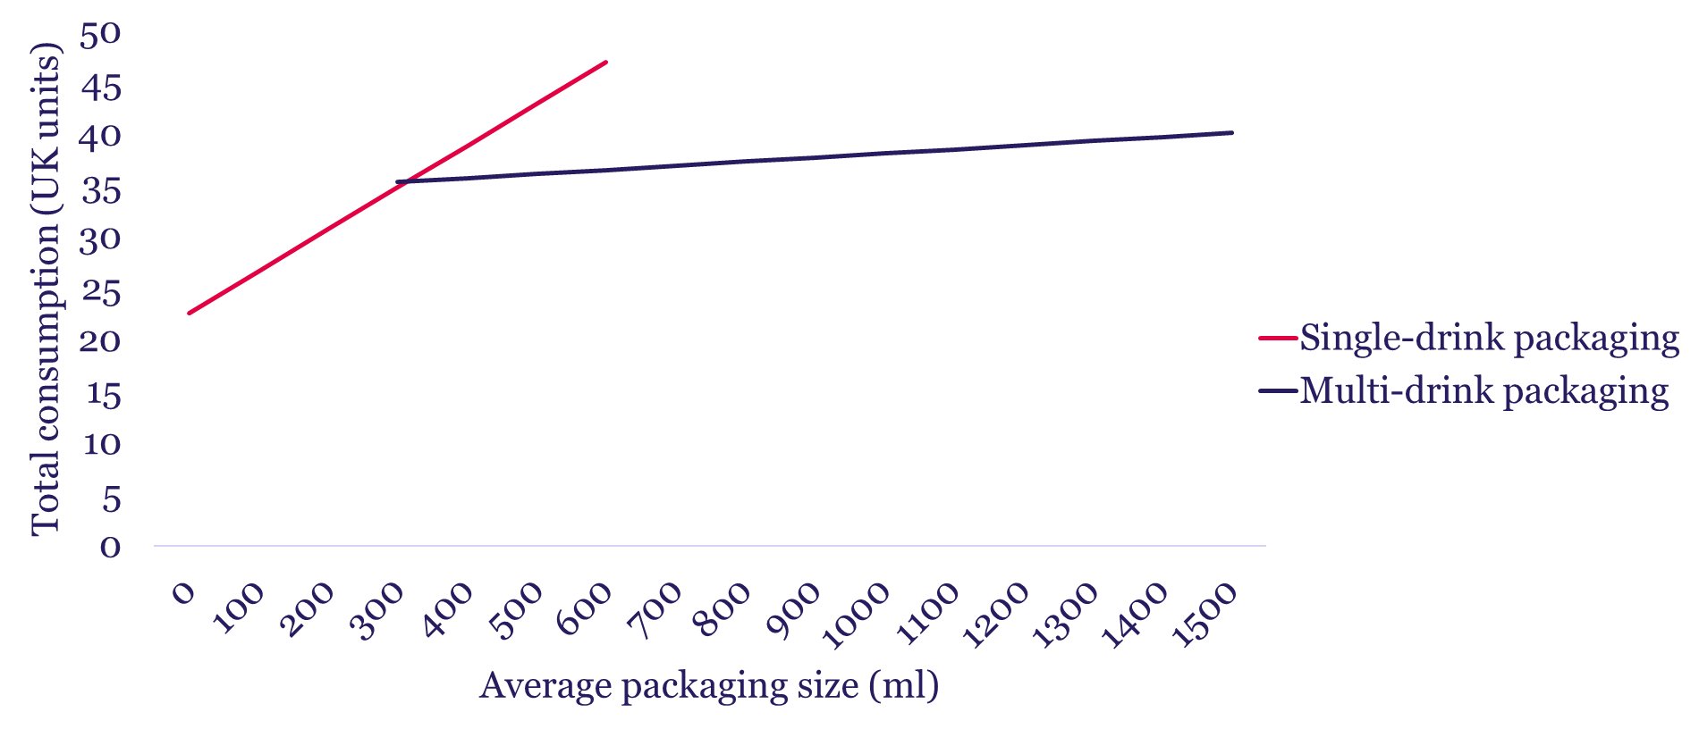

Slide 14
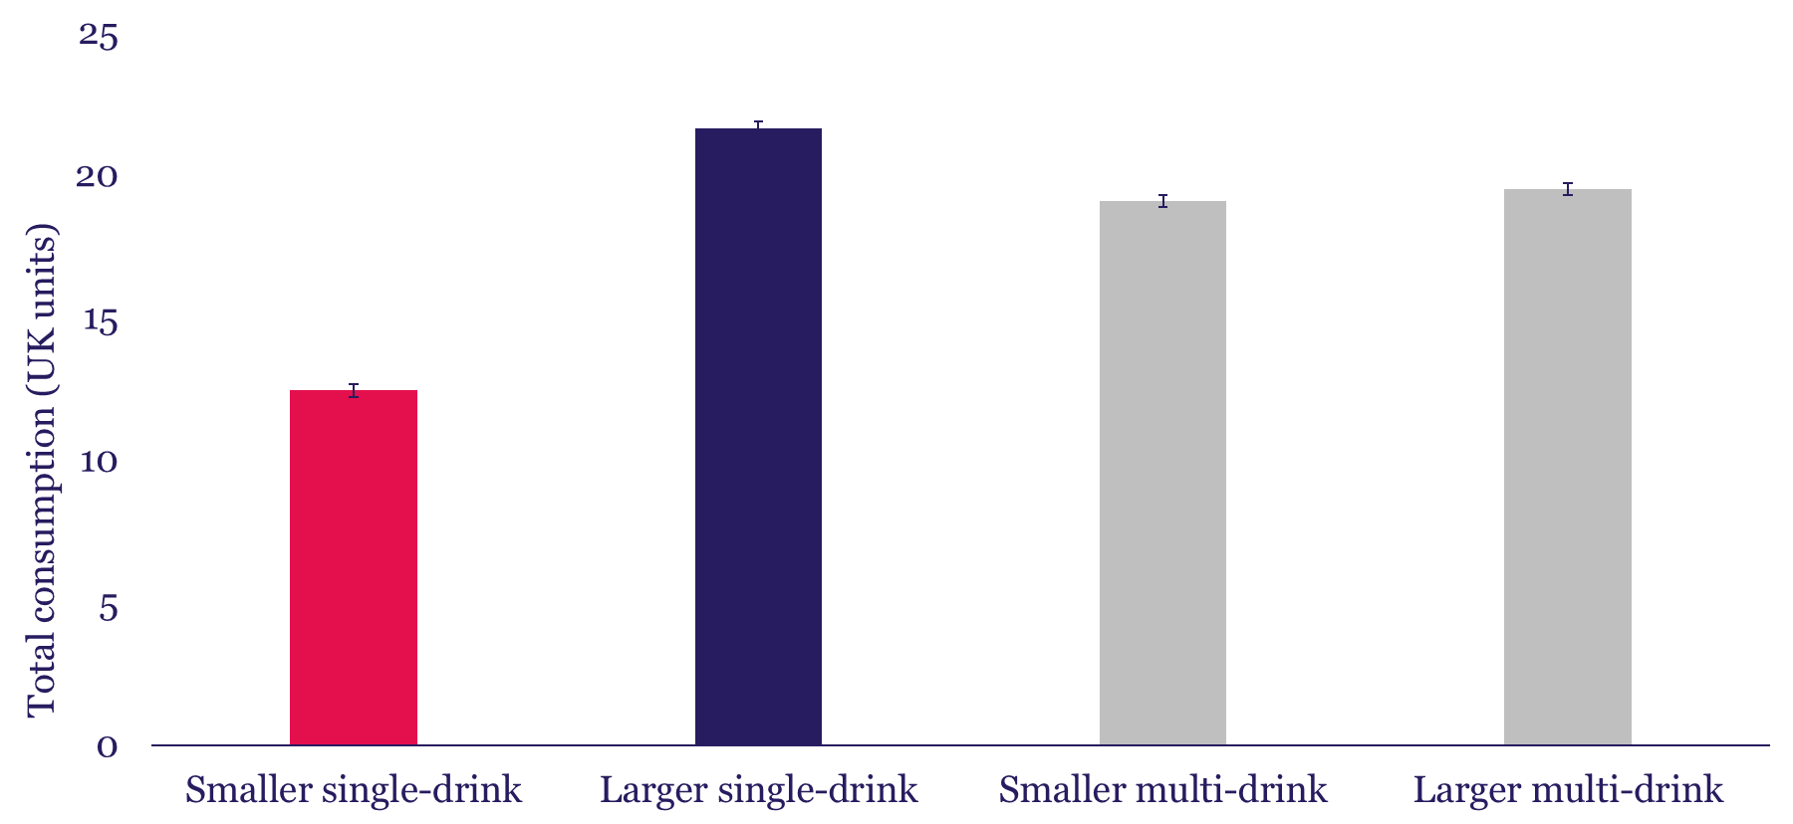

Slide 15
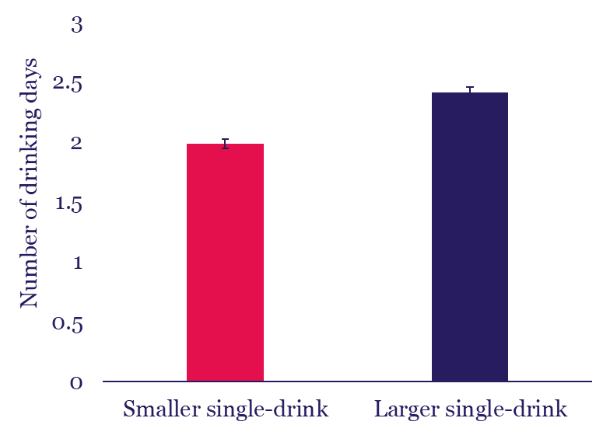
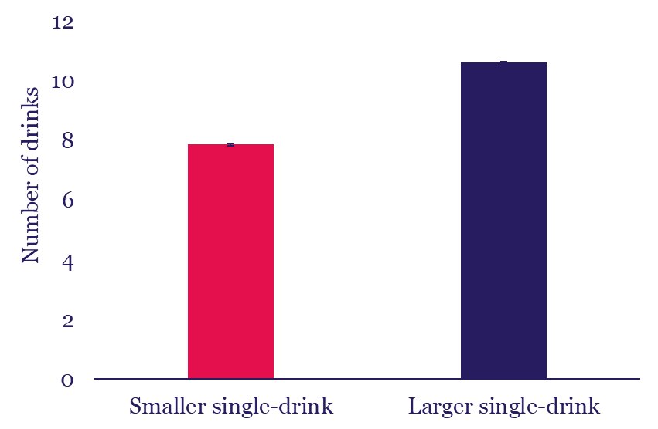
Other drinking characteristics

Slide 16

Limitations
Cross-sectional
Retrospective
Self-reported packaging size ‘bands’

Slide 17
Going into intervention design
Focus on single drink packaging
Various options:
  Removing largest drinks from market
  Introducing smaller drinks
  Social norms messaging around what entails a single drink
  …

Slide 18
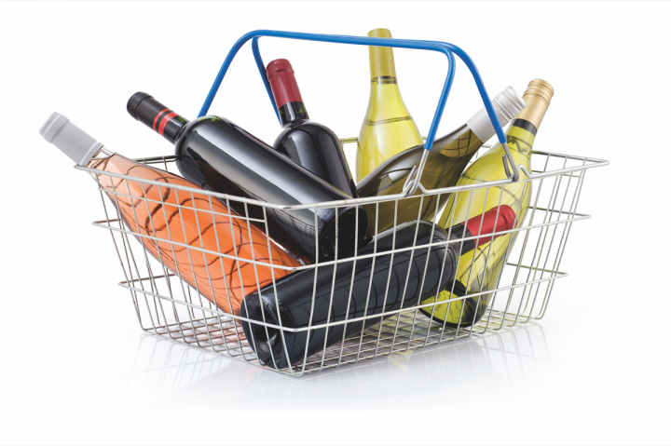
Going into intervention design
Why might heavier drinkers select larger drinks?
  As a side effect of other factors? E.g., price?
  Convenience?
  Preference?

Slide 19
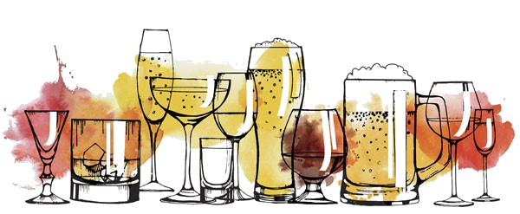
Conclusions
Packaging size associated with consumption
Single drink packaging size more strongly associated than multi drink
Consumption not due to failure to compensate

Slide 20
Thank you.
@Inge_Kersbergen
i.kersbergen@sheffield.ac.uk

