Slide 1
Gambling exposure in football: An analysis of Premier League and Championship matchday programmes
Steve Sharman
University of East London
SSA Annual Conference
November 2019

Slide 2
Disclosure of Conflict of Interest
The authors have no conflict of interest to declare
This work was funded by an internal UEL research grant.
Analysis and manuscript preparation were only conducted by the authors, with no external influences.

Slide 3
Presentation Structure
Why Gambling?
Why the Premier League / Championship?
Aims
Methods
Results
Implications

Slide 4
SOME GAMBLING STATS
Many different types of gambling available
Around 70% of the adult population gamble
Gross gambling yield – £14.5 billion
A little under 1% are classified as ‘disordered gamblers’

Slide 5
COSTS OF GAMBLING
Health costs: £180 million - £760 million
Welfare and employment costs: £40 million - £160 million
Housing costs: £10million - £60 million
Criminal justice costs: £40 million - £190 million
Total cost to Government between £260 million and £1.16 billion

Slide 6
The Premier League and Championship
Premier league is the most watched football division, on TV, in the world.
Premier League is the best attended football division in the world
Championship is the third best attended football division in the world

Slide 7
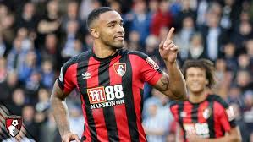
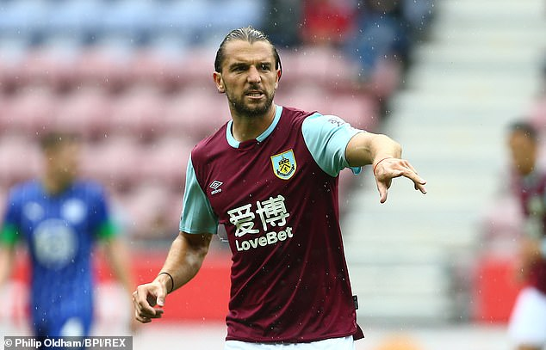
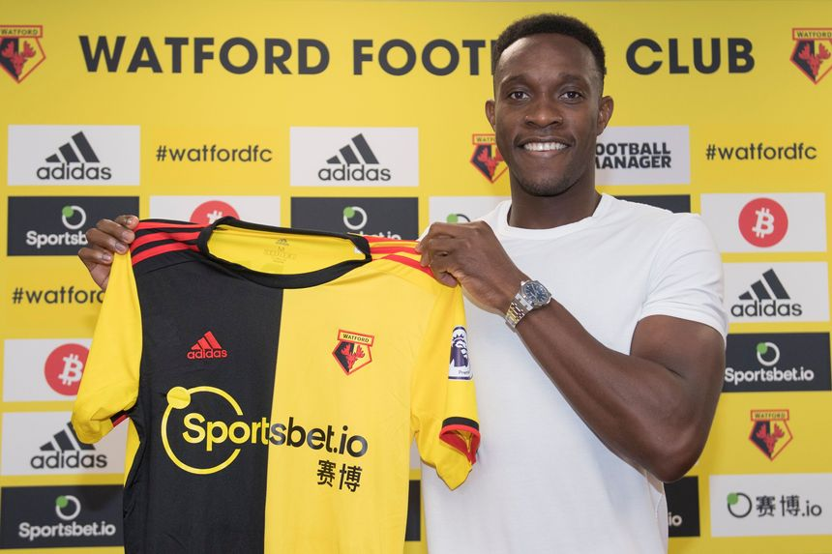
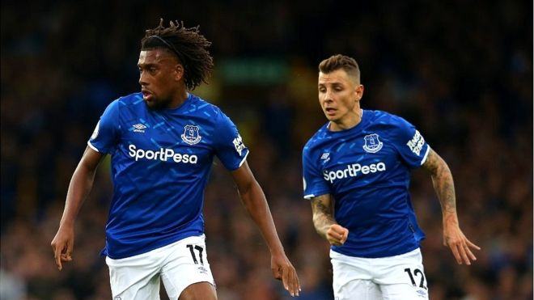
Football and Gambling – Premier League

Slide 8
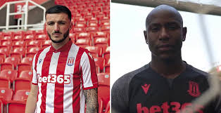
Football and Gambling – Championship

Slide 9
Aims

Slide 10
Aims
Compare numbers of gambling, alcohol, and responsible gambling adverts
Compare frequency of incidental exposure of gambling marketing
Explore via industry sponsor
Observe gambling, alcohol, smoking or responsible gambling exposure in child-specific sections of programmes

Slide 11
Methods
Data drawn from 44 matchday programmes (20 EPL / 24 Championship)
Our sample of programmes was made available to a total of 1,269,404 match-going fans.

Slide 12
Methods - Adverts

Slide 13
Methods – Incidental Exposure

Slide 14
Methods

Slide 15
Results – Adverts
Main effect of advert type (F (1.47, 63.3) = 65.5, p <.001, η² = .60).
More gambling ads than alcohol adverts (t (43) = 7.26, p < .001), and responsible gambling adverts (t (43) = 9.73, p < .001).

Slide 16
Results – Incidental Exposure (Proportion of pages)
Main effect of Type (F (1.29, 55.26) = 100.91, p <.001, η² = .70).
22.2% of pages had incidental gambling exposure
More than alcohol (2.8%; t (43) = 10.01, p < .001), and RG exposure (3.3%; t (43) = 11.27, p < .001).
Programmes for home teams with a gambling sponsor had more IE (31%) than teams sponsored by other industries (11%) (t (38.8) = 9.74, p <.001).

Slide 17
Results – Incidental Exposure (Absolute Counts)
Main effect of Type (F (1.1, 47.48) = 64.96, p <.001, η² = .60).
Average 37.8 counts for gambling incidental exposure
More than alcohol (3.8;t (43) = 7.96, p <.001), and RG (4.7;t (43) = 8.5, p <.001).
IE count home team with a gambling sponsor (57.3) was significantly higher than other industry sponsor (12.2;(t (29.56) = 10.6, p <.001)).

Slide 18
Results – Incidental Exposure (Children Specific Sections)
89% had a dedicated children’s section of the programme.
Incidental exposure was present in 59.0% of children’s specific sections of programmes, compared to 7.7% for alcohol (χ² (1) = 58.4, p <.001).
Children’s sections averaged 1.5 incidents of gambling exposure per section, more than the 0.08 average incidents of alcohol exposure (t (38) = 4.2, p =.001).

Slide 19
Implications
More gambling than smoking, drinking, or RG ads and exposure
This is magnified when team sponsored by a gambling company, but only for IE not for adverts.
Repeated exposure = normalisaton

Slide 20
Limitations
Only a snapshot of exposure
Only the paper version of matchday programmes
No content analysis
All limitations can be addressed in future studies

Slide 21
Next steps
Expand to other areas (junk food etc)
Look across a whole season
Examine other matchday / interim communications
Content analysis

Slide 22
Thanks
Main thanks to my collaborators
- Philip Newall, University of Warwick
Catia Ferreria, Anglia Ruskin University
Thanks to UEL for funding the study
ssharman@uel.ac.uk
@stevesharman81

