Slide 1
Improving Treatment Delivery Outcomes
Katie Witkiewitz
Associate Professor
Center on Alcoholism, Substance Abuse, and Addictions
Department of Psychology
University of New Mexico
katiew@unm.edu

Slide 2
Overview: Recent Research and Future Directions for Improving Addiction Treatment Outcomes
Tremendous need for effective addiction treatment
Seeing the forest for the trees…
Treatment matching
Mechanisms of change
New approaches to treatment
Mindfulness-based interventions
Future directions-personalized medicine

Slide 3
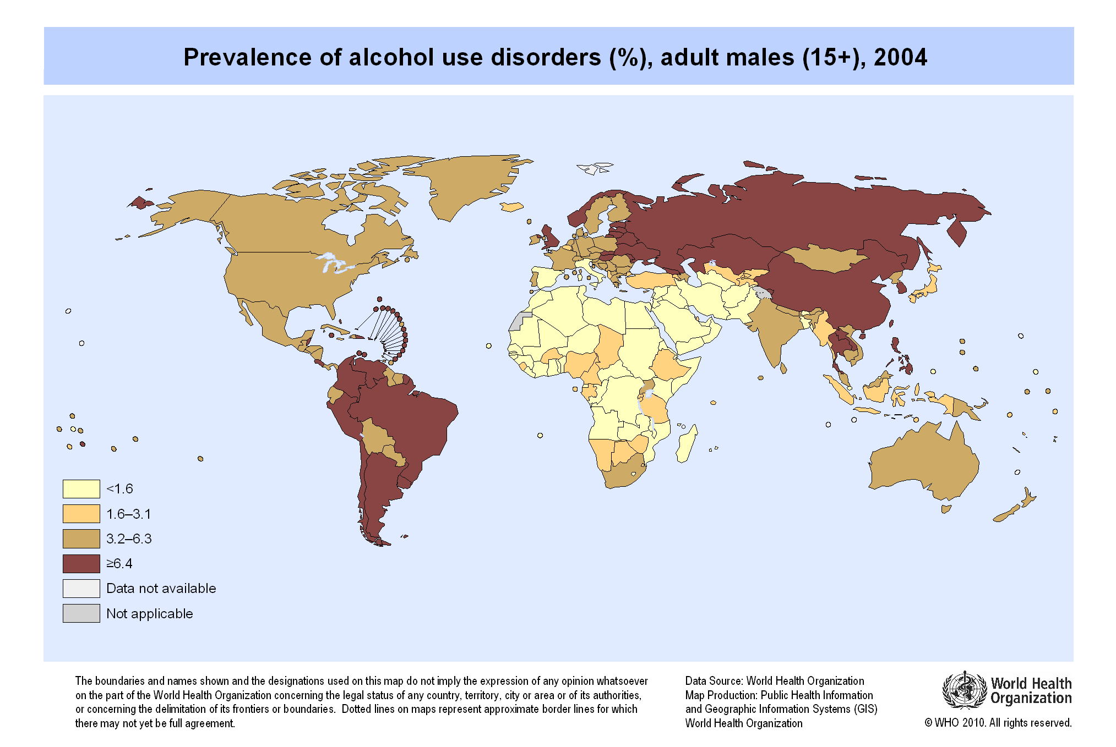
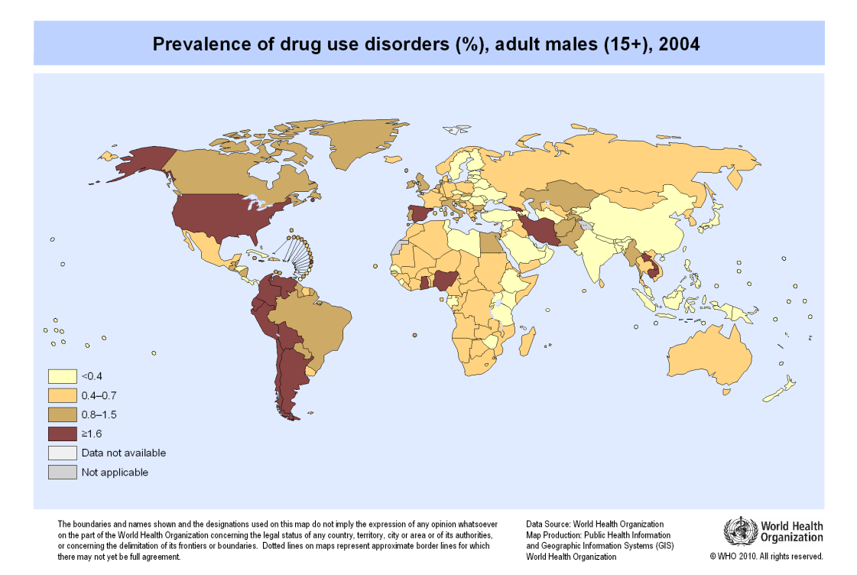
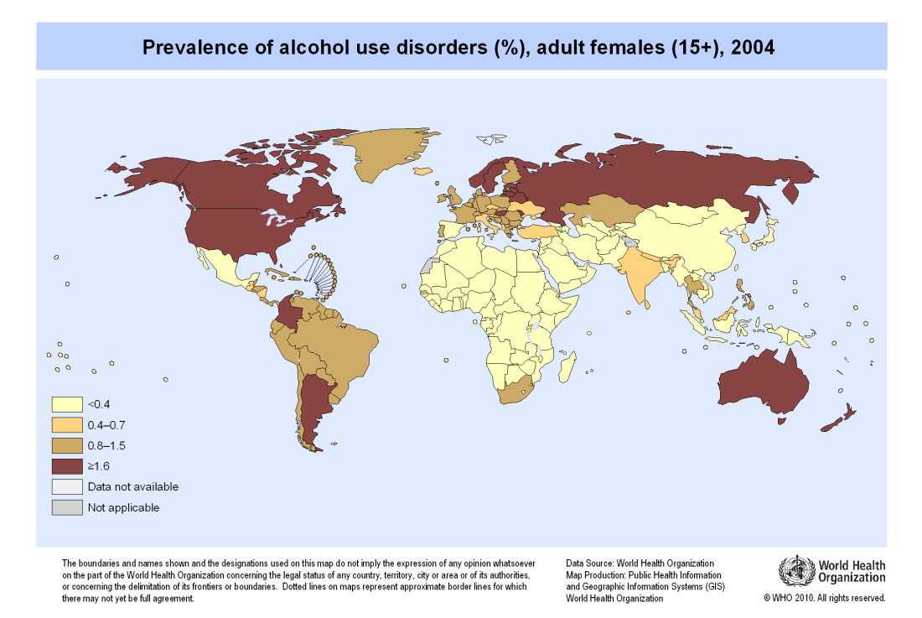
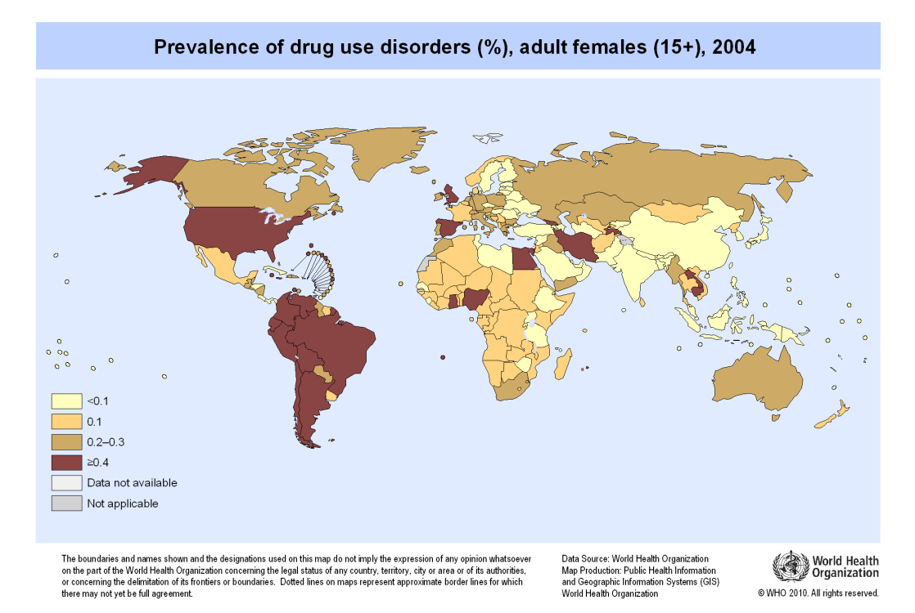
At least 15.3 million people worldwide suffer from alcohol and drug use disorders.

Slide 4
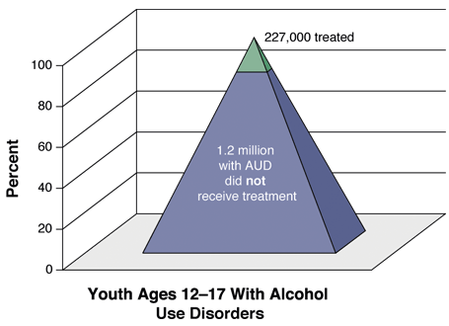
There is a substantial unmet need for substance use disorder treatment.
Substance Abuse and Mental Health Services Administration, Results from the 2010 National Survey on Drug Use and Health: Summary of National Findings, NSDUH Series H-41, HHS Publication No. (SMA) 11-4658. Rockville, MD: Substance Abuse and Mental Health Services Administration, 2011.

Slide 5
Of those who receive treatment for a substance use disorder...

Slide 6
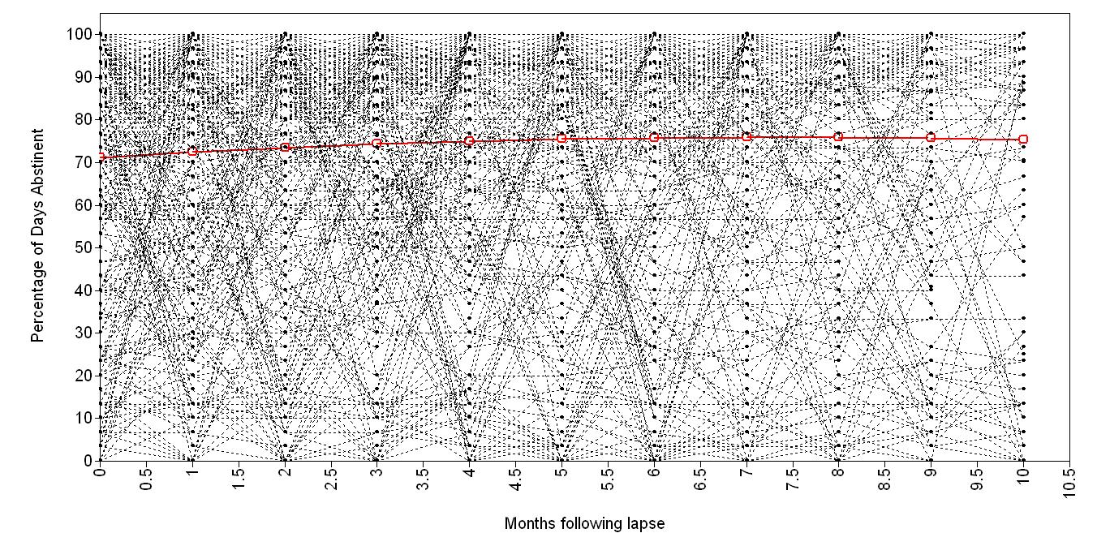
Of those who receive treatment for a substance use disorder…variability in outcomes after an initial lapse
Witkiewitz & Masyn (2008) Psychol Addictive Behaviors, 22, 157-167.

Slide 7
Variability in substance use behavior during and following treatment is clinically relevant.
“Variable-centered” analyses (e.g., aggregate mean changes) can mask treatment effects and mechanisms of change
Project MATCH, 1 out of 16 primary matching hypotheses was supported in original treatment-by-time analyses
COMBINE study – few differences between treatments
“Person-centered” analyses allow modeling of individual variability in change over time
Re-analyses of Project MATCH with person-centered analyses provided support for matching hypotheses
Analyses of COMBINE data to examine mechanisms of change

Slide 8
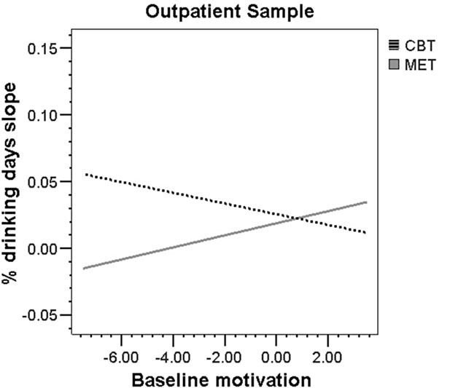
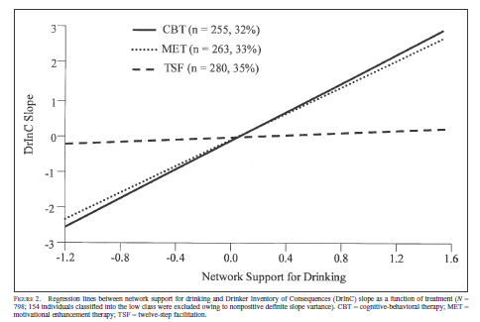
Maximizing treatment outcomes via patient - treatment matching
Project MATCH (n =1,726): Cognitive Behavioral Treatment (CBT), Motivation Enhancement (MET), or Twelve Step Facilitation (TSF)
Matching hypothesis: individuals with low baseline motivation will have better outcomes if assigned to MET
Matching hypothesis: individuals with greater network support for drinking will have better outcomes if assigned to TSF
Witkiewitz et al (2010). Addiction, 105, 1403-1413.
Wu & Witkiewitz (2008). JSAD, 69, 21-29

Slide 9
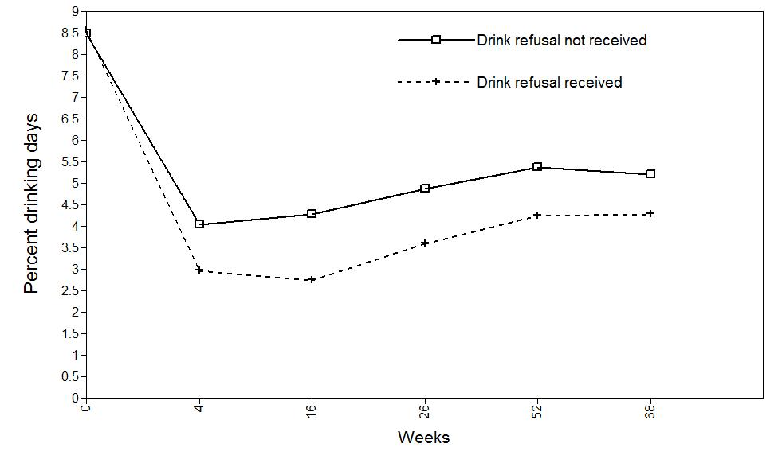
Maximizing treatment outcomes via studies of mechanisms of change
COMBINE Study - Combined Behavioral Intervention (n = 776)
Drink refusal skills module:
assessment of social pressures
assessment of coping skills
behavioral rehearsal
- Changes in self-efficacy as mechanism of change following drink refusal skills training in the COMBINE study?
Witkiewitz et al (2012). J Consul Clin Psychol, 80, 440-449.

Slide 10
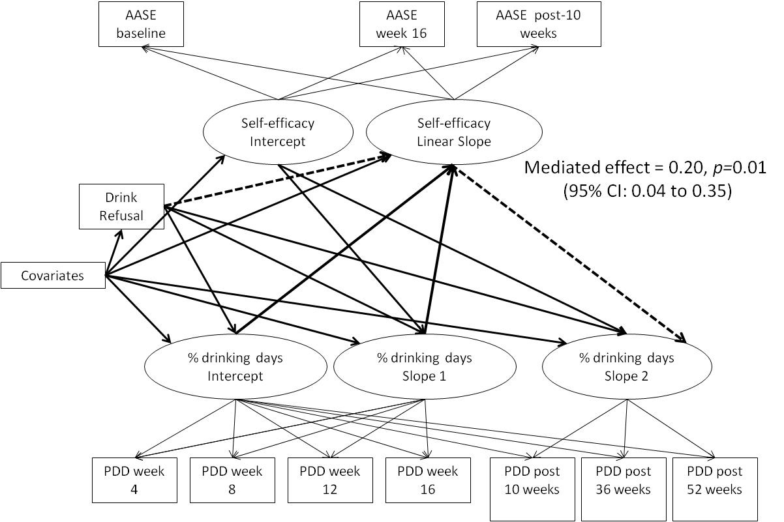
Maximizing treatment outcomes via studies of mechanisms of change
Mechanism of change was supported in mediation analyses…
Witkiewitz et al (2012). J Consul Clin Psychol, 80, 440-449.
Data from the COMBINE Study (n = 1383; COMBINE Study Research Group, 2003)

Slide 11
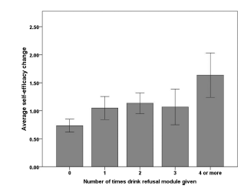
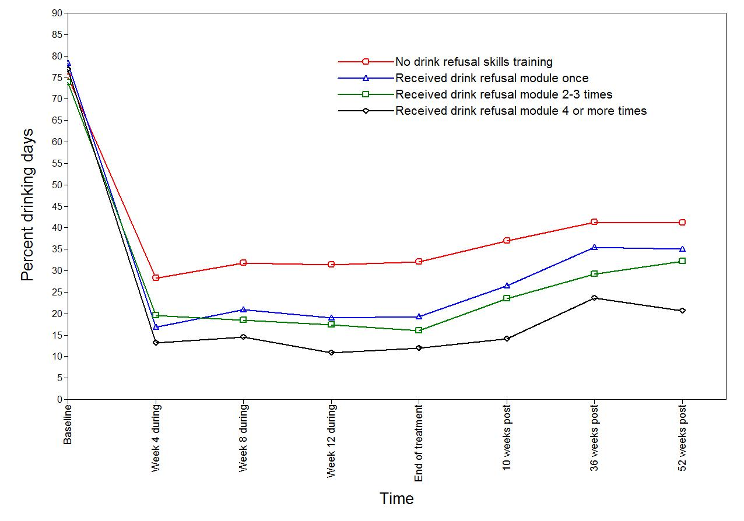
Maximizing treatment outcomes via studies of mechanisms of change
Mechanism of change was further supported by dose-response relationships…
Witkiewitz et al (2012). J Consul Clin Psychol, 80, 440-449.
Data from the COMBINE Study (n = 1383; COMBINE Study Research Group, 2003)

Slide 12
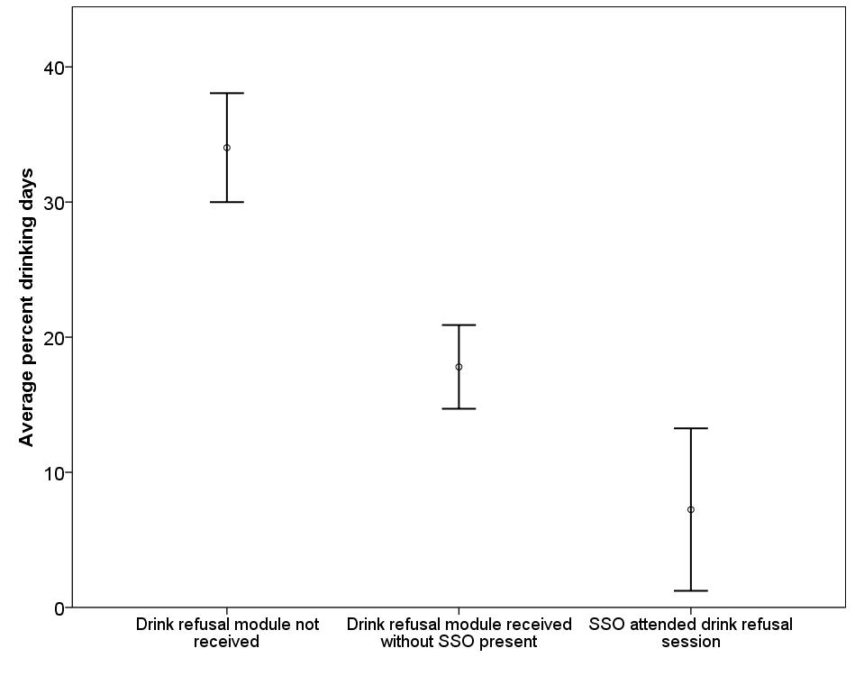
Maximizing treatment outcomes via studies of mechanisms of change
Effect of drink refusal training was moderated by participation of supportive significant other (SSO)
Hunter-Reel et al (2012). ACER, 36, 1237-1243.

Slide 13
“New” approach to treatment… Mindfulness-Based Relapse Prevention (MBRP)
Mindfulness practices with relapse prevention skills training
Patterned after Mindfulness-Based Stress Reduction (Kabat-Zinn, 1990), Mindfulness-Based Cognitive Therapy (Segal et al. 2002)
Three randomized clinical trials, as compared to treatment as usual and active relapse prevention
Format
Aftercare or post-detoxification/stabilization
Group format, 8 weekly 2 hr. sessions
Daily home practice
Bowen, Chawla & Marlatt (2010); Witkiewitz, Marlatt & Walker (2005)

Slide 14
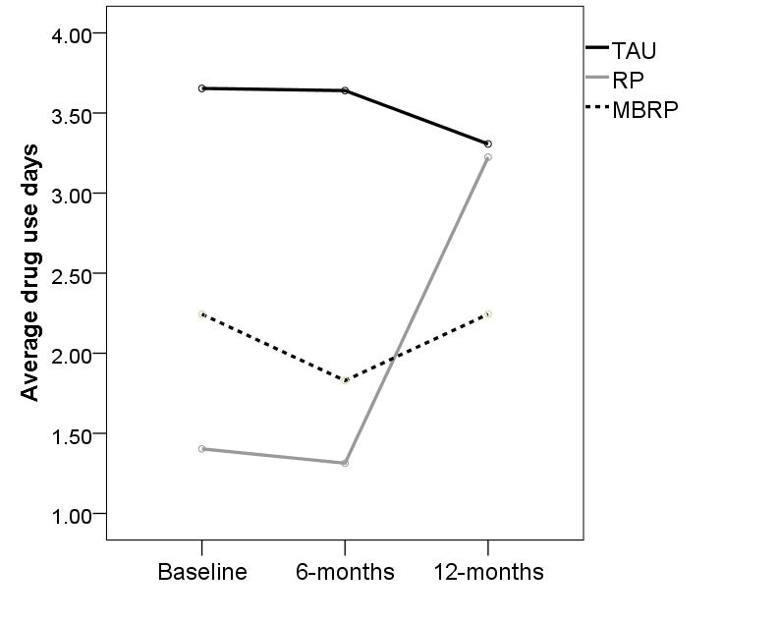
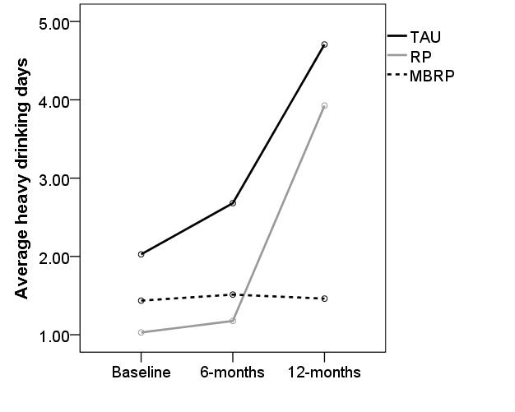
Novel treatment approaches… Mindfulness-Based Relapse Prevention (MBRP)
MBRP vs. Relapse Prevention vs. treatment as usual (TAU)
N = 286, from community service agency after completing initial treatment
72% male, average age = 40
51% white, 22% African American, 7% Native American, 8% Hispanic
Bowen et al. (accepted). JAMA Psychiatry

Slide 15
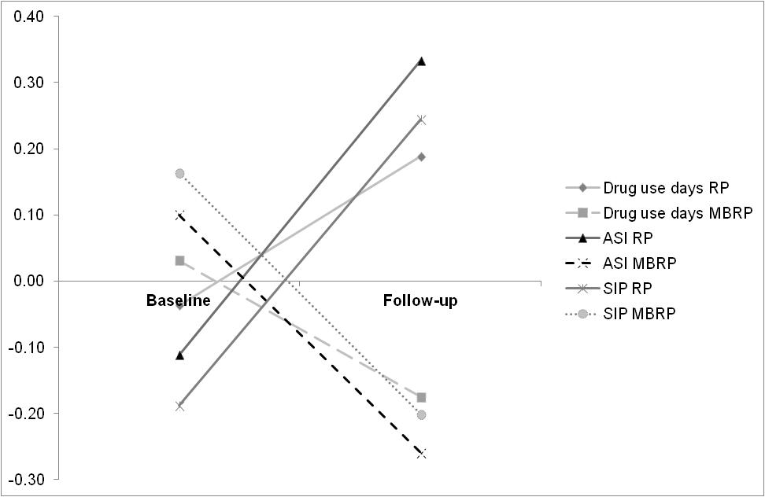
Novel treatment approaches… Mindfulness-Based Relapse Prevention (MBRP)
MBRP vs. RP
N=105, from residential addiction treatment program for female criminal offenders; 100% female, average age = 33
64% white, 17% African American, 13% Native American, 2% Hispanic
RP
Standardized scores
MBRP
Witkiewitz et al. (in press). Substance Use & Misuse

Slide 16
Future Directions…toward a personalized medicine approach to treatment of AUD
Integrated data analysis of alcohol treatment studies:
- Data from four studies with one-year follow-ups:
Project MATCH (n=1726)
COMBINE (n=1383)
Relapse Replication and Extension Project (n=563)
UKATT (n=742)
Combined n = 4,414
Examine drinking outcomes using person centered analyses

Slide 17
Future Directions…toward a personalized medicine approach to treatment of AUD
Research Questions…
1. Tests of moderation
What individual characteristics predict outcomes?
Are certain treatments more or less effective for certain individuals?
2. Tests of mediation
Why do changes in drinking occur?
What factors during treatment change the course of drinking?
3. Tests of moderated mediation
Why do changes in drinking occur for some people, but not others?
Are there interactions between individual characteristics and time-varying factors in predicting ultimate treatment outcomes?

Slide 18
Future Directions…toward a personalized medicine approach to treatment of AUD
Ultimately inform treatment delivery and decision making…
Recommendations using data-informed probabilities of drinking outcome:
Inform client of probabilities for different outcomes based on:
- Abstinence vs. moderation goal
- Amount of treatment
- Strengths/ vulnerabilities
- Environmental factors
- Locate specialty treatment and support group geared toward client needs
Inform client of probabilities for different long term outcomes based on:
Current drinking
Continued treatment options
- Personal strengths/ vulnerabilities
- Environmental factors
Coordinate care based on recommendations for altering negative trajectory (if lapsed) and for maintaining successful trajectory (if abstinent)
Discuss options for continuing care
Client presents at clinic (e.g., primary care office, alcohol treatment, mental health clinic)
Initial assessment of client characteristics and goals
How does the clinician address the client’s needs for alcohol treatment?
Lapses during treatment
Abstinent throughout treatment

Slide 19
Thank you and questions?

