Slide 1
What can the experience of combating tobacco addiction tell us about better ways of addressing other addictions?
Robert West
University College London
November 2013

Slide 2
Declaration of competing interest
I undertake research and consultancy for companies that develop and manufacture smoking cessation medicines and licensed nicotine products
I am a trustee of the charity, QUIT
I am an honorary co-director of the National Centre for Smoking Cessation and Training
My salary and most of my research is funded by Cancer Research UK

Slide 3
Overview
What is needed to change behaviour?
Interventions and policies to reduce tobacco use
Implications for combating other addictive behaviours

Slide 4
A crucial distinction
The question ‘why is X happening?’ has a million answers
The question ‘how to change things?’ has a lot fewer
Why do people smoke? Because ...
nicotine is rewarding
nicotine can be addictive
they can afford it
of social pressure
of nicotine withdrawal symptoms
they are depressed
there is nothing much to stop them
they are not worried enough about the health risks
of their genes
their parents smoke
etc.

Slide 5
What is needed for behaviour to change
To change the incidence of a behaviour there must be a change in one or more of ...
Capability: | physical and psychological abilities underlying the behaviour
Opportunity: | environmental factors that stimulate or inhibit behaviour
Motivation: | mental processes that energise and direct behaviour
… relating to the target behaviour or other behaviours that compete with or support it

Slide 6
The COM-B model of behaviour
Michie S, M van Stralen, West R (2011) Implementation Science, 6, 42.

Slide 7
What is needed for behaviour change: The COM-B model
Physical and psychological capability:
knowledge, skill, strength, stamina

Slide 8
The COM-B model of behaviour change
Physical and social opportunity:
time, resources, triggers, concepts

Slide 9
The COM-B model of behaviour change
Reflective and automatic motivation:
plans, evaluations, desires and impulses

Slide 10
Ways of influencing behaviour
Education | Increasing knowledge or understanding
Persuasion | Using communication to induce positive or negative feelings or stimulate action
Incentivisation | Creating expectation of reward
Coercion | Creating expectation of punishment or cost
Training | Imparting skills
Restriction | Using rules that limit engagement in the target behaviour or competing or supporting behaviour
Environmental restructuring | Changing the physical or social context
Modelling | Providing an example for people to aspire to or imitate
Enablement | Increasing means/reducing barriers to increase capability or opportunity

Slide 11
Policy options for achieving this
Legislation | Making laws
Comms/marketing | Media campaigns and social marketing
Guidelines | Creating and disseminating guidance
Environmental planning | Creating new environments
Service provision | Providing a service
Regulation | Setting rules short of legislation
Fiscal policy | Taxation

Slide 12
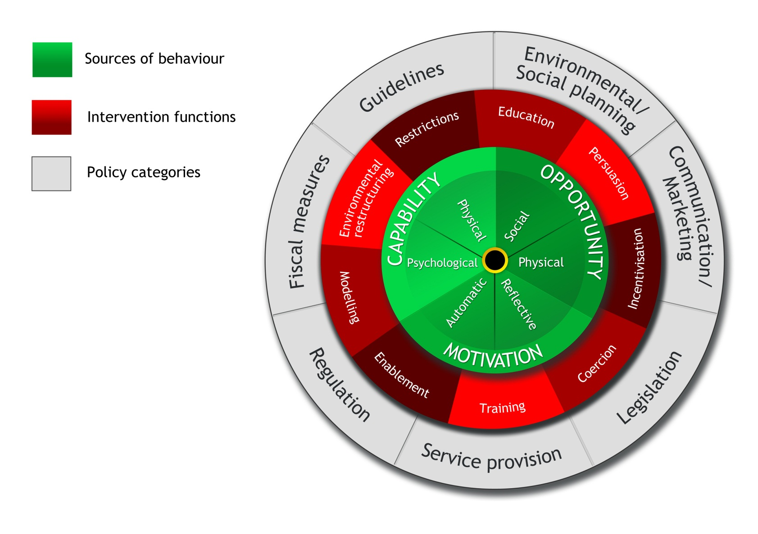
Behaviour Change Wheel
Michie S, M van Stralen, West R (2011) Implementation Science, 6, 42.

Slide 13
Influencing motivation
Plans
Educate or train to form clearer personal rules/action plans, and train to remember and apply the rules when needed
Evaluations
Educate or persuade to create more positive beliefs about desired, and less positive ones about undesired, behaviour
Motives
Persuade, incentivise, coerce, model or enable to feel attracted to the desired behaviour and less attracted to the undesired one
Impulses/inhibition
Train or enable to strengthen habitual engagement in the desired behaviour or weaken the undesired one
Responses
Model desired behaviour to induce automatic imitation

Slide 14
Influencing capability
Knowledge
Educate about ways of enacting the desired behaviour or avoiding the undesired one
Skill
Train in cognitive, physical or social skills required for the desired behaviour or avoid the undesired one
Strength
Train or enable development of mental or physical strength required for the desired behaviour or to resist the undesired one
Stamina
Train or enable endurance required for desired behaviour or sustained resistance to undesired one

Slide 15
Influencing opportunity
Train or restructure the environment to reduce time demand or competing time demands for desired behaviour (and additionally use time restrictions to reduce undesired behaviour)
Time
Resources
Restructure the environment to increase financial or other resources, social support and cultural norms for desired behaviour (and additionally use restrictions to reduce access to undesired behaviour)
Cues/prompts
Restructure the environment to provide cues and prompts for desired behaviour (and converse for undesired behaviour)
Concepts
Restructure the social environment or use modelling to shape people’s ways of thinking

Slide 16
Smoking as a behaviour
Low to moderate enjoyment
Low fulfilment of psychological needs
Moderate-high drive to smoke
Moderate-high habit strength
Low-high normative pressure
High availability
Low immediate personal cost
Low-moderate financial cost
High delayed personal cost

Slide 17
Global situation on tobacco control
Focus on smoking as the most harmful form of tobacco use
For each means of reducing smoking prevalence
judge the global situation in terms of how far this is being applied to populations or major sub-populations (e.g. women)
Illustrate with data from various countries

Slide 18
Education
How well informed is the target population about
the harms of X?
how best to avoid or stop X?

Slide 19
Tobacco control: education
Target | Current status
Understanding of harmfulness of smoking | Low-Moderate
Best ways of avoiding starting to smoke | Unknown
Best ways of stopping smoking | Low

Slide 20
Survey of tobacco users in Delhi
Do you think smoking is harmful to health?
What kind of health problems?
N=1211
Source: Sarkar et al In preparation

Slide 21
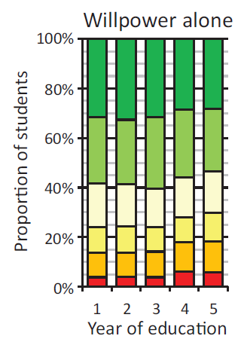
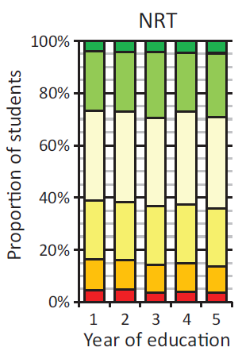
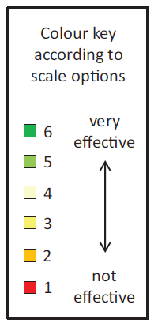
Survey of German medical students
N=19,526
Raupach et al 2013 N&TR, 15, 1892

Slide 22
Routes to quit in England
Where more than one method is used the most intensive one is represented Smoking Toolkit Study

Slide 23
Persuasion, incentivisation and coercion
How much does the target population
feel they want to avoid or stop X?
feel they need to avoid or stop X?
feel concerned about harms of X?
feel concerned about cost of X?
feel concerned about penalties for X?
feel attracted by benefits of avoiding or stopping X?

Slide 24
Tobacco control: persuasion, incentivisation and coercion
Target | Current status
Feeling of wanting to stop smoking | Low-Moderate
Feeling of need to stop smoking | Low-Moderate
Concern about cost of smoking | Low-Moderate
Concern about health effects of smoking | Low-Moderate
Concern about effect of smoking on friends and family | Low-Moderate
Concern about stigma from smoking | Low-High

Slide 25
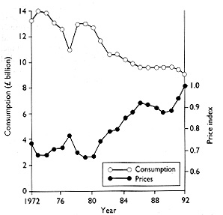
Relation between consumption (pounds sterling billion at 1992 prices) and real price (1992=1.0) of cigarettes in Britain during 1972-92.
Townsend J et al. BMJ 1994;309:923-927
©1994 by British Medical Journal Publishing Group
Notes:
Relation between consumption (pounds sterling billion at 1992 prices) and real price (1992=1.0) of cigarettes in Britain during 1972-92. (From Office of Population Censuses and Surveys2)‏

Slide 26
Smoking concerns and quit attempts among smokers in England
Final model from forward stepwise logistic regression of attempt to stop in past 12 months on to beliefs about smoking. Odds ratios less than 1 represent negative associations. N=5647; Source: Smoking Toolkit Study

Slide 27
Desire to stop of smokers in England
N=6,000+
Source: Smoking Toolkit Study

Slide 28
Concerns of smokers in England
N=15,000+
Source: Smoking Toolkit Study

Slide 29
The Stoptober effect
Brown et al Drug and Alocohol Dependence in press:October quit rate significantly higher compared with previous months in 2012 versus pre-2012 by logistic regression, p=0.005

Slide 30
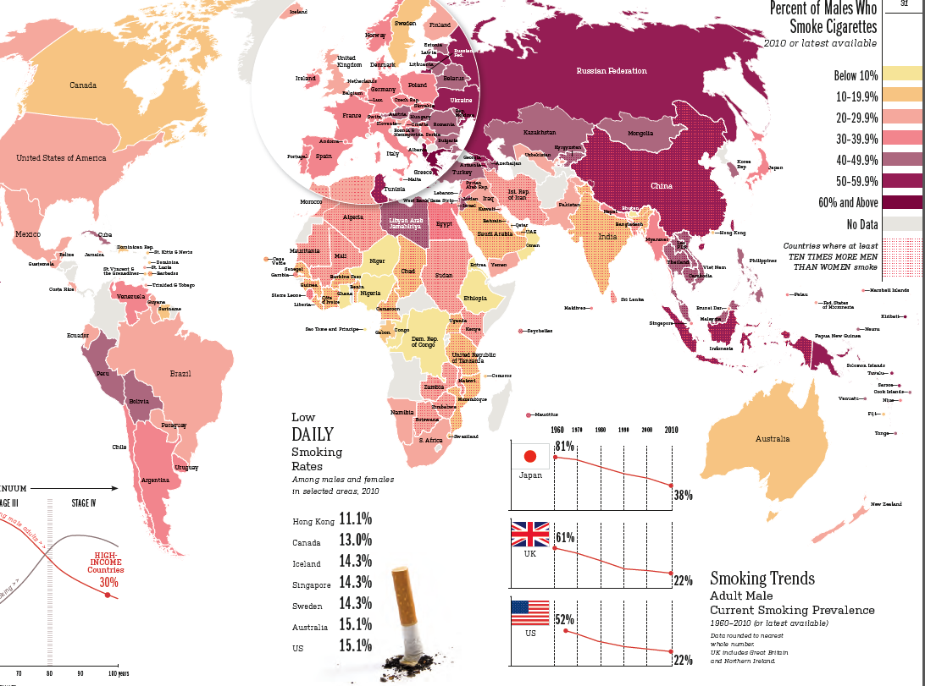
Male smoking prevalence
Tobacco Atlas

Slide 31
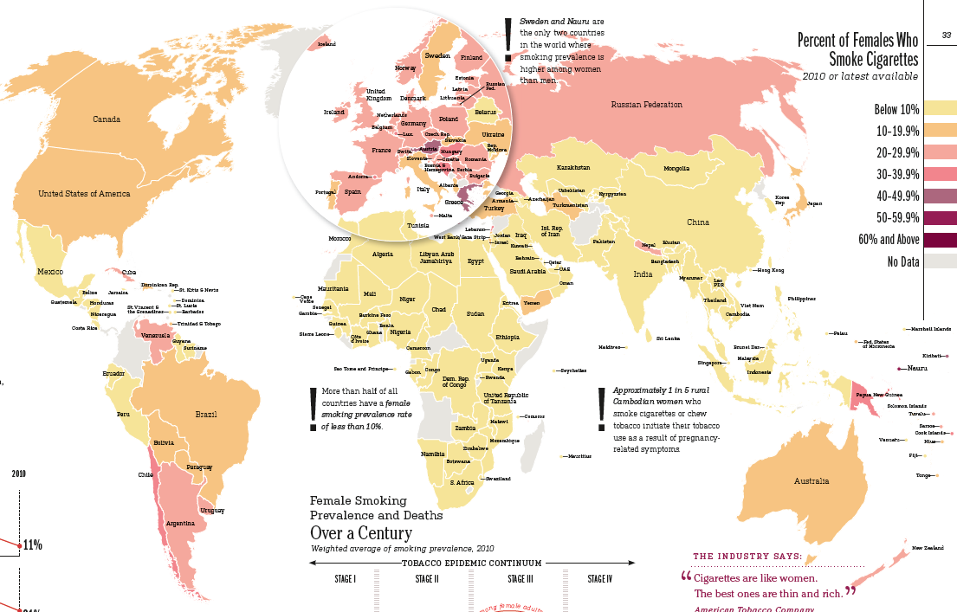
Female smoking prevalence
Tobacco Atlas

Slide 32
Training
How far has the target population acquired
the planning skills needed to avoid or stop X?
the social skills needed to avoid or stop X?
the mental strength to avoid or stop X?
the mental stamina to avoid or stop X?

Slide 33
Tobacco control: training
Target | Current status
Planning skills for avoiding smoking | Unknown
Planning skills for stopping smoking | Low-Moderate
Social skills for avoiding smoking | Unknown
Mental strength for self-control | Unknown
Mental stamina for self-control | Unknown

Slide 34
Abrupt versus gradual quitting among smokers in England
Quitting abruptly: 49.2%
Odds of success for abrupt versus gradual: 3.2, p<0.001
N=901. Adjusting for baseline age, gender, social grade, cigarette dependence, use of quitting aids, motivation to quit, time since quit attempt, previous quit attempts. Smoking Toolkit Study

Slide 35
Restriction
How far does the target population experience
restrictions in availability of X?
restrictions in locations where X is permitted?

Slide 36
Tobacco control: restriction
Target | Current status
Restrictions on getting cigarettes | Low
Restrictions on where smoking is permitted | Low-moderate

Slide 37
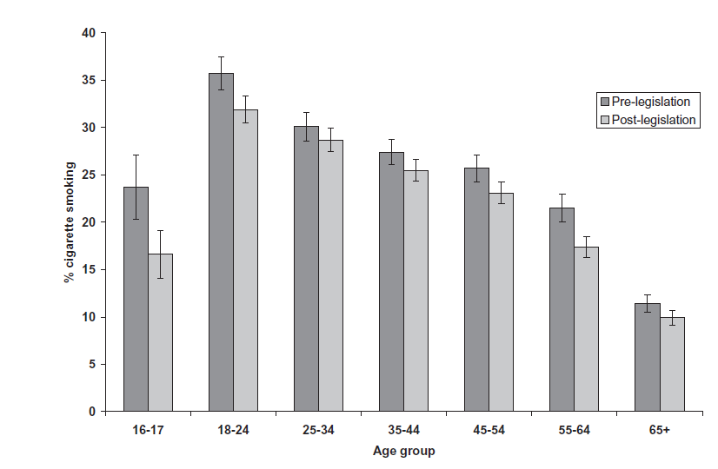
Effect of raising the age of sale from 16 to 18 years in England
Fidler et al (2010) Addiction, 105, 1984

Slide 38
Smoking prevalence before ‘smoke-free’
www.smokinginengland.info
Notes:
Pre- smoke-free, smoking prevalence was declining at an estimated rate of 0.165% per month

Slide 39
Smoking prevalence immediately after ‘smoke-free’
www.smokinginengland.info
Notes:
In the 8 months post smoke-free the rate of decline in prevalence increased to 0.72% per month.

Slide 40
Smoking prevalence to Jan 2012
www.smokinginengland.info
Notes:
At the ‘official’ start of the recession there was an upturn in prevalence and since then prevalence has been declining very slowly at 0.046% per month.

Slide 41
Decrease in smoking prevalence in England following smokefree legislation
Base: All adults

Slide 42
Environmental restructuring
How far is the target population’s environment
limiting availability of X?
limiting prompts and cues for X?
making X non-normative or stopping X being normative?
providing triggers for stopping X?

Slide 43
Tobacco control: environmental restructuring
Target | Current status
Limited availability of cigarettes | Low
Limited prompts to smoke | Low-Moderate
Exposure to triggers to stop smoking | Low-Moderate

Slide 44
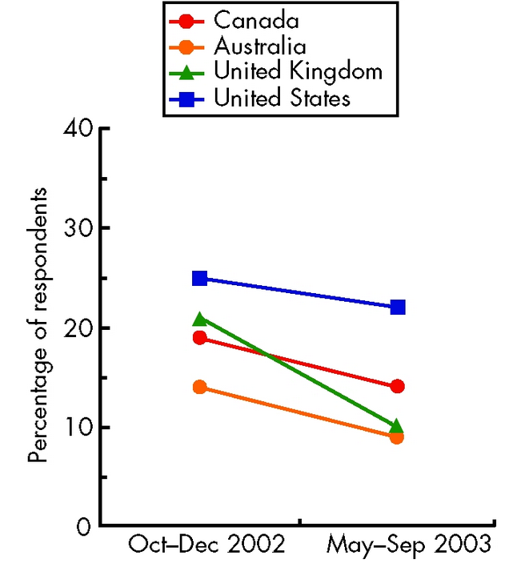
Effect of advertising ban in UK on awareness of tobacco marketing
Harris et al (2006) Tobacco Control suppl 3 26

Slide 45
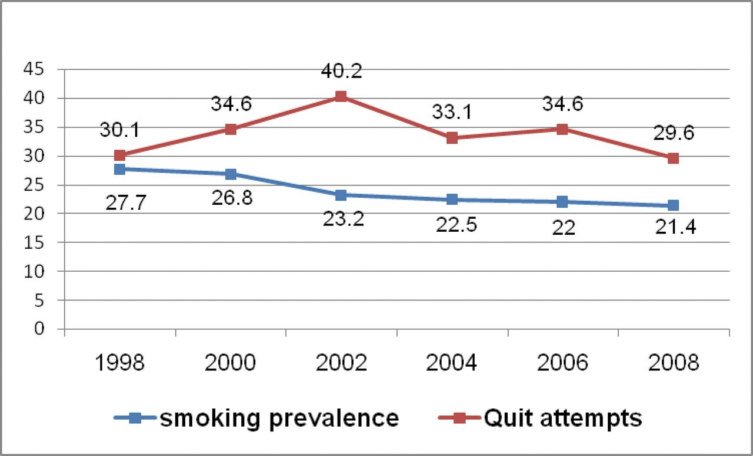
Smoking prevalence and quit attempts following introduction of graphic health warnings in Canada
Azagba S , and Sharaf M F Nicotine Tob Res 2013;15:708-717
© The Author 2012. Published by Oxford University Press on behalf of the Society for Research on Nicotine and Tobacco. All rights reserved. For permissions, please e-mail: journals.permissions@oup.com
Notes:
Smoking prevalence and quit attempts.

Slide 46
Modelling
How far are social models in the target population’s environment
not doing X?
stopping X?
talking about X in ways that discourage use?

Slide 47
Tobacco control: modelling
Target | Current status
‘Non-smoker’ modelling | Low
Modelling stopping smoking | Low
Role models discouraging smoking | Low

Slide 48
Enablement
How far does the target population
have ways of limiting drives and impulses for X?

Slide 49
Tobacco control: enablement
Target | Current status
Effectiveness of stop smoking medicines | Moderate
Effectiveness of alternative nicotine products | Low-moderate
Effectiveness of stop smoking advice/support | Moderate
Access to stop smoking medicines | Low-moderate
Access to stop alternative nicotine products | Low-moderate
Access to behavioural support | Low-moderate

Slide 50
Medications: efficacy
Stead et al 2008, Cahill et al 2012, Cochrane
Varenicline: N=6,166
Single NRT: N=51,265
Dual NRT: 4,664
NRT for ‘reduce to quit’: N=3,429
95% confidence intervals from meta-analyses
Hughes et al 2008, Cahill et al 2012, Cochrane
Bupropion: 11,440
Nortripyline: N=975
Cytisine: N=937
95% confidence intervals from meta-analyses

Slide 51
Behavioural support: efficacy
Stead et al 2012, Cochrane¹
Pro-active telephone vs reactive: N=24,994
Individual vs brief advice: N=7,855
Group vs self-help: N=4,375
Internet vs nothing: N=2,960
Text messaging versus control messages: N=9,110
Written materials: N=15,117
95% confidence intervals from meta-analyses

Slide 52
What about other addictive behaviours?
Should policies follow tobacco control?
Run mass media campaigns
Promote brief advice from health professionals
Impose moderately high duty and control illicit supply
Partially stigmatise use
Permit widespread sale
Impose legal age of sale
Restrict marketing
Restrict locations where can be used
Require warning labels on packets
Provide treatments to aid cessation

Slide 53
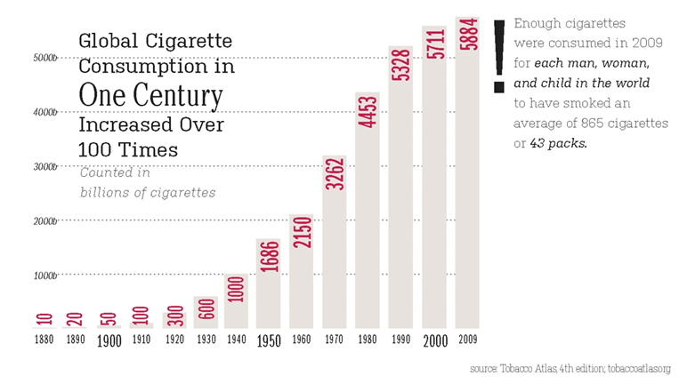
Is this a success story?

Slide 54
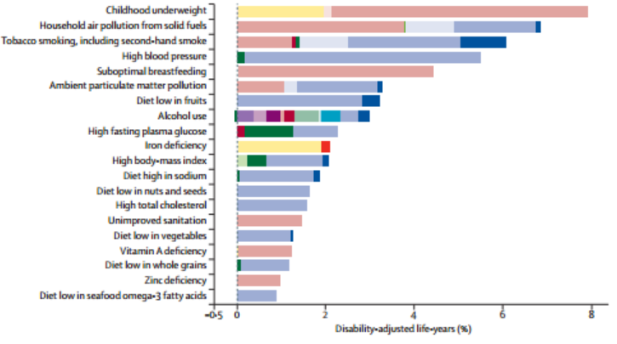
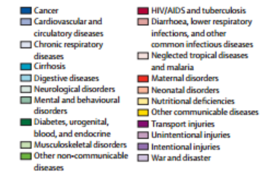
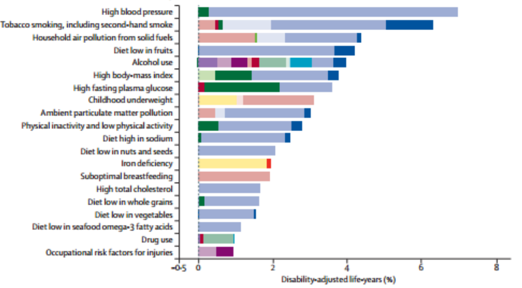
Is this a success story?
1990
2010
Lim et al 2012 Lancet 380 2224

Slide 55
Commercial interests and political indifference

Slide 56
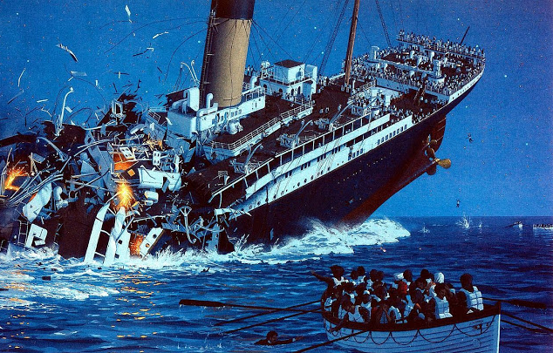
Tobacco control policies

Slide 57
Conclusions
Tobacco control is probably not a good example of how to combat a lethal addictive behaviour
Even in countries such as the UK where prevalence is falling, almost 1 in 5 adults smoke and 100,000 die prematurely each year
It is a behaviour that provides limited pleasure and meets few needs but involves a strong acquired drive and pharmacologically driven habit that is not adequately offset by countervailing factors
Almost every one of the potential levers of change to combat tobacco use is being applied in most of society at best to a moderate degree

Slide 58
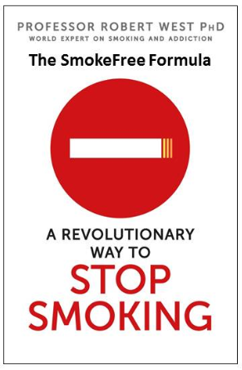
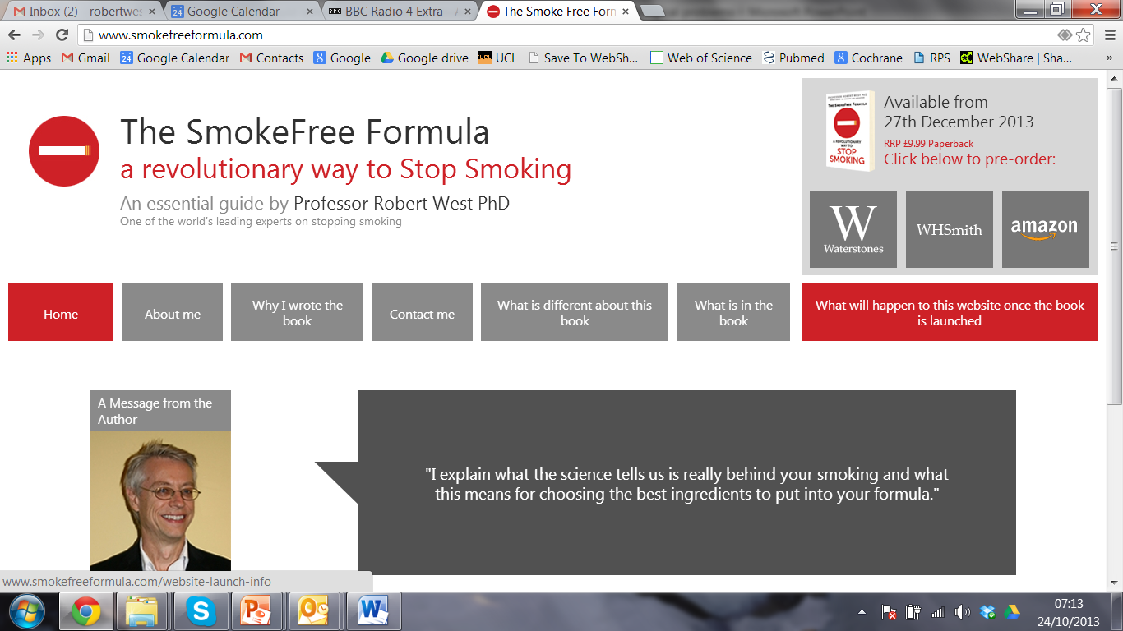
Helping smokers to help themselves by bring the science of stopping to smokers
www.smokefreeformula.com

