Slide 1
Clinical and Laboratory Investigation into Heroin and Opioid Overdose Risk
Basak Tas
Supervisors: Prof Sir John Strang & Dr Caroline Jolley
National Addiction Centre
King’s College London
Notes:
Hello,
Thank you for having me here. I’m a final year PhD student at King’s and work with Prof John Strang and Dr Caroline Jolley (respiratory physician at KCH)
My PhD is focused on risk factors of opioid and heroin overdose and specifically on further understanding and developing ways in which we can measure/monitor potential risk of overdose.
My thesis is primarily concerned with distinguishing vulnerabilities to opioid overdose and examining physiological markers as early signs of an opioid overdose in a laboratory setting. Today I’m going to presenting some of the initial findings from our experimental study that’s examining acute physiological changes to changes in dose of pharmaceutical heroin

Slide 2
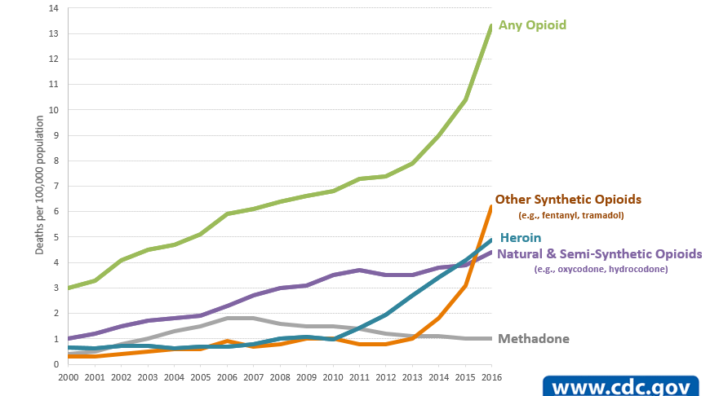
Background
Heroin & morphine deaths
England & Wales: steady rise since 2012 to more than double Office of National Statistics, 2018
Scotland: 30% rise since 2016 National Records of Scotland, 2018
Office of National Statistics, 2018
United States
Deaths per 1000,000 population
National Center for Health Statistics, CDC, 2017
Notes:
Globally, more than 100,000 people die annually from opioid overdose, and this number continues to increase. In the UK, opioid-related deaths are at an all-time high.
What’s more, looking at this table *POINT AT TABLE* despite having the lowest rates of use of 0.1% , heroin significantly and disproportionately causes the highest number of drug-related deaths.

Slide 3
Experimental Study into Heroin Overdose
Aim: Examine physiological & subjective drug effect responses to an increase in diamorphine (pharmaceutical heroin) dose.
Chemo-receptors
Respiratory Centres in the brain
Respiratory Muscles in the chest and rib-cage
Ventilation
Blood pH,
Oxygen,
Carbon Dioxide

Slide 4
Dose-related changes
100%
110%
Baseline
Baseline
2mins post-dose
2mins post-dose
3mins
3mins
Notes:
Remind people of measures. Whatever other changes we see, what is striking is the apneic episode phenomenon.
We are capturing these events, and really speaking to the true risk of overdose that these individuals experience.

Slide 5
Discussion
Magnitude of effect is subject to inter-individual variability.
Attempt to accurately capture the realistic scenarios that occur amongst long-term heroin addicts in order to:
Clinical: help us understand factors contributing to acute and fatal overdoses
Experimental Medicine: provide us a model to look at novel opioid agonists and antagonists
…But is the lab setting too different?
Notes:
So, we are seeing this resp depressive response at low and high doses, as well as baseline and incremental doses, so is this response just unpredictable?
Can feedback personalised results to individuals
Exp Med: where we could develop different overdose liability or respiratory depressant liability profiles of different opioids, different routes, different co-drugs such as alcohol and benzos, different contexts, or even people who are abstinent after period of long use, patients in ICU+prescribed opioids, etc.
etc. This work gives a real base to work with
We have to ask ourselves whether the weird lab setting is meaningful? We are actually asking people about this, we also ask whether their views change at each dose session. Overall, this work gives an experimental insight into the phenomenon of heroin overdose which we consider essential to inform better public health response to the overdose crisis.
Other issues:
Animal experiments: mice, morphine high dose, increased resp dep.
Other high dose experiments: methadone only, showed no difference.
Other patient populations: post-op hip replacement, 10mg morphine, no severe resp dep. 2. 14,000 (0.09% severe), 11,000 (0.2%)-RR,sedation. Incidence is rare, but risk seems greater in higher doses.
Healthy: remifentanil, rapid onset and duration

