Slide 1

THE HEALTH OF DOCTORS

Slide 2
LEARNING OUTCOMES
Recognise the responsibility all doctors have to ensure problems with their own health do not adversely effect their patients
Understand that help is available for colleagues in distress
Understand the responsibility doctors have to protect patients
Know how to manage a colleague who is suspected of having substance problems

Slide 3
CONTEXT
Substance problems is not uncommon among medical students and doctors
The pattern of substance misuse can start in medical school
Many of the doctors who face GMC disciplinary proceedings have substance problems
There are serious potential problems for doctors who misuse substances including removal from the medical register
Alcohol misuse is associated with depression and anxiety
Anaesthetists are more likely than other doctors to use narcotics

Slide 4
CONTEXT
Medical students: approximately 10% smoke tobacco, 17% drink above recommended limits, 37% had used other drugs, 9% current drug use
Any issues relating to substance use in students will be viewed in the same light as qualified doctors
Even actions in leisure time e.g. conviction for drink driving, can have an impact as this is notifiable to the GMC by police and the doctor
A caution for possession of cannabis will lead to GMC referral
Substance problems impact on the individual, families, professional career including colleagues, patients and organisations

Slide 5
If you are concerned about a student or a colleague, consider whether substance use may be a factor
Doctors and medical students should monitor their own alcohol consumption
Doctors and medical students have a responsibility to promote sensible drinking and healthy life style, to be accountable for their behaviour and promote a healthy life style

Slide 6
SPECIAL FEATURES
Medical students and doctors may present at a late stage in an effort to conceal problems due to the serious consequences on careers
Self treatment with controlled drugs
All doctors have a duty to act when they believe that patients’ safety, care and dignity
Specialities most at risk at A&E, anaesthetics, psychiatry, primary care
A doctor’s fitness to practise may be brought into question if that doctor has a medical condition eg drug and alcohol addiction, and does not appear to follow appropriate medical advice about minimising risks to patients

Slide 7
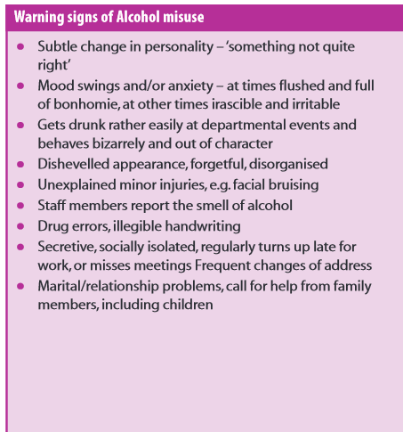
WARNING SIGNS TABLES

Slide 8
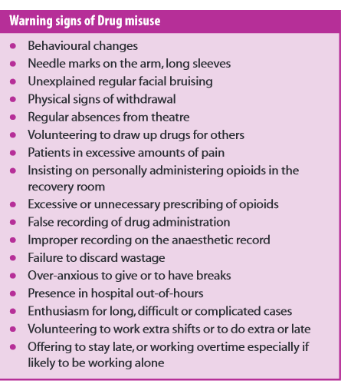
WARNING SIGNS TABLES

Slide 9
ASSESSMENT
Same as any other patient BUT sensitivity about confidentiality
Special services e.g. NHS Practitioner Health Programme
Medical students can be advised to seek help from their GP and occupational health doctor
Doctors may feel the need for out of area services in BMA or Sick Doctors Trust
Most common pre-disposing factors are family stress, anxiety, depression and personality difficulties

Slide 10
TREATMENT
Follows the same principles as the general population
Some dedicated services for health professionals
GMC guidance states that medical students and doctors should:
not treat themselves
have a GP outside the family to ensure independent care
consult a qualified colleague if s/he considers they have a condition which may affect judgement and performance

Slide 11
EARLY SIGNS
Deterioration in academic performance
Increased drinking after work and hangovers at work
Poor punctuality, absenteeism
Erratic behaviour
Concealed or denied use of substances
Acquiring hypnotic or controlled drugs from a ward or self-prescribing
Loss of driving licence
Being subject to disciplinary process, serious incident investigations

Slide 12
RECOGNITION and BARRIERS
Early diagnosis is critical – reluctance to seek help due to anxieties around:
Fear of consequences for career, references by whistle blowers
Fear of breach of confidentiality amongst colleagues or colleagues having access to NHS electronic records
Risk to training, provisional registration and licence to practise
Fear of getting another job
Revalidation and reputation
Ruined career
Criminal history
Stigma, shame, secrecy

Slide 13
TREATMENTS
Psychological interventions e.g. motivational interviewing, cognitive behavioural therapy, counselling
Group, family and couple therapy
Counselling for other addictions eg gambling
Pharmacological therapy
Mutual aid groups

Slide 14
SPECIFIC HELP FOR DOCTORS AND DENTISTS
NHS Practitioner Health Programme
British Medical Association
Sick Doctors Trust
Royal Colleges
General Medical Council
Occupational health
Student/staff support

Slide 15
NHS PRACTITIONER HEALTH PROGRAMME
Free and confidential for doctors and dentists in London who have physical/mental health problems & drug/alcohol problems provides:
Information and advice, assessment and referral
Treatment for psychological problems
Treatment for substance problems and other addictions eg gambling
Case management and monitoring
Advocacy, family support, education and prevention
Reports for GMC/GDC and employers with patient’s consent
http://php.nhs.uk/

Slide 16
SICK DOCTORS TRUST
Supports affected colleagues and protects patients by:
Identifying doctors suffering from effects of addiction
Persuading affected doctors that they have a treatable illness and assist them accessing such treatment
Assisting doctors with practical problems e.g. maintaining their livelihoods, supporting families
Help recovering doctors to develop a lifestyle that is conducive to uninterrupted recovery
http://sick-doctors-trust.co.uk/

Slide 17
GENERAL MEDICAL COUNCIL
Keeps up to date registers of qualified doctors
Fosters good medical practice
Promotes high standards of medical education and training
Dealing firmly and fairly with doctors whose fitness to practise is in doubt
Provides a list of resources for doctors with health concerns
http://www.gmc-uk.org/concerns/11551.asp

Slide 18
BMA SERVICES
BMA Counselling is staffed by professional telephone counsellors 24 hours a day, 7 days a week.
The Doctor Advisor service runs alongside BMA Counselling giving doctors and medical students in distress or difficulty the choice of speaking in confidence to another doctor.
Confidentiality and GMC issues
The Doctor Advisor service cannot provide an advocacy service or represent doctors at tribunals or GMC hearings.
The BMA Counselling and Doctor Advisor services are completely confidential and are not linked to any other external or internal agencies.
http://www.bma.org.uk/doctorsfordoctors

Slide 19
ADVICE AND SUPPORT WHEN RAISING A CONCERN
Seek advice and support if you are not sure whether or how to raise a concern by contacting:
educational supervisor or manager
medical defence body, Royal College or professional body
the appropriate regulator
NHS Whistleblowing helpline
GMC confidential helpline
Keep a record of concerns and actions taken to resolve them

Slide 20
References
American Society of Anesthesiologists (2015) Substance Use Disorder Prevention http://www.asahq.org/resources/publications/newsletter-articles/2015/february-2015/substance-use-disorder-prevention
Bonnet, U. & Scherbaum, N. (2012) Craving dominates Propofol addiction of an affected physician. Journal of Psychoactive Drugs, 44 (2), pp186 -190
Brooks, S, Chalder, T & Gerada, C (2011) Doctors vulnerable to psychological distress and addictions: treatment from the Practitioner Health Programme. Journal of Mental Health, no.2 pp157-164 http://dx.doi.org/10.3109/09638237.2011.556168
Brooks, S, Gerada C & Chalder, T (2013) Doctors and dentists with mental ill health and addictions: outcomes of treatment from the Practitioner Health Programme. Journal of Mental Health. http://dx.doi.org/10.3109/09638237.2012.734647
Cox J et al (2006) Understanding Doctors’ Performance Abingdon: Radcliffe Publishing Ltd.
Ghodse H, Mann S, and Johnson P.(2000)Doctor’s and their health Sutton: Reed Business Information.
Ghodse, A.H & Howes K (1994) substance use of medical students: a nationwide survey. Health trends, 26:85-8.
General Medical Council (2013) Good Medical Practice http://www.gmc-uk.org/guidance/good_medical_practice.asp
General Medical Council (2104) Your Health Matters – practical tips and support http://www.gmc-uk.org/DC7725_Your_health_matters_61930828.pdf

Slide 21
References
General Medical Council (2011) Medical Students: Professional Values and Fitness to Practise http://www.gmc-uk.org/education/ undergraduate/professional_behaviour.asp /=/ 1utro
General Medical Council (2009) Tomorrow’s Doctors, Outcomes and standards for undergraduate medical education, http://www.gmc-uk.org/Tomorrow_s_Doctors_1214.pdf_48905759.pdf
Henderson, M, Brooks, S.K, Del Busso, L, Chalder, T, Harvey, S.B, Hotopf, M, Madan, I & Hatch, S (2012) Shame! Self-Stigmatisation as an obstacle to sick doctors returning to work: a qualitative study. BMJ, 5, vol.2 http://dx.doi.org/10.1136/bmjopen-2012-001776
Hines R.(2003) Substance Abuse in Anesthesia Providers: An Update. Society of Academic Anesthesiology Associations http://citeseerx.ist.psu.edu/viewdoc/summary?doi=10.1.1.547.7660
Howes, K & Ghodse, G (1997) Hazardous drinking and its correlates among medical students. Addiction Research, 4, No.4, pp255-266
Practitioner Health Programme (PHP) http://php.nhs.uk/
Marshall E. J (2008) Doctor’s health and fitness to practise: treating addicted doctors. Occupational Medicine, 58: 334-340.
Newbury-Birch, D., White, M & Kamali F (2000) Factors influencing alcohol and illicit drug use amongst medical students. Drug and Alcohol Dependence 59, pp125-130.
NHS Information Centre (2007) Adult psychiatric morbidity in England, 2007, Results of a household survey
Public Health England (2016) Guidance: Health matters: harmful drinking and alcohol dependence https://www.gov.uk/government/publications/health-matters-harmful-drinking-and-alcohol-dependence/health-matters-harmful-drinking-and-alcohol-dependence
The Association of Anaesthetists of Great Britain and Ireland, (2011) Drug and Alcohol Abuse amongst Anaesthetists Guidance on Identification and Management. http://www.aagbi.org/sites/default/files/drug_and_alcohol_abuse_2011_0.pdf

