Slide 1
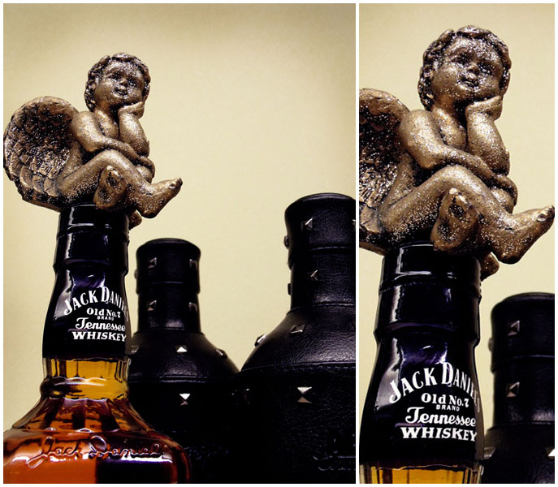
CHANGES OF INDICATORS OF SOCIAL INTELLIGENCE FOR SUBSTANCE USE DISORDERS PATIENTS AFTER TREATMENT
Velga Sudraba,MD
Riga Centre of Psychiatry and Addiction Disorders,
Assoc. Proffes. Kristine Martinsone, PhD
Riga Stradiņš University, Latvia

Slide 2
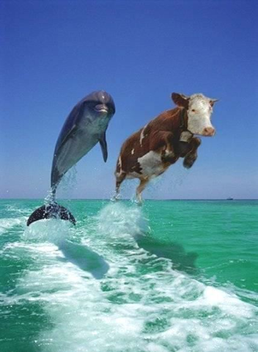
Background (1)
Social Intelligence is defined as a personality’s capacity, which is based on cognitive processes, emotional and social experience, understanding one-self and others and predicting his or her behavior.
Social Intelligence describes and establishes a personality’s skill: to successfully navigate through different social situations; to correctly define personal and external experiences; and allows taking adequate action in these situations.

Slide 3
Background (2)
As pointed out by researchers (Ham and Garcia, 2010; Scheier et al., 1999) social intelligence skills are directly related to alcohol and drug usage. In fact, the lower the skills, the higher the risk the addict will use drugs and vice versa; substance abuse creates disorders for social intelligence skills.

Slide 4
Research Objectives
to estimate indicator changes of Social Intelligence (SI) of substance use disorders (SUD) patients after detoxification and Minnesota program (MP) treatment

Slide 5
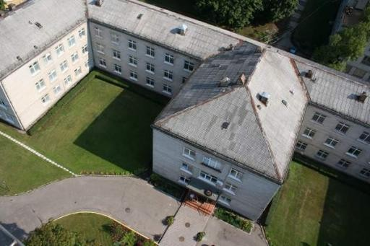
Research setting
„Riga Centre of Psychiatry and Addiction Disorders” SUD patients from two departments:
Detoxification
the Minnesota Program

Slide 6
Measurements
The first measurement was done at the beginning of treatment in MP or when detoxification was finished (patients are in equal state according towards uncontrolled psychoactive substances use.
The second measurement was done 6 months after treatment:
Descriptive statistic and ANOVA were used for data procesing.

Slide 7
Inclusion and Exclusion criteria
patients were found in the in-patient clinic departments: detoxification or MP
patient was given an addiction diagnosis (F10.2-F19.2) according to ICD-10
patients are at least 18 years of age
filled out the TSIS completely
understood Latvian
patients were not in an acute condition
patients that have come only to the Motivational course (7-12 days long)
patients who either refused to fill out or filled-out the TSIS incompletely

Slide 8
Participants in the first measurement
Selection of research was composed by 405 respondents with diagnosis of SUD (F10.2 – F19.2, ICD-10)
Patients from detoxification (n=201) with average age 41,7 (SD=11,0); 70,1% were male; 84,1%- alcoholics
Patients from MP (n=204), average age 39,6 (SD=11,1); 61,3%- male; 79,4%- alcoholics

Slide 9
Participants in the second measurement
Patients from detoxification (n=94); 63,8% were male; 86,2%- alcoholics
Patients from MP (n=109); 67,0%- male; 78,9%- alcoholics

Slide 10
Research instrument
The Tromso Social Intelligence Scale (TSIS)
(Silvera, Martinussen, Dahl, 2001)
contains 21 assertions
seven assertions in each SI component (Social information processing, Social skills and Social awareness)
the respondents must assess themselves by giving an assessment from one to seven; one meaning ’’completely unsuitable’’ and seven meaning ’’completely suitable.’’
TSIS was adapted in Latvia in 2006 (Kuzņecova, Šlosberga, 2006)

Slide 11
Results
SI indicators were counted and compared according to respondent`s addictions and treatment departments.
SI questionnaires only from patients, who took part in both measurements were counted.

Slide 12
Descriptive statistics results (male)
Factor of SI | Group | 1st measurement |  |  |  | 2nd measurement
 |  | Alcoholics |  | Drug addicts |  | Alcoholics |  | Drug addicts
 |  | M | SD | M | SD | M | SD | M | SD
SP | MP | 30,75 | (7,89) | 30,31 | (7,14) | 32,91 | (7,60) | 34,25 | (5,57)
 | Dx | 33,09 | (6,21) | 30,83 | (12,70) | 31,22 | (7,51) | 34,67 | (5,78)
SS | MP | 28,79 | (8,85) | 30,69 | (9,83) | 32,54 | (8,89) | 33,88 | (9,98)
 | Dx | 29,76 | (7,82) | 35,33 | (7,76) | 30,83 | (5,84) | 30,33 | (9,77)
SA | MP | 28,93 | (8,18) | 29,88 | (6,82) | 33,16 | (6,69) | 30,19 | (7,14)
 | Dx | 28,11 | (8,10) | 27,50 | (7,26) | 28,02 | (6,89) | 31,17 | (9,06)
Comm | MP | 88,47 | (19,57) | 90,88 | (16,67) | 98,61 | (17,56) | 98,31 | (17,84)
 | Dx | 90,96 | (12,67) | 93,67 | (19,05) | 90,07 | (14,18) | 96,17 | (23,20)

Slide 13
ANOVA results (male)
Factor of SI | F Time | F Time x group | F Time x addiction | F Between groups | F Between addictions
SP | 2,04 | 0,54 | 1,76 | 0,10 | 0,17
SS | 0,30 | 3,94* | 1,47 | 0,00 | 1,63
SA | 2,73 | 0,04 | 0,00 | 1,55 | 0,01
Comm on SI | 3,01 | 2,08 | 0,00 | 0,17 | 0,70
* - p≤0,05
F(2,245)-1st measurement;
F(2,131)- 2nd measurement

Slide 14
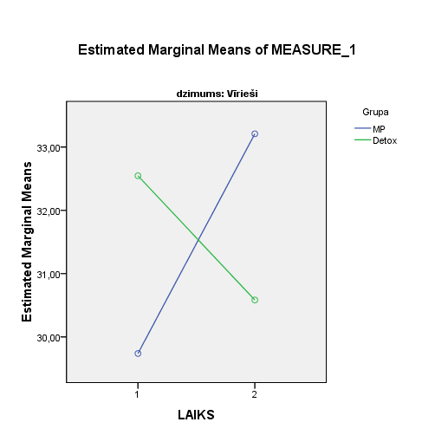
The interaction of time and group in Social Skills (SS) factor (male)

Slide 15
Descriptive statistics results (female)
Factor of SI | Group | 1st measurement |  |  |  | 2nd measurement
 |  | Alcoholics |  | Drug addicts |  | Alcoholics |  | Drug addicts
 |  | M | SD | M | SD | M | SD | M | SD
SP | MP | 30,41 | (7,22) | 28,71 | (10,66) | 32,48 | (8,02) | 30,14 | (8,39)
 | Dx | 30,96 | (10,55) | 33,57 | (7,96) | 26,00 | (6,26) | 25,71 | (4,39)
SS | MP | 29,59 | (8,18) | 31,14 | (10,78) | 30,34 | (8,08) | 32,71 | (10,09)
 | Dx | 31,26 | (9,61) | 34,57 | (11,12) | 32,11 | (7,68) | 26,00 | (6,81)
SA | MP | 28,00 | (7,59) | 25,71 | (9,01) | 30,21 | (7,22) | 31,86 | (6,52)
 | Dx | 27,56 | (9,76) | 29,71 | (6,52) | 32,07 | (7,03) | 29,14 | (5,21)
Comm SI | MP | 88,00 | (17,57) | 85,57 | (19,59) | 93,03 | (19,31) | 94,71 | (17,82)
 | Dx | 89,78 | (20,36) | 97,86 | (21,99) | 90,19 | (12,72) | 80,86 | (9,96)

Slide 16
ANOVA results (female)
Factor of SI | F Time | F Time x group | F Time x addiction | F Between groups | F Between addictions
SP | 1,93 | 5,90* | 0,28 | 0,61 | 0,06
SS | 0,70 | 2,45 | 1,80 | 0,00 | 0,02
SA | 4,34* | 0,56 | 0,04 | 0,14 | 0,04
Comm SI | 0,03 | 4,83* | 0,90 | 0,03 | 0,02
* - p≤0,05
F(2,125)-1st measurement;
F(2,68)- 2nd measurement

Slide 17
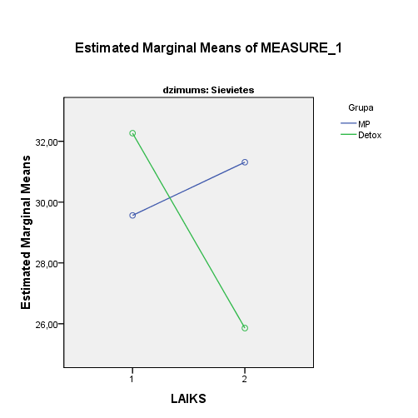
The interaction of time and group in Social information processing (SP) factor (female)

Slide 18
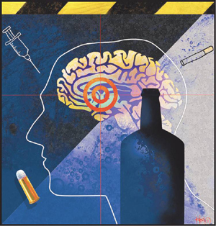
Conclusion
After results we gained, we found out, that increase of SI indicators is higher for respondents of Minnesota program. Related investigations show the same results (Dawson et al., 2005; Dawson et al., 2007), what points out, that MP offer a treatment that is focused on changes in patients thinking and behaviour and towards their skills of obtaining new patterns.
It is necessary to continue investigation, so we can estimate the duration of changes.
Results are helpful for specialists to understand more about acute and psychotherapeautical treatment influence on the changes of Social intellect during therapy process.Information of results might help to improve psychosocial functioning for SUD patients and help them to integrate into society without use of psychoactive substances.

Slide 19
References
Ham LS, Garcia TA. (2010) Assessment of Social Skills in Substance Use Disorders . In Nangle D.V., Hansen D.J., Erdley C.A., Norton P.J. (eds). Practitioner’s Guide to Empirically Based Measures of Social Skills. New York: Springer Science+Business Media. pp. 225-246.
Scheier LM, Botvin GJ, Diaz T, Griffin KW. (1999). Social skills, competence, and drug refusal efficacy as predictors of adolescent alcohol use. Journal of Drug Education,29(3):251-278.
Silvera D.H., Martinussen M., Dahl T. (2001) The Tromso Social Intelligence Scale, a self-report measure of social intelligence. Scandinavian Journal of Psychology, 42, 313-319.
Dawson DA, Goldstein RB, Grant BF. 2007. Rates and correlates of relapse among individuāls in remission from DSM-IV alcohol dependence: a 3-year follow-up. Alcohol Clin Exp Res. 2007;31(12):2036-45.
Dawson DA, Grant BF, Stinson FS, Chou PS, Huang B, Ruan WJ., 2005. Recovery from DSM-IV alcohol dependence: United States, 2001-2002. : Addiction. 100(3):281-92.

Slide 20
Thank you for your attention!

Slide 21
CHANGES OF INDICATORS OF SOCIAL INTELLIGENCE FOR SUBSTANCE USE DISORDERS PATIENTS AFTER TREATMENT
Velga Sudraba, MD
Riga Centre of Psychiatry and Addiction Disorders, Latvia
E-mail: velgasudraba@gmail.com

