Slide 1
Pain and problematic use of opioids
Society for the Study of Addiction: York 2014
Dr Cathy Stannard: Bristol
cfstannard@aol.com

Slide 2
Session overview
About pain
About opioids for pain
Prescription opioids: harms data
  US
  UK and Europe
Pain and opioid treatment: a recipe for disaster?
Avoiding prescription opioid related harms

Slide 3
About pain
Pain and problematic use of opioids

Slide 4
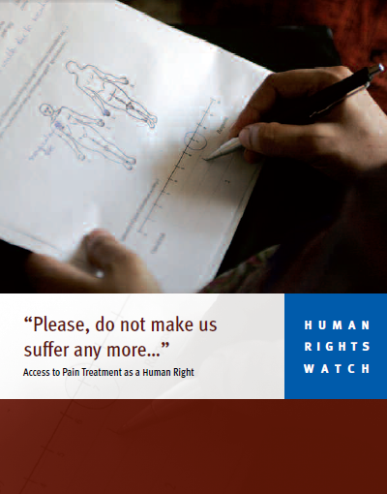

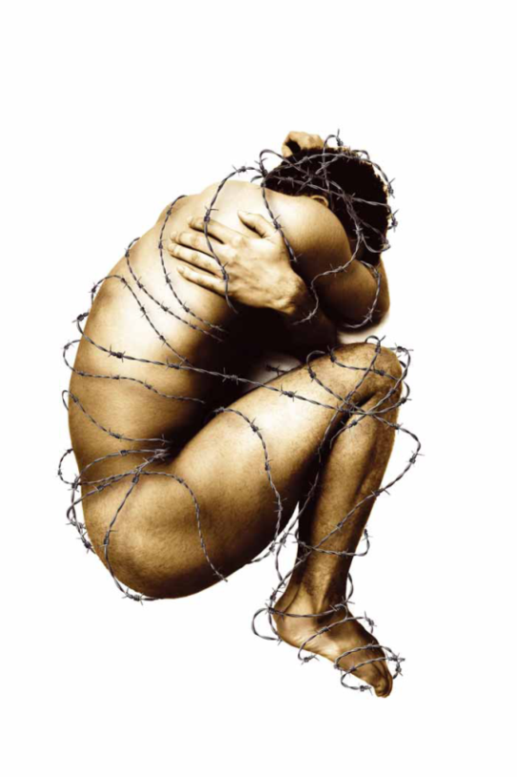
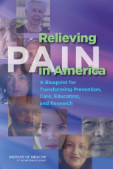

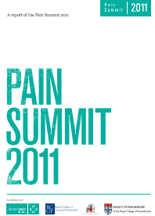
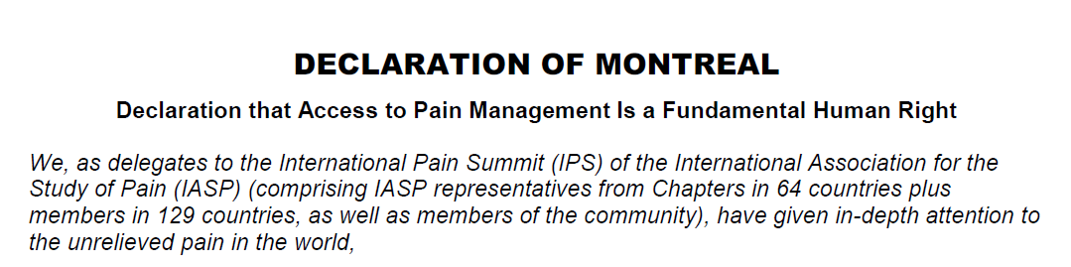

Slide 5
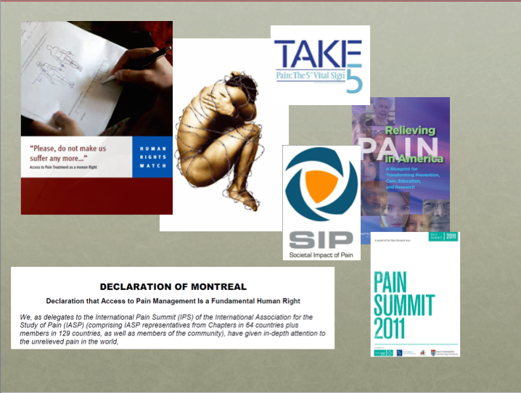
Thoughts about pain relief
Yes we should try to treat pain but…
Pain can’t always be treated
Inability to reduce a patient’s pain intensity is neither a reflection of lack of effort nor a sign of incompetence
Trying hard to treat pain and making the patient worse is not a result

Slide 6
Some Risk factors for chronic pain include…
Mental health diagnoses
Emotional trauma
Perceived disability
Substance misuse disorders (including alcohol)

Slide 7
About opioids for pain
Pain and problematic use of opioids

Slide 8
Why are opioids prescribed?
Because…
they are strong analgesics
persistent pain is hard to treat so something strong is a tempting idea

Slide 9
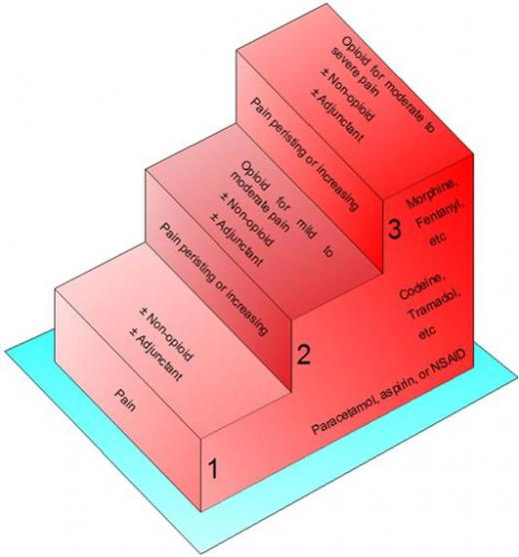
WHO 1986

Slide 10
WHO 1986

Slide 11
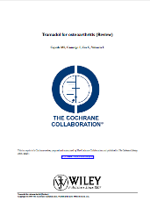
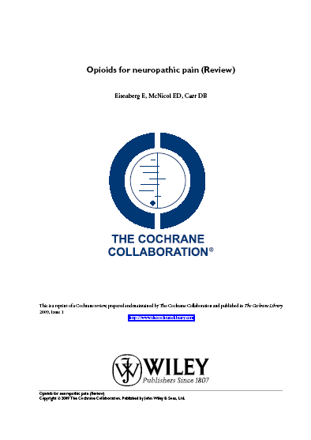
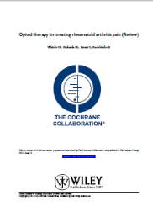
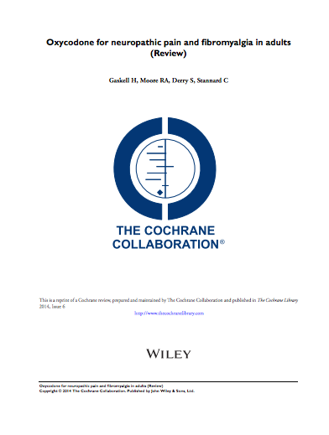
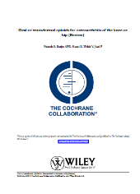
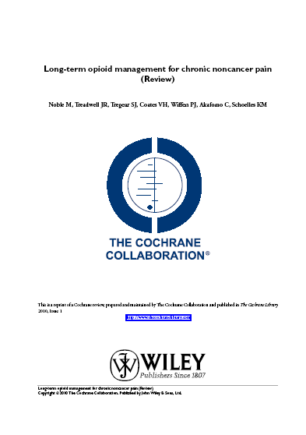
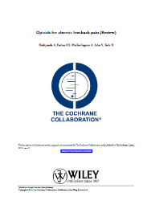
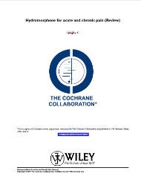

Slide 12
Why are opioids prescribed?
Because…
they are strong analgesics
persistent pain is hard to treat so something strong is a tempting idea
pain sufferers exhibit distress
distress makes clinicians want to do something
we know there are risks but think we can handle them

Slide 13
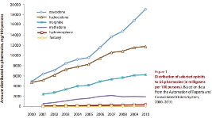
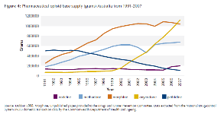
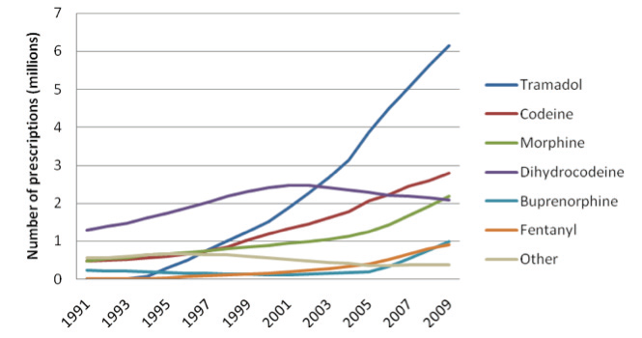
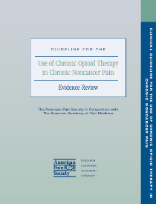
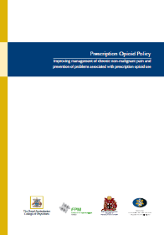
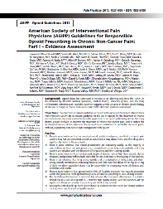
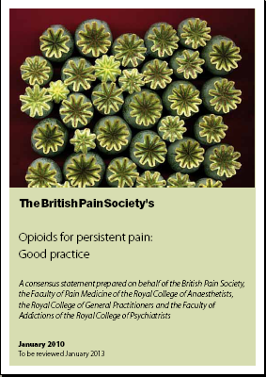
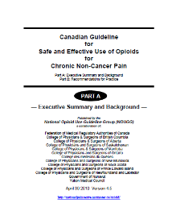
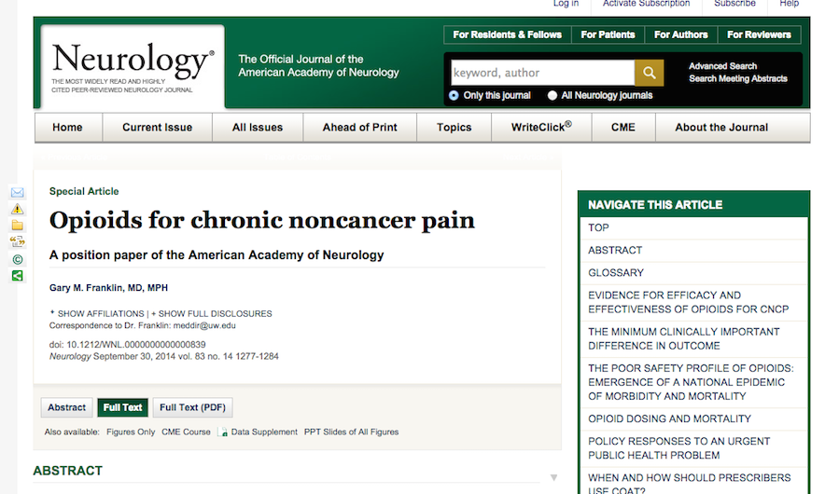

Slide 14
Strong opioids: Prescription Cost Analysis
Items
Cost

Slide 15
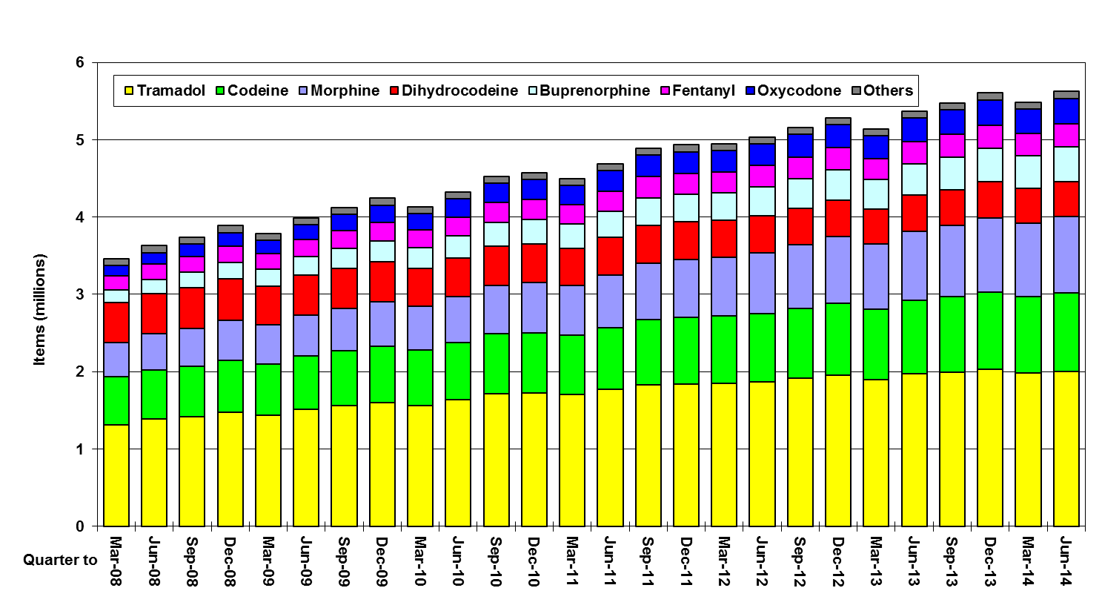
Trends in Prescribing of Opioid Analgesics on NHS prescriptions in England
© Copyright NHSBSA 2014

Slide 16
Number of patients prescribed opioids
Number of patients
Zin CS et al. Eur J Pain 2014.

Slide 17
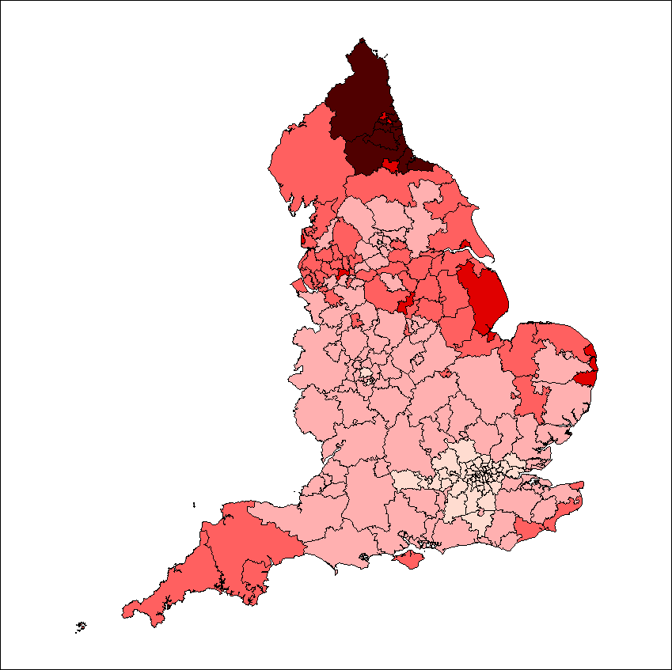
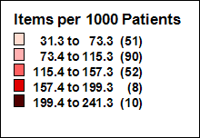
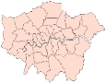

Variation Between Clinical Commissioning Groups in Prescribing of Opioid Analgesics (Quarter to June 2014)
© Copyright NHSBSA 2014

Slide 18
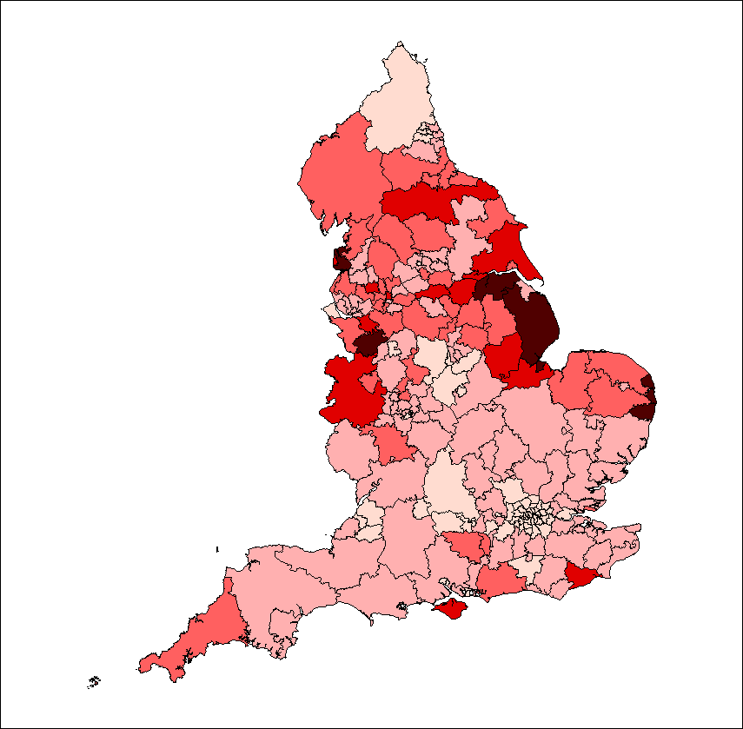
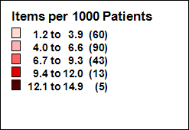
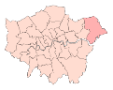
Variation Between Clinical Commissioning Groups in Prescribing of Fentanyl
(BNF 4.7.2)
(Quarter to June 2014)
London CCGs
© Copyright NHSBSA 2014

Slide 20
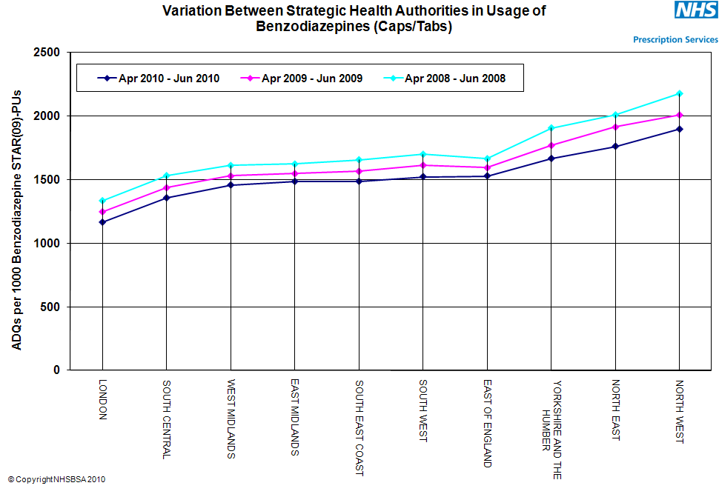
Variation between Strategic Health Authorities in prescribing of Benzodiazepines (Quarter to March 2010) NHS prescribing services.

Slide 21
Prescription Opioids harms data
Pain and problematic use of opioids

Slide 22
Opioid pain reliever (OPR) death rates and sales, U.S., 1999-2010
15 000 deaths
Source: National Vital Statistics System. Age-adjusted rates per 100,000 population for OPR deaths and crude rates per 10,000 population for kilograms of OPR sold. Some overdose deaths were not included in the total for 2009 because of delayed reporting of the final cause of death. The reported 2009 numbers are underestimates.
Notes:
During 1999–2008, overdose death rates, sales, and substance abuse treatment admissions related to OPR increased in parallel.
Sales of prescription painkillers, shown on the top dotted line, in 2010 were four times those in 1999. By 2010, enough OPR were sold to medicate every American adult with a typical dose of 5 mg of hydrocodone every 4 hours for 1 month.
The overdose death rate, the middle solid line, in 2008 was nearly four times the rate in 1999.
The substance abuse treatment admission rate, the bottom dotted line, in 2009 was almost six times the rate in 1999.

Slide 23
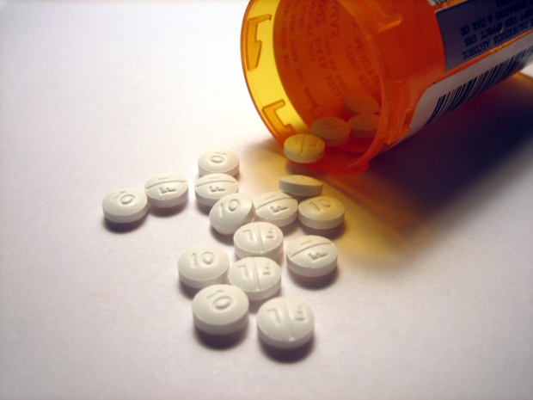
Public health impact of opioid pain reliever use
For every opioid overdose death in 2009 there were:
9
30
118
795
Based on 15,597 OPR overdose deaths in 2009.
Treatment admissions are for primary use of opioids from Treatment Exposure Data set for 2009.
Emergency department (ED) visits are from DAWN (Drug Abuse Warning Network) for 2009
Abuse/dependence and nonmedical use in the past year are from the 2009 National Survey on Drug Use and Health
Notes:
What is the total health impact of opioid pain reliever use?
In 2009, for every 1 overdose death involving opioids there were
9 substance abuse treatment admissions
30 emergency department visits for misuse or abuse
118 people who met the criteria for abuse or dependence on opioids
795 people 12 and older who reported using these drugs nonmedically
Clearly the misuse and abuse of opioids exacts enormous consequences on individuals, families, and society as a whole.

Slide 24
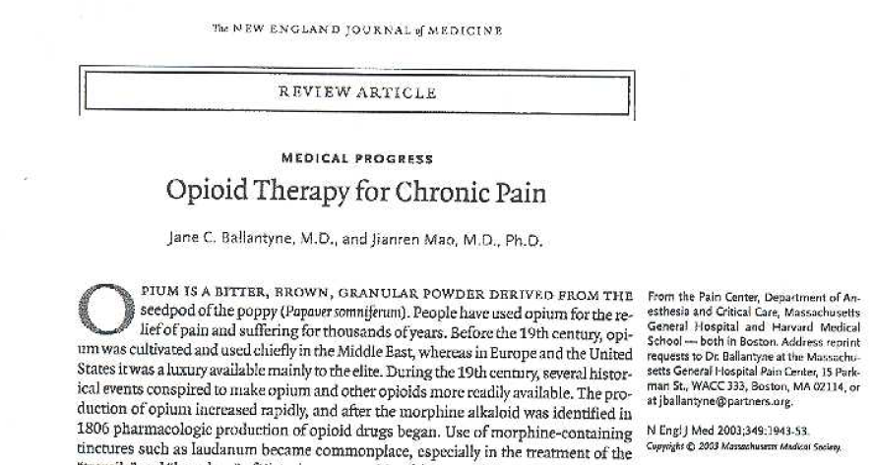

Slide 25
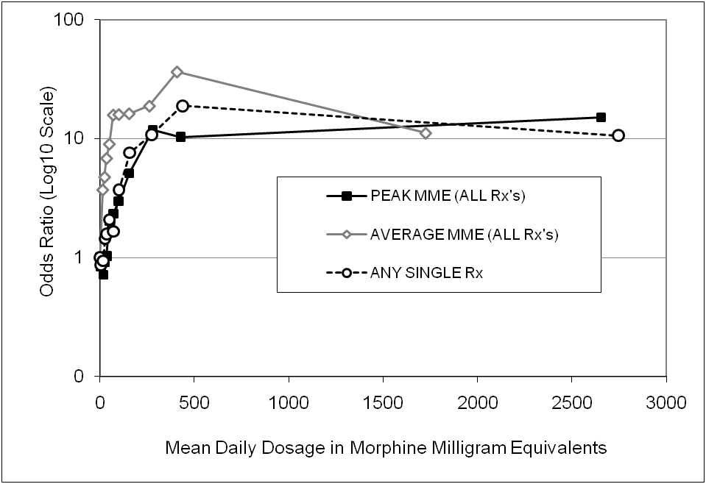
Crude association of daily dosage of opioid analgesics with risk of unintentional drug overdose death,
New Mexico, October, 2006—March, 2008
DEATHS AND HIGH DOSES
Paulozzi , et al. Pain Med 2012; 13:87-95
Dunn et al., Annals Int Med, 2010
Gomes et al., Arch Int Med, 2011
Bohnert et al., JAMA, 2011

Slide 26
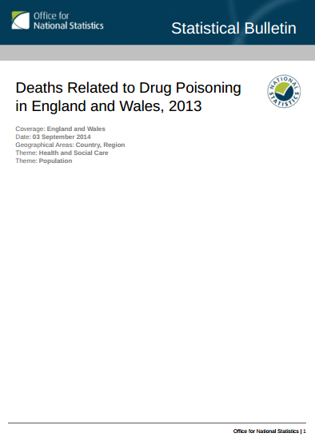
Deaths related to drug poisoning/misuse
England and Wales 2013
2 955 drug related deaths ↑
765 heroin/morphine ↑
methadone ↑
232 codeine, DHC ↓
220 tramadol ↑ ↑

Slide 27

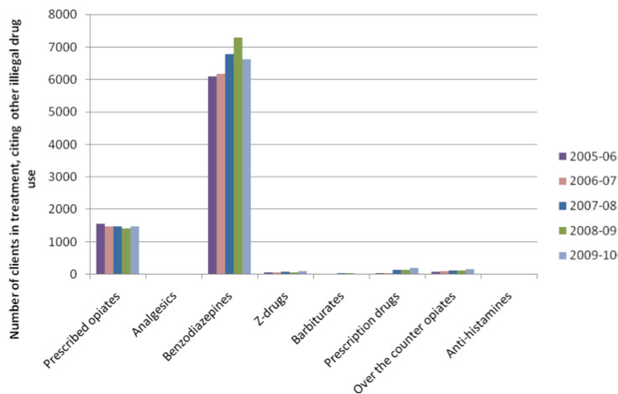
Population 56.1m
(16% population in treatment)
Figure 7: POM/OTC compounds identified as being problematic by
individuals new to drug treatment who report other illegal drug use
(2005-06 to 2009-10). NTA 2011

Slide 28
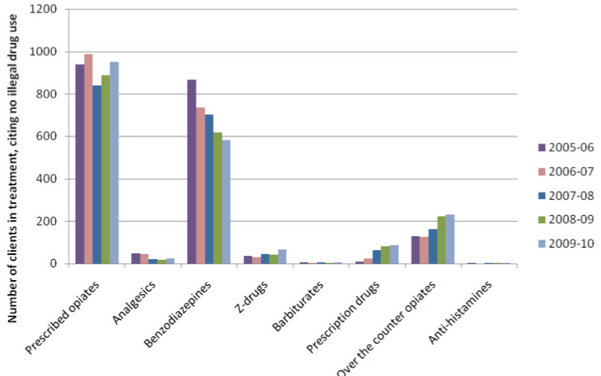
Population 56.1m
Figure 6: POM/OTC compounds identified as being problematic by
individuals new to drug treatment services who do not report problems with other illegal drug use (2005-06 to 2009-10).
NTA 2011

Slide 29
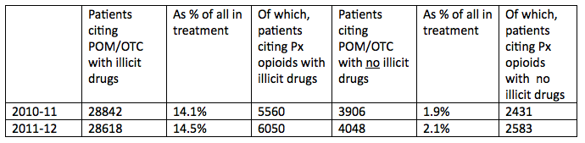
NDTMS personal communication

Slide 30
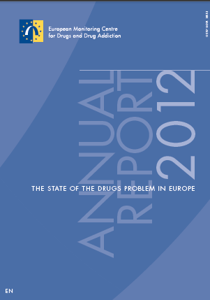
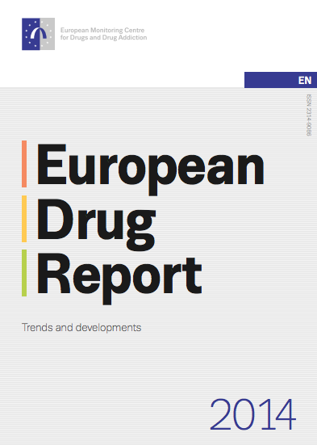

Slide 31
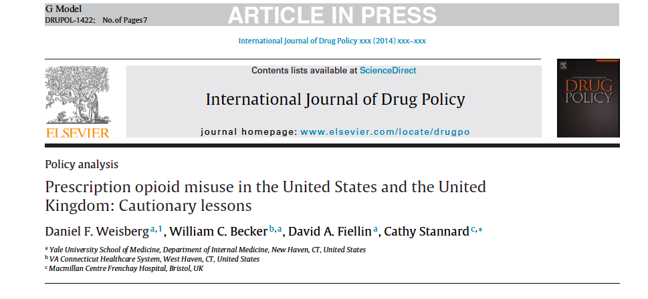
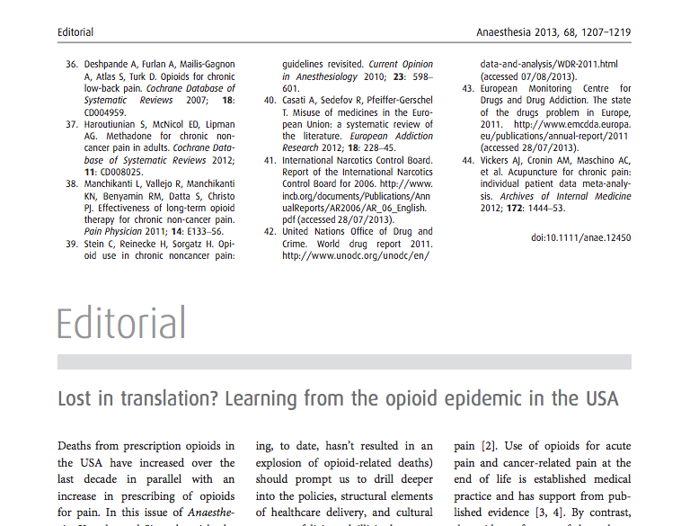

Slide 32
Pain and opioid treatment a recipe for disaster?

Slide 33
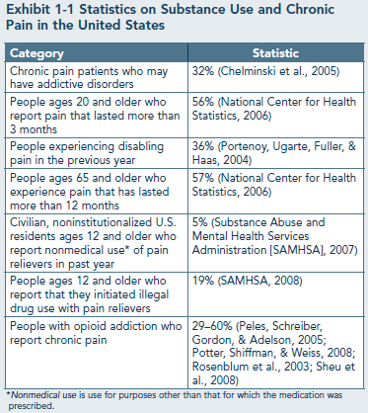

Slide 35
Risks of running into problems with high dose opioids
Patient factors
  Depression/common mental health diagnoses
  Alcohol misuse/non-opioid drug misuse
  Opioid misuse
Drug factors
  High doses
  Multiple opioids
  More potent drugs
  Concurrent benzodiazepines/sedative drugs

Slide 36
Who gets long term opioid therapy?
Increased risk includes:
Patient factors
  Depression/common mental health diagnoses (x3-4)
  Alcohol misuse/non-opioid drug misuse (x4-5)
  Opioid misuse (x5-10)
  and
At risk patients are more likely to receive
  High doses
  Multiple opioids
  More potent drugs
  Concurrent benzodiazepines/sedative drugs

Slide 37
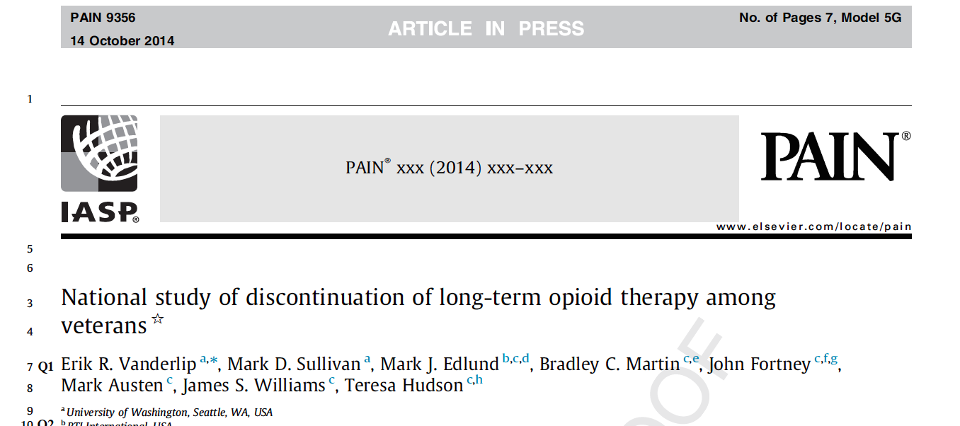

Slide 38
Discontinuation of opioids
N = 550 616
Fewer than 20% discontinued at 3.5 years
Factors associated with discontinuation
  High doses ⬇
  Young or old age ⬆
  Tobacco consumption ⬇
  Mental health disorders and substance misuse disorders ⬆

Slide 39
Avoiding prescription opioid related harms
Pain and problematic use of opioids

Slide 40
Sensible prescribing
Recognition of public concerns and ability to contextualise these
Awareness of literature on effectiveness and harms
Comprehensive evaluation and formulation of patient problems
Practice always underpinned by evidence

Slide 41
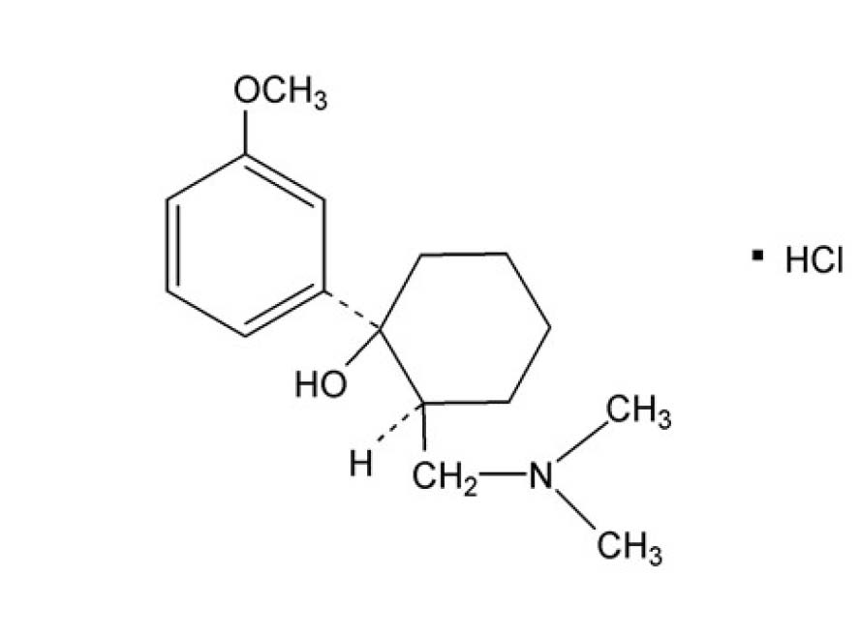
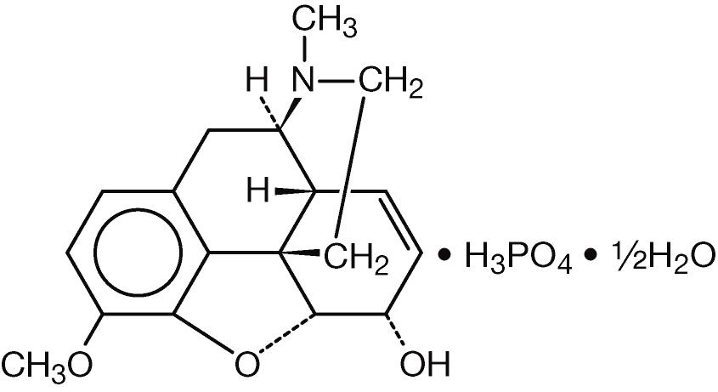
Sensible prescribing
Recognition of public concerns and ability to contextualise these
Awareness of literature on effectiveness and harms
Comprehensive evaluation and formulation of patient problems
Practice always underpinned by evidence
Safest
  Old
  Low dose
  Intermittent
PERSONAL ANECDOTE

Slide 42
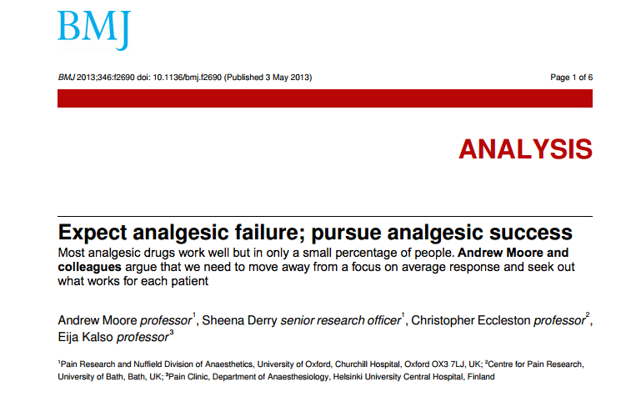

Slide 43
Iatrogenesis
Sullivan and Howe Pain 154 (2013) S94-100
Reproduced in
J Epidemiol Community Health 2003;57:919-922 doi:10.1136/jech.57.12.919
Ivan Illich Medical Nemesis
“By becoming unnecessary, pain has become unbearable. With this
attitude, it now seems rational to flee pain rather than to face
it, even at the cost of addiction. It also seems reasonable to
eliminate pain, even at the cost of health…
…For a while it can be argued that the total pain
anaesthetised in a society is greater than the totality of pain
newly generated. But at some point, rising marginal
disutilities set in. The new suffering is not only unmanageable,
but it has lost its referential character. It has become
meaningless, questionless torture. Only the recovery of the
will and ability to suffer can restore health into pain.”

