Slide 1

SURGERY AND ANAESTHETICS

Slide 2
LEARNING OUTCOMES
To be aware of the range of substance use disorders that are relevant to anaesthetics and surgery
To identify signs and symptoms of substance use disorders in patients presenting for anaesthesia and surgical procedures
To identify at pre-operative assessment of surgical patients those who misuse substances licit and illicit
To identify patients at increased risk of post-operative complications secondary to substance misuse
To identify patients at increased risk to theatre staff and take appropriate precautions
To describe a care plan for anaesthesia and surgery for substance misusers

Slide 3
CONTEXT
Substance misusers may require anaesthesia and surgery in:
Obstetrics in labour and medical emergencies
Trauma for emergency surgery or life saving situations
Elective surgery
Therefore a knowledge of the following is important:
Pain management
Anaesthetic options that are beneficial or detrimental
The most common illicit drugs
Side effects
Common presentations with intoxication or chronic misuse

Slide 4
CONTEXT
Chronic alcohol use is more common in surgical patients than in other hospital patients
15-30% of male surgical patients in urban UK hospitals may have alcohol problems
Many trauma beds are filled with patient who were injured whilst under the influence of alcohol
The rate of post operative morbidity and mortality is higher in chronic alcohol patients
Risk identification at pre-operative stage is vital to assess the needs during peri operative care

Slide 5
CONTEXT
Recognition of current substance problems or recovery from substance problems in patients being prepared for anaesthesia is necessary so as to adjust treatment
Availability and routine use of substances in anaesthetic departments makes them a target for patients’ drug seeking
Anaesthetists are at risk of substance misuse
Admission for surgery requiring anaesthetics can be planned or an emrgency

Slide 6
BARRIERS TO DETECTION
Patients are not forthcoming because:
May not see the relevance to planned surgery
May fear being judged
May have had previous poor experiences
May over report for fear of not receiving enough pain relief
May underreport so as not to be perceived as a drug addict

Slide 7
SPECIAL FEATURES
Pre-operative assessment must identify patients at risk of complications secondary to substance misuse
All patients must be asked about recent and current licit and illicit drug use including alcohol and tobacco, over the counter medications, psychoactive medications prescribed by a doctor
Patients may be taking substances to control physical or mental health problems

Slide 8
COMPLICATIONS
Post-operative infection
Cardiovascular complications
Bleeding disorders
Enhancement or reduction in an individual’s sensitivity to anaesthetic drugs
Respiratory depression
Overdose due to inaccurate reporting of drug use
Lack of knowledge about purity of drugs

Slide 9
ASSESSMENT
Be aware that the patient may deny use for fear of the consequences
Patients may bring in and hide medication for fear of inadequate prescribing
Some patients may request that ‘mind altering’ drugs are NOT used if they are in recovery
Explain to the patient that reduction in smoking can dramatically improve outcome
Explain to the patient that accurate reporting ie being honest, is important so that they receive adequate pain relief or not too much so that they are sedated which have safety implications

Slide 10
ASSESSMENT
Effects of intoxication ie altered metabolism, drug interactions, existing end organ damage must be established and documented
Seek corroboration from family and carers especially where there is a reason for limited information gathering eg neurological deficits
Screening for alcohol, licit, illicit, over the counter, prescribed should be routine so that patients at high risk of complications during or after surgery are identified

Slide 11
TREATMENT – PREOPERATIVE MANAGEMENT PLAN
An assessment can reduce the risk of alcohol withdrawal syndrome (AWS) post operatively
Adequate prophylaxis may prevent this
Thiamine prophylaxis can be administered if procedure is elective
Pre-operative liver function tests including GGT is essential
If AWS does develop it is likely to be milder if preventive procedures are in place
AWS can lead to the need to be treated in ITU

Slide 12
PREOPERATIVE MANAGEMENT
When post operative confusion develops in alcoholic patients, exclude other complications:
Bleeding
Metabolic or electrolyte disturbance
Infection
Hypoxia
Pain

Slide 13
PREOPERATIVE MANAGMENT
A full substance use history is important to minimise risk
Respiratory depression is a complication of opioid use for pain
Caution is required if patients are on several sedative medications
Awareness of other respiratory conditions is important to prevent respiratory depression
Accidental overdose is the most common cause of respiratory depression

Slide 14
PREOPERATIVE MANAGEMENT
Major surgery – non-steroidal anti-inflammatory drugs (NSAIDS), local anaesthetics and pure opiate antagonists (morphine, fentanyl) for pain relief
Minor surgery – may be possible to avoid completely
Opiate dependent patients scheduled for surgery should take usual dose of opioid including methadone on the morning of surgery
If the patient did not do this, a roughly equivalent laiding dose of morphine or other opioids can be administered pre-operatively or during the operation
The possibility of a reduction regime commencing after surgery and when pain has subsided, should be discussed

Slide 15
MANAGEMENT UNDER ANAESTHETIC
Sedation and pain management should be discussed before surgery
Addicted patients may be receiving substitution therapy from a substance misuse services which is DIFFERENT from the medication for pain relief
Titration of analgesics should be regulated against analgesic response in line with clinical guideline
The difference between poor analgesic response and withdrawal should be recognised

Slide 16
MANAGEMENT UNDER ANAESTHETICS
Anxiety and pain are the major precipitants of relapse in addicts
Inadequate pain management and prejudicial attitudes towards the patient increases anxiety and relapse risk
Non addiction inducing analgesics with selective nerve blocks can be used for relief of postoperative pain to reduce opioid requirements
Use of opioids must be guided by clinical indications
Use of patient controlled analgesia may bring about risk of association of pain with a reinforcing drug
Behavioural responses to pain management need regular evaluation

Slide 17
POST OPERATIVE MANAGEMENT
If AWS develops, benzodiazepines may be required
Pain management should include maintenance with regular substitution medication but to provide pain control with other opiate based medications which should be reduced and replaced by non-addictive medications
In an emergency contact can be made with addiction services and pharmacists to establish what medication the patient usually takes
A discharge planning discussion should be held with all relevant services to support the patient and ensure accurate medication dosage and

Slide 18
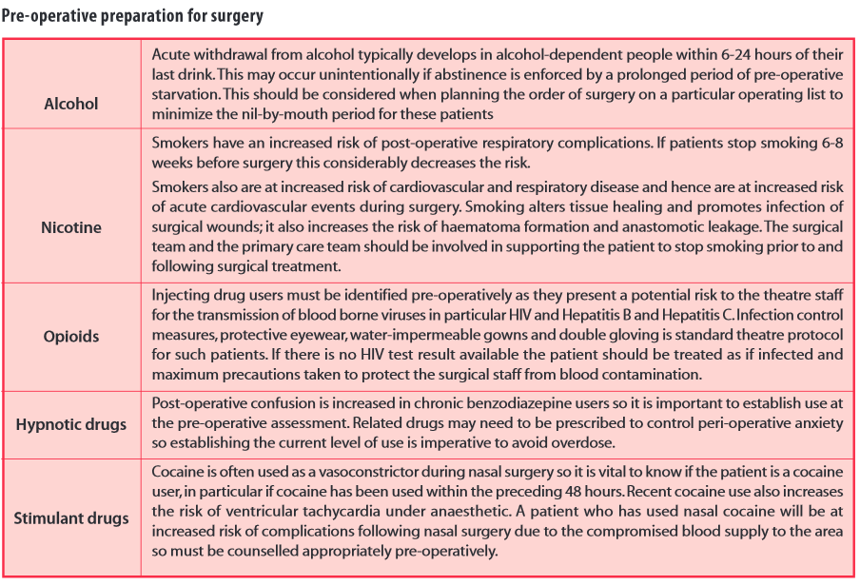
PREOPERATIVE PREPRATION FOR SURGERY

Slide 19
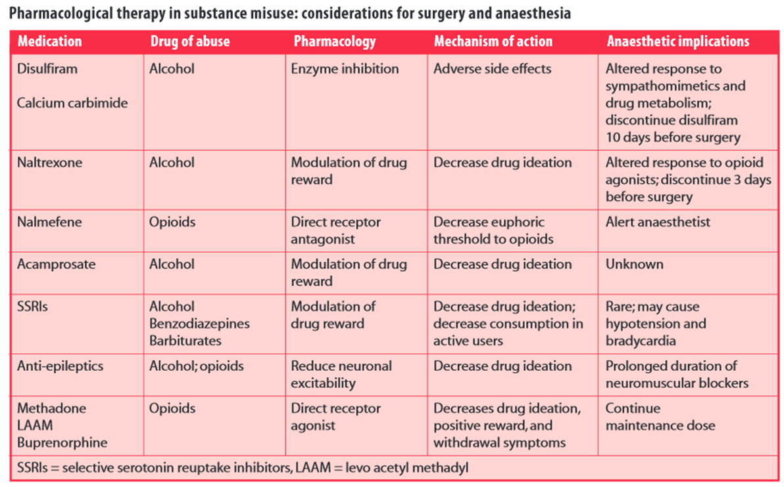
PHARMACOLOGICAL THERAPY IN SUBSTANCE MISSUE

Slide 20
References
British Pain Society (2010) Opioids for persistent pain: Good practice
http://www.britishpainsociety.org/pub_professional.htm#opioids
Chapman R (2009) Alcohol and anaesthesia Continuing Education in Anaesthesia, Critical Care & Pain 2009 9(1):10-13
Chick J (1993) Brief interventions for alcohol misuse: British Medical Journal. 307:1374
Dureuil B Smoking and Surgery: La Presse Medicale; 35: 6: 1009- 15
http://www.em-consulte.com/article/131492
Heymann, A.,Nachtigall, I, Goldmann A, and Spies, C. (2010) “Alcohol Withdrawal in the Surgical Patient: Prevention and Treatment” in O’Donnell J.M & Nagul F (ed) Surgical Intensive Care Medicine, 2nd edn. Springer: New York, pp659-666

Slide 21
References
Hill GE, Ogunnaike BO, Johnson ER. (2006) General anaesthesia for the cocaine abusing patient. Is it safe? British Journal of Anaesthesia. 2006 (5):654-7.
Kudoh, Akira MD; Takase, Hajime MD; Takahira, Yoko MD; Takazawa, (2004) Post- operative confusion increases in elderly long term benzodiazepine Users. Anaesthesia and Analgesia, 99 (6): 1674-1678.
May, J.A (2001) The Patient Recovering from Alcohol or Drug Addiction: Special Issues for the Anesthesiologist , Anesthesia and Analgesia 2001;92:1601-1608
University of Cardiff-Pain Community Centre Substance Misuse: Hospital Management
http://www.paincommunitycentre.org/article/substance-misuse-hospital-management
Prince, V Pain. Management in Patients with Substance-Use Disorders PSAP-Pain Management 188 VII Chronic Illnesses http://www.accp.com/docs/bookstore/psap/p7b05.sample03.pdf
Saunders, D (2006) Substance abuse and dependence in anaesthetists. Best Practice & Research Clinical Anaesthesiology, 20, (4)pp 637-643

