Slide 1
New Drugs, New Problems? Responding to Club Drugs in Leeds
Dr John Roche
Consultant Addiction Psychiatrist
Leeds Addiction Unit
j.roche@nhs.net
www.leedsclubdrugclinic.com

Slide 2
Overview
What are club drugs?
Who uses them?
What are the problems?
What can be done about it?

Slide 3
What are club drugs?
“Party drugs”
MDMA/ecstasy
Ketamine
GHB/GBL
Gammahydroxybutyrate/gammabutyrolactone
Mephedrone
Legal highs “Novel Psychoactive substances”
+ alcohol, cannabis, poppers, amphetamines

Slide 4
Who uses them?
Clubbers
Association with electronic dance music
LGBT
Bodybuilders
Students

Slide 5
New problems
Ketamine
Ketamine bladder
Mephedrone
Psychosis, agitation, self harm
GHB/GBL
Physical dependence

Slide 6
Mephedrone
Legal high “plant food” from internet/head shops 2007-2010
Class B drug from March 2010
Usually snorted or taken orally
AKA meow, m-cat, drone

Slide 7
Mephedrone – why take it?
Feeling of well being
Stimulant effect
Increased energy
Cheap and widely available
£10-20 per gram
Is more popular since becoming illegal

Slide 8
Mephedrone - problems
Problems associated with stimulant drugs
Raised blood pressure
Cardiac problems
Staying awake for 3+ days leading to paranoia and hallucinations
Addictive?
Compulsive re-dosing
Tendency to continue until supply is finished

Slide 9
Mephedrone – Is it common?
4.4% of 16-24 year olds report use in the last year (similar to powdered cocaine)
British Crime Survey 2010-11
In NW England one dealer running £500k/week operation importing kilo bags of mephedrone from China
http://www.guardian.co.uk/society/2012/mar/11/mephedrone-more-popular-after-ban

Slide 10
Ketamine
Anaesthetic agent on World Health Organisation’s list of “essential medicines” that all hospitals should stock
Street value £20-40 per gram
Usually snorted, can be taken orally or injected

Slide 11
Ketamine –Why take it?
Low doses
“floaty feeling”
Relaxing
Feel “stoned”
Similar pattern of use to cannabis smokers
Cheap and only Class C
Ecstasy is class A
Higher doses
Disassociation
Out of body experiences
“K-hole”
Will appear heavily sedated/unconscious to others

Slide 12
Ketamine - problems
Ketamine bladder
Exposure to high doses for extended period leads to ulceration of bladder
Several cases of otherwise healthy users in early 20s needing bladder removal/replacement
Danger when intoxicated
Death of people falling asleep in bath etc

Slide 13
Ketamine addiction
hi there.. my brother is addicted to ketamine. he had a full bladder reconstruction 2 years ago and has continued to use. he has been taking 5 to 7 grams a day, and now seems to be in constant pain with stomach cramps.. he says he doesn’t get high anymore it just helps him get through the day. the amount of weight he had lost is unreal.. he doesn’t even look like my brother anymore.. he says he can’t look in a mirror anymore and just wishes he was better. ketamine has such a hold on him that we as a family just don’t know what to do anymore. he has been to the doctors who gave him tramadol.. he says it makes the cramps worse.. he has big blisters from hot water bottles all over his body.. from trying to ease the pain. i think he has hit rock bottom.. we have tried cutting his intake to 1gram a day to try to wean him off it.. but he then sneaks it when we don’t know.. he says to take the pain away...is there anything we can do to help him.. as this is breaking all our hearts.
Enquiry received through facebook page November 2012
Notes:
7 mins

Slide 14
Ketamine – Is it common?
British Crime Survey 2010-11
Use in the last year in England and Wales:
1.3% of 16-19 year olds
2.6% of 20-24 year olds
1.0% of 25-29 year olds
Amongst 16-59 year olds Yorkshire and Humber used almost twice national average
1.2% v 0.7%

Slide 15
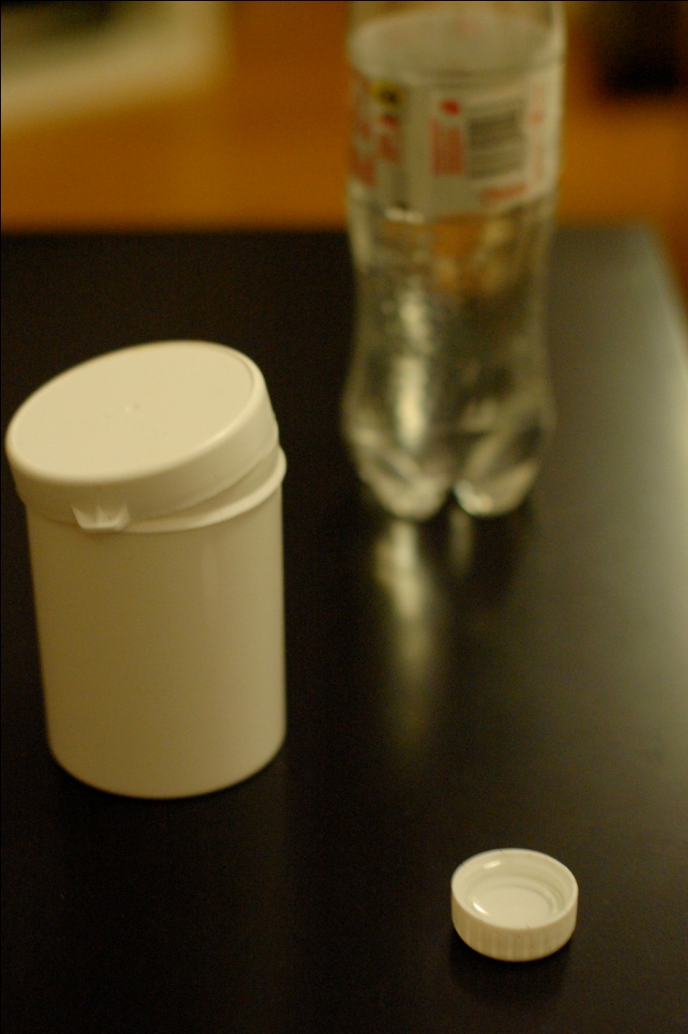
GHB/GBL
GHB bought in “tubs” and crystals dissolved in water
GBL bought online

Slide 16
GHB/GBL – Why take it?
Similar effects to alcohol
Socialising
Aphrodisiac effects
Sleep

Slide 17
GHB/GBL – problems
Coma and death from overdose
Severe physical dependence
Need specialist medical management for detoxification
Diazepam (GABA-A) + baclofen (GABA-B)
Withdrawal can lead to seizures/death
Used as “date rape” drug – spiking drinks

Slide 18
GHB/GBL – Is it common?
Little prevalence data
More popular amongst clubbers, body builders, LGB community

Slide 19
New distribution
Dealers using mobile phones and internet
Silk road website
Ebay for drugs
Need to access through an IP address masking client called Tor
Use bitcoins
untraceable electronic currency
Approx £7 per bitcoin
Notes:
10 mins

Slide 24
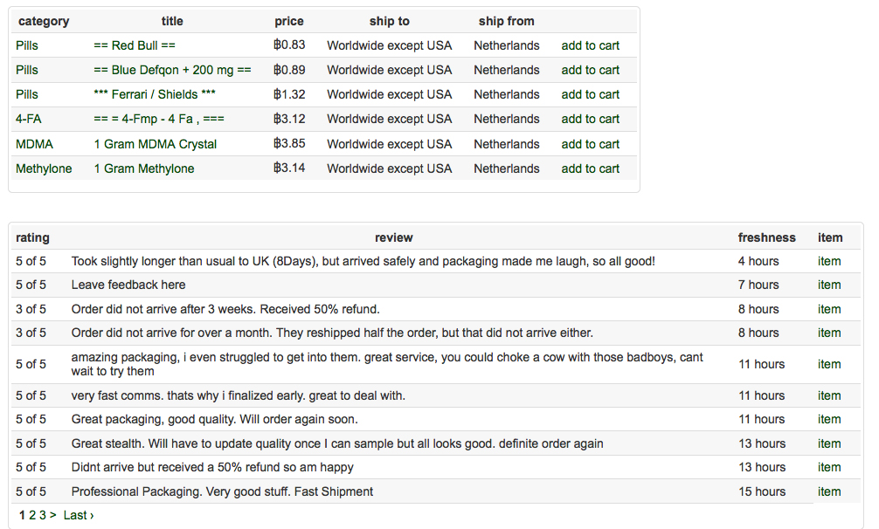

Slide 25
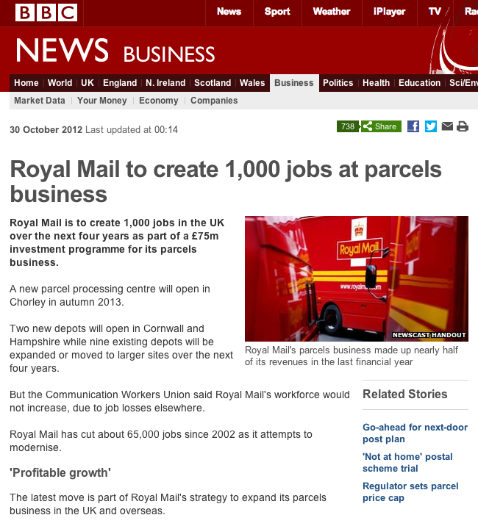
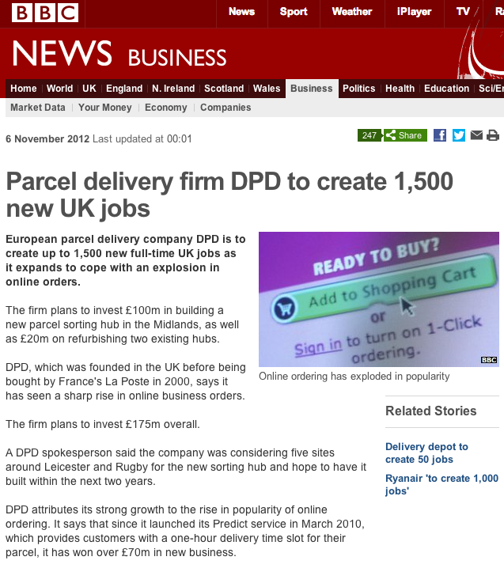

Slide 26
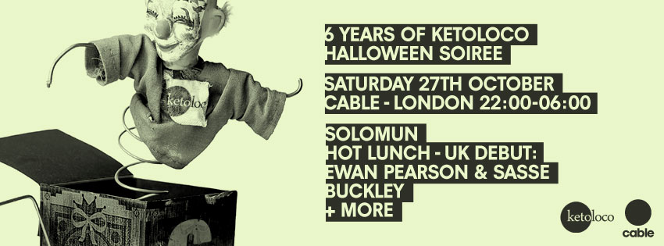
Club Drugs in Leeds
Notes:
15 mins

Slide 27
Referrals to LAU
2007 - Dec 2011
31 ketamine referrals
1 mephedrone referral
4 GHB referrals
Since starting LCDC in Dec 2011
22 ketamine referrals
20 mephedrone referrals
6 GHB referrals
1 MXE, 1 Happy popper pills, 2 synthetic cannabis

Slide 28
Ketamine referrals 2008-2011 n=31

Slide 29
How to engage this population?
Feedback from users
Health professionals often not aware of these drugs
Not “serious enough” as not crack, heroin or alcohol
Often working/studying – worried of admitting criminal offence
Survey of 1041 Uni students July 2012
15% would ask doctor about drugs
67% would look online
http://www.guardian.co.uk/education/interactive/2012/oct/12/university-drug-culture-survey

Slide 30
Leeds Club Drug Clinic
Website with drug info, advice, self help and details of services
Facebook and Twitter @leedsdropin
Media exposure
Local radio (Capital FM Leeds/York)
Local press (Yorkshire Evening Post)
BBC3 documentary
France 24 ran a health story about club drugs
Enable people to hear real account of ket problem

Slide 31
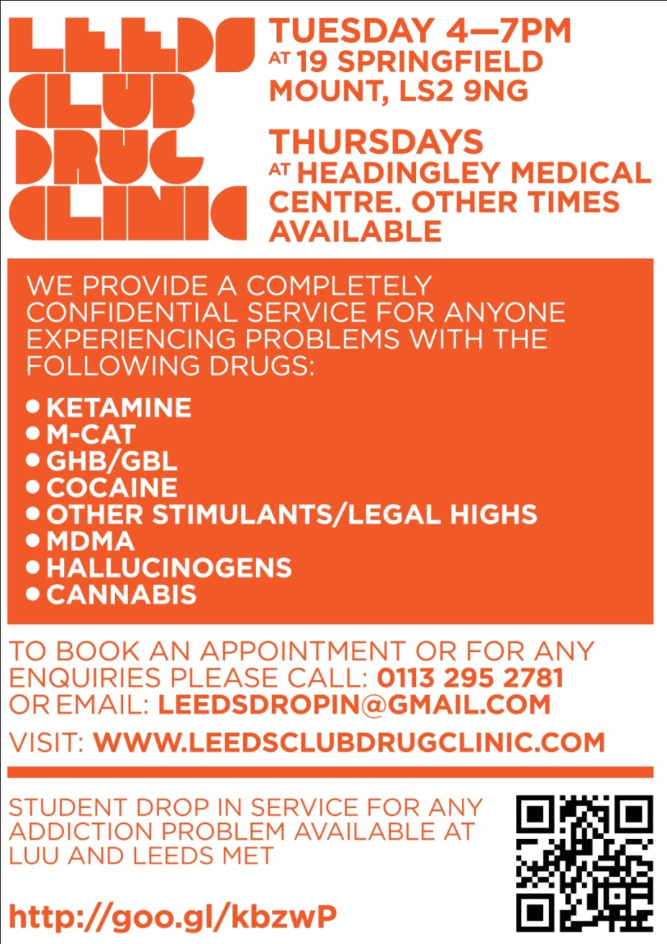

Slide 32
Liaison Clinic at GP Surgery Blue – ketamine Yellow – mephedrone Green - GHB

Slide 33
www.leedsclubdrugclinic.com

Slide 34
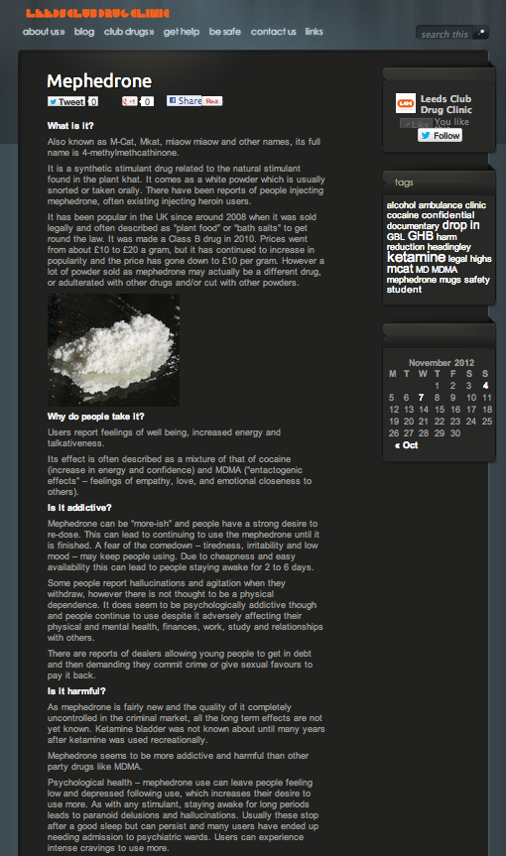
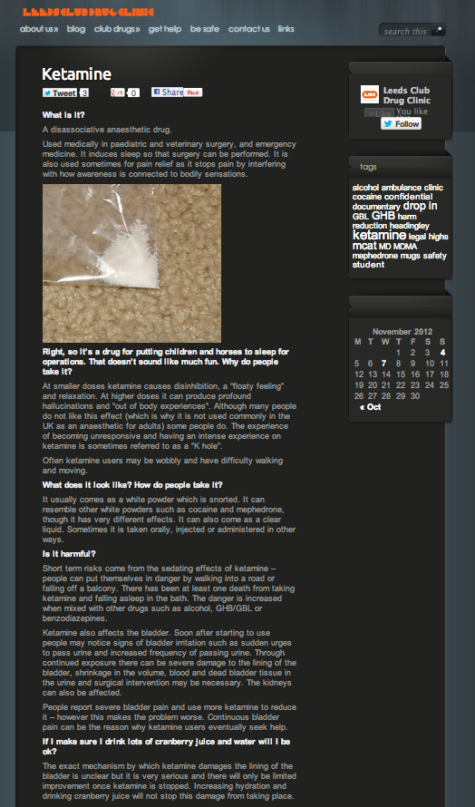

Slide 35
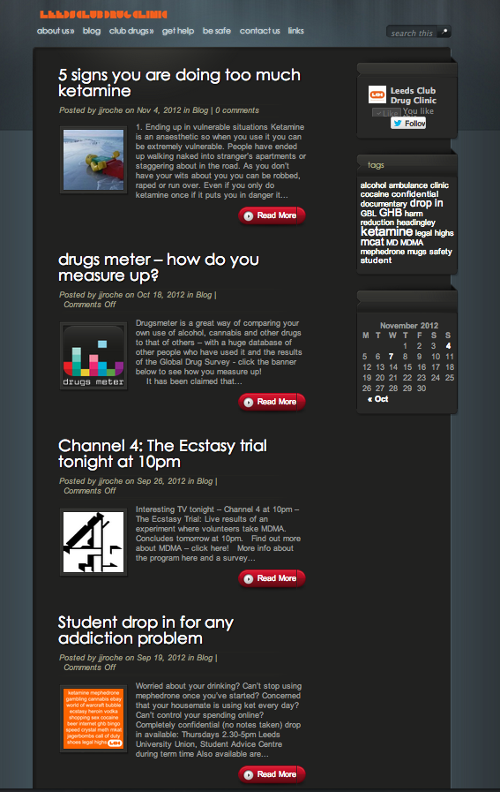
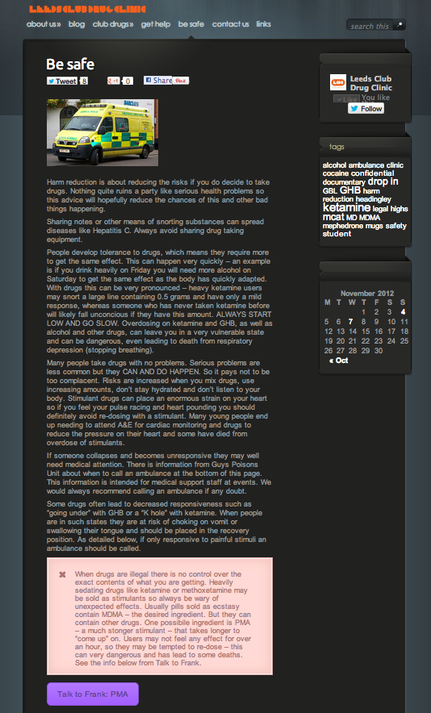

Slide 36
Promoted with facebook page

Slide 37
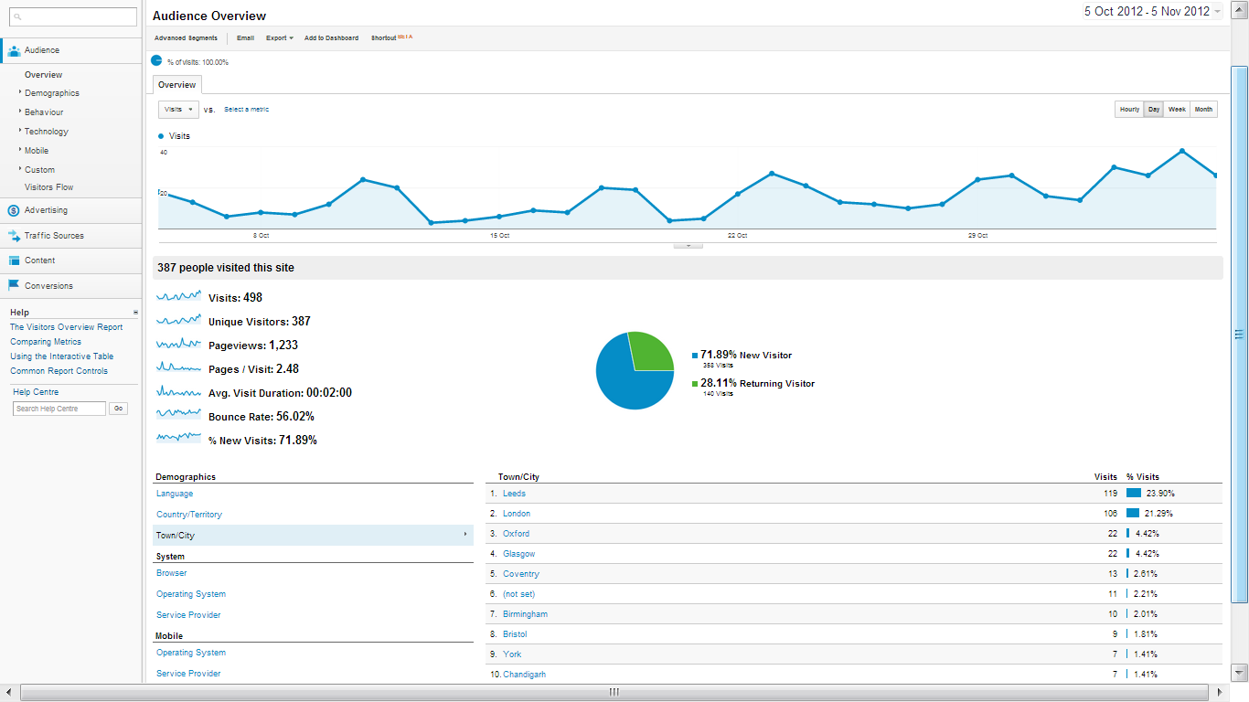
Google analytics

Slide 38
Facebook insights

Slide 39
Ketamine referrals 2008-2011 n=31

Slide 40
Ketamine referrals since Dec 11 n = 22

Slide 41
Mephedrone referrals since Dec 11 n=20

Slide 42
GHB referrals since Dec 11 n=6

Slide 43
Gender distribution

Slide 44
Future plans
Boost links with LGBT health services
Medical students currently developing club drug diary smartphone app
Group treatment
Foster links with other agencies in other cities

Slide 45
Thank you
Dr John Roche
j.roche@nhs.net
www.leedsclubdrugclinic.com
Twitter @leedsdropin
www.facebook.com/leedsclubdrugclinic

Slide 46
New Drugs, New Problems? Responding to Club Drugs in Leeds
Dr John Roche
Consultant Addiction Psychiatrist
Leeds Addiction Unit
j.roche@nhs.net

