Slide 1

PREGNANCY

Slide 2
LEARNING POINTS
Awareness of the range of substance use disorders in pregnancy
Understand how different substances affect the fetus
Identification of substance misuse in pregnancy or risk of substance misuse
Management of substance use in pregnancy

Slide 3
EPIDEMIOLOGY
During pregnancy between 25-50% of women may be using some alcohol, up to 15% may be using illicit drugs, and about 20% may be smoking tobacco
The proportion of women using substances at term is less than in the early stages of pregnancy
Variability is due to differences in patterns and modes of use, availability, price, social acceptability, and policies
About 20-40% of smokers will give up during pregnancy and a smoking ban leads to a 8% reduction in both still births and newborn deaths
During pregnancy, only 3% continued to drink the same, 40% abstaining and the rest drink less
Substance misuse rises sharply in the first 6 months post partum
Detection in obstetric units is low, but as perinatal intervention reduces mortality and morbidity on mother and baby, effective screening strategies should be introduced

Slide 4
CONTEXT
Substance misuse is associated with considerable maternal and fetal morbidity and some mortality
There are associated legal, social, environmental problems
Multidisciplinary team involvement is essential in the management
Health problems to be discussed include general nutrition, anaemia, alcohol and nicotine consumption, oral hygeine and infection from injecting

Slide 5
SPECIAL FEATURES
Presentation as a result of intervention by parents, teachers, social workers, criminal justice, GPs
Patients tend not to be regular attenders of antenatal services
Patients need to be encouraged to attend for care
Poor health and nutrition, social deprivation, psychiatric complications, and even homelessness
Patients need to be treated with kindness, respect and dignity
Patients’ views, beliefs and values should be sought

Slide 6
DISTINCTIVE FEATURES
Pregnancy can be the time when women will seek help for substance problems so as to protect their child
Women often present in late pregnancy
Since drug use may lead to amenorrhoea, they may not realise that they are pregnant
Risks of BBV eg Hepatitis B, C and HIV, are risk to mother and child
Opiate withdrawal syndrome occurs in 50% of babies born to mothers using opiates

Slide 7
BARRIERS TO DETECTION
Fear of being judged
Fear of guilt about the harm they might have inflicted on child
Fear of contact services for fear of losing baby and other children
Reluctance to provide a urine sample
Lack of professionals skilled to detect, manage, refer and encourage women for helo
Irregular attendance at clinic appointments

Slide 8
ASSESSMENT
All pregnant women and their partner should be routinely asked about substance use in detail
Patients who are using, should be referred to addiction services if they are not already in treatment
Patients should consent to a urine screen, which should be checked at every visit to the service
An assessment should be made about the patient’s vulnerability eg if she has an older partner

Slide 9
TREATMENT
A multidisciplinary approach is needed for care for pregnant substance misusers and members should liaise regularly
Early referral should be made for consultant assessment
All pregnant women should be offered screening for blood borne viruses, sexually transmitted diseases and referral to a genitourinary clinic made
This team should include a GP, midwife, obstetrician, neonatologist, substance misuse service, community drug team, smoking cessation input, social services and other relevant authorities
Child protection should be considered and referral to social services

Slide 10
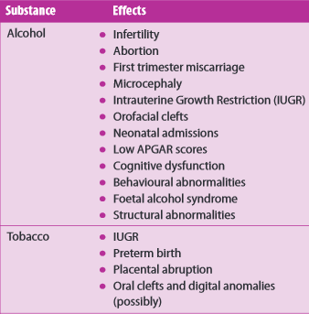
TABLE OT SUBSTANCE USE AND ASSOCIATED PROBLEMS

Slide 11
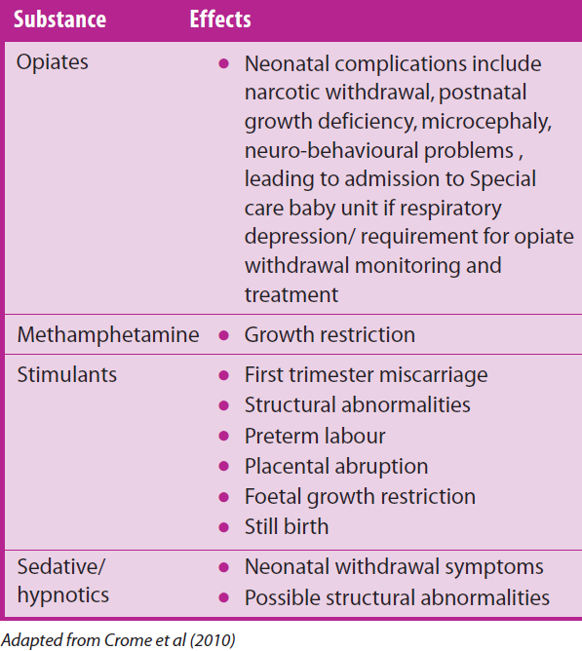
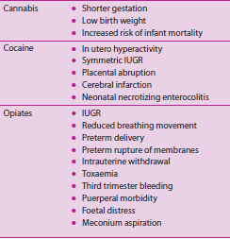
SUBSTANCE USE AND ASSOCIATED PROBLEMS

Slide 12
MANAGEMENT
Abrupt discontinuation of opioids in an opiate dependent woman can lead to pre term labour, fetal distress, or fetal death
Special attention should be paid to ensuring adequate maintenance, pain management, prevention of relapse, risk of overdose and unintended pregnancies after delivery, and discussing this with the patient
Medically supervised withdrawal during pregnancy is not recommended
Analgesia may be required if patients are on maintenance methadone or buprenorphine

Slide 13
ADVICE
Women may be concerned about the effects on the baby as they might not have known that they were pregnant while using
Women need to be prepared for the fact that their baby may exhibit withdrawal and require treatment
Women need to know what puts the fetus at risk ie using street drugs with unknown adulterants), infections from injecting equipment
Street drugs may contain impurities which could place the mother’s health at risk
If the woman notices changes in the baby’s movement, she should go to the GP or antenatal services
Women should NOT stop ANY (alcohol, drugs, benzodiazepines) substance use abruptly. This must be with medical advice and supervision
Mothers who use substances should not share beds with the baby, nor feed the baby lying down in case they suffocate or injure the baby

Slide 14
MANAGEMENT
Assess evidence of intoxication, withdrawal and craving over the previous 24 hours
Assess additional substance use over the last 24 hours
Assess side effects and other adverse effects from medication or drugs used
Check adherence to dosing regime
Assess patient’s satisfaction

Slide 15
REFERRAL NETWORKS
A coordinated care plan should be developed
Clear referral pathways should be outlined
Guidance about domestic violence should be included
Sources of support and safety advice for women should be provided
Follow up care and referrals should be planned
Ensuring that the patient can be contacted by telephone
Awareness of local safeguarding protocol

Slide 16
References
Crome IB Kumar TM 2007 Epidemiology of drug and alcohol use in young women Seminars in Fetal and Neonatal Medicine 12 98-105
Crome IB Ismail KM 2009 Substance misuse in Eds Henshaw C, Cox J, Barton J Modern management of perinatal disorders 94-122 Royal College of Psychiatrists London
Velez ML Jansson LM 2015 Perinatal addictions: intrauterine exposures in N el-Guebaly et al (eds) Textbook of Addiction treatment: International Perspectives 2333-2363 pringer-Verlag Italia

