Slide 1

Substance Misuse Factsheet Slides-Category IV Distinctive Groups:
Older People

Slide 2
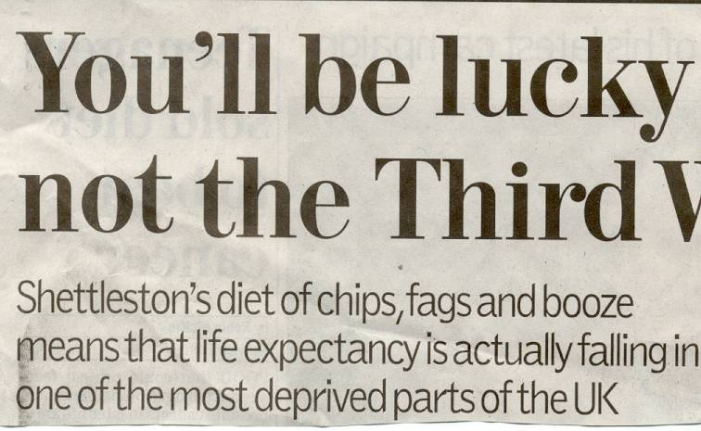
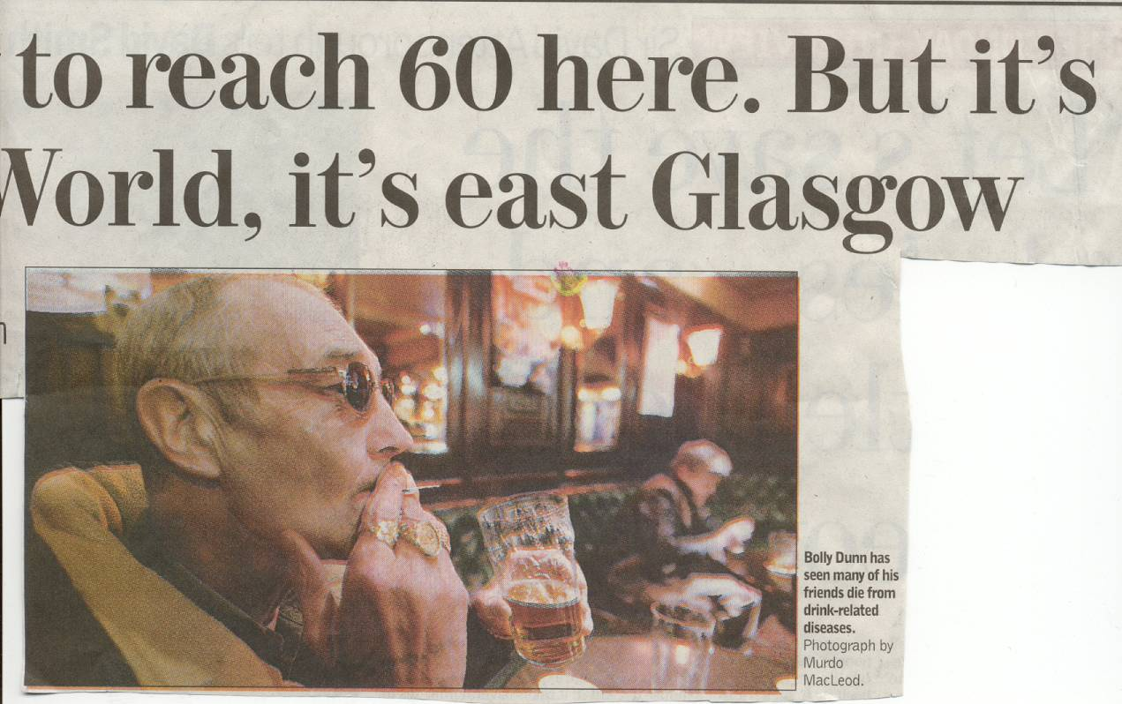

Slide 3
LEARNING OUTCOMES
Recognition of core distinctive issues for older people with substance misuse
Appreciation of key components of a detailed history relevant to older people
Provide effective advice about the impact of substances on daily living
Initiation of a care plan appropriate to older people
Acknowledgement that older people do respond positively to effective treatment

Slide 4
INTRODUCTION
Older people present with complex problems which may be atypical and subtle
Physical health problems can precipitate substance misuse in older people
Psychiatric comorbidities are common in older people with substance problems
Social issues e.g. bereavement, retirement, may be associated

Slide 5
PREVALENCE
Older people, 60+, will constitute 42% of the UK population by 2027
‘Older’ generally means over the age of 60, though it can
refer to clients over 40 years, or over 50 years
‘Older’ people are using more legal & illegal drugs including over the counter & prescription drugs
22% men,17% women over 60 still smoke
60% NHS prescriptions for over 60s, Alcohol consumption above adult ‘safe limits’: 20% in men, 10% in women over 65
Highest alcohol death rate is in ages 55-74

Slide 6
Prevalence (contd)
Older people can present in any health and social care setting with the effects of substance use but older people fail to get same attention as younger people
Alcohol & prescription drugs are the most commonly used substances in the older age group
Number of people aged 60+ receiving drug treatment has increased rapidly during the period 2006-2013
Older people may take more than prescribed due to poor memory, concentration, and judgment, anxiety, malaise
Effects may be misattributed to ageing, or stereotyping substance use are a young person’s activity
62% of older people aged 60+ who receive treatment complete treatment free of dependency compared to 47% of 18-59 yr olds

Slide 7
The relationship may be missed due to atypical and subtle presentation
Substances can interact with physical and mental health conditions which are part of ageing, and for which medications are prescribed
Older people drink less but more frequently than younger counterparts
The impact from a similar amount at a younger age may be greater in old age

Slide 8
BARRIERS TO DETECTION
Older people may:
Feel stigmatised
Fear being judged
Feel no one cares about them, there is no one to care for them
Feel they are a burden, and no one is there to help

Slide 9
BARRIERS TO DETECTION
Practitioners:
are not trained
are not confident
do not easily recognise atypical or subtle presentations
Do not have a high index of suspicion

Slide 10
WARNING SIGNALS
Sleep complaints
Cognitive impairment, memory or concentration disturbance
Depression and anxiety
Pain
Liver function abnormalities
Incontinence
Poor hygiene and self neglect
Unusual restlessness/agitation or persistent tiredness
Unexplained nausea and vomiting
Changes in eating habits
Alteration in and erratic behaviour
Slurred speech, tremor, poor coordination
Frequent falls and unexplained bruising
Requests for more prescription drugs
Evidence of illegal activities

Slide 11
Detailed substance use history
Demographics Age/Sex/ethnicity/living arrangements/living environment
Presenting problem may be masked
Past and Family Psychiatric history
Occupational and Psychosexual history
Medical history (especially known complications from substance and
effects on existing age-related impairment)
Forensic history (especially public order and acquisitive offences)

Slide 12
Detailed substance use history
Discuss substances separately (Alcohol/nicotine/OTC/prescribed/Illicit)
- Age at first use, weekend, weekly, daily use
- Age of dependence syndrome
- Maximum use and when/how long
- Pattern (Quantity/Frequency) over day/week
- Route
- Cost/’funding’
- Abstinence/relapse, link stability/life events
- Preferred substance(s)
Treatment (dates, service, intervention, outcome)

Slide 13
Consent and Capacity
Social vulnerability Risk of falls, social/cultural isolation, financial abuse
Social function Activities of daily living, statutory/voluntary/private care
Social support Informal carers and friends
Social pressures Debt, substance using ‘carers’, open drug dealing
Investigations (including cognitive testing and neuroimaging)

Slide 14
ASSESSMENT - COLLATERAL
Collateral information
Relatives
GP consultations and medications
Hospital discharge summaries
Home carers
Day centres
Housing officers/Wardens of Sheltered accommodation
Criminal justice agencies

Slide 15
TREATMENT
Evidence exists which demonstrates that older people want to stop substance use and do well with treatment
The treatment that is offered will depends on the nature and extent of the problems and availability and accessibility of services
Assess to what extent patient wishes to change pattern of substance use
Support with reducing/abstaining from substance use should be given
May include home visits, supervision by medical and care staff or family, admission to hospital e.g. detoxification for acute presentation with alcohol withdrawal
Withdrawal of unnecessary prescribed medication gradually

Slide 16
PHARMACOLOGICAL TREATMENT
Pharmacological treatment should be undertaken cautiously and be safe, effective and tolerated
Diagnosis of dependence is necessary
Medication for substitution therapy should be initiated after discussion with an addiction specialist
Medications are usually prescribed at about half that for adults
Short acting benzodiazepines are first choice for alcohol withdrawal
Some medications e.g. acamprosate, naltrexone and disulfiram should be administered with extreme caution
Pharmacological treatment should always be implemented within the context of psychosocial interventions

Slide 17
PSYCHOSOCIAL INTERVENTIONS
No single empirically supported approach which is superior
Responsive to needs and supports adaptive strategies
Education and advice
Brief interventions
Motivational interviewing
Cognitive behavioural therapy
Mutual self help

Slide 18
MULTIDISCIPLINRY TEAM WORKING
Work as multidisciplinary team which is responsive, flexible & coordinated
Include geriatricians, old age psychiatrists, GPs, care homes (wardens), housing officers, community pharmacists, employers, social services
Include family and significant others
Use the interaction as an opportunity for education about the effects of substances or how to cope with symptoms eg insomnia without resort to medications
Explore strategies to cope without substances
Offer of brief interventions, behavioural treatments, social support
Referral to substance misuse services, voluntary services eg Red Cross, Age Concern, Alzheimer’s Society, religious organisations and volunteers

Slide 19
ADMISSION
Threshold for admission for older people is lower than adults
Criteria: Chaotic lifestyle, heavy substance use and dependence, emergency presentations, comorbid conditions, social circumstances
Exclude head injury (detected or suspected), infections, malnutrition, depression, Wernicke Korsakoff
Exclude other causes of thiamine deficiency eg AIDS, thyrotoxicosis, metastases, congestive heart failure, thyrotoxicosis
Assess the need to institute treatment immediately eg if Wernicke Korsakoff’s is a possibility
Undertake investigations on serum and urine

Slide 20
CONCLUSION
The number of older people with substance use problems is rising as is the proportion of older people in our population
Older people are entitled to the same treatment as young people
Older people can and do respond to effective treatment
Older people have distinctive differences which impact on the manner in which assessment and treatment are delivered

Slide 21
REFERENCES
http://www.ons.gov.uk/ons/rel/subnational-health4/alcohol-related-deaths-in-the-united-kingdom/2013/stb---alcohol-related-deaths-in-the-united-kingdom--registered-in-2013.html
http://www.ons.gov.uk/ons/rel/npp/national-population-projections/2012-based-projections/stb-2012-based-npp-principal-and-key-variants.html#tab-Changing-Age-Structure
ASH Smoking Statistics Illness and death 2014, http://www.ash.org.uk/files/documents/ASH_107.pdf
PHE (2014) Alcohol treatment in England 2013-14 http://www.nta.nhs.uk/uploads/adult-alcohol-statistics-2013-14-commentary.pdf
The Forgotten People: Drug in Later Life: A Report for the Big Lottery Fund – July 2014 https://www.basw.co.uk/resource/?id=3384

