Slide 1




Real world experiences of using e-cigarettes for avoiding relapse to smoking
- emergent findings from an ongoing qualitative study
Dr Caitlin Notley, PI
Lecturer in Mental Health
UK Society for the Study of Addiction Research Fellow,
Norwich Medical School, University of East Anglia
@Addictionuea
Norwich Medical School

Slide 2


Competing interests - No tobacco industry, electronic cigarette company or pharmaceutical industry funding.
Norwich Medical School

Slide 3
Background – Smoking and Nicotine addiction
Tobacco smoking remains the leading preventable cause of death worldwide (WHO, 2013; Health & Social Care Information Centre, 2015).
“Smokers smoke for the nicotine, but die from the tar” Professor Mike Russell, Maudsley Smokers Clinic, 1979.
In the UK, NHS stop smoking services effective at supporting motivated people to quit.
Many quit attempts in the general population are ‘unaided’.
Although many smokers quit, in the general population more than 90% of quit attempts result in eventual relapse (Etter & Stapleton, 2006).
Faculty of Medicine and Health Science
Norwich Medical School
Norwich Medical School
Notes:
Rates of smoking reduced in UK recently lowest levels ever – around 17% of all adults in UK now (smoking toolkit study), but smoking still leading preventable cause of death. Smokers continue to smoke and find it hard to quit due to nicotine addiction, but it is the combustible smoke that kills them – tar and other carcinogens. Cessation the easy bit, continued abstinence is what is so difficult

Slide 4
Why is continued abstinence from smoking so difficult to achieve?
Physical dimension – Nicotine addiction, ‘benefits’ of smoking (appetite and weight control)
Psychological dimension – Beliefs about use and function of smoking (stress, anxiety)
Social dimension – smoking as a group behaviour, association of smoking with particular environments
Cultural dimension – smoking norms
Identity – as a concept intersects psychological, social and cultural dimensions
Faculty of Medicine and Health Science
Norwich Medical School
Norwich Medical School
Notes:
…despite well known health risks and increasing cultural / social non-acceptance of smoking. E.g. public smoking bans in UK

Slide 5
Cessation and relapse prevention – the options for support
Cold turkey
Alternative therapies (e.g. hypnotherapy)
Pharmacological therapies
Psychological therapies
Combined pharmacological and psychological therapy - the ‘gold standard’
The problem for relapse prevention is the inability of any of these methods to address all of the dimensions of smoking behaviour simultaneously
Norwich Medical School
Norwich Medical School
Notes:
Before e cigarettes…

Slide 6
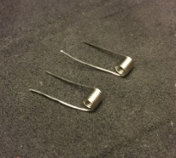
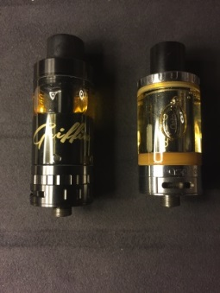
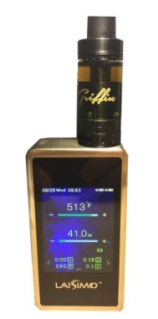
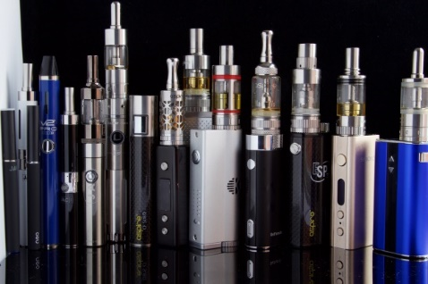

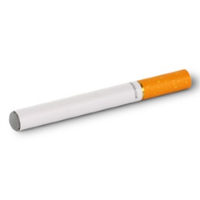
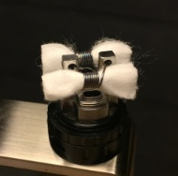
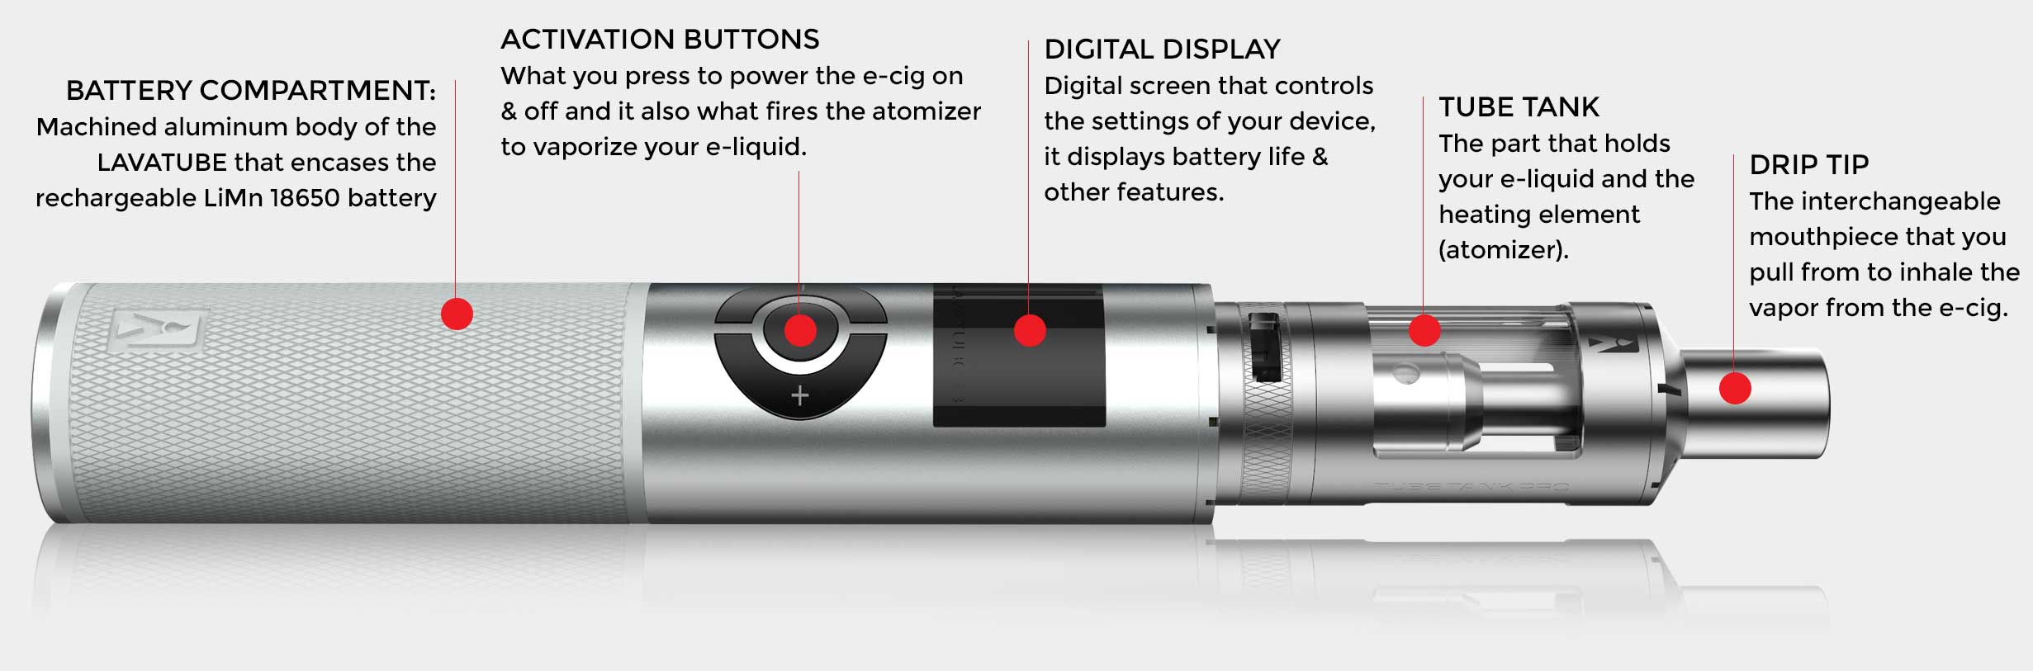
Electronic cigarettes – a consumer product and a ‘disruptive technology’
Technology progression
Coil build process
Norwich Medical School
Notes:
Quote for ‘disruptive technology’ Fagerstrom (2015 – Nicotine and tobacco research) Consumer product exploded onto the market, attractive potentially to whole groups of people otherwise not likely to stop smoking. Rapid form of nicotine delivery, and devices improving all the time. Mimic cigarettes for the nicotine delivery, but also the behavioural action, the social element, and possibly meet an identity need (continuum of smoker identity, or a whole new ‘vaper’ identity? most current e-cigarette users state that they use e-cigarettes for smoking cessation or to cut down from smoking, with an eventual aim of quitting smoking completely (McNeill et al, 2015).

Slide 7
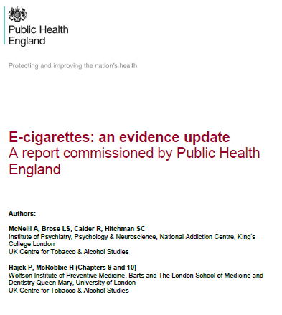
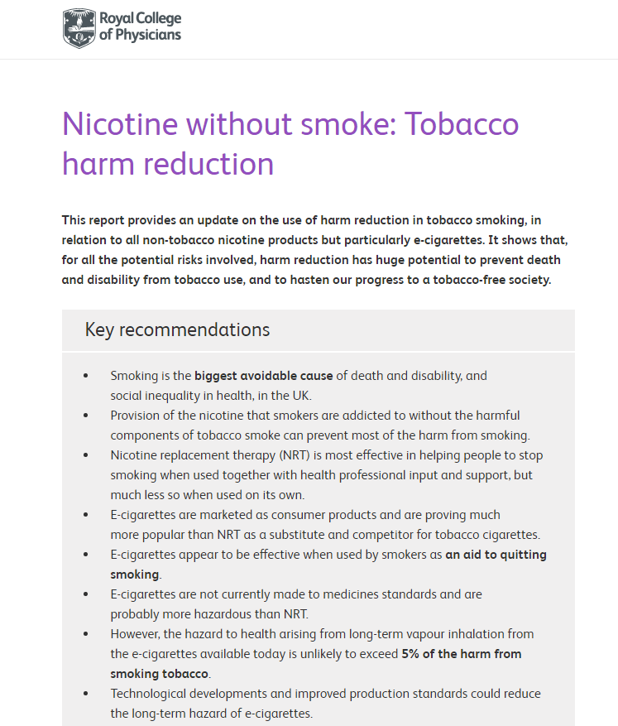
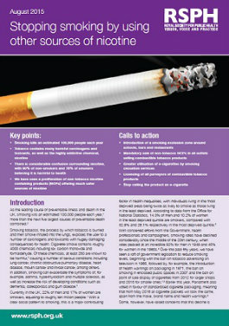
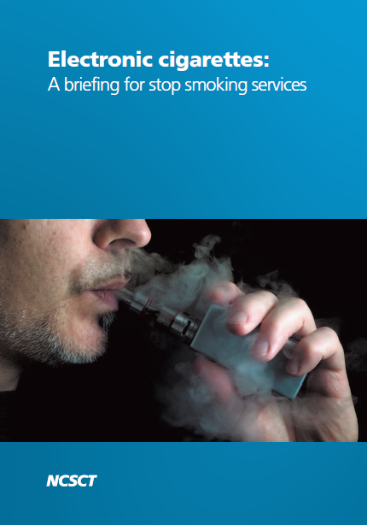
Notes:
UK tradition of harm reduction approaches to addiction treatment has seen the emergence of a ‘cautiously permissive’ use of e cigarettes. Recommendations by PHE, RCP, RSPH and NCSCT to support smokers to quit using e cigarettes if that is their choice. Howevere still notable controvery in the public health and medical community – McKee and colleagues Lancet Editorial criticised the PHE report and accused it of being insufficianetly ‘evidence based’ – a claim that was robustly and successfully defended by McNeill and colleagues.

Slide 8

Real world experiences of using e-cigarettes for avoiding relapse to smoking - the ECtra Study
Little known about people who quit smoking using an e-cig and risk of relapse.
Study seeks to explore in-depth participant perspectives on patterns of e-cigarette use over time in the context of smoking cessation or relapse.
Qualitative study initially purposefully recruiting from a larger longitudinal survey.
Interviews (approximately 30-40 until saturation) iteratively analysing data according to Grounded theory principles.
Emergent findings from initial interviews (n=5).
Faculty of Medicine and Health Science
Norwich Medical School
Norwich Medical School

Slide 9
Key Findings – cessation revelations
Interviewees report long histories of smoking and nicotine addiction
Multiple unsuccessful quit attempts
Eventual ‘inevitable’ relapse, often explained by social factors and influenced by alcohol use
Previous histories of more formal support – self-help, Nicotine gum, nicotine mints
‘Discovering’ vaping as a revelation – instantly able to stop and stay stopped
Vs. experimentation with different devices and periods of dual use with tobacco until finding a suitable product
Experimentation with e liquids and nicotine strengths – realisation that sufficient substitution is important to satisfy cravings
Norwich Medical School
Norwich Medical School

Slide 10
Continued abstinence
Reports of longer periods of abstinence than with any other cessation method previously tried
BUT occasional lapses
Lapse perceived as less significant than previously – no slide to regular smoking, but brief ‘blip’ then ability to continue vaping
Concerns over long term vaping health effects, but good knowledge of health benefits compared to smoking
Possibly more likelihood of dual use for some than others
Faculty of Medicine and Health Science
Norwich Medical School
Norwich Medical School
Notes:
Hig

Slide 11
Continued abstinence
“I gave up smoking completely when I got the vaporiser […] which was in July 2015 so, you know, a good, well over a year ago now (ok), and I went I reckon pretty much a whole year without having a cigarette.”
R: not one single cigarette?
“The only times I’ve had a cigarette are just social environment again, but I’ve only done it a handful of times, if that, and the great thing is when I have had one I haven’t even enjoyed it (ok wow), because it just doesn’t taste very nice, it makes you smell, and it’s not a particularly pleasant thing to be doing compared to vaporising, its just so much nicer.” (01M)
Norwich Medical School

Slide 12
Potential for long term relapse prevention
Vaping - satisfies all the dimensions of smoking cessation – physical, psychological, social, cultural and identity?
Physical: substitutes nicotine - fast acting; ‘on demand’.
Psychological – enables user to use to address stress / anxiety in a similar way to smoking.
Social – vapers report retaining their social group where previously they had tried to avoid social situations to remain abstinent from smoking; creation of new social groups
Cultural – less acceptance of smoking – stigma. Vaping has a reported stigma but less perceived stigma than smoking.
Identity – moving on from smoker identity to new ‘vaper identity’.
Faculty of Medicine and Health Science
Norwich Medical School
Norwich Medical School
Notes:
Hig

Slide 13
Long term Relapse prevention?
“smokers do actually enjoy smoking, which is a bit of a weird concept, but once you become a smoker you do know what I mean, so I think vaping allows you to carry on enjoying ‘smoking,’ but obviously withdrawing from tobacco itself, being less harmful to yourself, which is great” (03M)
Norwich Medical School

Slide 14
Vaping ‘better than smoking’ (01M)
Interviewees talked about multiple additional benefits of e cigarette use compared to other forms of smoking cessation support, and in comparison to smoking:
Less harmful to health
(Greatly) reduced expense
More convenient
No smell
Reduced stigma
Less loss to working hours
Choice – devices, e liquids
Modification – attractiveness to some of ‘gadgetry’
New social groups – vaping identity
Norwich Medical School
Norwich Medical School
Notes:
Vaping ‘95%’ less harmful than tobacco smoking (PHE)

Slide 15
‘Better than smoking’
“I just thought to myself ‘wow, this thing is brilliant’, like first of all, you don’t smell, secondly you know the sort of primary research so far suggests that it’s not as bad for you as smoking normally, thirdly, it’s miles cheaper, and I suppose a fourth point is you can pretty much do it whenever you want, you can just have a sneaky blast on it without anyone knowing, so, you know, I could just go and make a cup of coffee and have a couple of drags on my vaporiser, or you know, go to the toilet have a drag on it whereas when you’re smoking cigarettes, you know, it’s a sort of five minute activity to smoke a cigarette, whereas with the vaporiser you can just, a couple of seconds get it out of your pocket, have a drag, job done” (01M)

Slide 16
Vaping ‘different to smoking’ – more than a substitute
“I find it quite good that I can actually carry on enjoying a ‘smoke’ even though for people that don’t smoke that is certainly a weird concept, (yes) but in a safe, almost safe way, which is quite nice, and I find it slightly geeky, so I build up my tanks and all that, so I’m a bit geeky so I think that also takes part of that, part of myself” (03M)

Slide 17
Conclusions
Smoking remains the leading preventable cause of death worldwide
Deaths are due to combustible tobacco use, not nicotine addiction
Various forms of smoking cessation support, of varying effectiveness
Relapse common
E cigarettes are a potentially ground-breaking consumer development – a ‘disruptive technology’ that have provided a new dimension to smoking cessation
Meet the needs of ex-smokers by satisfying physical, psychological, social, cultural and identity related dimensions of addictive behaviour
The potential of vaping as ‘better than smoking’ suggests a real possibility of a tobacco free future.
Norwich Medical School

Slide 18


Study Team and acknowledgements
Richard Holland – Professor of Public Health Medicine, UEA
Lynne Dawkins – Associate Professor, London South Bank University
Divya Nelson – Foundation Year 2 Doctor, UEA
Dr Emma Ward – Senior Research Associate, UEA
Thanks to funders:
Faculty of Medicine and Health Science
Norwich Medical School
Norwich Medical School

Slide 19

The Addiction Research Group at UEA:
https://www.uea.ac.uk/medicine/research/addiction
Contact: c.notley@uea.ac.uk
Twitter: @Addictionuea
Phone: (+44) 01603 591275
Norwich Medical School

