Slide 1
Alcohol licensing and public health
Bringing research and practice together
James Nicholls, Alcohol Research UK

Slide 2
Licensing and public health: From evidence to practice
(Alcohol Focus Scotland)
National network on licensing and public health (Public Health England)

Slide 3
Licensing and public health overview
Scotland: statutory licensing objective to ‘promote and protect public health’
England and Wales: DPH now a ‘responsible authority’ in local licensing

Slide 6
Using licensing to protect public health: from evidence to practice
Six stakeholder events (261 attendees)
8 semi-structured interviews
Development of licensing toolkits
Pre- and post-analysis of Statements of
Licensing Policy (30 in 2010 and 25 in 2013)
Establishment of UK-wide ‘dialogue group’

Slide 7
National network on licensing and public health
Public Health England
Alcohol Research UK
Institute of Licensing
Local Government Association
Department of Health
Home Office
Trading Standards Institute
Institute of Alcohol Studies
Alcohol Concern
Safe Sociable London Partnership
Drinkwise
Balance North East
Alcohol Focus Scotland
National Association of Licensing and Enforcement Officers
ACPO
Universities of Sheffield, Oxford, LSHTM

Slide 8
Using licensing to protect public health: from evidence to practice
Low confidence in identification, analysis and interpretation of data
Policy highly dependent on membership / leadership of licensing boards
Increase in explicit use of health data in Statements of Licensing Policy between 2010-2013 (from 3/41 to 9/25)
Number of overprovision policies 7 (2010) to 10 (2013) (large geographical areas up from 1 to 5)
‘When considering the published statements of licensing policy in 2013 as a whole, progress has been relatively limited’ (Mahon and Nicholls, 2014: 38)

Slide 9
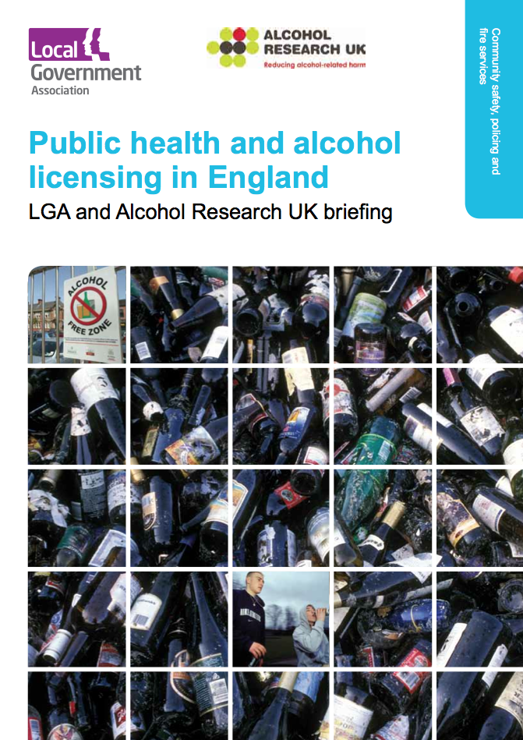
National network on licensing and public health
National survey of DPHs
National survey of licensing officers
Preliminary survey of public health teams in Local Alcohol Action Areas (n=19)

Slide 10
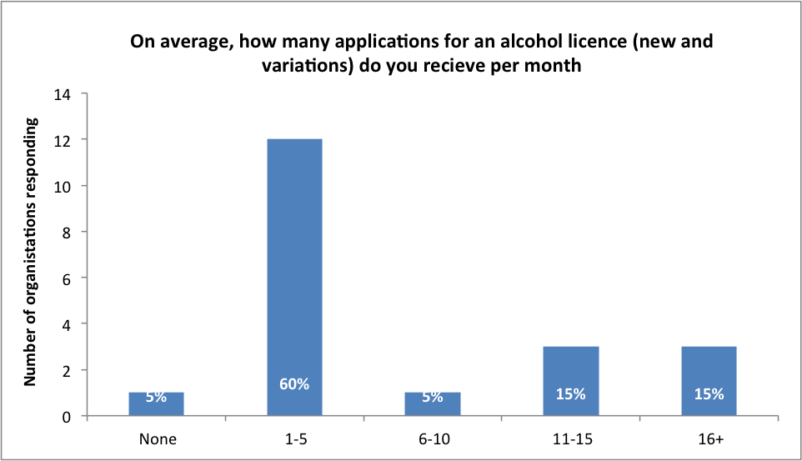

Slide 11
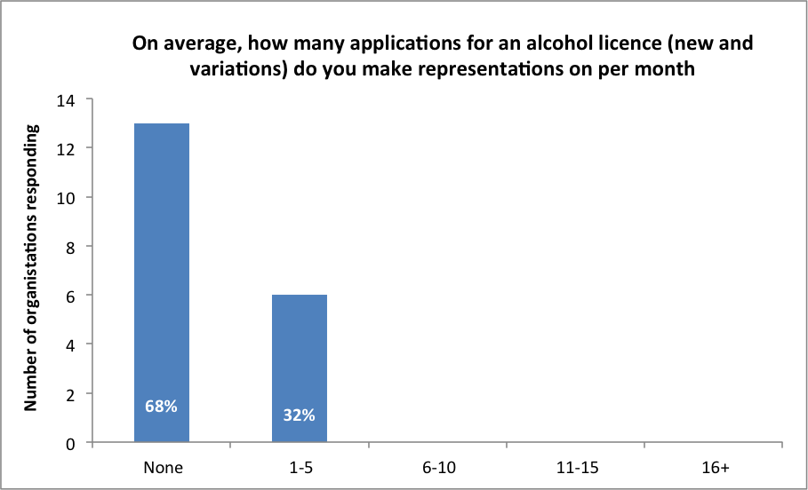

Slide 13
Summary
Some promising developments, but very patchy
Dependent on DPH interest; staff capacity; good relations with licensing board members; structured support from NGOs
Data identification, analysis and presentation problem
Barriers include: capacity; process; legislative clarity; trade power; ‘cultures of evidence’

Slide 15
The culture of licensing
Case-specific
Proximate, behavioural harms
Responsive, not strategic
Discretionary, not policy-driven

Slide 16
Street-level bureaucracy
The ‘decisions of street-level bureaucrats, the routines they establish and the devices they invent to cope with uncertainties and work pressures, effectively become the public policies they carry out.’ (Lipsky, M. [1980], Street-level bureaucrats: dilemmas of the individual in public services, xii)

Slide 17
World Health Organisation
International trade bodies
European Union
NGOs
National trade bodies
POLICY PRINCIPLES
Treasury
Westminster
Number 10
Dept of Health
BIS
Home Office
DCMS
Police
Trading standards
Local trade interests
Local Authority
Public Health
DISCRETION
Residents
Child protection
Elected members
Fire service
Appeal court

Slide 18
Multiple stakeholders and interests
Local retailers
Elected members
Inward investment
Police testimony
Local residents
Statutory guidance
Tourism
Legal advice
Crime data
LICENSING
Children’s services
Trading standards
Planning
Public health
Economic indicators
Accident and emergency
Fire and rescue
Trade bodies

Slide 19
Multiple ‘cultures of evidence’
(Lorenc,T. et al.,2014)
‘In terms of the evidence base, we must remember that a solicitor's definition of evidence and a public health definition are likely to be incomparable. A solicitor may look for documents or material objects to determine whether a belief is true or not. Public Health evidence is likely to consist of guidance, reviews of research and evaluation documents. While the expression is the same, the characterization of 'evidence' is likely to differ.’
(Carbey, F. (2014). Case study: application for a premises licence for a home delivery service in Bury [Briefing Note to PHE licensing network])

Slide 20
‘International’ ≠ ‘compelling’
‘International’ = ‘not relevant’

Slide 21
Moving forward
Goal-setting – routine use
Evidence deployment – limitations of the international evidence; build local evidence (but accept high cost to results ratio)
Partnership development – find a fit with ‘street-level bureaucracy’
Strategic approach – target Statements of Licensing Policy, overprovision and cumulative impact

Slide 22
Us and them #1
‘You have no idea how [the licensing board] interpret data. They don’t understand data. I’m not saying they’re not clever, it’s just if you’re not used to thinking in an academic way then you can’t look at it and say how this relates to you.’
(Public health professional, cited in Fitzgerald, N. (2014),
Influencing the implementation of a public health objective in Scottish
alcohol licensing: a qualitative interview study. Report for
University of Stirling)
‘Haven’t they heard of RCTs??’
(Heard at LSHTM seminar on public health and local
Government recently…)

Slide 23
Us and them #2
Previous public health engagement in licensing ‘saw the indiscriminate, badly-considered carpet-bombing of applications – with embarrassing results.’
(Jack Cummings, ‘A fact-based take on alcohol please’. Scottish Licensed Trade News. July 10 2014)

Slide 24
Licensing sees the street (not the population)
‘Street-level bureaucrats are conspicuously prone to scan their environment for empirical validations of their views … They are particularly inclined to believe that experience provides the basis for knowledge.’ (Lipsky, Street-Level Bureaucrats, 115)

Slide 25
You research, I reckon
‘And as acknowledged by virtually all in attendance at the last board meeting – including legal and police representatives – anyone can quote from academia to support their own view.’
(Councillor Nick Cook, Licensing critics forget our individual liberty, Edinburgh News 3rd Nov 2014)

Slide 26
‘I like being helpful – I think I’m good at it … I’d rather see you before we got to court, before I have to dry clean my suit.’
(Licensing officer, cited in Phillips, G. and Green, J. Working for the public health: politics, localism and epistemologies of practice. Sociology of Health and Illness [in press])

