Slide 1
EXPERIENCES OF NALOXONE RESUSCITATION
Jo Neale & John Strang
National Addiction Centre
Institute of Psychiatry, Psychology & Neuroscience
King’s College London
SSA, York
November 2015

Slide 2
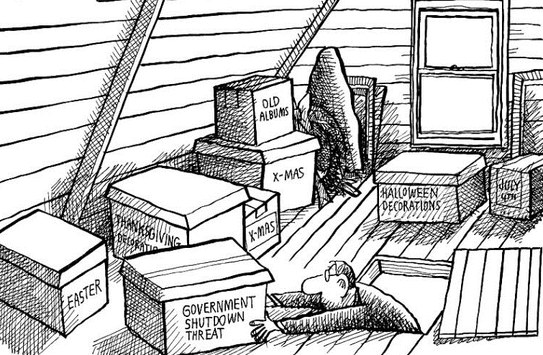
AKA: PROJECT DATA IN THE ATTIC

Slide 3
BACKGROUND
Clinicians do not agree on naloxone dose or route
We need a better understanding of opiate users’ views & experiences of emergency naloxone to inform dosing
Specifically, is it possible to do harm by administering too much emergency naloxone?
Secondary analysis of non-fatal overdose study
Date: 1997-1999
Location: 2 Scottish cities
Data: 200 qualitative interviews & observations from hospital emergency departments
Reference: Neale J. & Strang J. (2015) “Naloxone – does over-antagonism matter? Evidence of iatrogenic harm after emergency treatment of heroin/opioid overdose”, Addiction; doi:10.1111/add.13027.

Slide 4
PARTICIPANTS
Demographic characteristics | Group A (A&E) n = 77 | Group B (Drug agencies, pharmacies, snowballing) n = 123 | All n = 200
Gender
Male | 54 (70%) | 77 (63%) | 131 (66%)
Female | 23 (30%) | 46 (37%) | 69 (35%)
Mean age (years) | 27 (range 15-47) | 28 (range 17-45) | 28 (range 15-47)
Mean age of first use (years) | 16 (range 5-32) | 16 (range 7-32) | 16 (range 5-32)
Mean years of use | 11 (range 1-27) | 12 (range 1-31) | 12 (range 1-31)
Ever overdosed
Yes | 76 (99%) | 77 (63%) | 153 (77%)
No | 1 (1%) | 46 (37%) | 47 (24%)

Slide 5
KNOWLEDGE OF NALOXONE
Poor general knowledge
Fieldnote: Barry asks the doctor about the needle that was put into his heart last time he was in the emergency department. [Barry, 29 years, group A]
Few participants knew naloxone by its generic or trade name, Narcan
Nearly all participants understood street terms, such as ‘the jag’, ‘adrenaline’, or ‘the reverse’, or recognized naloxone from the researcher’s description

Slide 6
PERSONAL EXPERIENCES OF NALOXONE
Naloxone had made participants feel ‘horrible’ or unwell, and had induced acute withdrawal symptoms
They gave me that injection, that, er, reverse, and I woke up absolutely shaking… It was like instant withdrawals. It was the most horrendous experience that I've ever been through. [Beverley, 33 years, group A]
Naloxone-induced withdrawal symptoms were so severe that participants reported going ‘mad’ or ‘crazy’ or losing their temper & becoming aggressive or violent
I said to them [hospital staff], ‘Please don’t give me adrenaline’. And he [doctor] said ‘No, I’m not going to give you adrenaline’. [And he] stuck the needle in my arm. And I knew because I felt the tingling in my foot…I went crazy… Grabbed the metal side of the bed and I was kicking it and screaming and pulling my hair out. [Rab, 25 years, group B]

Slide 7
ACTIONS TO COUNTER NALOXONE EFFECTS
Participants frequently discharged themselves in order to find & use more drugs
I just bolted. Signed myself out [of hospital]. I came home… got a loan of a tenner [£10] off somebody… and I just went out and got another one [deal of heroin]. [Willy, 29 years, group B]
Withdrawal symptoms were often so severe that hospital staff had prescribed methadone or lofexidine to counter the naloxone

Slide 8
GENERAL VIEWS OF NALOXONE
Naloxone should be avoided as it caused instant withdrawals
It ‘takes your stone away’, ‘strings you out’, ‘makes you rattle’, ‘is instant hangout’, ‘makes you feel sick’, ‘causes a headache’, ‘ruins the hit’, ‘makes you feel worse’.
Others refused to go to hospital, climbed out of ambulances, signed themselves out of hospitals, & experienced prolonged withdrawals
Those who overdosed would be angry that they had ‘wasted their money’ & would now need to commit more crime to get drugs
Anybody waking up and being totally right into withdrawals would be angry. And the possibility is they've spent all their money and they've not got money to get anything else. [Suzanne, 31 years, group B]

Slide 9
PERSONAL RESPONSES TO THE OFFER OF NALOXONE
Few willingly accepted naloxone & many did their best to avoid naloxone
Group A participants had sometimes been given naloxone whilst unconscious, BUT often insisted they hadn’t received naloxone
No withdrawals observed by the researcher; several participants reported feeling better
Participant: They were going to give me Narcan, but I didn’t want it. I started screaming.
Researcher: So you didn’t get any?
Participant: No… I would have marks on me if I had, because they’d have had to get a vein… If I’d had Narcan, I’d have been shivering now. I’ve not had it. [Marjorie, 28 years, group A]

Slide 10
DISCUSSION
Opiate users were very negative about naloxone & repeatedly reported withdrawals & negative outcomes caused by over-administration
However, negative experiences were absent from the observational data
How might we explain this?
In a context of poor knowledge about naloxone, poor communication & lack of trust between heroin users & hospital staff, & a frightening life-threatening situation, instances of poor naloxone administration (however rare or unlikely) can have a disproportionately harmful impact through reputational damage

Slide 11
CONCLUSIONS
More attention needs to be paid to protocols for titrating naloxone dose against response to prevent sudden acute withdrawal syndrome, with the attendant risks of medical self-discharge, further drug use & even death, but…
Good treatment also involves building & sustaining trust with patients, providing clear information on how naloxone works & its potential side effects, & being sensitive to patients’ likely & understandable fears
The context in which naloxone is provided may be as critical as the dose administered if we want to ensure that treatment achieves maximum benefit

Slide 12
ACKNOWLEDGEMENTS
The original study was funded by the Scottish Office and the grant holder was Professor Neil McKeganey. Marion McPike conducted a small number of the Group B interviews. Accident and Emergency consultants Dr William Morrison and Dr Gordon McNaughton and charge nurse Derek Nelson provided retrospective insights into naloxone dosing during the study period. The authors would like to thank the above as well as the 200 opiate users for agreeing to be interviewed and the hospital and service staff for providing access to their patients. Joanne Neale is now part-funded by, and John Strang is supported by, the National Institute for Health Research (NIHR) Biomedical Research Centre for Mental Health at South London and Maudsley NHS Foundation Trust and King's College London.

