Slide 1

NOVEL PSYCHOACTIVE SUBSTANCES (NPS)

Slide 2
Learning Points
Gain awareness of
the rapidly changing nature of the recreational drug scene,
trends in substance abuse,
current usage patterns,
ease with which new psychoactive substances can be obtained.
Understand
need to ask patients about the use of ‘legal highs’
potential effects of such substances
need to treat the presenting symptoms

Slide 3
Definitions of Novel Psychoactive Drugs
Often called ‘designer drugs’, ‘legal highs’, ‘herbal highs’ or ‘bath salts’
They may not be new, but may have recently emerged on the market, and were not controlled until Psychoactive Substances Act 2016 enacted by UK Government -May 2016
Advisory Council on the Misuse Drugs defines NPS as follows: “Psychoactive drugs which are not prohibited by the United Nations Single Convention on Narcotic Drugs or by the Misuse of Drugs Act 1971, and which people in the UK are seeking for intoxicant use.” https://www.gov.uk/government/uploads/system/uploads/attachment_data/file/119139/acmdnps2011.pdf

Slide 4
Definitions of Novel Psychoactive Drugs
United Nations Office Drug Control defines NPS as follows:
“New psychoactive substances are substances of abuse, either in a pure form or a preparation, that are not controlled by the 1961 Single Convention on Narcotic Drugs or the 1971 Convention on Psychotropic Substances, but which may pose a public health threat. In this context, the term ‘new’ does not necessarily refer to new inventions but to substances that have been recently become available.” http://www.unodc.org/documents/scientific/NPS_2013_SMART.pdf

Slide 5
Definitions of Novel Psychoactive Drugs
European Monitoring Centre Drugs & Drug Addiction defines NPS as follows:
“a new narcotic or psychotropic drug, in pure form or in preparation, that is not controlled by the United Nations Drug Conventions, but which may pose a public health threat comparable to that posed by substances listed in these conventions”. http://www.emcdda.europa.eu/attachements.cfm/att_229598_EN_TDAN14001ENN.pdf

Slide 6
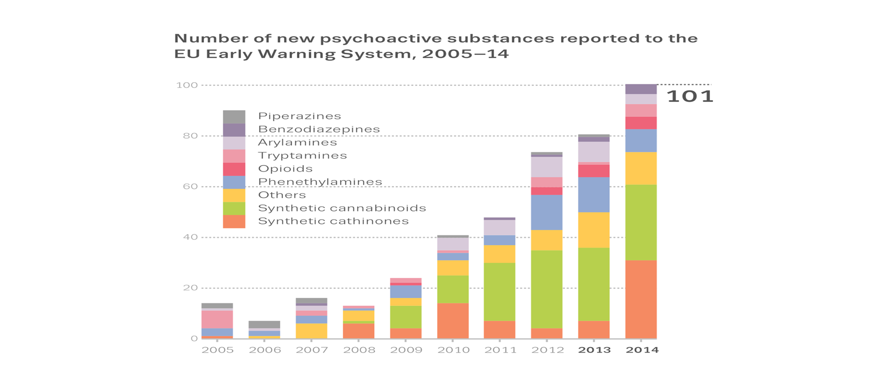
Increase in the number and diversity of new drugs
Source: EMCDDA(2015) New psychoactive substances in Europe. An update from the EU Early Warning System (March 2015) http://www.emcdda.europa.eu/publications/2015/new-psychoactive-substances

Slide 7
Prevalence
Use of New Psychoactive Substances (NPS) in the last year appears to be concentrated among young adults aged 16 to 24. Around 1 in 40 took an NPS in the last year https://www.gov.uk/government/statistics/drug-misuse-findings-from-the-2014-to-2015-csew
NPS have been implicated in deaths, at least 155 in England deaths since 2009 (source NPSAD (2015)Drug related deaths in England, Northern Ireland and the Islands Jan –Dec 2013 (not yet published).

Slide 8
UK GOVERNMENT STRATEGIES
Banned more than 500 new drugs
Created the Forensic Early Warning System to identify NPS in the UK
In December 2013, the Home Office convened an expert panel to look at NPS and provide recommendations.
Called for enhanced response to prevention, treatment and information sharing regarding NPS
Psychoactive Substances Act 2106

Slide 9
CASE STUDY – from fact sheet.
35 year old male no past history – medical or psychiatric
Presented to A& E – hallucinations & agitation
Suspected viral encephalitis – tests negative
Presented 4 more times – treated with sedatives/ anti-psychotics
5th presentation – disclosed recreational use of NRG-3 (man-made ‘designer drug’ with stimulant properties, obtained from the Internet)

Slide 10
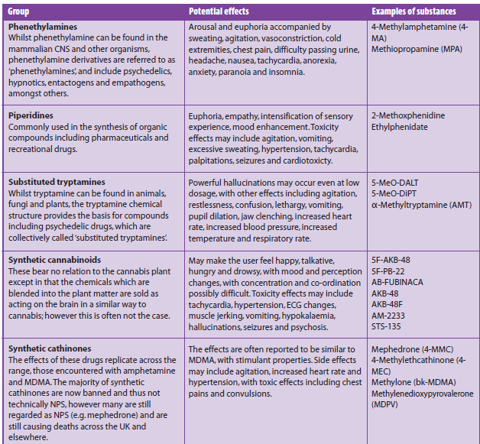
EXAMPLES OF NPS AND THEIR REPORTED EFFECTS

Slide 11
Clinical presentations
Acute toxicity
Symptoms related to side effects or adverse effects
Patients and witnesses should be asked about use of NPS and other substance use routinely
NPS might have been taken with alcohol or other substances
Patients should be treated symptomatically

Slide 12
Health harms/effects
Overdose
Temporary psychotic states
Suicidal ideation – often when effects of drugs wear off and use feels depressed
Violence and aggression
Sympathomimetic symptoms such as increased heart rate, hypertension etc.
Acute liver and kidney failure
Cardiovascular toxicity
Fatalities

Slide 13
Physical harms
Bleeding in the muscles and internal organs
Swelling of brain
Unconsciousness
Sweating/overheating,
Difficulty breathing
Rigidity of body, “hands stuck open with fingers squeezing together like claws”
Fitting/ foaming at mouth
Problems peeing/ very painful damage is so bad that the bladder has to be removed by surgery.
Notes:
High temperature (38.9 C 41.8; 42.9; 41.2)

Slide 14
Health harms
Longer term health issues including:
Increase in mental health issues including:
psychosis, paranoia, anxiety, ‘psychiatric complications’ & depression
Physical and psychological dependence which develops quite rapidly after a relatively short period – which can be within weeks - of intense use

Slide 15
Health harms;mental health
Acute psychoactive effects: changes in mood, anxiety, perception, thinking, memory, and attention
Agitation, ‘jittery’, ‘titchy’, fidgety, distress
Confusion, disorientation,
Paranoid thoughts “Talking described as nonsensical”

Slide 16
Practice Points
•Be aware of the emergent drugs especially in the locality in which you are practising
Keep channels of communication open between relevant specialists eg clincians, toxicologists, forensic services, police
•Have a high index of suspicion look for hints of atypical and subtle presentations which may alert you and reflect the use of novel substances perhaps combined with the ‘classical’ drugs of misuse.
•Undertake a comprehensive history and clinical examination – ask about use of non-prescribed drugs and other substances

Slide 17
Practice points
Attempt to obtain as much information as possible from multiple sources about the drug use of the individual
Attempt to obtain toxicological assessment of the individual
Monitor the clinical state frequently as appropriate for the environment be it A&E, inpatients, community services
Bear in mind that individuals or witnesses MAY NOT BE AWARE that they might have taken some of these new substances
Products are unregulated: there is no guarantee that what is on the packet is actually contained in the product, and often contents are not listed

Slide 18
References
EMCDDA (2015) New psychoactive substances in Europe. An update from the EU Early Warning System (March 2015) http://www.emcdda.europa.eu/publications/2015/new-psychoactive-substances
Baumeister ,D. Tojo L,M.& Tracey D, K. (2015) Legal highs: staying on top of the flood of novel psychoactive substances.Therapeutic Advances in Psychopharmacology, 5,2: 97-132 http://tpp.sagepub.com/content/5/2/97
Home Office (2014) New psychoactive substances review: report of the expert panel https://www.gov.uk/government/uploads/system/uploads/attachment_data/file/368583/NPSexpertReviewPanelReport.pdf
House of Commons ( 016) Psychoactive Substances Act Chapter 2 http://www.legislation.gov.uk/ukpga/2016/2/pdfs/ukpga_20160002_en.pdf
Kihara, R. and Day, E. (2014), Transient psychotic episodes following recreational use of NRG-3. Prog. Neurol. Psychiatry, 18: 14–18. doi: 10.1002/pnp.331 : http://onlinelibrary.wiley.com/doi/10.1002/pnp.331/pdf
Lucas A. Johnson, Rebecca L. Johnson, Ray-Bernard Portier, (2013) Current “Legal Highs”, The Journal of Emergency Medicine, Vol 44, Issue 6, pp 1108-1115 http://dx.doi.org/10.1016/j.jemermed.2012.09.147.
Nelson, E.M., Bryant S,M. & Aks, S.E (2014) Emerging Drugs of Abuse, Emerg Med Clin N Am 32 1–28 http://dx.doi.org/10.1016/j.emc.2013.09.001

Slide 19
References
Novel Psychoactive Treatment UK Network(NEPTUNE) Guidance on the Clinical Management of Acute and Chronic Harms of Club Drugs and Novel Psychoactive Substances http://neptune-clinical-guidance.co.uk/wp-content/uploads/2015/03/NEPTUNE-Guidance-March-2015.pdf
Royal College of Psychiatrists (2014) One new drug a week Why novel psychoactive substances and club drugs need a different Response from UK treatment providers http://www.rcpsych.ac.uk/pdf/FR%20AP%2002_Sept2014.pdf
Smith, C.D., and Robert, S., (2014)’Designer drugs’: update on the management of novel psychoactive substance misuse in the acute care setting. Clinical Medicine 2014 Vol 14, No 4: 409–15
Takematsu, M., Hoffman, R.S., Nelson, L.S., Schechter, J.M., Moran, J.H. & Wiener, S.W. (2014) A case of acute cerebral ischemia following inhalation of a synthetic cannabinoid. Clinical toxicology Vol. 52, Issue 9, 2014. http://www.tandfonline.com/doi/abs/10.3109/15563650.2014.9586
UNODC Resource list with links to reports and papers on NPS https://www.unodc.org/LSS/Page/NPS/Resources,

