Slide 1

NEUROLOGY

Slide 2
LEARNING OUTCOMES
Describe the range of neurological symptoms associated with substance use disorders
Identify signs and symptoms of neurological disorders affected by substance misuse
Describe an appropriate care plan

Slide 3
CONTEXT
Overlap between neurological and substance use disorders is significant
20% neurology patients have a lifetime history of a substance use disorder, and 13% have a current disorder
Neurological disorders can arise from intoxication, withdrawal and chronic use of substances
Substance misuse can lead to memory, attention, decision making problems, medical emergencies ie seizures, confusion and cognitive deterioration

Slide 4
COMMON PRESENTATIONS
Substance misusers may present late with severe neurological deficits
Neurological complications may be ignored by the patient
Patients may not see the relevance of substance use to the presentation and therefore may not disclose
Every patient with a neurological disorder should have a full substance misuse history
Practitioners should be skilled in undertaking a history
Intoxication may complicate the clinical picture

Slide 5
EFFECTS OF SUBSTANCE MISUSE ON THE NERVOUS SYSTEM
Neurotoxicity
Violence and loss of control may be direct result of neurotoxic effect of eg alcohol on prefrontal cortical function
Focal neurological signs are not expected in alcohol intoxication
Acute stimulant intoxication may lead to anxiety, panic, psychosis
Cocaine intoxication leads to euphoria, bizarre erratic violent behaviour
Sudden death may occur with cocaine intoxication (especially when combined with alcohol) as well as irritability, restlessness, anxiety, panic, paranoia, tremors, vertigo, muscle twitches

Slide 6
Opiate intoxication leads to pupillary constriction
Opiate withdrawal leads to yawning, sweating, running eyes and nose
Sedative withdrawal leads to tremor, abnormal movements, dilated pupils as well as clammy skin, vomiting, pallor
Acute cannabis intoxication can lead to confusion, delirium, cognitive impairment
Chronic cannabis use can lead to neuropsychological decline
Novel psychoactive substances can include delirium, convulsions, hallucinations, delusions
Ketamine can cause dream like states, delirium, amnesia

Slide 7
NEUROLOGICAL CONDITIONS
Coma and stroke
Convulsions
Cognitive deterioration
Wernicke’s encephalopathy
Alcohol related dementia
Peripheral neuropathy
Autonomic neuropathy
Progressive cerebellar deterioration
Pellagra
Marchiafava-Bignami Disease

Slide 8
COMA AND STROKE
Alcoholics may have cerebral atrophy leading to subdural haematomas, disordered coagulation making them vulnerable to intracerebral haemorrhage
Illicit drug use can increase risk of ischemic and haemorrhagic strokes
Drug use is the most common predisposing condition for stroke among patients under 35 years old
Main illicit drugs associated with stroke are: cocaine, amphetamine, MDMA/ecstasy, 0phencyclidine (PCP), lysergic acid (LSD)

Slide 9
STROKE
Cocaine is associated with stroke, seizures, headaches, cognitive dysfunction, coma, disturbances of heart rhythm, heart attacks
MDMA/ecstasy can be associated with strokes, and intoxication leads to hypertension, faintness, panic attacks, loss of consciousness, fits
Methamphetamine increases risk of strokes
Tobacco misuse is associated with heart attacks and strokes

Slide 10
CONVULSIONS
Most common cause is alcohol withdrawal which occurs in 5-15% of alcohol dependent people
Occur 6-48 hours after last alcohol use
Tonic clonic seizures
Withdrawal from benzodiazepines and GHB/GBL are also associated with seizures
Other causes are intoxication with cocaine, amphetamine, and MDMA

Slide 11
COGNTIVE DETERIORATION
Long term alcohol use leads to mild defects eg memory, attention, concentration and decision making to alcoholic dementiaand Wernicke Korsakoff’s psychosis
Wernicke encephalopathy presents with the classic triad of ocular abnormalities, ataxia and confusional state in 16% of patients
Onset may be acute or gradual and is a reversible if treated
If untreated is fatal in 17% cases, and permanent brain damage in 85% of those who do not receive appropriate treatment. It may lead to
Korsakoff’s psychosis characterised by amnesia, confabulation & irritabilty
It is caused by lack of vitamin B1 thiamine

Slide 12
ALCOHOL RELATED DEMENTIA
Caused by long term excessive drinking
Alcohol is responsible for about 10% of dementia cases
Usually occurs in over 65 year olds
Dementia begins gradually and progress slowly
Symptoms include general inability to plan, memory loss, and apathy

Slide 13
PERIPHERAL NEUROPATHY
Chronic alcohol use can cause toxicity and vitamin deficiency leading to peripheral neuropathy ie pain and tingling in limbs
Lower limbs are affected more that upper, with foot and wrist drop, muscle weakness and wasting
Nerve damage is usually permanent
Continued drinking leads to disability and chronic pain
Avoiding alcohol and eating well can minimise the effects

Slide 14
Conditions
Autonomic neuropathy – damage to nerves responsible to blood pressure, heart rates, sweating, bowel and bladder emptying and digestion.
Caused by alcohol, AIDS/HIV and liver disease
Progressive cerebellar deterioration – alcohol is the m ost common cause and most likely due to thiamine deficiency
Presentation – ataxic gait, truncal ataxia
Pellagra – chronic lack of niacin B3. Chronic alcohol use can cause poor absorption which results in skin, gastrointestinal and mental abnormalities leading to memory impairment, delusions, hallucinations, dementia, delirium
Marchifava-Bignami disease – rare progressive condition corpus callosum demyenlination caused by alcohol use. Presents with stupor, coma or fits, dementia, apraxia, ataxia.

Slide 15
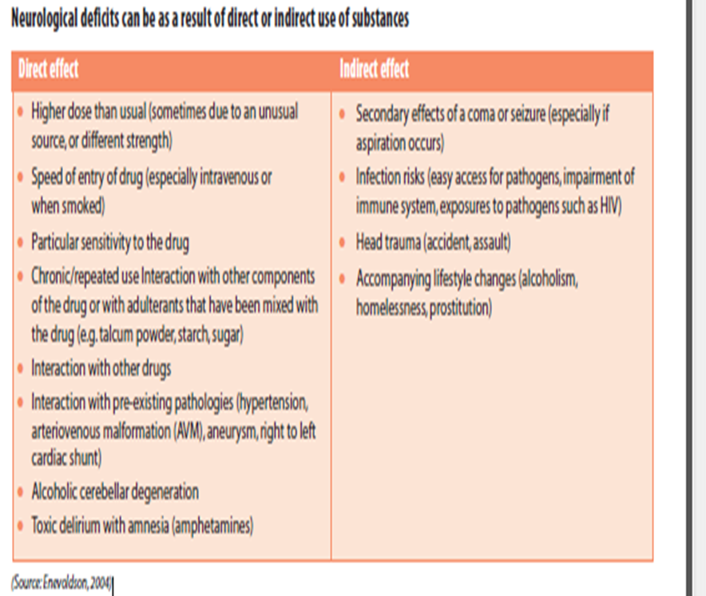
Effects of Substance Use –Direct/Indirect

Slide 16
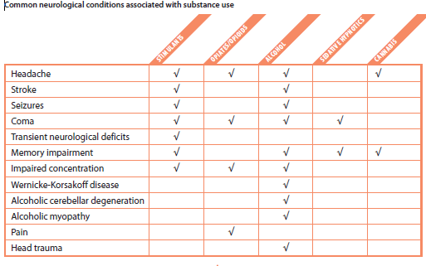
Common Neurological Conditions/ Substance Use

Slide 17
ASSESSMENT
Undertake comprehensive substance misuse assessment if possible
Undertake a full physical examination
Be aware that patients may have been using several licit and illicit substances, and may be at a different level of dependence for each
Undertake a range of investigations

Slide 18
TREATMENT
Treat neurological disorder if needed
Detoxify or stabilise the patient if appropriate, so that the assessment of the neurological condition can be done so as to diagnose and treat
Medical emergencies need urgent intervention:
Delirium tremens – associated with high mortality; treatment is with benzodiazepines; abstinence may lead to improvement
Seizures – brain imaging should be done for first seizure and if there are focal signs
Wernicke’s Encephalopathy – parenteral thiamine should be administered
Alcohol related dementia – can be reversible if patient becomes abstinent, is prescribed vitamins and eats a healthy diet

Slide 19
NETWORKS, REFERRALS, SERVICES
Local services should be contacted to discuss an appropriate management plan for patients presenting with a neurological problems directly or indirectly associated with substance misuse
Severely dependent patients are best managed with advice and support from substance misuse teams
Patients with harmful use or high risk drinking or drug use, may respond to brief interventions, and can be referred on for specialist support with psychosocial interventions

Slide 20
References
Brust. J.C. (2014). Neurologic Complications. An illicit Drug Abuse. Continuim life long Learning in Neurology, 20.3, 642-656
The Centre for Public Health, Faculty of Health & Applied Social Science, Liverpool John Moore's University, on behalf of the Department of Health and
National Treatment Agency for Substance Misuse (2011) A summary of the health harms of drugs http://www.nta.nhs.uk/uploads/healthharmsfinal-v1.pdf
Crome IB & Bloor, R (2008) Alcohol problems, in Murray R. et al (eds) Essential Psychiatry. Cambridge University Press. pp 198-229
Day E, Betham, P.W., Callaghar, Kuruvilla T, and George, S (2013) Thiamine for prevention and treatment of Wernicke Karsakoff syndrome in people who
abuse alcohol. Cochrance Syst. Rev. doi 10. 1002/j1465 1858. CD 004033. pub3. Cochrane Database of Systematic Reviews 2013, Issue 7. Art. No.: CD004033. DOI: 10.1002/14651858.CD004033.pub3.
Enevoldson, P (2004) Recreational drugs and their neurological consequences. Journal of Neurology, Neurosurgery & Psychiatry, ;75:iii9-iii15
doi:10.1136/jnnp.2004.045732 http://jnnp.bmj.com/content/75/suppl_3/iii9.full
Esse, K, Fossati-Bellani, M, Traylor, A & Martin-Schild, S (2011) Epidemic of illicit drug use, mechanisms of action/addiction and stroke as a health hazard. Brain and behaviour, http://www.ncbi.nlm.nih.gov/pmc/articles/PMC3217673/
Fink P, Hansen MS, Sondergaard L, Frydenberg M (2003). Mental illness in new neurological patients. Journal of Neurology, Neurosurgery & Psychiatry, (74),817-819.
Goforth, H.W., Murtagh, R & Fernardez F. (2010). Neurologic Aspects of Drug Abuse. Neurologic Clinics, 28(1) pp 199-215.

Slide 21
References
McIntosh C, Chick J. Alcohol and the nervous system. Journal of Neurology, Neurosurgery & Psychiatry, 75(Suppl 3):16–21.
Meier, M.H, Caspla, AmblerA, Marringtonte, Houts R, Keefe RS, McDonald K, Ward A, Poulton R, Moffitt T. E. (2012) Persistent cannabis users show neuropsychological decline from childhood to midlife. Proceedings of the National Academy of Sciences. doc: http://www.pnas.org/content/109/40/E2657.abstract
Serdaru M, Hausser-Hauw C, Laplane D, et al. The clinical spectrum of alcoholic pellagra encephalopathy. A retrospective analysis of (1988) 22 cases studied pathologically. Brain;111:829–42
Welch, K (2011) Neurological complications of alcohol and misuse of drugs. Practical Neurology (11):206-219
http://pn.bmj.com/content/practneurol/11/4/206.full.pdf
US Department of Health and Human Sciences (2000) 10th special report to US Congress on Alcohol and health. The neurotoxicity of alcohol; Chapter 2: Alcohol and the Brain: Neuroscience and Neurobehavior
http://pubs.niaaa.nih.gov/publications/10report/chap02e.pdf

