Slide 1


Modelling the effectiveness of alcohol price policy
Professor Petra Meier
Dr John Holmes
Sheffield Alcohol Research Group
ScHARR
University of Sheffield
Email: p.meier@shef.ac.uk
© The University of Sheffield

Slide 2
Content
Price policy options and UK developments
Alcohol Policy Model
Modelling the effect of minimum pricing
Outlook: Ongoing programme of work

Slide 3
UK price policy options
Excise duty: strong evidence of effectiveness but...
Minimum unit taxation: revenue goes to state but...
Minimum unit price (MUP): guaranteed threshold linked to alcohol content but...
Discount bans: Removes incentive to overbuy but...
Ban below cost selling: prevents loss-leading but...

Slide 4
Policy developments
Alcohol duty escalator of 2% above inflation since 2008. Backbench MPs debate on 1 Nov following a petition
Below cost ban – plans abandoned
  England & Wales: Government committed to MUP with a consultation on the level imminent
  Scotland bill to implement a MUP. Ministers set level - SWA legal challenge
Notes:
Below cost ban is explicitly abandoned before implementation in the Alcohol Strategy
consultation is ON the level of MUP as well as other proposals
the Scottish bill implements a MUP and the bill gives ministers the power to set the level (i.e. 50p isn’t written into the bill itself and they could change it if they chose).
Canada’s MUP isn’t MUP in some places. BC is minimum price disconnected from strength (so a arbitrary price for different beverages) and Saskatchewan is MUP but the unit price varies by beverage.

Slide 5
Minimum pricing in an international context
Republic of Ireland and Northern Ireland
  Cross-border strategy on MUP agreed with legislation to follow
Australia
  In Oct, government consultation recommended taxation by volume rather than MUP to ensure money goes to state.
New Zealand
  In 2010, Law Commission recommended MUP but not included in Alcohol Reform Bill, which is currently in Parliament but opposition unsuccessful in introducing MUP amendment
Canada
  Minimum pricing policies vary by province. Ongoing research evaluates different strategies
Notes:
ROI/NI – A joint conference was held in Jan 2012 where a commitment to work together to implement MUP in both countries was announced. Figures of 45p-50p have been discussed. As yet no legislation and the junior Health Minister responsible (Roisin Shortall) has just resigned following tensions over other issues. There appears to be some debate as to whether her alcohol policies will survive her.
Australia: ANPHA appears to be a Federal Government quango and is running a consultation specifically on MUP. It is expected to report back imminently with a recommendation to implement MUP. Unclear whether the government supports it.
NZ: The 2010 Law Commission report provided a basic for the current Alcohol Reform Bill. The Bill has been criticised for not including some of the important recommendations. Opposition Parliamentarians attempted to introduce an amendment for MUP to be included in the bill but were unsuccessful.
Canada: Not 100% what’s happening here. My understanding is there is nothing formal happening and Tim’s/ScHARR’s research on a Canada model will inform any further developments

Slide 6
UK Trends

Slide 7
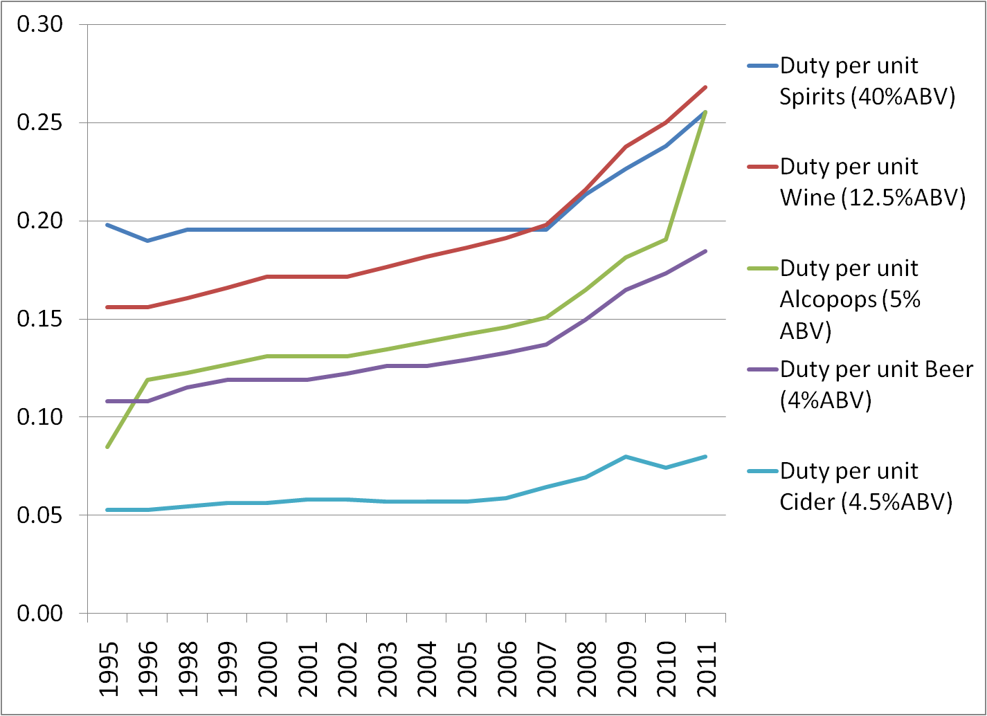
Duty in £ per 1 unit of alcohol: substantial differences between beverage types

Slide 8
Affordability: Off-sales vs on-sales (price relative to income and inflation)
Recession?
Duty escalator?
70% of alcohol now bought in supermarkets

Slide 9
Around 80% consumption is concentrated in 30% heaviest drinkers
Notes:
9
This slide shows us the distribution of alcohol consumption in the population, based on % of actual alcohol units consumed by each consumption decile.
The bottom 70% of UK population drink about 25% of all alcohol consumed in the UK.
The heaviest 10% of drinkers consume 45% of all alcohol, and 30% of drinkers drink nearly 80% of all alcohol. This is not typical of alcohol – for most products consumption is concentrated in a small proportion of the population.
The take home message here is that any pricing policy automatically targets the heaviest drinkers, just by the fact that these drink the vast majority of all alcohol volume sold in the UK.

Slide 10
“Old” weekly recommended limits used to classify drinking for average consumption
Drinker type | Units per week
 | Men | Women
Moderate | Less than 21 | Less than 14 | 70-75% of population
Hazardous | 21 – 50 | 14 – 35 | 25% of population
Harmful | 50+ (> 20 pints of beer or 5 bottles of wine) | 35+ | 8-10% of population

Slide 11
Average price paid per unit of alcohol (in 2005/6)

Slide 12
And now to the modelling…

Slide 13
THE SHEFFIELD ALCOHOL POLICY MODEL
Appraises the effectiveness and cost-effectiveness of alcohol policies in UK and elsewhere
  Pricing: MUP, Discount Bans, Below-cost selling ban, Tax (in progress)
  Availability: Outlet density, licensing hours (in progress)
  Screening + brief interventions in primary care and A&E
  Advertising: abandoned until better data is available
For price policies, it gives estimates of changes in consumption, harm (health, crime, employment-related), costs of harm, consumer spending and government revenue

Slide 14
Sheffield model structure
Evidence on effectiveness
Intervention/policy
Evidence on attri-bution & risk
Consumption before & after policy
Evidence on costs & QALY value
Harm before & after policy
Valuation of harm change

Slide 15
Structure and evidence base
From policy change to consumption change:
  Econometric approach (price elasticities)
  Based on individual-level expenditure and consumption data and aggregated sales data (for England)
From consumption to harm:
  Model based on epidemiology
  Uses published and newly estimated risk functions or attribution levels

Slide 16
Work for DH and NICE
Policies
Different MUPs (10p-70p)
Restriction of off-trade discounting
10%, 25% general price increases (across the board)
Harms
Health, crime, unemployment, workplace absence
Costs to healthcare, social care, criminal justice
Populations
Total population
Moderate vs hazardous vs harmful drinkers, by gender x age group
© The University of Sheffield
Notes:
16

Slide 17
Selected Findings

Slide 18
Price policy effects on consumption
10% general price increase →
4.2% reduction
English below cost ban→
0% – 0.4% reduction
Total ban off-trade discounts →
2.7% reduction
Notes:
Minimum unit price starts to have substantial effects above 40p per unit.
Stopping off-trade discounting is only has a modest effect

Slide 19
Policy effects on consumption: by drinker type
Notes:
Harm reduction from pricing policies is seen for all drinker types but greatest effects are seen for hazardous and harmful drinkers.
.

Slide 20
Policy effects on health harms: by drinker type (example: hospital admissions)
Notes:
Harm reduction from pricing policies is seen for all drinker types but greatest effects are seen for hazardous and harmful drinkers.
Pricing policies set at too low a level have minimal benefit even for those drinking at harmful levels.

Slide 21
Estimated effects: wider impacts
40p minimum price per unit
Overall reduction in consumption | 2.4%
Health savings over ten years
Deaths | 9,979
Hospital admissions | 326,355
Annual savings
Crimes | 10,100
Days absent | 133,600
Unemployed persons | 11,500
10 year cost reduction
Health | £626m (direct) | £759m (QALY)
Crime | £97m (direct) | £27m (QALY)
Work | £2.5bn
Total | £4bn
Revenue changes
Retailers | +£432m (off) | +£316m (on)
Duty + VAT | -£89m (off) | +£105m (on)

Slide 22
The annual cost of minimum pricing to drinkers: by drinker type
Notes:
Minimum unit price starts to have substantial effects above 40p per unit.
Stopping off-trade discounting is only has a modest effect

Slide 23
Take home messages
Pricing policies are effective in reducing alcohol consumption and harm
All price policies target heavy drinkers as they
  purchase most of the alcohol sold
  spend more of their disposable income on alcohol
Minimum pricing is particularly well targeted on heavier drinkers, as they purchase cheaper alcohol.

Slide 24
Filling evidence gaps: Work programme
Age, period, cohort study: How much of the current consumption trends are explained by age, period and cohort effects?
Context factors study: How do external influences (e.g. recession, smoking ban) affect policy effectiveness?
APISE study: first UK panel data set to provide English and Scottish comparison for evaluation
New elasticities: allow flexibility in modelling, eg bespoke groups “What is the likely effect of minimum unit pricing on low income young male drinkers?”

Slide 25
Filling evidence gaps II
Tax pass through study – Are duty increases passed through to prices by retailers? How do price changes differ by beverage type?
Availability study: What is the joint effect of two different types of policy: price and temporal and density licensing restrictions
Drinking patterns study: how would policies impact on level and frequency of heavy drinking occasions and associated harm?
Risk functions study – Modelling policy effects on harms that are associated with both average and heavy episodic drinking, e.g. domestic violence?
Notes:
JH: Add something on impacts on harm and reviewing evidence to improve our modelling of the relationship between both average and heavy episodic consumption and health, crime and workplace harms.

Slide 26
Some concluding remarks
Decision models synthesise large range of published evidence and primary data to support intervention planning
Iterative process: new policy questions, evidence/data become available
Evidence gaps examined via sensitivity analysis (“How different are results for alternative assumptions?”) and further studies

Slide 27
Development of the Sheffield Model have been/are being funded by
MRC
ESRC
Policy Research Programme, Dep of Health
Scottish Government
NICE
Home Office
EU FP7
The views expressed are not necessarily those of the funders.
Thanks to the team: Colin Angus, Andrew Booth, Alan Brennan, Yelan Guo, Dan Hill-McManus, Yang Meng, Robin Purshouse, Rachid Rafia, Karl Taylor
© The University of Sheffield

Slide 28

Any questions?
p.meier@sheffield.ac.uk
john.holmes@sheffield.ac.uk
All results are taken from: Purshouse, R. et al. (2009) ‘Modelling to assess the effectiveness and cost-effectiveness of public health related strategies and intervention to reduce alcohol attributable harm in England using the Sheffield Alcohol Policy Model version 2.0’, Report to the NICE Public Health Programme Development Group
Notes:
28

Slide 29
METHODS SLIDES

Slide 30
Step one: Modelling the effect of price changes on consumption

Slide 31
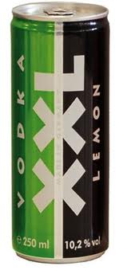
MODELLING CONSUMPTION (RISK FACTOR)
3 main mechanisms:
  Average volume drunk over time (chronic harms, e.g. throat cancer) – survey data
  Level of intoxication (acute, e.g. injuries) – survey data
  Setting: Going out vs drinking at home (i.e. off-trade and on-trade consumption) – modelled via EFS purchasing diary data and NDNS data

Slide 32
BASELINE ALCOHOL PRICES PAID
Prices paid using Expenditure and Food Survey 2 week purchasing diary
  Diary of item ‘transactions’ for >75,000 individuals, includes alcohol purchases
  Generate baseline price per unit distribution for on-trade and off-trade purchasing
Price sensitivity varies by product & setting
  Beer, wines, spirits, alcopops
  on-trade/off-trade (pub vs supermarket)

Slide 33
PRICE ELASTICITIES:
∆price ➔ ∆ consumption
Econometric model tells us the following
  All else being equal, within each population group
  “if the price of supermarket/off-license beer rises by x%, how much less off-trade beer do people purchase?” and also on other product categories: “what effect does this have on pub beer, or supermarket cider etc”
Notes:
Ref Lancet online appendix

Slide 34
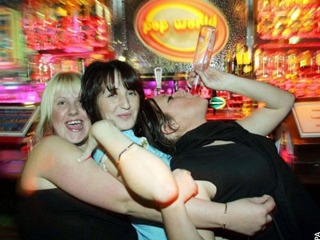
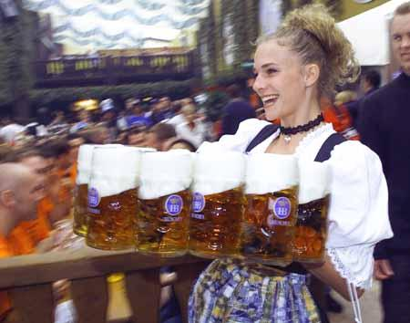

MODELLING WHO IS AFFECTED BY A POLICY
Different alcohol buying and drinking preferences
  Beer, wine, spirits…
  Going out vs drinking at home
  “Quality experience”
Different risks
  Acute vs chronic harms
  Health vs crime vs workplace harms
  (Meier et al. 2009: Addiction)
  In Model V1 and V2: Gender, age, drinking
  V3 will be individual level consumption –
  e.g. can consider income, geography…

Slide 35
Therefore, model gives answers to questions such as
  All else being equal, “if beer prices in supermarkets rose by 10%, how much less beer, wine etc would 18-24 year old male heavy drinkers be expected to purchase?”

Slide 36
Step two: Modelling the effect of consumption changes on alcohol harm

Slide 37
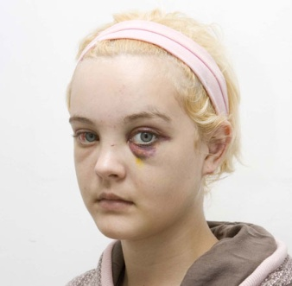


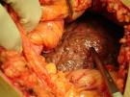
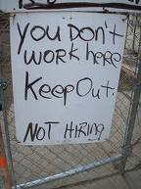

ALCOHOL-RELATED HARM
  Acute vs chronic harms (e.g. accidents vs cancers)
  Health vs crime vs workplace harms
  Micro-level (e.g. drinker, family) and macro-level (e.g. lost productivity, NHS resource implications)

Slide 38
GETTING RISK FUNCTIONS
Risk functions are needed to link alcohol consumption levels to harm levels.
Evidence direct from literature - risk functions relating mean consumption to relative risk (RR) of mortality or disease prevalence or
If published risk functions unavailable
use published alcohol attributable fraction estimates
Assume no elevated risk up to a threshold (moderate drinkers), then fit regression to match actual age/gender specific England data on levels of harm
For chronic harms, we assume an average time lag of 10 years to full effect.

Slide 39
The model provides answers to questions such as
All else being equal, “if the average weekly consumption of alcohol in 55-64 year old women dropped by 10%, what effect would that have on the incidence of breast cancer over the next 10 years?”

Slide 40
Step 3: Health economics

Slide 41
MONETARY VALUATION
Government and industry – loss in revenue
Health harms
  direct costs (NHS & social care)
  QALYs
Crime
  unit cost of a crime from literature
  crime victim QALY loss
Workplace
  Sickness absence & unemployment valued based on average earnings in each subgroup

Slide 42
MAIN POLICY OPTIONS
Pricing and taxation
Regulating availability
Modifying the drinking environment
Drink driving measures
Restrictions on marketing
Education and persuasion
Treatment and early intervention
Notes:
Wide range of policies have been tried and stopped in various countries over the years.
Different ministries, departments and administrative agencies each have some aspect of alcohol policy under their purview. Challenge of getting coherence in concept and implementation when policy responsibilities are dispersed horizontally (depts) and vertically (UK, devolved, local) and are prone to being shifted around.
Currently, one focus is on pricing strategies after rising concern about the role of strong cheap alcohol in youth drinking and dependent drinking.

Slide 43
PRICING: key evidence

Slide 44
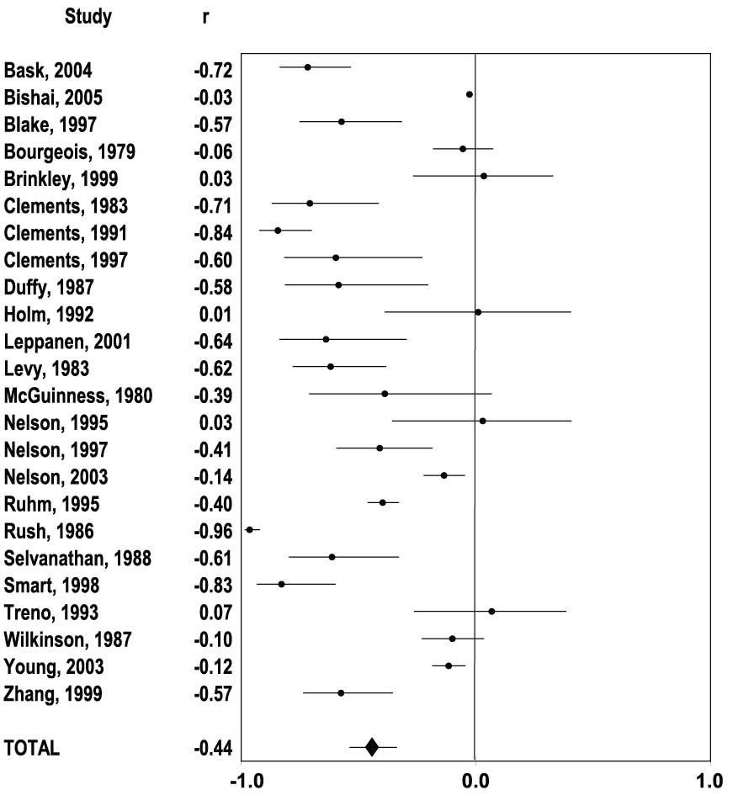
Effects of Price on Alcohol Consumption:
A meta-analysis of 112 studies
Wagenaar et al 2009
Example: Average effect of a price increase on the consumption of all beverages
Notes:
Found significant effects for:
Total alcohol & individual beverages
Younger & older drinkers
Moderate & binge drinkers

Slide 45
Conclusions – Effect of Price on Consumption and Harm
Similar results from meta-analysis for effects of price changes on alcohol related harm
Evidence for relationship between alcohol price and drinking/harm is consistent
10% increase in price reduces drinking by 4.4% on average
Magnitude of observed effects is large compared to other policies
Many more studies than on other prevention efforts

Slide 46
Public health policymakers are interested in how much alcohol we drink…
Consumption of alcohol
Harmful outcomes
Average consumption
Heavy episodic drinking (binges)
Health
Crime
Workplace
… and in using price as an intervention
Change in price
Change in alcohol consumption
Change in volume of harm

