Slide 1
What should the policy response be to e-cigarettes?
Ann McNeill
Professor of Tobacco Addiction
King’s College London

Slide 2
Summary
Patterns of use in youth
International picture
Safety
Current policy responses in the UK
Risks and opportunities for public health

Slide 3
Youth

Slide 4
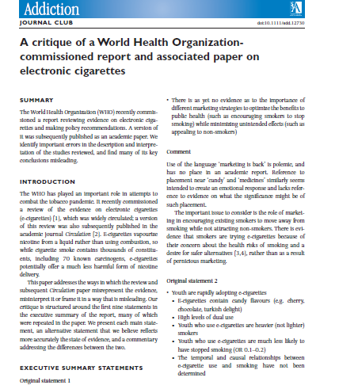

Slide 5
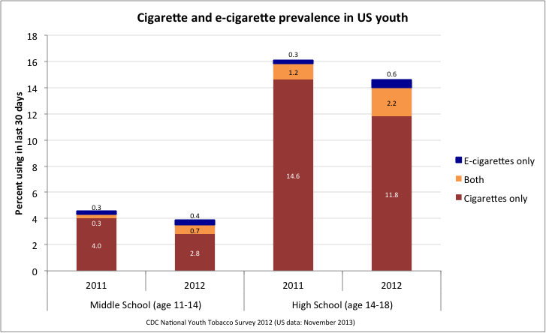
US trends
US CDC data from National Youth Tobacco Survey 2011 and 2012. Current use (last 30 days); Bates & Rodu redrawn
Notes:
Most egregious eg of misuse of gateway hypothesis

Slide 6
ASH Smokefree Youth survey (England)
Conducted by YouGov 11-18 year olds, 2013, 2014
Recruitment involved random emails to panellists of individuals who had consented to be contacted
    16-18 year olds via direct email
    11-15 year olds via parents / guardians
Data from both years merged and weighted to be representative of age, gender and region (from ONS)
Analyses conducted in STATA using the complex survey package svy:, adopt Rao-Scott corrections for complex survey design
Eastwood et al, manuscript in preparation

Slide 7
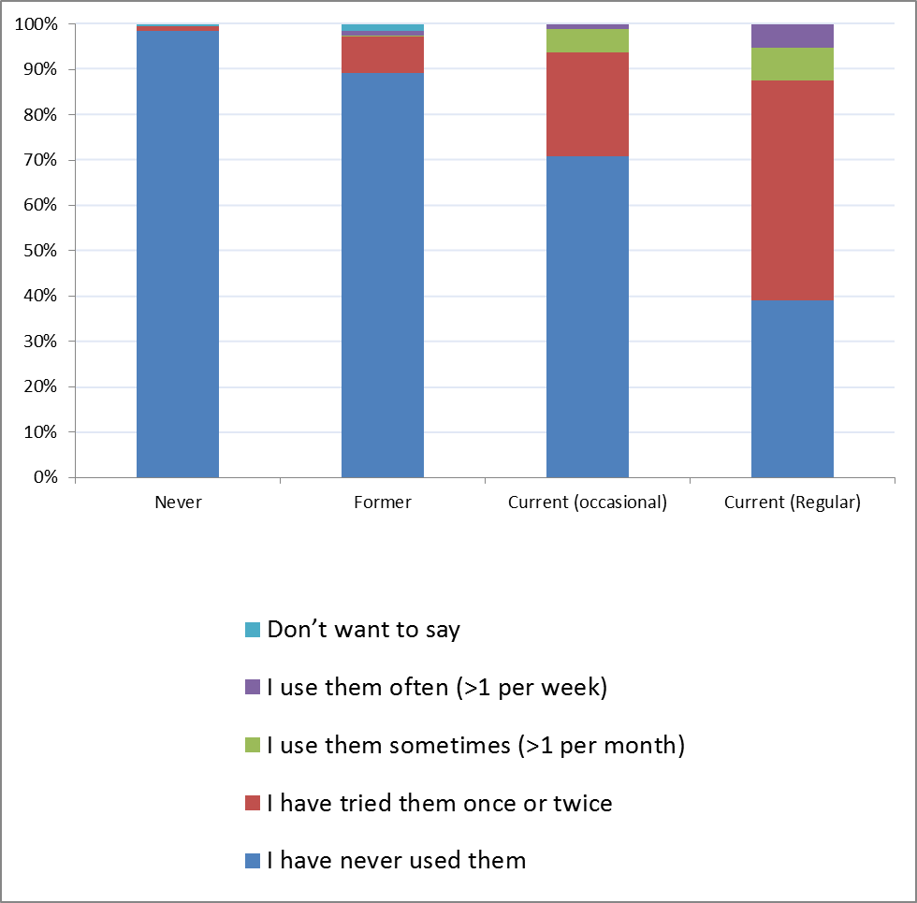
E-cigarette use 11-18 year olds, 2013, 2014
2013
Of those who didn’t want to disclose their smoking status 84% in 2014 had never used them and 9% has used them once or twice
2014
Notes:
NB. Those who have never smoked appear to be heavily protected from e-cig experimentation (98.5% in 2013 had never used an e-cig, compared with 97.8% in 2014).

Slide 8
Smoking prevalence among children continues to fall
Smoking, drinking and drug use among young people in England 2004 - 2013

Slide 9
Conclusions: youth
Regular use has increased, but confined to smokers/ex-smokers
Vast majority of youth still not tried e-cigarettes
Youth smoking prevalence continuing to fall
Need to continue monitoring

Slide 10
International picture

Slide 11

























The International Tobacco Control Policy Evaluation Project (the ITC Project)
Canada
United States
Australia
United Kingdom
Ireland
Thailand
Malaysia
South Korea
China
Uruguay
Mexico
New Zealand
France
Germany
Netherlands
Bangladesh
Brazil
Mauritius
Bhutan
India
Zambia
Kenya
11
11
Notes:
11
11
11
We put all of those principles into place in 2002, when we created the International Tobacco Control Policy Evaluation Project--the ITC Project.
Starting first with 4 countries, we have now expanded so that we are conducting the only international evaluation system across 20 countries.

Slide 12
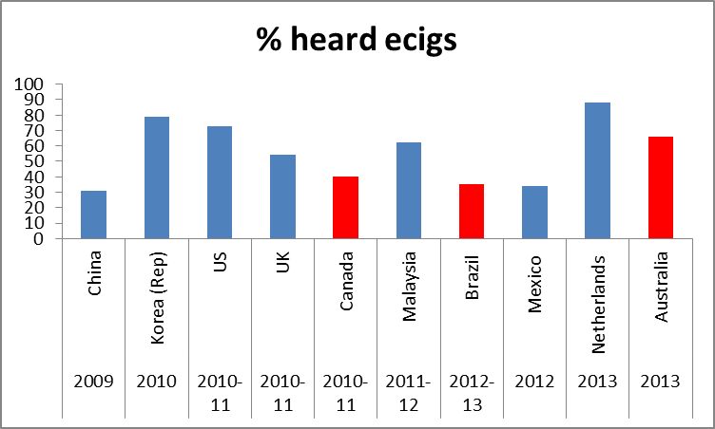
ITC data (Gravely et al, SRNT, 2014)
Notes:
This series of slides show that controls don’t necessarily work – banning is unlikely to be the answer

Slide 13
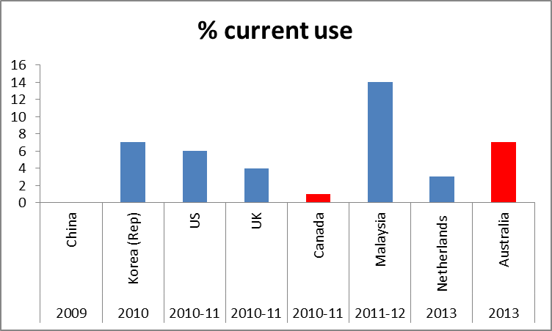
ITC data (Gravely et al, SRNT, 2014)

Slide 14
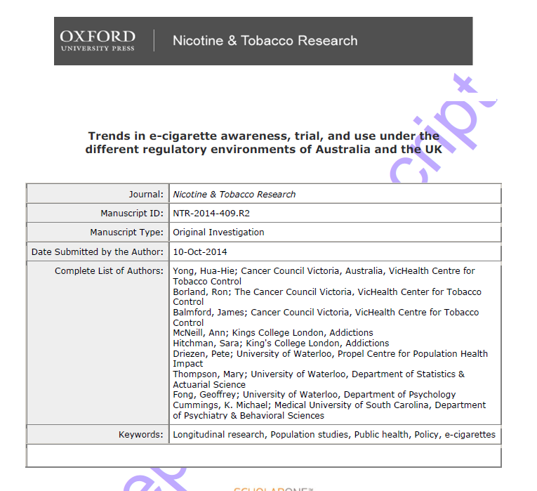

Slide 15
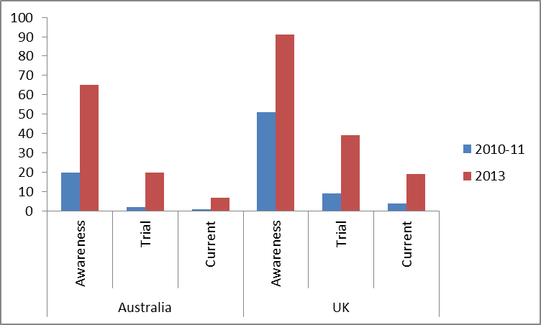
Recent Australia/UK comparative e-cig data (Yong et al, 2014)
Australia
UK
%

Slide 16
Conclusions: international picture
Use/awareness increasing globally
Prohibition will not prevent people vaping

Slide 17
Safety

Slide 18
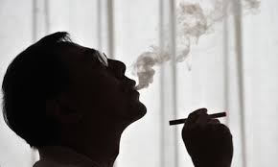
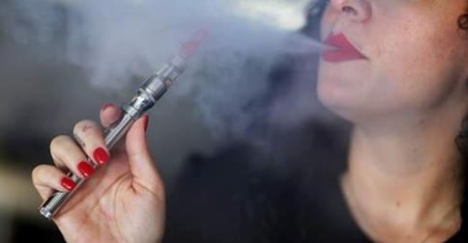
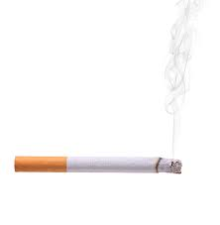
What do we know?

Slide 19
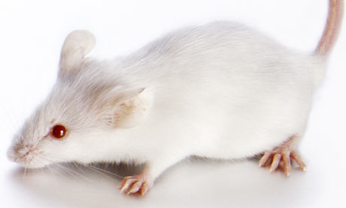

Safety issues: nicotine-related
Nicotine
  Mice studies?
  NRT since 1981
Nicotine in e-liquids
  Nicotine toxicity overestimated
  (Mayer, 2014)
  Child-safe caps (ISO)

Slide 20
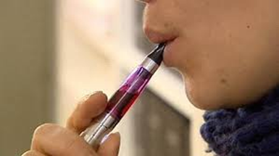
Safety issues: e-cigarettes
Contaminants
  Nitrosamines, metals
Substances added intentionally
  Some flavourings
  Diacetyl/acetyl propionyl
Thermal breakdown of contents
Chargers/batteries (ISO)
Sell-by dates
Safety to others
Notes:
Sweet flavoured - D and AP still lower than in cigarettes but avoidable
High temperatures - formaldehyde

Slide 21
Conclusions: safety
E-cigarettes are much less harmful than traditional cigarettes
Need for surveillance & regulation to make them safer

Slide 22
Policy

Slide 23
Some policy conundrums
Should vapers be allowed to vape in enclosed work and public places?
Should the tobacco industry be encouraged to produce e-cigarettes?
Should e-cigarettes be advertised?

Slide 24
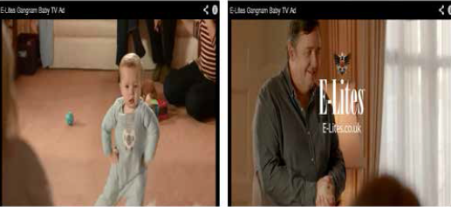



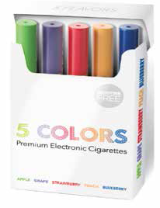


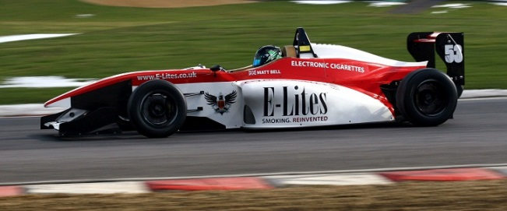


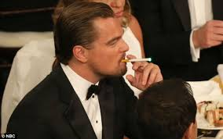

Slide 25
Marketing
Challenge – how do we attract smokers to e-cigarettes without:
  Making them attractive to children and never smokers?
  Detracting from quitting smoking altogether
  Equating vaping to smoking
  Making nicotine use seem a good thing

Slide 26
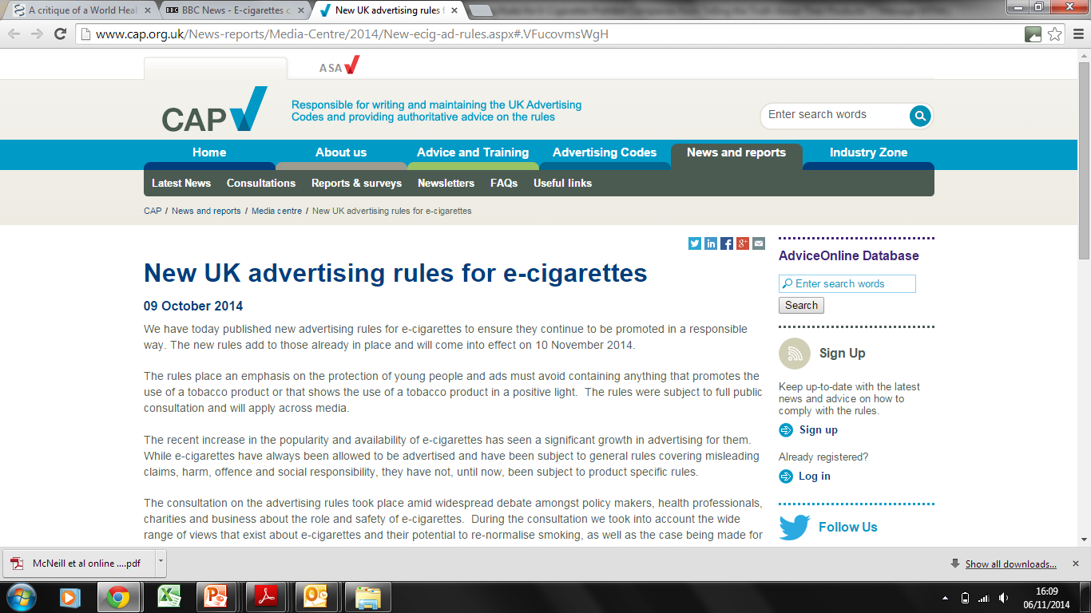
Notes:
UK’s committee of advertising practice

Slide 27
With effect from 10th November, ads must
Not appeal to <18
Not show people vaping who appear/ are <25
Not encourage non-smokers or non-nicotine user to use e-cigarettes
Be clear it is an e-cigarette not a tobacco cigarette
Comply with scheduling restrictions on TV/radio to reduce chance of children seeing/hearing
Unless own MHRA licence, not convey e-cigarettes less harmful than tobacco cigarettes

Slide 28
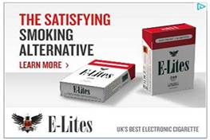
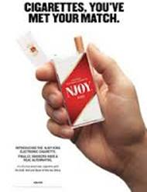

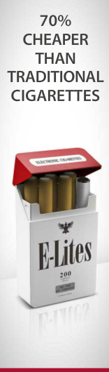

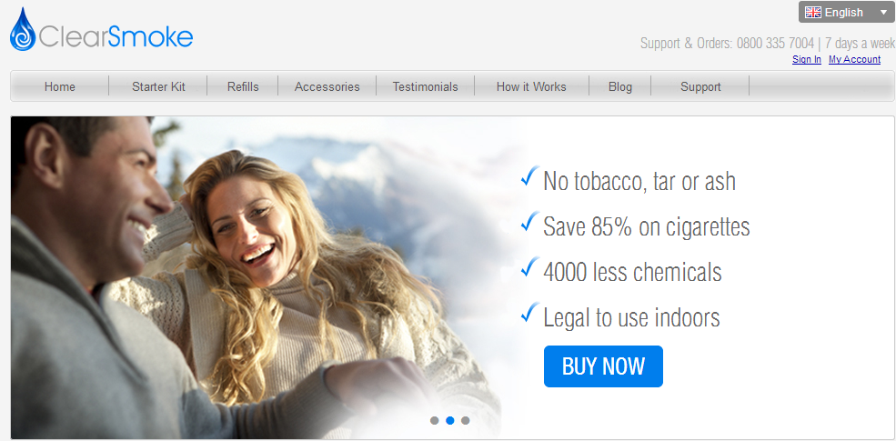

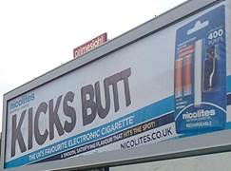




Slide 29
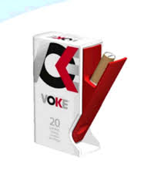
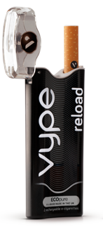
Future regulatory environment for e-cigarettes
EU TPD: May 20th 2016
OR can get MHRA licence
Most advertising banned
Limits on strength 20 ml/mg
10ml /2ml size limit
30% health warning on packs about nicotine
20% sales tax
Member States retain powers e.g. banning flavours
Products widely available
Adult advertising allowed
Flexibility on strength
Safety and quality ensured
No health warning
5% sales tax
Some flavours allowed
Products prescribable
BUT
Voke (inhaler, Kind Consumer/BAT) now has medicinal licence
Vype (ecig) BAT in pipeline
BSI standard being developed

Slide 30
Risks and opportunities for public health
E-cigarettes have potential to reduce smoking, reduce inequalities & improve public health
Limited regulation of e-cigarettes in the UK has been
  Associated with a rise in quitting rates
  Not acted as a gateway into smoking

Slide 31
Risks and opportunities for public health
So what are we trying to fix?
  some safety concerns
Risk of over-regulation which means smokers will continue to smoke

Slide 32
Risks and opportunities for public health: an appropriate regulatory framework
Trade-off?
  Encourage improvements in quality, safety and efficacy
  Ensure easy access for smokers
  Restrict marketing to adult smokers
  Communicate accurate information on relative risks
  Support innovation
  Support/endeavour to quit smoking/nicotine completely
  Monitor
Involvement of tobacco industry in e-cigarette market

Slide 33
Thank you
Any questions?

