Slide 1


Part I
Why Integrate Addiction Care into Mainstream Medicine?
A. Thomas McLellan
Treatment Research Institute

Slide 2
Closing Thoughts
“Substance use disorders” will soon be part of mainstream healthcare:
SUDs are too common, dangerous & expensive in healthcare to be ignored
Public understanding that addiction is an illness not a sin
Mainstream healthcare can do this!
  Chronic Care Management protocols are appropriate

Slide 3
Substance Use Among US Adults
Very
Serious
Use
In Treatment ~ 2,300,000
Addiction ~ 23,000,000
Harmful – 40,000,000
Use
Little or No Use
Little/No
Use
Notes:
3
Before we talk about the specific priorities in the Strategy it is important to understand the full spectrum of the Substance USE problem in our country; different policies are needed for different parts of the overall problem This pyramid describes this very well
1 – As represented by the broad base of this pyramid –most people in the US either do not use substances or use them very very few times - Here the best policies are prevention – to keep use low
2 – As you go up the pyramid to the wavy dotted line – this shows when “use” becomes “harmful use” – either to an individual’s health or their productivity or their relationships. It is NOT a diagnosis and people can go back and forth across that line – but there are a lot of these folks about 65 – 70 million They are the people who drink and drive, or make their asthma problem worse by smoking marijuana, or are failing school because of too much weekend partying with drugs. Here we need convenient, attractive, potent but probably brief interventions to reduce use and prevent problems from becoming worse
3 –The bright solid line means that the frequency and intensity of use has reached a DIAGNOSTIC threshold – there are 23 – 25 million adults who meet diagnostic criteria for the most serious problems “SUSTANCE ABUSE AND DEPENDENCE” - Click – In comparison, most people think there is an “epidemic” of diabetes and there is - about 24 million people are diabetic.
4 - The orange pinnacle shows the number of people who are receiving any kind of treatment – about 2.3 – 2.5 million or only 1/10 of those who meet the diagnosis – even smaller proportion of those with “harmful use” – This is the “Treatment GAP” that we want to close – the worst in all of medicine
5 – The OVAL indicates that we need policies and interventions that will reach a FAR broader range of people with “substance use problems”

Slide 4
1
3 Reasons to
Integrate SA Care
Because it will improve
general medical care
2. Because it will save money
Because it’s the law.

Slide 5
1
3 Reasons to
Integrate SA Care
Because it will improve
general medical care
2. Because it will save money
Because it’s the law.

Slide 6
Substance Use Impact on Healthcare
Alcohol and drug use below “addiction” lead to:
misdiagnoses,
poor adherence to care,
interference with prescribed meds,
more physician time,
unnecessary medical testing,
poor outcomes
increased costs
Particularly in chronic illness.
Vinson D, Ann Fam Med, 2004. Brown RL, J Amer Board Fam Prac, 2001. Humeniuk R, WHO, 2006. Manwell LB, J Addict Dis, 1998. Longabaugh R. Alcohol Res Health, 1999. Healthiest Wisconsin 2010, WI DHFS, 2000. USPSTF, Screening for Alcohol Misuse, 2004. National Quality Forum, National Voluntary Consensus Standards, 2006. Bernstein J, Drug Alcohol Depend, 2005. Saunders B, Addiction, 1995. Stephens RS, J Consult Clin Psychol, 2000. Copeland J, J Subst Abuse Treat 2001. Fleming MF, Med Care, 2000. Fleming MF, Alcohol Clin Exp Res, 2002. Gentilello LM, Ann Surg, 1999. Estee S, Medicaid Cost Outcomes, Interim Report 4.61.1.2007.2, Washington State Department of Social and Health Services. Yarnall KSH, Am J Public Health, 2003. Solberg LI, Am J Prev Med, 2008. National Committee on Prevention Priorities, http://www.prevent.org/content/view/43/71/.

Slide 7
Systematic Reviews
Diabetes:
  Howard et al. Ann Intern Med.
Hypertension:
  McFadden et al. Am J Hypertens.
Chronic pain:
  Martell et al. Ann Intern Med.
Breast cancer:
  Terry et al. Ann Epidemiol.
Sleep:
  Dinges et al. JAMA

Slide 8
Risk of Mortality & Drinks/Day
1.4
1.3
1.2
1.1
Risk of Mortality
1.0
0.9
0.8
0.7
0.6
3
4
0
1
2
5
6
7
Drinks per Day
Di Castelnuovo et al. Arch. Int. Med. 2006;166(22):2437

Slide 9
What Are Low-Risk Drinking Limits?
Source: NIAAA, Rethinking Drinking: Alcohol and Your Health, 2009

Slide 10
1
Example 1
Alcohol &
Breast Cancer

Slide 11
Alcohol Use and Breast Cancer
Before Diagnosis – heavy drinkers
1.5 times chance of contracting
2.3 times chance w/BRCa2 gene
After Diagnosis – ANY Drinking
Increases risk of relapse
Interferes radio & chemo therapy

Slide 12
1
Example 2
Drug X Drug
Interactions

Slide 13
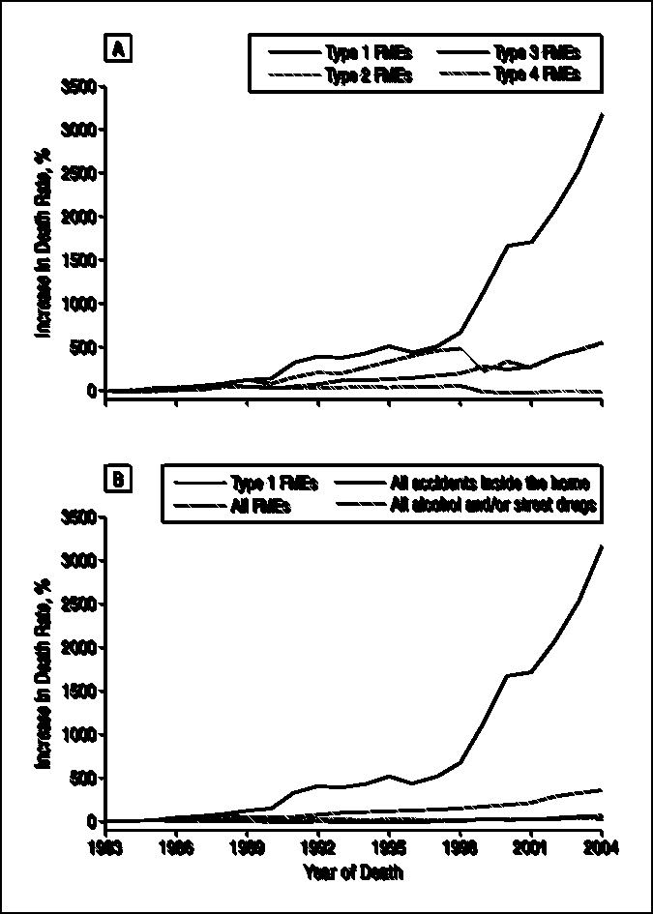

Potential impact on Safety: Fatal Medical Errors
FME Death Rate
1983 - 2004
Alc/Drg Related
Fatal Errors
Phillips, D. P. et al. 2008;168:1561-1566.

Slide 14
Drug-Drug Interactions – Safety Issues
BU study of 87 patients with undisclosed opioid use receiving primary care at BU Medical Center.
100% received at least one medication with a significant drug-drug interaction
  Average number of significant interactions = 5
  15 of 87 patients (17%) were treated by ED for their interaction ($$$)
Walley et al., J. Gen Internal Medicine, 24(9): 1007-11, 2009

Slide 15
1
Example 3
Opioids &
Chronic Pain

Slide 16
What Causes Accidental Death?
>60% OD deaths - opioids
450,000 ED visits - opioids
#1 Overdose
#2 Automobile Accidents
#3 Gun Accidents
Source: CDC, 2013

Slide 17
Physician Response
Pain Society and State Guidelines for Pain Management
Model policy for the use of opioids in the treatment of pain.
http://www.fsmb.org/pdf/2004_grpol_Controlled_Substances.pdf
Gilson AM, Joranson DE, Maurer MA. Improving state pain policies: recent progress and continuing opportunities.
CA Cancer J Clin. 2007;57(6):341–353

Slide 18
Practice Elements
Screening for & discussing substance use
Patient contract – Single doc & pharmacy
Patient & family education on safe storage of medications
Urine Screening pre and during prescribing (expanded test panel)

Slide 19
1
3 Reasons to
Integrate SA Care
Because it will improve
general medical care
2. Because it will save money
Because it’s the law.

Slide 20
Substance Use Cost in Healthcare
Very
Serious
Use
In Treatment ~ 2,300,000
$40B
Yr
Addiction ~ 23,000,000
$80B
Yr
“Harmful – 40,000,000
Use”
Little or No Use
Little/No
Use
Notes:
20
Before we talk about the specific priorities in the Strategy it is important to understand the full spectrum of the Substance USE problem in our country; different policies are needed for different parts of the overall problem This pyramid describes this very well
1 – As represented by the broad base of this pyramid –most people in the US either do not use substances or use them very very few times - Here the best policies are prevention – to keep use low
2 – As you go up the pyramid to the wavy dotted line – this shows when “use” becomes “harmful use” – either to an individual’s health or their productivity or their relationships. It is NOT a diagnosis and people can go back and forth across that line – but there are a lot of these folks about 65 – 70 million They are the people who drink and drive, or make their asthma problem worse by smoking marijuana, or are failing school because of too much weekend partying with drugs. Here we need convenient, attractive, potent but probably brief interventions to reduce use and prevent problems from becoming worse
3 –The bright solid line means that the frequency and intensity of use has reached a DIAGNOSTIC threshold – there are 23 – 25 million adults who meet diagnostic criteria for the most serious problems “SUSTANCE ABUSE AND DEPENDENCE” - Click – In comparison, most people think there is an “epidemic” of diabetes and there is - about 24 million people are diabetic.
4 - The orange pinnacle shows the number of people who are receiving any kind of treatment – about 2.3 – 2.5 million or only 1/10 of those who meet the diagnosis – even smaller proportion of those with “harmful use” – This is the “Treatment GAP” that we want to close – the worst in all of medicine
5 – The OVAL indicates that we need policies and interventions that will reach a FAR broader range of people with “substance use problems”

Slide 21
1
Example:
Early Intervention

Slide 22
Population Prevalence
Population Prevalence
In Treatment ~ 2,300,000
X
LOTS
Addiction ~ 25,000,000
Target
Group
“Harmful – 60,000,000
Use”
Little or No Use
LITTLE
Notes:
22
Before we talk about the specific priorities in the Strategy it is important to understand the full spectrum of the Substance USE problem in our country; different policies are needed for different parts of the overall problem This pyramid describes this very well
1 – As represented by the broad base of this pyramid –most people in the US either do not use substances or use them very very few times - Here the best policies are prevention – to keep use low
2 – As you go up the pyramid to the wavy dotted line – this shows when “use” becomes “harmful use” – either to an individual’s health or their productivity or their relationships. It is NOT a diagnosis and people can go back and forth across that line – but there are a lot of these folks about 65 – 70 million They are the people who drink and drive, or make their asthma problem worse by smoking marijuana, or are failing school because of too much weekend partying with drugs. Here we need convenient, attractive, potent but probably brief interventions to reduce use and prevent problems from becoming worse
3 –The bright solid line means that the frequency and intensity of use has reached a DIAGNOSTIC threshold – there are 23 – 25 million adults who meet diagnostic criteria for the most serious problems “SUSTANCE ABUSE AND DEPENDENCE” - Click – In comparison, most people think there is an “epidemic” of diabetes and there is - about 24 million people are diabetic.
4 - The orange pinnacle shows the number of people who are receiving any kind of treatment – about 2.3 – 2.5 million or only 1/10 of those who meet the diagnosis – even smaller proportion of those with “harmful use” – This is the “Treatment GAP” that we want to close – the worst in all of medicine
5 – The OVAL indicates that we need policies and interventions that will reach a FAR broader range of people with “substance use problems”

Slide 23
Major Advances in Brief Interventions
“Harmful substance use” is accurately identified with 2 – 3 questions.
  Prevalence rates of 20 – 50% in healthcare
  60% of all ER admissions (10 million/yr)
Brief counseling (5 – 10 minutes) by produces lasting changes & savings
23

Slide 24
Washington’s Screening
Brief Intervention & Treatment Evaluation
SBIRT in 9 Emergency Depts.
Case Control Study of 1557 pts
  Matched group – got ER care but no BI
Measured healthcare utilization and costs for one year

Slide 25
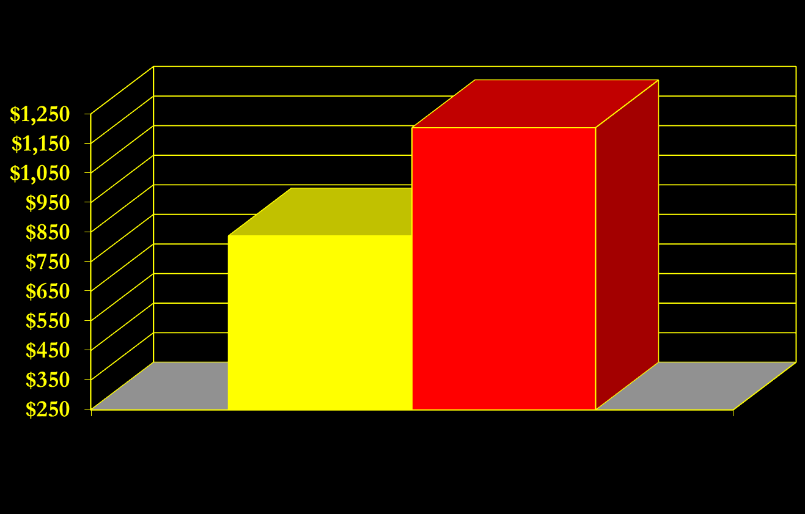
Medicaid Costs Following SBIRT in
Washington State
SBIRT patients = 1557
Matched controls = 1557
Medicaid Costs PM/PM
$4,000 Savings PM/PY
Estee et al. Medical Care. 2010.

Slide 26
1
3 Reasons to
Integrate SA Care
Because it will improve
general medical care
2. Because it will save money
Because it’s the law.

Slide 27
2009 Parity Act
“MHPAEA”
“If” a health plan covers MH/SA benefits should be comparable to those of similar physical illnesses”
Notes:
27
This is basically the charge of the current talk
1 – I have tried to put myself and the research literature I have reviewed into the position of a legislator faced with the difficult public health and public safety problems associated with addiction – BUT with competing demands for resources and reservations about what can really be expected from addiction treatment
Will the public really get its money’s worth? What should we expect? How can we tell whether we are getting the best impact for the most reasonable (not necessarily the cheapest) expense?
These are the issues addressed here.

Slide 28
2010 Affordable Care Act
SA care is “Essential Service”
  SA is firmly part of healthcare
Funds full continuum of care
  Prevent, BI, Meds, Spec Care
Significant change in benefit
  The nature/number of benefits
  The types of eligible providers
Notes:
28
This is basically the charge of the current talk
1 – I have tried to put myself and the research literature I have reviewed into the position of a legislator faced with the difficult public health and public safety problems associated with addiction – BUT with competing demands for resources and reservations about what can really be expected from addiction treatment
Will the public really get its money’s worth? What should we expect? How can we tell whether we are getting the best impact for the most reasonable (not necessarily the cheapest) expense?
These are the issues addressed here.

Slide 29
SUD Benefits Today
Very
Serious
Use
In Treatment ~ 2,300,000
Addiction
Addiction ~ 23,000,000
“Harmful – 40,000,000
Use”
Little or No Use
Little/No
Use
Notes:
29
Before we talk about the specific priorities in the Strategy it is important to understand the full spectrum of the Substance USE problem in our country; different policies are needed for different parts of the overall problem This pyramid describes this very well
1 – As represented by the broad base of this pyramid –most people in the US either do not use substances or use them very very few times - Here the best policies are prevention – to keep use low
2 – As you go up the pyramid to the wavy dotted line – this shows when “use” becomes “harmful use” – either to an individual’s health or their productivity or their relationships. It is NOT a diagnosis and people can go back and forth across that line – but there are a lot of these folks about 65 – 70 million They are the people who drink and drive, or make their asthma problem worse by smoking marijuana, or are failing school because of too much weekend partying with drugs. Here we need convenient, attractive, potent but probably brief interventions to reduce use and prevent problems from becoming worse
3 –The bright solid line means that the frequency and intensity of use has reached a DIAGNOSTIC threshold – there are 23 – 25 million adults who meet diagnostic criteria for the most serious problems “SUSTANCE ABUSE AND DEPENDENCE” - Click – In comparison, most people think there is an “epidemic” of diabetes and there is - about 24 million people are diabetic.
4 - The orange pinnacle shows the number of people who are receiving any kind of treatment – about 2.3 – 2.5 million or only 1/10 of those who meet the diagnosis – even smaller proportion of those with “harmful use” – This is the “Treatment GAP” that we want to close – the worst in all of medicine
5 – The OVAL indicates that we need policies and interventions that will reach a FAR broader range of people with “substance use problems”

Slide 30
2010 Medicaid Benefit
Detoxification – 100%
  Ambulatory – 80%
Opioid Substitution Therapy – 50%
Urine Drug Screen – 100%
  7 per year
Notes:
30

Slide 31
1
Compared to What?
Medicaid Diabetes benefit

Slide 32
Diabetes Insurance
Physician Visits – 100%
Clinic Visits – 100%
Home Health Visits – 100%
Glucose Tests, Monitors, Supplies – 100%
Insulin and 4 other Meds – 100%
HgA1C, eye, foot exams 4x/yr – 100%
Smoking Cessation – 100%
Personal Care Visits – 100%
Language Interpreter - Negotiated
Notes:
32

Slide 33
SUD Insurance Under ACA
Very
Serious
Use
In Treatment ~ 2,300,000
Insurance
for “Substance
Use
Disorders”
Addiction ~ 23,000,000
“Harmful – 40,000,000
Use”
Little or No Use
Little/No
Use
Notes:
33
Before we talk about the specific priorities in the Strategy it is important to understand the full spectrum of the Substance USE problem in our country; different policies are needed for different parts of the overall problem This pyramid describes this very well
1 – As represented by the broad base of this pyramid –most people in the US either do not use substances or use them very very few times - Here the best policies are prevention – to keep use low
2 – As you go up the pyramid to the wavy dotted line – this shows when “use” becomes “harmful use” – either to an individual’s health or their productivity or their relationships. It is NOT a diagnosis and people can go back and forth across that line – but there are a lot of these folks about 65 – 70 million They are the people who drink and drive, or make their asthma problem worse by smoking marijuana, or are failing school because of too much weekend partying with drugs. Here we need convenient, attractive, potent but probably brief interventions to reduce use and prevent problems from becoming worse
3 –The bright solid line means that the frequency and intensity of use has reached a DIAGNOSTIC threshold – there are 23 – 25 million adults who meet diagnostic criteria for the most serious problems “SUSTANCE ABUSE AND DEPENDENCE” - Click – In comparison, most people think there is an “epidemic” of diabetes and there is - about 24 million people are diabetic.
4 - The orange pinnacle shows the number of people who are receiving any kind of treatment – about 2.3 – 2.5 million or only 1/10 of those who meet the diagnosis – even smaller proportion of those with “harmful use” – This is the “Treatment GAP” that we want to close – the worst in all of medicine
5 – The OVAL indicates that we need policies and interventions that will reach a FAR broader range of people with “substance use problems”

Slide 34
Proposed SUD Insurance
Physician Visits – 100%
  Screening, Brief Intervention, Assessment
  Evaluation and medication – Tele monitoring
Clinic Visits – 100%
Home Health Visits – 100%
  Family Counseling
Alcohol and Drug Testing – 100%
4 Maintenance and Anti-Craving Meds – 100%
Monitoring Tests (urine, saliva, other)
Smoking Cessation – 100%
Notes:
34

Slide 35
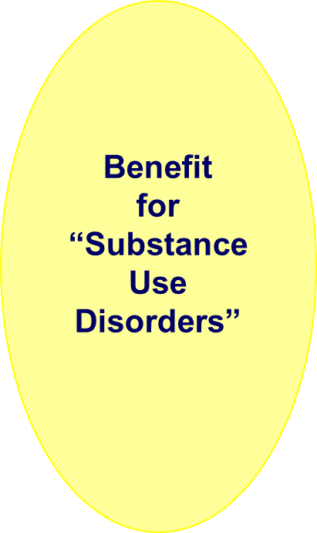
Substance Use Among US Adults
Very
Serious
Use
In Treatment ~ 2,300,000
Chronic Care
Model
Addiction ~ 23,000,000
Early
Intervention
“Harmful – 40,000,000
Use”
Prevention
Little or No Use
Little/No
Use
Notes:
35
Before we talk about the specific priorities in the Strategy it is important to understand the full spectrum of the Substance USE problem in our country; different policies are needed for different parts of the overall problem This pyramid describes this very well
1 – As represented by the broad base of this pyramid –most people in the US either do not use substances or use them very very few times - Here the best policies are prevention – to keep use low
2 – As you go up the pyramid to the wavy dotted line – this shows when “use” becomes “harmful use” – either to an individual’s health or their productivity or their relationships. It is NOT a diagnosis and people can go back and forth across that line – but there are a lot of these folks about 65 – 70 million They are the people who drink and drive, or make their asthma problem worse by smoking marijuana, or are failing school because of too much weekend partying with drugs. Here we need convenient, attractive, potent but probably brief interventions to reduce use and prevent problems from becoming worse
3 –The bright solid line means that the frequency and intensity of use has reached a DIAGNOSTIC threshold – there are 23 – 25 million adults who meet diagnostic criteria for the most serious problems “SUSTANCE ABUSE AND DEPENDENCE” - Click – In comparison, most people think there is an “epidemic” of diabetes and there is - about 24 million people are diabetic.
4 - The orange pinnacle shows the number of people who are receiving any kind of treatment – about 2.3 – 2.5 million or only 1/10 of those who meet the diagnosis – even smaller proportion of those with “harmful use” – This is the “Treatment GAP” that we want to close – the worst in all of medicine
5 – The OVAL indicates that we need policies and interventions that will reach a FAR broader range of people with “substance use problems”

Slide 36
1
Is there a working model
of Continuing Care ?
Treatment of Addicted Physicians

Slide 37
Physician Health Plans
49 PHPs
  All authorized by state licensing boards
  Most treat many types of health professionals
Do NOT provide treatment
  Assess, Intervene, Evaluate, Refer, Monitor, Report and Advocate
  All under authority of Board
McLellan, DuPont, Skipper 2008, BMJ

Slide 38
Evaluation and Contracting
Phase 1 - Evaluation (1 month)
  Evaluate/diagnose referred physician
  Explain PHP and Contract
Result is signed contract
  3 – 5 years in duration
  Protection from immediate adverse actions
  Monitoring with report to Board – 4 yrs

Slide 39
Treatment and Monitoring
Phase 2 – ~1 yr
  Selected residential treatment 30 – 90 days
  Referral to IOP or OP ~ 6 months
    Return to practice ~ month 3
  Aftercare program ~ 3-6 months
Phase 3 – 4 yrs
  AA attendance - Caduceus Society meetings
  Family Therapy
Urine Drug Screenings - throughout
  Weekly - monthly (random during weekdays)
  Worksite visits

Slide 40
Results Through Five Years
No Positive Urine Over
5 Years
78%

Slide 41
Results Through Five Years
Second Positive Urine After One Slip
26%

Slide 42
Closing Thoughts
“Substance use disorders” will soon be part of mainstream healthcare:
SUDs are too common, dangerous & expensive in healthcare to be ignored
Public understanding that addiction is an illness not a sin
Mainstream healthcare can do this!
  Chronic Care Management protocols are appropriate

Slide 43
Thank You
Notes:
43

