Slide 1

Family Interventions for Alcohol and Drug Problems
Barbara S. McCrady
University of New Mexico
Presented at the Annual Meeting of the
Society for the Study of Addiction
November 10, 2011

Slide 2
Outline of presentation
Rationale for studying families
Overview of our couples therapy research program and findings
Presentation of our current research on mechanisms of change
Conclusions and future directions

Slide 3
Rationale for studying families

Slide 4
Why focus on families?
Substance use disorders are family disorders:
  Attitudes and patterns of drinking and drug use are influenced heavily by the family
  Couples influence each other’s alcohol and drug use
  Drinking and drug problems develop within a social network
  The social network is central to the initiation, resolution,
  and maintenance of change

Slide 5
Alcohol and the family – some facts
Alcohol use disorders directly affect a large proportion of the population:
  In the US, 23% of Americans report a first degree relative with an alcohol problem
  38% report any blood relative with a drinking problem
Separation and divorce rates are about four times that of the general population
Physical violence is common (occurs in about 2/3 of couples)
Alcohol use disorders affect the physical and psychological health of spouses and children

Slide 6
Our clinical trials of family-involved treatment

Slide 7
Study 1: The Joint Admission study
Study of joint hospital admission, conjoint therapy, and individual therapy
33 patients with alcohol problems
Assessed at baseline, one month, 6 month, and 4 year follow-up

Slide 8
Study 1: Joint Admission study
Quantity-Frequency Index
Baseline
1-month
6 months

Slide 9
What did we learn?
In the short run, inpatient treatment did not add substantial benefit
Inpatient treatment was disruptive to families, inconvenient, expensive, and unlikely to be covered by health insurance
Developing ambulatory models was likely to be more valuable in the long run

Slide 10
Our ambulatory couples therapy model:
Alcohol Behavioral Couples Therapy (ABCT)
Focuses on the primary intimate relationship
Draws on cognitive-behavioral approaches to:
  Alcohol use disorders
  Distressed relationships
Includes 3 major treatment elements to:
  Teach abstinence skills
  Teach partner behaviors to cope with drinking and support change
  Improve intimate relationship

Slide 11
Structure of treatment
Outpatient treatment
Stand-alone treatment, or integrated with other treatment programs
Both partners present for all sessions
Sessions are 1½ hours in length
Treatment is manual-guided
Length of treatment ranges from 12-24 sessions

Slide 12
Goals of treatment
Decrease/stop substance use
Enhance motivation to change
Develop individual coping skills to stay clean - behavioral, cognitive, interpersonal
Develop better contingent responses by partner – decrease behaviors that cue use, increase support for positive change; decrease attention to negative behavior
Improve relationship as incentive for maintenance

Slide 13
Study 2: Components of spouse involved treatment
Randomized clinical trial (RCT) of components of spouse involvement:
  Spouse presence, but individual CBT
  Individual CBT + spouse change skills
  Individual CBT + spouse change skills + relationship change
45 alcoholics and spouses (33 male; 12 female)
Assessed at baseline, then monthly post-treatment for 18 months

Slide 14
Studying components of spouse involvement
Percent Abstinent Days
Number of Marital Problems
1
2
3
4
5
6
Baseline 18 months
Quarters Post-treatment

Slide 15
What did we learn?
Ambulatory conjoint therapy is viable
Addressing the relationship leads to better drinking outcomes as well as greater marital stability and satisfaction
Relapses are common

Slide 16
Study 3: Maintenance of change
RCT of ways to maintain change after ABCT – relapse prevention and AA/Alanon
90 male alcoholics and their female partners
Assessed at baseline and followed monthly for 18 months after treatment

Slide 17
Maintenance of change
Percent Abstinent Days
Mean length of drinking episodes
3 mos
6 mos
9 mos
12 mos
15 mos
18 mos
ABCT AA/ABCT RP/ABCT
Baseline

Slide 18
What did we learn?
Adding relapse prevention elements made a small additional contribution to positive outcomes
Combining AA with CBT and couple therapy did not contribute to better outcomes

Slide 19
Study 4:
Rutgers Women’s Treatment Project I
Randomized clinical trial of 102 women with alcohol use disorders and their male partners
  Alcohol Behavioral Couple Therapy (ABCT)
  Alcohol Behavioral Individual Treatment (ABIT)
Assessed at baseline, post-treatment, and 6 and 12 months post-treatment

Slide 20
Alcohol Behavioral Couples Therapy and Abstinence
100
90
80
70
60
50
ABIT
Percent Days Abstinent
Treatment
Follow-up
ABCT
40
30
20
10
0
*
*
*
*
*
*
*
*
*
*
*
*
1
2
3
4
5
6
7
8
9
10
11
12
13
14
15
16
17
18
Months

Slide 21
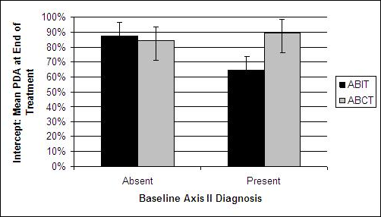
Psychopathology and Drinking – Post Treatment
Women with axis II psychopathology at baseline had more abstinent days by the end of treatment if they received couples rather than individual therapy

Slide 22
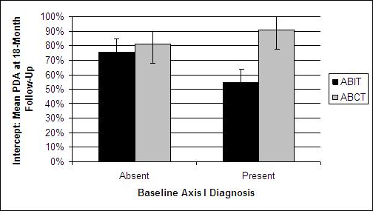
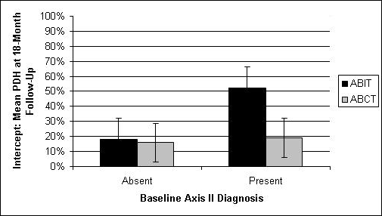
Psychopathology and Drinking – Follow-Up
Women with axis I psychopathology at baseline had more abstinent days by the end of follow-up if they received couples rather than individual therapy
Women with axis II psychopathology at baseline had fewer heavy drinking days by the end of follow-up if they received couples rather than individual therapy

Slide 23
What did we learn?
For women who:
  Had a male partner
  Were willing to have the partner come to treatment
  Whose male partner was willing to come to treatment
Conjoint therapy was more effective than individual treatment, even for women with other Axis I or Axis II disorders
Among women who inquired about but did not come to treatment, male partner involvement was the #1 deterrent

Slide 24
Study 2:
Rutgers Women’s Treatment Project II
Woman
calls
Woman’s choice
Individual
treatment
Couple
treatment
Randomization
Randomization
Individual
CBT
Female-
Specific
CBT
ABCT
Blended
CBT &
ABCT

Slide 25
What did women want?
When given the choice, women overwhelmingly chose individual treatment
Why did they say they chose individual treatment?
  Desire to change on her own
  Logistical barriers to partner attendance
  Concerns about the relationship
Why did they say they chose couple treatment?
  Desire to have her partner understand her needs
  Concerns about the relationship
Trend for women in the blended treatment to attend more sessions than women in the all-couple treatment
(9.5 versus 7.8 sessions)

Slide 26
Drinking outcomes – abstinence
Percent abstinent days
Percent days heavy drinking

Slide 27
So far, we’ve been running “horse races”

Slide 28
Now we’d like to look inside the horse

Slide 29
Model for studying mechanisms of change¹
Patient
Response/
Statistical
Mediator
Mechanism
of
Change
Treatment:
Common
factors
Specific
factors
Outcome
Moderators
¹Special thanks to Scott Tonigan for his input on this slide.

Slide 30
ABCT model of mechanisms of change
ABCT
therapist:
Therapeutic
alliance:
>Each partner
>Couple
Alcohol-focused
interventions:
>Identified patient
>Significant other
Relationship-
focused
interventions
IP behavior
in session
SO behavior
in session
Behavior
change
outside of
session
Drinking and
relationship
outcomes
Couple
behavior
in session
Background
Factors:
Age
Education
Length of relationship
Relationship problems

Slide 31
Testing the ABCT model
1st session
IP/CSO
behavior
Mid-treatment IP/CSO behavior
Mid-treatment Couple behavior
1st session
Couple
behavior
Drinking
outcomes
Drinking
1st half of
treatment
1st session
Therapist
behavior
Mid-treatment Therapist behavior
Red lines = correlations at same time point; blue lines = correlations within a person/unit;
black lines = predictive relationships across time

Slide 32
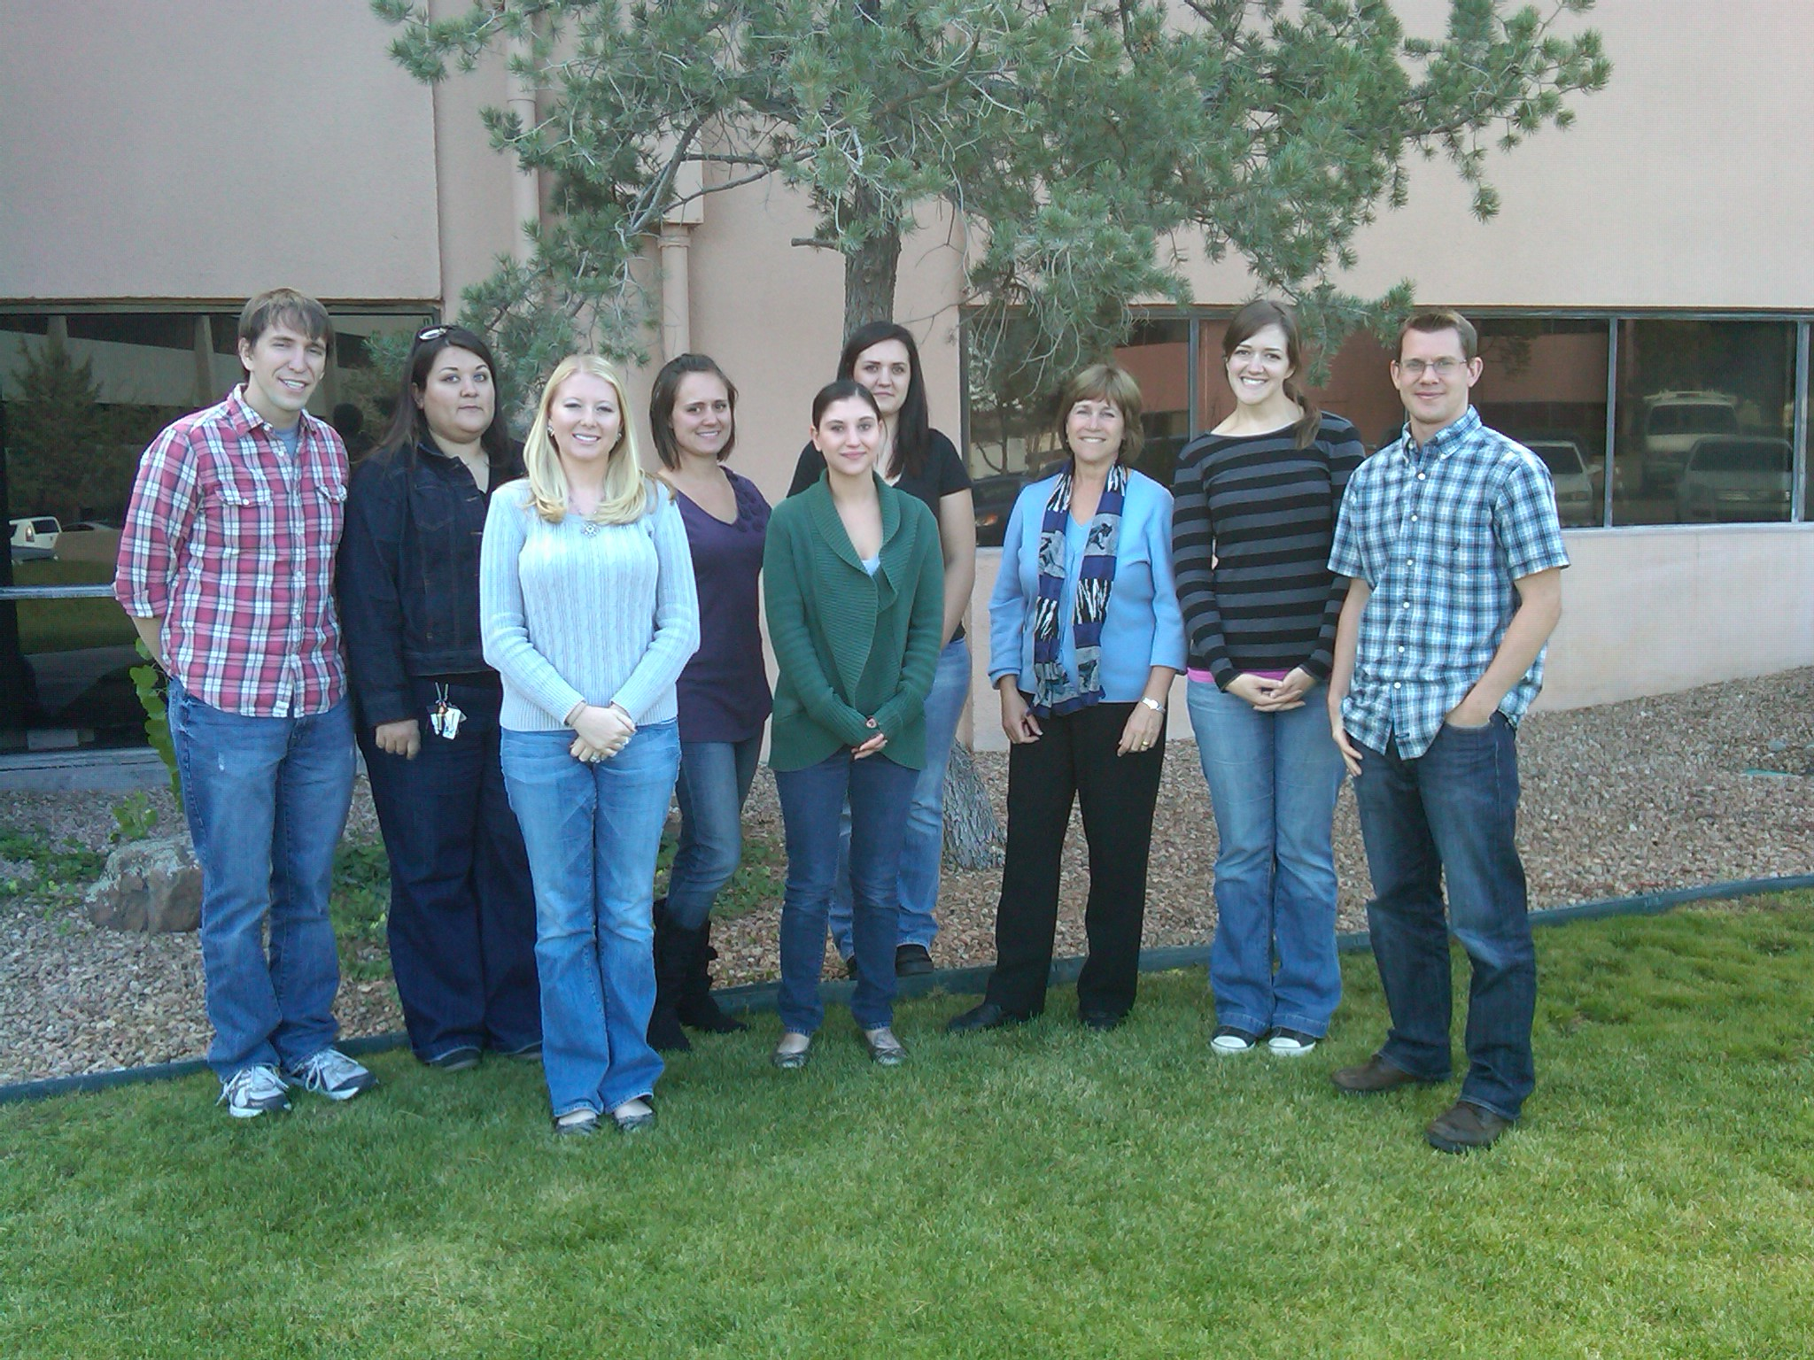
MATES: Mechanisms in alcohol treatment engaging significant others (R01 AA018376)

Slide 33
MATES staff
Administration:
  PI: Barbara McCrady
  Admin: Sylvia Law
Graduate students:
  Julie Brovko
  Shirley Crotwell
  Kevin Hallgren
  Ben Ladd
  Leslie Merriman
  Rosa Muñoz
  Mandy Owens
Transcribers:
  Accustat
  Kalie Archuleta
  Amanda Geilenfeldt
  Ariana Goertz
  Paul Hardman
  Alyssa Tidler
  Alexandra Tonigan
  Kayla Worley

Slide 34
MATES design overview
Use therapy session tapes from four RCTs of ABCT
  Session 1
  Mid-treatment session
Transcribe the sessions
Code the tapes for:
  Therapist behavior
  Identified patient (IP) utterances
  Significant other (SO) utterances
Test ABCT model of mechanisms of change
  Drinking during treatment
  Drinking for at least 6 months post-treatment

Slide 35
MATES Sample and method
Sample:
  Men and women with alcohol use disorders (186 couples)
  Received some variation of ABCT
The tapes
  322 tapes (90 minutes/tape)
  With reliability monitoring, 514 tapes to code
Transcribing:
  Approximately 20 hours to transcribe a 90-minute tape
  Transcripts are ~40-55 pages in length
  Transcribers:
    Professional transcription service
    University of New Mexico (UNM) undergraduates (7)

Slide 36
MATES method
Parsing:
  A coder first listens to the tape to:
    Correct transcription errors
    Parse drinker and SO utterances into discrete units
  2% of tapes are parsed by all coders to examine the reliability of parsing
  Corrections and parsing take about 3 hours/tape

Slide 37
MATES procedures
Coding:
  A different coder listens to the tape to code global IP and SO behaviors and therapist behaviors
  The same coder listens to the tape a second time to code each discrete IP and SO utterance
  The two coding passes take about 4 hours/tape
Coders:
  UNM graduate students (n = 7 to date)
Reliability
  10% of tapes are coded by all coders
  Coders are blind to which tapes are being used for reliability analyses
  ICCs and percent agreements are examined approximately monthly to identify problems in specific codes or coders
Total time for each tape ~27 hours
Weekly research meetings to address coding questions and problematic codes

Slide 38
Coding System – Adapted from the MISO¹
(Motivational Interviewing with Significant Others)
Global Ratings:
  Support
    General (IP & SO)
    Alcohol-specific (SO)
  Collaboration (IP & SO)
  Contempt (IP & SO)
Behavior Counts:
  Giving information
    General (IP & SO)
    Alcohol (IP & SO)
  Discuss self
    General (IP & SO)
    Alcohol (IP)
  Advice (IP & SO)
  Encourage/support
    General (IP & SO)
    Alcohol (SO)
  Direct (IP & SO)
  Confront (IP & SO)
  Change talk (IP & SO)
  Counter change talk (IP & SO)
¹The MISO was developed originally by Jennifer Knapp Manuel and Tim Apodaca

Slide 39
Sample definition for global rating
SO Support – Alcohol Specific
Low |  |  |  | High
1 | 2 | 3 | 4 | 5
SO explicitly discourages IP abstinence and treatment and/or provides encouragement for continued drinking. | SO provides few statements of support for IP abstinence and treatment. Statements of support may be artificial or completely lacking, but the SO does not explicitly discourage IP abstinence. | SO either responds both positively and negatively or generally responds neutrally to the IP’s drinking and attempts to change the IP’s drinking. | SO offers support to the IP regarding abstinence and treatment but does not actively encourage and reinforce nondrinking behaviors. | SO explicitly encourages, reinforces, and assists the IP in goals of abstinence and treatment. SO indicates 1) willingness to change his or her own behavior and 2) willingness to support the IP in behavior changes.

Slide 40
Snippet of a transcribed, coded transcript
T | Therapist 77: So what…
GIGSO | Female 82: He may have done nothing.
T | Therapist 78: Right. But…
GIGSO | Female 83: To me that’s not fair and in a marriage you’re supposed to be open and honest.
T | Therapist 79: But a trigger was one morning he got up early and didn’t tell you where he went.
DSSO | Female 84: And the next day I asked him the same question /and he refused to tell me.
GIGSO
T | Therapist 80: Why’d you ask him the next day? Cause he did it again the next day?
DSSO | Female 85: No, no. I just wanted to see if he was kind enough to answer my question the next day, /which he wasn’t.

Slide 41
Coding system - therapist
The codes
  Rated on 1 – 5 scale
  Two ratings per category – quantity and quality
  37 items
Categories
  CBT specific skills
  Partner-focused skills
  Couple-focused skills
  Common factors

Slide 42
Snippet of therapist rating form
1a. ASSESSMENT OF CLIENT’S DRINKING & RELATIONSHIP SATISFACTION: To what extent did the therapist assess the client’s drinking since the last session, including the pattern of alcohol use (if any), or the extent and pattern of the client’s cravings or urges, by reviewing and graphing the client’s self -monitoring cards for the week? Coverage of partner recording and graphing of relationship satisfaction would also go here.
1------------------2------------------3------------------4-------------------5 99 (session 1)
not at all a little somewhat considerably extensively N/A
1b. Rate the quality of the delivery of this component as specified in the manual:
1------------------2------------------3------------------4-------------------5 99 (session 1)
poor fair adequate good excellent N/A

Slide 43
Let’s listen to an actual tape

Slide 44
Status of the project (as of Oct. 1)
Transcribing:
  185 tapes transcribed (57.4%)
Coding:
  154 (30%) tapes parsed and coded
Reliability (ICCs):
  Therapist ratings:
    Overall ICC = .567
    Quantitative ratings ICC = .639
  MISO reliability
    Globals - coder pairs ICC = .535
    SO behavior codes overall - coder pairs ICC = .66
    IP behavior codes overall – coder pairs ICC = .73

Slide 45
Results – who talks? (First 40 coded tapes)
Percent of utterances

Slide 46
Results – what do they talk about? (n = 40)
Percent of utterances

Slide 47
Results – a few significant correlations
IP codes:
  Encouragement/support correlates with giving advice to the SO (r = .41)
  Giving advice and giving directions to the SO correlate (r = .396)
  Change talk and counterchange talk correlate (r = .86)
SO codes:
  General and alcohol-specific encouragement/support to the IP correlate (r = .57)
  General (r = .44) and alcohol-specific (r = .51) encouragement/support correlate with giving advice to the IP

Slide 48
Results – a few significant correlations
Correlations between IP and SO:
  Positive behaviors:
    IP encouragement/support correlates with SO encouragement/support (general and alcohol-specific; r’s = .73, .45)
    IP encouragement/support correlates with SO advice-giving (r = .59)
    IP and SO advice-giving are correlated (r = .37)
  Negative behavior:
    IP and SO confrontation are correlated (r = .86)

Slide 49
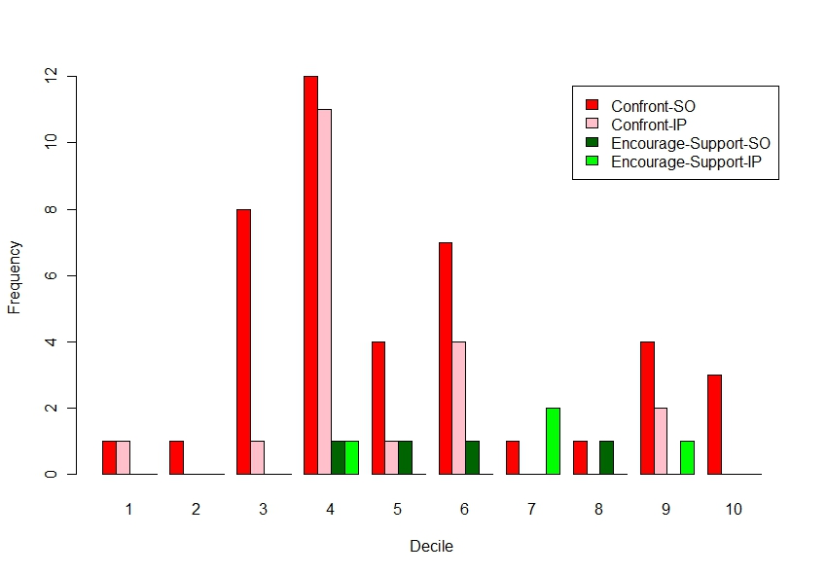
A sample of cool stuff for the future:
The anatomy of a treatment session

Slide 50
Summary and conclusions
Partner-involved treatment is more effective than individual treatment in decreasing drinking and increasing relationship happiness in couples willing to attend treatment together
Partner-involved treatment consistently results in more drinking early in treatment, but improving outcomes in the long-run
Surprisingly, couples treatment works better than individual treatment (in women) when the IP also has other Axis I or II psychopathology
However, many women, in particular, prefer individual therapy
Offering women a combination of individual and couple therapy increases their attendance at therapy sessions but probably not their outcomes

Slide 51
Summary and conclusions
We believe that couples therapy works by increasing positive exchanges, decreasing negative exchanges, increasing motivation for change, and increasing support for change
If we successfully isolate specific IP and SO behaviors and behavioral sequences most associated with positive outcomes:
  Therapists can better target these in treatment
  We will have an empirical basis for simplifying and streamlining partner-involved treatment
  We will be able to use this knowledge to develop and refine treatments that involve any family member by targeting these key behaviors

Slide 52
Future directions

Slide 53
Current work in our lab
We are:
  Developing a brief form of ABCT appropriate for drinkers and any family member (Barbara McCrady)
  Testing a model to identify and provide a brief intervention for family members seen in primary care settings who have been affected by a loved one’s drinking (Ben Ladd)
  Using social network analyses to model how changes in individual and network variables impact drinking (Kevin Hallgren)
  Extending Orford et al.’s family coping model to families coping with cancer (Julie Brovko)
  Testing the role of social factors in relapse among substance abusing offenders after incarceration (Mandy Owens)

Slide 54
Beyond the family:
Other questions about social support

Slide 55
Q1: Does social support lead to internal/individual changes in a person with an alcohol/drug problem?
Psychological question: Does social support impact psychological functioning?
  Motivation?
  Self-efficacy?
  Outcome expectancies?
  Coping skills?
  Affect regulation?
Cognitive neuroscience questions:
  Does social support damp down craving in the presence of cues to drink?
  Does social support impact pathways in the brain associated with rewards or executive control?

Slide 56
Q2a: What are effective and ineffective means to get good social support?
How does a drinker/drug user find social networks that will support nonproblem alcohol or drug use?
What can a drinker/drug user do to engage others to provide support?
Can a drinker or drug user drive others away through alienating behaviors (other than those associated with the substance use)?

Slide 57
Q3: What are more and less effective ways for others to provide social support?
We know that having a sponsor is one of the strongest predictors of success in AA, but we know nothing about effective and ineffective sponsoring
We know that having a supportive family enhances outcomes, but we have not isolated effective family behaviors

Slide 58
It’s an exciting future!

