Slide 1
“National co-ordination and provision of
take-home naloxone: Scotland first ”
SSA, 2015
York
Andrew McAuley
Health Protection Scotland, and
Glasgow Caledonian University

Slide 2
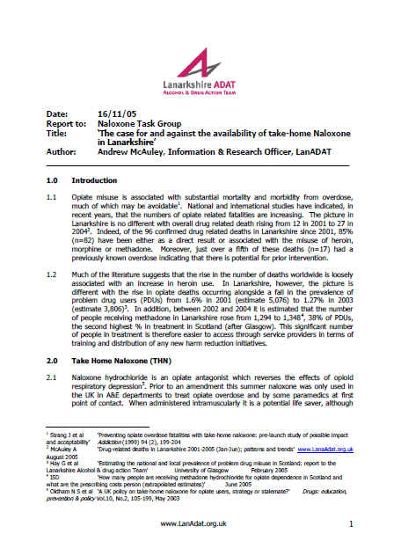
Notes:
Today marks somewhat of a personal milestone for me with regards to naloxone. When preparing this talk I stumbled across the first ‘paper’ I ever wrote on naloxone which is almost 10 years ago exactly, a lot has certainly changed since then.

Slide 3
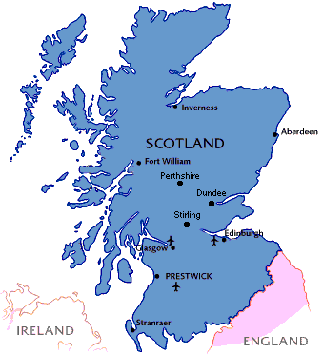
Scotland, 2015
Population ~ 5 million
14 Health Boards
30 Alcohol & Drug Partnerships
15 Prisons
--------------------------------------
~ 60,000 ‘Problem Drug Users’
~ 20,000 PWID
~ 25,000 Px OST
Widespread availability of IEP services
Notes:
For those who don’t know much about Scotland apart from haggis, irn-bru and the loch ness monster I thought it would be useful to put our addiction into context:
Population ~ 5 million
14 Health Boards
30 Alcohol & Drug Partnerships
15 Prisons
--------------------------------------
~ 60,000 ‘Problem Drug Users’
~ 20,000 PWID
~ 25,000 Px OST
Widespread availability of IEP services

Slide 4
Naloxone, why Scotland first?

Slide 5
Naloxone, why Scotland first?
DRDs, 2006-2010 = 1,970
HIV deaths, 1983-2012 = 1,864
Notes:
Arguably the main reason that Scotland was first to adopt a national naloxone programme is the fact that we are in the midst of, and have been so for some time, an epidemic of drug-related death. Numbers have increased steadily over the past 20 years and far exceed other known causes of premature mortality among people who use drugs e.g. HIV. For instance, there were more DRDs in 2006–2010 (1970) than deaths from HIV/AIDS in the thirty years from 1983–2012 (1864).

Slide 6
Naloxone, why Scotland first?
Accidental
Source: NRS (2015)
Notes:
Crucially, the vast majority of these are both accidental and preventable, evidenced through years of research both nationally and internationally.

Slide 7
Naloxone, why Scotland first?
DRDs per 100,000 population (all ages), 2012
Source: UK Focal Point (2013)
Notes:
The other crucial factor in Scotland’s case is that drug-related mortality rates far exceed those elsewhere in the UK and are among the highest in Europe.
It is within this landscape that more innovative solutions to address the DRD epidemic have been considered.

Slide 8
Timeline to implementation
1996 Strang et al propose naloxone for peer administration
2004 Local proposals for naloxone pilots (Lanarkshire)
2005 Scottish Advisory Committee on Drug Misuse (SACDM) recommends take-home naloxone
-------------------------------------------------------------------------------------------------------------------
2005 Medicines for Human Use (Prescribing) (Miscellaneous Amendments) Order
-------------------------------------------------------------------------------------------------------------------
2007 National Forum on Drug Related Deaths Annual Report recommends take-home naloxone
2007 Glasgow / Lanarkshire Pilots Launched
2008 Glasgow Pilot Evaluation Published
2009 Lanarkshire Pilot Published
2009 Inverness Pilot Launched
2010 Inverness Pilot Evaluation Published
2010 National Forum on Drug Related Deaths Annual Report recommends take-home naloxone
Notes:
Prior to its implementation, take-home naloxone was not a new concept within Scotland. Indeed it had been considered, proposed and recommended by a number of different bodies both locally and nationally.

Slide 9
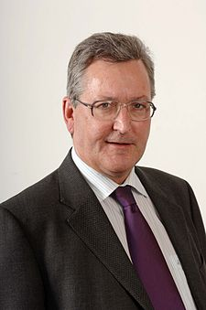
Timeline to implementation
“The aim of this national programme is to increase the availability and awareness of naloxone across Scotland, in order to increase the chance of it being administered during an opiate overdose… I hope that the impact of increased naloxone availability will contribute to a reduction in fatal opiate overdoses in Scotland and I am very grateful for your support in taking forward this important initiative.”
Fergus Ewing, Minister for Community Safety, 01/11/10
Notes:
However, it was not until the actions of this man that the concept of a national naloxone programme became a reality. Fergus Ewing, the then Minister for Community Safety, visited the pilot naloxone project in his Highland constituency in 2010 and was impressed enough to announce a national programme within a matter of months. Years of research, evaluation and advocacy were finally acted upon and the national naloxone programme was born.

Slide 10
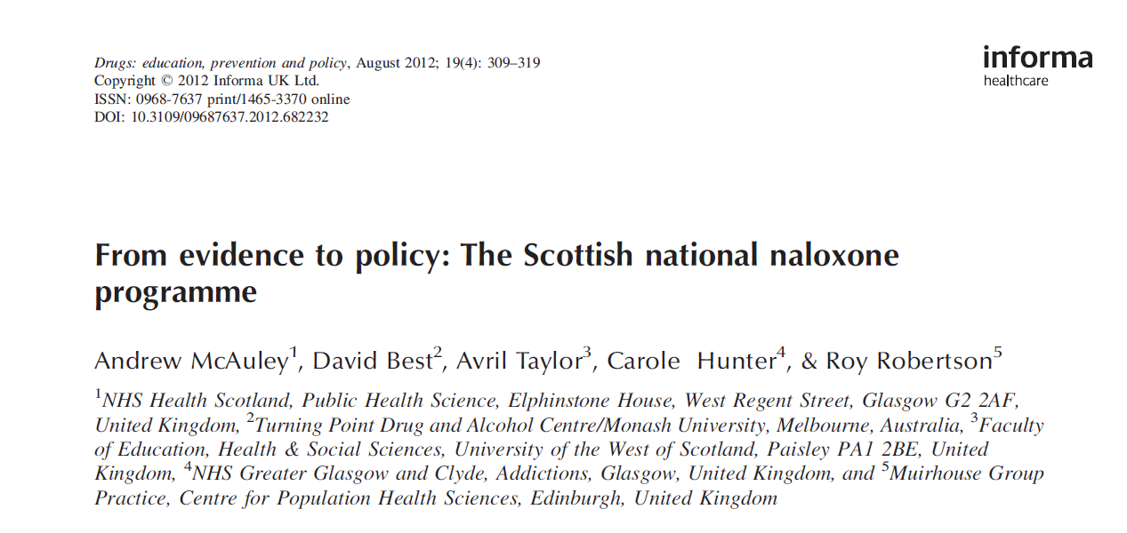
Notes:
For those interested, this paper details the other components we thought were vital contributors to NNP establishment alongside ministerial involvement.

Slide 11
Naloxone in Scotland, a quick guide...

Slide 12
Naloxone in Scotland: eligibility
Who can receive a supply of naloxone?
  ANY Individual with current or a history of opioid use.
    Esp. Those receiving ORT, those released from prison, those discharged from hospital, all of whom are at increased risk of opioid overdose and DRD.
  Nominated representatives of individuals with current or a history of opiate use (consent required).
  Staff working for services in contact with people at risk of opiate overdoses.
Notes:
Anyone at risk of opioid OD can receive a naloxone supply in Scotland. This includes current and former users. Within this, there is particular focus on supplying prisoners on release and those discharged from hospital, both at increased risk of DRD.
In addition, nominated representatives of individuals with current or a history of opiate use can also get a supply provided consent is given from the person at risk.
Staff are also eligible to receive a kit, initially this was only healthcare staff but this was widened to any staff working for services in contact with people at risk of opiate overdoses via the Lord Advocates Guidance.

Slide 13
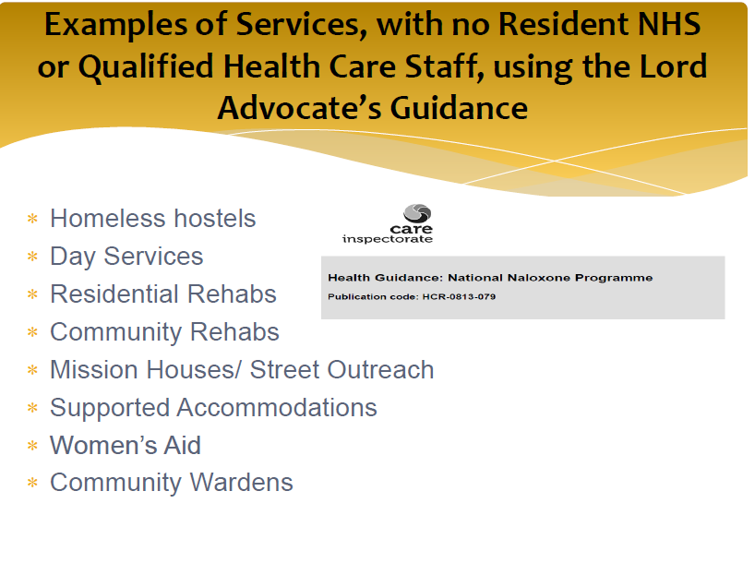
Notes:
The Lord Advocates guidance is a uniquely Scottish exemption, and examples of services that have utilised this to facilitate storage of stocks of naloxone for use in an emergency include homeless hostels, residential and community rehabs, street outreach teams, supported accommodation, women’s aid and community wardens.

Slide 14
Naloxone in Scotland: training
Who trains?
  Nurses, IEP workers, community pharmacists, pharmacy technicians, social care staff, voluntary sector workers, prison staff, and peer trainers.
How do they train?
  Brief intervention
  One-to-one / Group
Notes:
Training is widespread and involves a range of professionals from across the health, social care and third sector. More recently, peer trainers have been used with enormous success.
The training programme itself has evolved from around 2-hours to a more brief intervention style which lasts just 10-15 minutes. Training typically is done on a 1-to-1 basis, but there are still settings who utilise group based training e.g. Prisons.

Slide 15
Naloxone in Scotland: supply
Who supplies?
  Nurses, Pharmacists via PGD
  Doctors
Where do they supply?
  13/14 Health Boards
    Community addiction and harm reduction teams
    Injecting equipment provision (services)
    Community pharmacy
  All 15 prisons
    Liberation (including court)
Notes:
Following training, naloxone is supplied via a patient group direction (PGD) by nurses, pharmacists

Slide 16
Naloxone in Scotland: supply
Who supplies?
  Nurses, Pharmacists via PGD
  Doctors
Where do they supply?
  13/14 Health Boards
    Community addiction and harm reduction teams
    Injecting equipment provision (services)
    Community pharmacy
  All 15 prisons
    Liberation (including court)
New legislation introduced 1 October 2015 = no Px or PGD required!
Notes:
These supply routes are likely to change given the new legislation introduced on 1 October 2015 and the lack of commitment from SG to fund the programme beyond March 2016.

Slide 17
Results

Slide 18
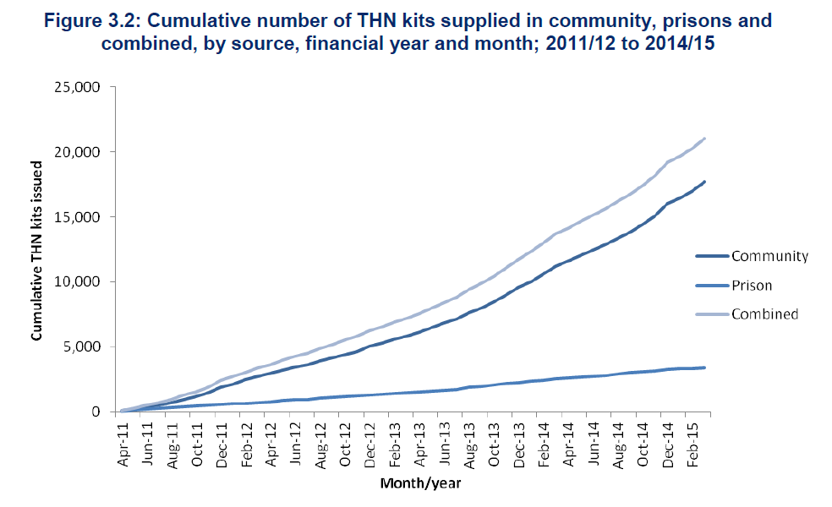
Naloxone in Scotland: implementation
Source: ISD (2015)
Notes:
Since it was formally launched in 2011, the first four years have saw over 20,000 naloxone kits issued in Scotland. The bulk of these have been issued in the community (84%), with prison supplies making up about 16% of all supplies. The actual number of kits supplied in the community has increased year on year, with a fall in numbers supplied via prison in 2014/15.

Slide 19
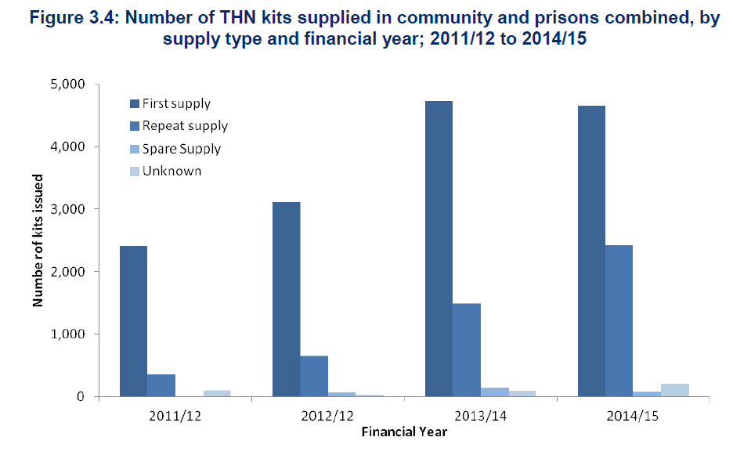
Naloxone in Scotland: implementation
Source: ISD (2015)
Notes:
Table 3.4 provides a breakdown of the reasons for repeat supply of naloxone for community and prison outlets from 2011/12 to 2014/15. An indication of the use of kits can be gained from repeat THN supply where the previous kit was reported as having been used to treat an opiate overdose in self or others.
There have been almost 5000 repeat supplies in the 4-years since the programme began, almost 1500 of which were reported as having been used to treat an opiate overdose in self or others.
It is interesting to note here that ‘first supplies’ fell in 2014/15 comapred to 2013/14, evidence that the critical mass has been reached?

Slide 20
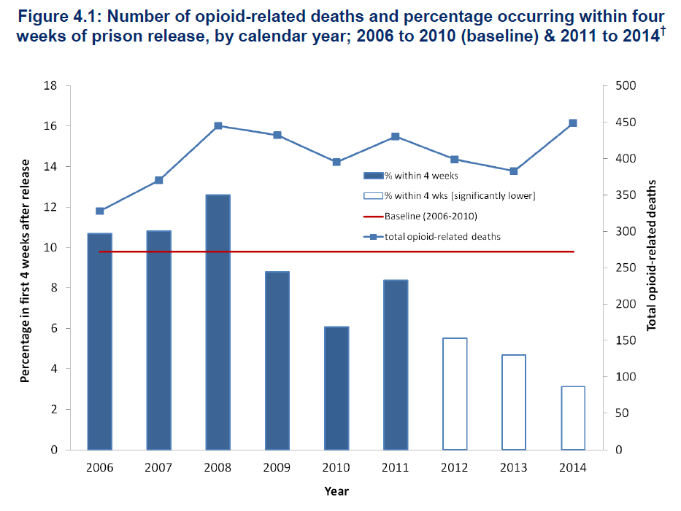
Naloxone in Scotland: primary outcome
Source: ISD (2015)
Notes:
The primary outcome indicator for Scotland’s NNP is the % of opioid-related deaths occurring within 4-weeks of prison release. It is not the number of opioid –related deaths which had been on a rising trajectory prior to implementation of NNP making them unsuitable for epidemiological evaluation purposes. Sheila Bird will talk more about this tomorrow.
The key result here being that the % of opioid-related deaths occurring within 4-weeks of prison release has almost halved from a baseline of 9.8% (2006-10) to just 5.4% (2011-14). We ascribe this fall to the NNP.

Slide 21
Naloxone in Scotland: wider impact
Take-home naloxone prescriptions and carriage by people who inject drugs (PWID) in Scotland; 2011-12 and 2013-14
 |  | Have you been prescribed take-home naloxone in the past year? |  | Between era¹ difference p-Value (95% CI) | Are you carrying any take-home naloxone with you today? |  | Between era¹ difference p-Value (95% CI)
NESI study |  | 2011-12 | 2013-14 |  | 2011-12 | 2013-14
Overall
 | x/N (%) | 175/2146 (8) | 745/2331 (32) | <0.01 (21.6, 26.0) | 27/169 (16) | 39/741 (5) | <0.01 (-5.6, -17.1)
Access up, carriage down...
Source: McAuley, Bird, Munro, Taylor (2015), submitted
Notes:
Additional research using data from the Needle and Syringe Exchange Initiative, a 2-yearly survey of people who inject drugs, suggests that reach of the programme has increased among this at-risk population, from 8% to 32%. Conversely, the proportion reporting they had naloxone on their person when attending the service had decreased from 16% to 5%. Possible reasons for this low carriage rate may the bulky itself, fear of police stop and search, or that some of the NESI venues include treatment services. All areas which merit further exploration.

Slide 22
What next?
Impact of take-home naloxone on ambulance attendance at opioid overdose [manuscript in preparation]
Supply and carriage of take-home naloxone among people who inject drugs [manuscript in preparation]
Lived experiences of individuals who have used naloxone to save their peers [PhD thesis...nearly there!]
5-year evaluation of the national naloxone programme [Autumn 2016]

Slide 23
Thank you
Andrew McAuley
Senior Epidemiologist
Health Protection Scotland
phone: 0141 282 2279
email: andrew.mcauley@nhs.net
website: www.hps.scot.nhs.uk
twitter: @arjmcauley

Slide 24
EXPERIENCES OF NALOXONE RESUSCITATION
Jo Neale & John Strang
National Addiction Centre
Institute of Psychiatry, Psychology & Neuroscience
King’s College London
SSA, York
November 2015

Slide 25
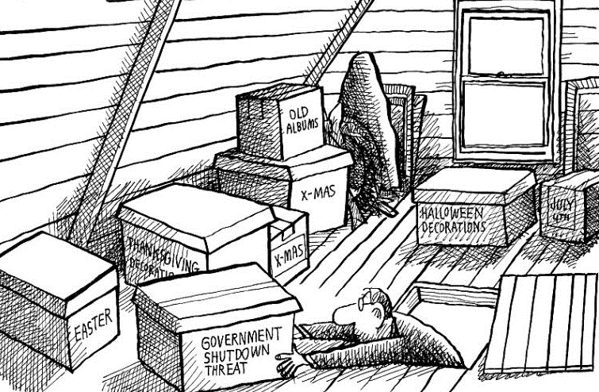
AKA: PROJECT DATA IN THE ATTIC

Slide 26
BACKGROUND
Clinicians do not agree on naloxone dose or route
We need a better understanding of opiate users’ views & experiences of emergency naloxone to inform dosing
Specifically, is it possible to do harm by administering too much emergency naloxone?
  Secondary analysis of non-fatal overdose study
    Date: 1997-1999
    Location: 2 Scottish cities
    Data: 200 qualitative interviews & observations from hospital emergency departments
    Reference: Neale J. & Strang J. (2015) “Naloxone – does over-antagonism matter? Evidence of iatrogenic harm after emergency treatment of heroin/opioid overdose”, Addiction; doi:10.1111/add.13027.

Slide 27
PARTICIPANTS
Demographic characteristics | Group A (A&E) n = 77 | Group B (Drug agencies, pharmacies, snowballing) n = 123 | All n = 200
Gender
Male | 54 (70%) | 77 (63%) | 131 (66%)
Female | 23 (30%) | 46 (37%) | 69 (35%)
Mean age (years) | 27 (range 15-47) | 28 (range 17-45) | 28 (range 15-47)
Mean age of first use (years) | 16 (range 5-32) | 16 (range 7-32) | 16 (range 5-32)
Mean years of use | 11 (range 1-27) | 12 (range 1-31) | 12 (range 1-31)
Ever overdosed
Yes | 76 (99%) | 77 (63%) | 153 (77%)
No | 1 (1%) | 46 (37%) | 47 (24%)

Slide 28
KNOWLEDGE OF NALOXONE
Poor general knowledge
    Fieldnote: Barry asks the doctor about the needle that was put into his heart last time he was in the emergency department. [Barry, 29 years, group A]
Few participants knew naloxone by its generic or trade name, Narcan
Nearly all participants understood street terms, such as ‘the jag’, ‘adrenaline’, or ‘the reverse’, or recognized naloxone from the researcher’s description

Slide 29
PERSONAL EXPERIENCES OF NALOXONE
Naloxone had made participants feel ‘horrible’ or unwell, and had induced acute withdrawal symptoms
    They gave me that injection, that, er, reverse, and I woke up absolutely shaking… It was like instant withdrawals. It was the most horrendous experience that I've ever been through. [Beverley, 33 years, group A]
Naloxone-induced withdrawal symptoms were so severe that participants reported going ‘mad’ or ‘crazy’ or losing their temper & becoming aggressive or violent
    I said to them [hospital staff], ‘Please don’t give me adrenaline’. And he [doctor] said ‘No, I’m not going to give you adrenaline’. [And he] stuck the needle in my arm. And I knew because I felt the tingling in my foot…I went crazy… Grabbed the metal side of the bed and I was kicking it and screaming and pulling my hair out. [Rab, 25 years, group B]

Slide 30
ACTIONS TO COUNTER NALOXONE EFFECTS
Participants frequently discharged themselves in order to find & use more drugs
  I just bolted. Signed myself out [of hospital]. I came home… got a loan of a tenner [£10] off somebody… and I just went out and got another one [deal of heroin]. [Willy, 29 years, group B]
Withdrawal symptoms were often so severe that hospital staff had prescribed methadone or lofexidine to counter the naloxone

Slide 31
GENERAL VIEWS OF NALOXONE
Naloxone should be avoided as it caused instant withdrawals
  It ‘takes your stone away’, ‘strings you out’, ‘makes you rattle’, ‘is instant hangout’, ‘makes you feel sick’, ‘causes a headache’, ‘ruins the hit’, ‘makes you feel worse’.
Others refused to go to hospital, climbed out of ambulances, signed themselves out of hospitals, & experienced prolonged withdrawals
Those who overdosed would be angry that they had ‘wasted their money’ & would now need to commit more crime to get drugs
  Anybody waking up and being totally right into withdrawals would be angry. And the possibility is they've spent all their money and they've not got money to get anything else. [Suzanne, 31 years, group B]

Slide 32
PERSONAL RESPONSES TO THE OFFER OF NALOXONE
Few willingly accepted naloxone & many did their best to avoid naloxone
Group A participants had sometimes been given naloxone whilst unconscious, BUT often insisted they hadn’t received naloxone
No withdrawals observed by the researcher; several participants reported feeling better
    Participant: They were going to give me Narcan, but I didn’t want it. I started screaming.
    Researcher: So you didn’t get any?
    Participant: No… I would have marks on me if I had, because they’d have had to get a vein… If I’d had Narcan, I’d have been shivering now. I’ve not had it. [Marjorie, 28 years, group A]

Slide 33
DISCUSSION
Opiate users were very negative about naloxone & repeatedly reported withdrawals & negative outcomes caused by over-administration
However, negative experiences were absent from the observational data
How might we explain this?
  In a context of poor knowledge about naloxone, poor communication & lack of trust between heroin users & hospital staff, & a frightening life-threatening situation, instances of poor naloxone administration (however rare or unlikely) can have a disproportionately harmful impact through reputational damage

Slide 34
CONCLUSIONS
More attention needs to be paid to protocols for titrating naloxone dose against response to prevent sudden acute withdrawal syndrome, with the attendant risks of medical self-discharge, further drug use & even death, but…
Good treatment also involves building & sustaining trust with patients, providing clear information on how naloxone works & its potential side effects, & being sensitive to patients’ likely & understandable fears
The context in which naloxone is provided may be as critical as the dose administered if we want to ensure that treatment achieves maximum benefit

Slide 35
ACKNOWLEDGEMENTS
The original study was funded by the Scottish Office and the grant holder was Professor Neil McKeganey. Marion McPike conducted a small number of the Group B interviews. Accident and Emergency consultants Dr William Morrison and Dr Gordon McNaughton and charge nurse Derek Nelson provided retrospective insights into naloxone dosing during the study period. The authors would like to thank the above as well as the 200 opiate users for agreeing to be interviewed and the hospital and service staff for providing access to their patients. Joanne Neale is now part-funded by, and John Strang is supported by, the National Institute for Health Research (NIHR) Biomedical Research Centre for Mental Health at South London and Maudsley NHS Foundation Trust and King's College London.

