Slide 1




Associations of Child and Adolescent Anxiety with Later Alcohol Use and Disorders:
A Systematic Review and Meta-Analysis of Prospective Cohort Studies
Maddy Dyer (maddy.dyer@bristol.ac.uk)
Kayleigh Easey, Jon Heron, Matthew Hickman, & Marcus Munafò
University of Bristol

Slide 2

Background and Aims
Relationship between anxiety and alcohol use is unclear.
Different theories & inconsistent evidence.
Previous systematic reviews are limited:
- one type of anxiety disorder,
- small number of studies,
- and/or methodological weaknesses.
Research Questions:
Is anxiety in childhood/adolescence positively or negatively associated with later alcohol use?
Do characteristics of included studies explain inconsistencies in findings?

Slide 3





Methods
Data Extraction
Cohort, country, % male, anxiety exposure (type, age, measure), alcohol outcome (type, age, measure), results, confounders, and sample size.
Classification & Synthesis
Narrative synthesis & meta-analysis.
Identification of Studies
English language publication, anxiety exposure in childhood or adolescence, alcohol outcome ≥ 6 months later and distinct from substance use.
Associations coded by strength & direction of evidence (6 categories).
Associations categorised by anxiety exposure (8 categories) and alcohol outcome (3 categories)
Study 2
Study 1
Study 3
DATA
Anxiety

Slide 4

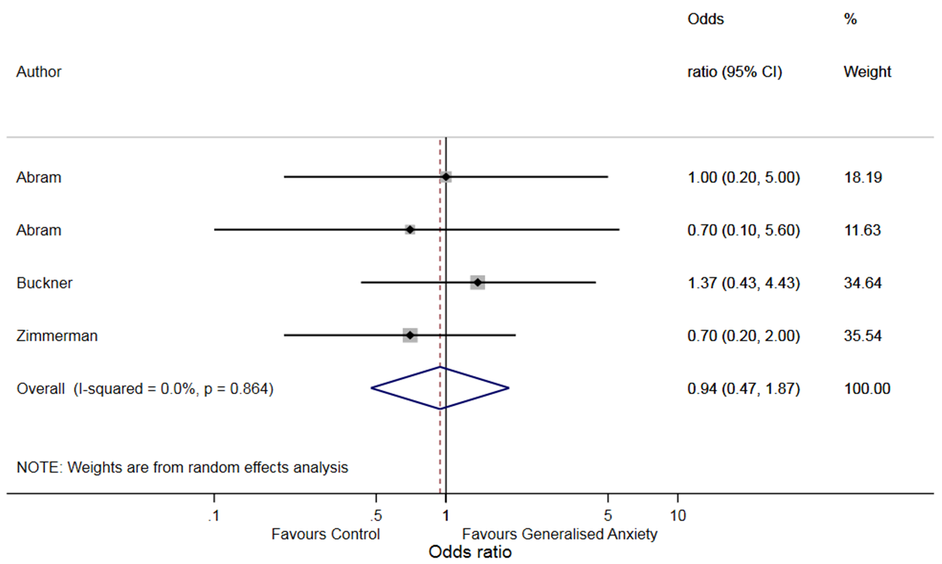
Results
3990 Titles/
Abstracts
92 Full Text Articles
51 Studies in Narrative Synthesis
3 Studies in Meta-Analysis
97 Associations
Narrative Synthesis
Drinking Frequency/Quantity N = 8 (22%) E = 9 (24%) P = 9 (24%) U = 11 (30%) inconsistent evidence | Binge Drinking N = 4 (29%) E = 2 (14%) P = 3 (21%) U = 5 (36%) inconsistent evidence
Alcohol Use Disorders N = 5 (11%) E = 14 (30%) P = 20 (43%) U = 7 (15%) evidence - positive association | Alcohol Consumption Total N = 17 (18%) E = 25 (26%) P = 32 (33%) U = 23 (24%) evidence – positive association
Meta-Analysis
No clear evidence of an association between generalised anxiety and
later alcohol use disorder
(OR 0.94, 95% CI 0.47 to 1.87).
And no clear patterns based on study characteristics.

Slide 5
Discussion and Conclusions
Summary Some evidence that child/adolescent anxiety is positively associated with later alcohol use disorders Relationship with drinking frequency/quantity and binge drinking inconsistent Characteristics of included studies did not appear to account for mixed findings | Limitations Study weaknesses – small samples, confounding Between-study heterogeneity English language publications – bias? Unclassifiable associations – loss of data Observational studies – cannot infer causality
Strengths Largest SR on this topic Range of anxiety disorders Supports previous reviews | Future Research Mendelian randomisation Ecological momentary assessment Distinguish between anxiety symptoms Identify moderators

Slide 6
Thank You!
Supervisors: Prof. Marcus Munafò, Prof. Matthew Hickman, & Dr Jon Heron
Funders: MRC Addiction Research Clinical Training Programme (MARC)
Colleagues: Tobacco and Alcohol Research Group (TARG)
Angela Attwood: Senior Research Fellow Anna Blackwell: Research Associate Laura Brocklebank: Research Associate Vicky Carlisle: PhD Student Miriam Cohen: PhD Student Emily Crowe: PhD Student Katie De-Loyde: Research Associate Katie Drax: PhD Student Maddy Dyer: PhD Student Kayleigh Easey: PhD Student | Andy Eastwood: PhD Student Meg Fluharty: PhD Student Elis Haan: PhD Student Eleanor Kennedy: PhD Student Jasmine Khouja: PhD Student Rebecca Lawn: PhD Student Jim Lumsden: PhD Student Olivia Maynard: Lecturer Marcus Munafò: Professor Sarah Peters: PhD Student | Joe Matthews: Research Associate Hannah Sallis: Postdoc Laura Schellhas: PhD Student Carlos Sillero: PhD Student Chris Stone: Research Associate Andy Skinner: Postdoc Steph Suddell: PhD Student Jorien Treur: Postdoc Robyn Wootton: Research Associate
maddy.dyer@bristol.ac.uk

