Slide 1


Journeys of Recovery following Alcohol Detoxification in a General Hospital: a Mixed Methods Study
CLAHRC Wessex
Lucy Dorey PhD Student
Supervisors:
Professor Judith Lathlean,
Professor Greta Westwood
Professor Paul Roderick
Notes:
A number of studies have indicated that treatment seeking and openness to change in those with alcohol dependence often follows a crisis event.
My study provides evidence that contact with the hospital during a health crisis can be a turning point, and there is an opportunity to influence recovery in this setting. However, in order to influence recovery we need a better understanding of the recovery process, so
I asked:
What is the process of change in early recovery following detoxification in a general hospital ?
What treatment and non-treatment factors are seen as initiating, supporting and posing barriers to recovery?
This was a mixed methods study. I will focus mainly on the qualitative findings here, but will initially draw on some of the quantitative to provide context.

Slide 2
Demographics:
Patient Characteristics N=742
Primary admission diagnosis:
Acute alcohol withdrawal
Acute intoxication
Intentional overdose
Digestive disease
Circulatory disease
Respiratory disease
Falls (over sixties)
Use of specialist services:
Less than 45% used services
in the five years prior to baseline
32% Females,
68% Males
20% Employed,
52% Unemployed
28% Retired
High Co-morbidity
physical and mental health
High AUDIT scores (median 34)
Notes:
In the quantitative analysis I looked at 742 patients who had their first detox in a general hospital. The age range was primarily working age, but only 20% were employed. People came to hospital most commonly for these reasons: read out. Less than half had any contact with community alcohol services in the prior five years. There were high levels of co-morbidity- both physical and mental health.
The 24 patients recruited to the qualitative study were purposively selected to cover the range of characteristics shown here. People were interviewed at several points over the course of a year to get a close up account of the recovery process.

Slide 3
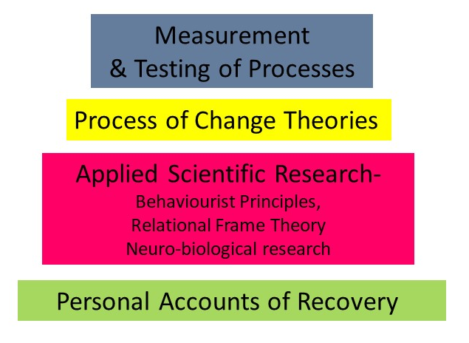
A four layered approach to understanding the process of change
Notes:
This four layered approach was used to develop a theory of the process of change for this patient group.
Firstly as advocated in the literature by Orford et al. it was considered important to ground an understanding of the process of change in the accounts of those in recovery. I used thematic analysis.
Secondly , drawing on Mark Lewis’ work, it was considered that basic principles of science both neuro and behavioural could be related to personal accounts.
This approach also drew on the contextual behavioural science approach to theory development , in that basic principles such as conditioning and RFT inform process theory and ultimately test the theory.

Slide 4
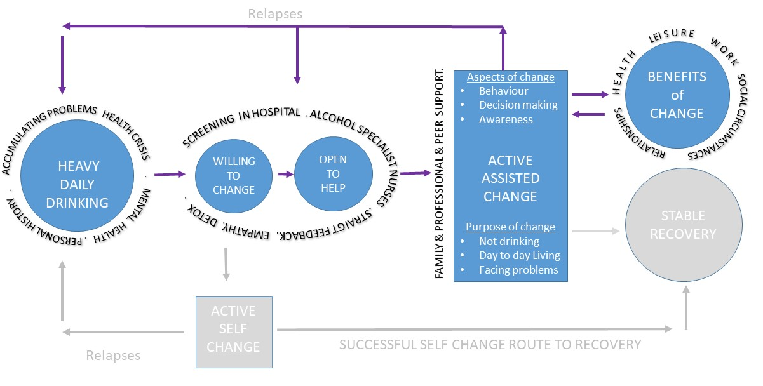
The process of change in early recovery
based on patient accounts
Notes:
This is the model I developed based on people’s personal accounts:
Heavy drinking in the context of increasing problems and health crisis, gave way to a willingness to change and openness to help. The impact of straight talking empathic nurses led to engagement in active assisted change. People made many changes in awareness, decision making and behaviour patterns with the purpose of not drinking, living life again and facing personal problems. Those who made most progress accessed several sources of support (seldom the community alcohol services). They felt the benefits of change through work and existing relationships. Being able to open up and be validated were important. Those who struggled most were isolated, unemployed, unwell, and found little reward in their efforts to change.

Slide 5
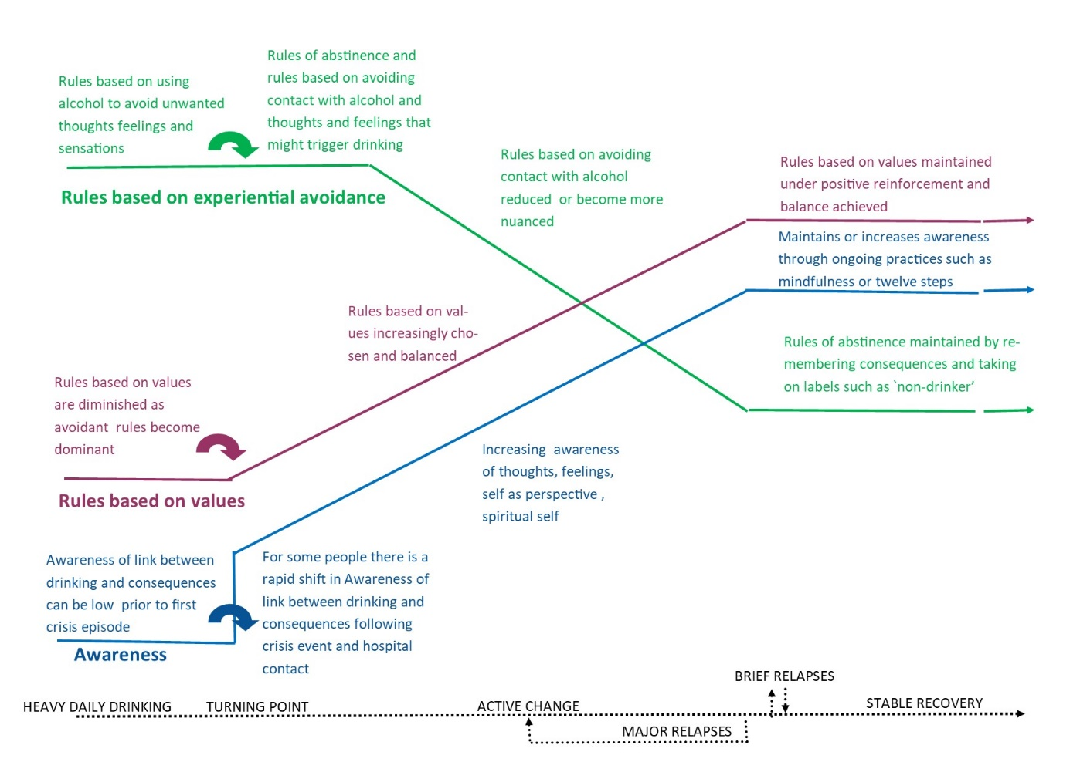
Notes:
I then went on to develop a theoretical perspective grounded in contextual behavioural principles such as rule governed behaviour and experiential avoidance. In brief, at first recovery involved following new rules to avoid contact with alcohol and triggers. As awareness increased over time people followed rules of recovery that led to repair of relationships, and engagement in living. Awareness progressed from thoughts related to drinking, feeling states and behavioural patterns, as well as the ability to stand back and see self as separate from these. Avoidance did not end as it was still important to use strategies to remind oneself to avoid drinking. It was however in a new balance with increased awareness and valued living.

Slide 6
References
Orford J (2008) Asking the right questions in the right way: the need for a shift in research on psychological treatments for addiction. Addiction 103(6): 875-85; discussion 886-92
Orford J et (2006) Why people enter treatment for alcohol problems: findings from UK Alcohol Treatment Trial pre-treatment interviews Journal of Substance Use
Lewis M (2015) The Biology of Desire: Why Addiction Is Not a Disease. New York: Public Affairs 1(3): 161-176
Plumb J (2010) Research: Basic & Applied. Available from: https://contextualscience.org/rftsupp]
Hayes SC, Strosahl KD and Wilson KG (1999) Acceptance and Commitment Therapy: An Experiential Approach to Behaviour Change. New York: The Guildford Press

