Slide 1
RECOVERY – A NEW AGENDA OR NOT?
PoLICy, Research & a grassroots movement
Tim Leighton
SSA Symposium
November 2012

Slide 2
Research, Policy, Practice, Outcomes
No neat rational relationship between any of these:
Prevalence/scheduling (Stevens)
Controlled drinking vs abstinence outcomes independent of treatment advice (Sobells)
Ideas that fit, discourse coalitions (Stevens)

Slide 3
The Recovery Community in the UK
Meetings of mutual aid groups: Narcotics Anonymous, Cocaine Anonymous, SMART Recovery, Methadone Anonymous
Recovery Walks: Liverpool 2009, Glasgow 2010, Cardiff 2011, Brighton 2012, Birmingham 2013
Recovery cafés: Glasgow, Edinburgh, Dundee, Bristol, Liverpool, Worcester etc.
Recovery website: Wired In
Recovery organisations: UK Recovery Federation, Recovery Academy, Recovery is out there (R.I.O.T.)

Slide 4
Worcester
5 SMART meetings (one each weekday)
2 Narcotics Anonymous meetings weekly
5 Alcoholics Anonymous meetings weekly
Recovery café(s)
“Pathway to recovery” service (CRI)
Community-based Intensive Day Programme due to start shortly

Slide 5
Narcotics Anonymous, Cocaine Anonymous, SMART Recovery in the UK 2011

Slide 7
Is this new?
Answer 1: NO
There have been mutual aid meetings in the UK for a long time (AA since 1949, NA since 1980)
The current recovery movement is in significant respects reminiscent of the 19th century Temperance movement
(viz. BERRIDGE, V. (2012) The rise, fall, and revival of recovery in drug policy. The Lancet, 379/9810, 22-23.)
An emphasis on abstention is nothing new, but a return to the pre-Harm Reduction days, in which abstinence was linked with rehabilitation.
Therapeutic Communities and Minnesota Model centres have focused on reforming character and rebuilding relationships for 50 years or so.

Slide 8
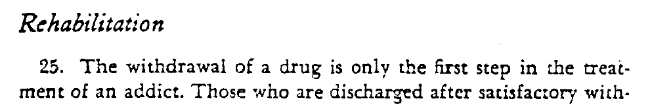
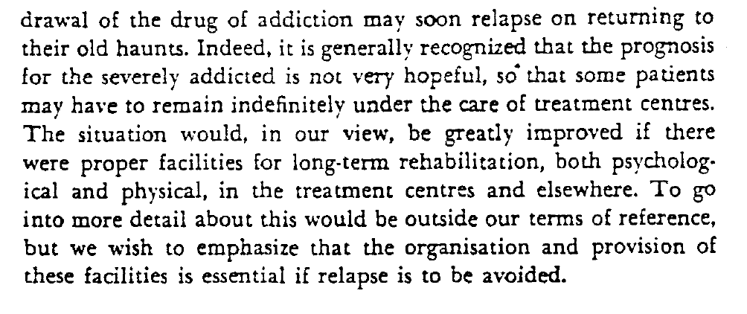

Slide 9
Is this new?
Similarities with Temperance
Emphasis on repairing harm to family and community.
Recovery champions: heroic example, return of the prodigal son.
“Environmental therapeutic” approaches: recovery cafés – Quaker reading rooms, temperance hotels and lodging houses.
Mutual aid societies such as the Washingtonians.
Public visibility (e.g. recovery walks/temperance marches)

Slide 10
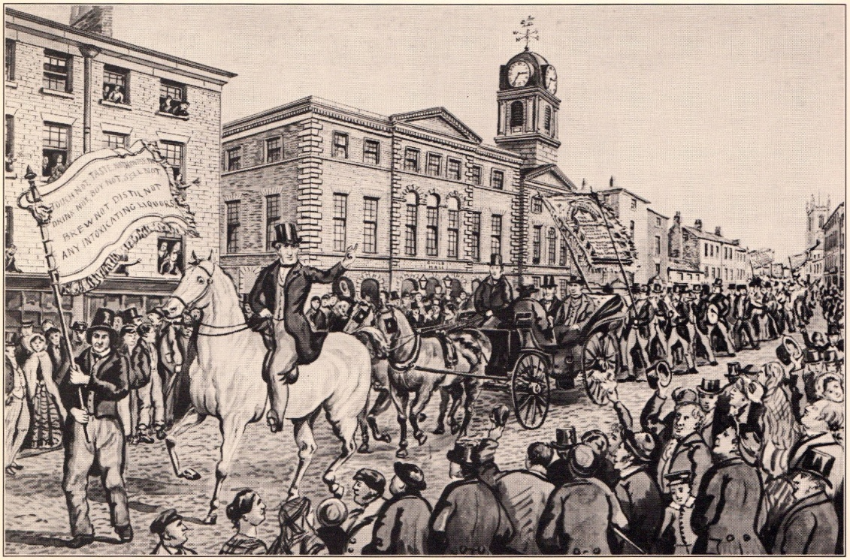


Slide 11
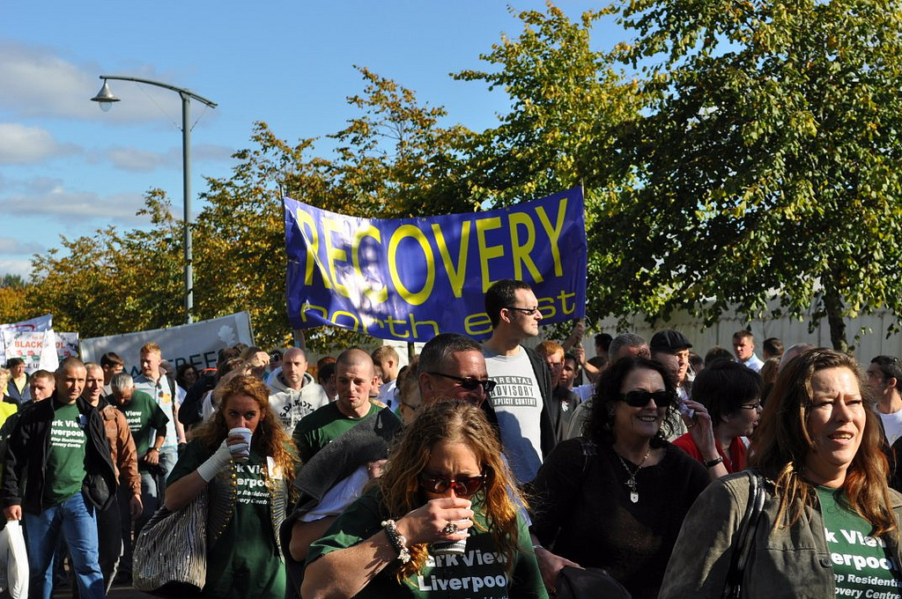

Glasgow 2010
(Liverpool & North-East contingents)
Brighton 2012

Slide 12




Slide 13
Is this new?
Differences from Temperance
Not led by ministers, priests and upper middle-class businessmen and women.
Much less identified with Christian churches and sects.
Pluralistic.
May be starting to integrate non-abstinent approaches.

Slide 14
Research
Research seems to be joining in with this recovery thing too.
Despite 40 years of Moos, Finney and colleagues proclaiming the importance of processes and context, it is only recently that research into mechanisms of change and in particular factors that predict longer term recovery has achieved some salience in the literature.
Kelly et al. (2011) Determining the relative importance of the mechanisms of behavior change within Alcoholics Anonymous: a multiple mediator analysis. Addiction, 107/2, 289-299.
Kelly et al. (2011) Spirituality in recovery: a lagged mediational analysis of Alcoholics Anonymous’ principal theoretical mechanism of behavior change. Alcoholism: Clinical and Experimental Research, 35/3, 454-463.

Slide 15
Research
De Maeyer et al. (2011) A good quality of life under the influence of methadone: A qualitative study among opiate-dependent individuals. International journal of nursing studies, 48/10, 1244-1257.
De Maeyer et al. (2011) Current quality of life and its determinants among opiate-dependent individuals five years after starting methadone treatment. Quality of Life Research, 20/1, 139-150.
Tiffany et al. (2012) Beyond drug use: a systematic consideration of other outcomes in evaluations of treatments for substance use disorders. Addiction, 107, 709-718

Slide 16
Number of mentions of ‘recovery’ in UK policy documents
(other than in phrases such as ‘asset recovery’ or ‘civil recovery’)
England
Tackling drugs to build a better Britain (1998) 0
Updated drugs strategy (2002) 0
Alcohol harm reduction strategy for England (2004) 0
Tackling drugs, saving lives (2004 update) 0
Safe, sensible, social (2007) 0
Drugs: protecting families & communities (2008) 1
2008 drug strategy one year on (2009) 2
Commissioning for recovery (NTA 2010) 95
Reducing demand, restricting supply, building recovery (2010) 72
Putting full recovery first (2012) 180
Scotland
Tackling drugs in Scotland: action in partnership (1999) 0
Protecting our future (Scottish Executive’s Drug Action Plan 2006) 0
The road to recovery (2008) 140

Slide 17
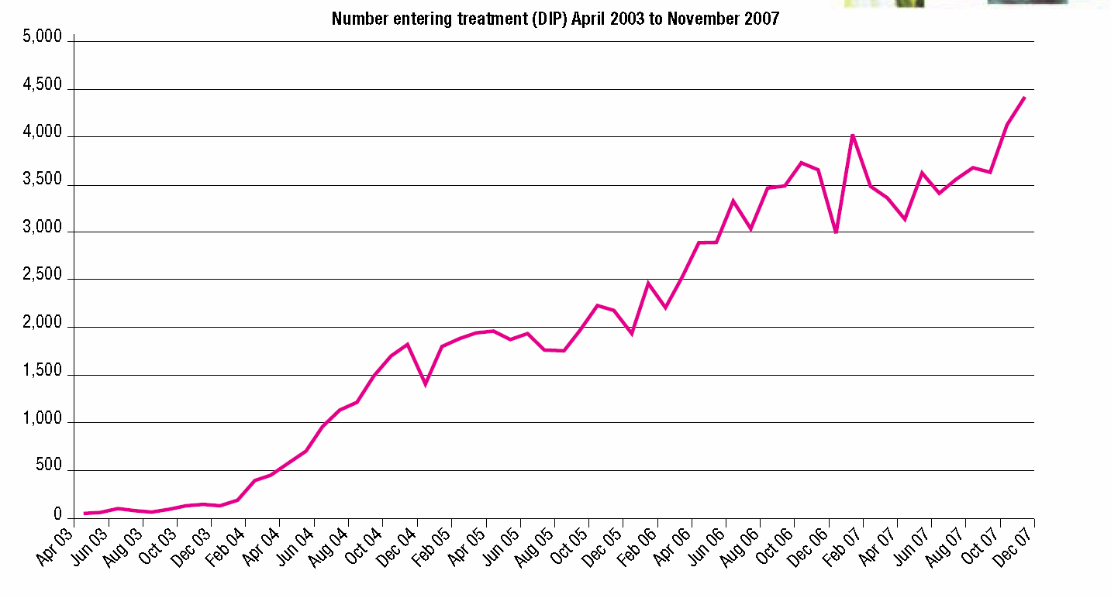
1998-2008
PSA targets regularly stressed increasing numbers of participants into drug treatment.
Diverting offenders into treatment e.g via the DIP
(graph published in the 2008 Drugs Strategy document “Drugs: protecting families & communities”)

Slide 18
1998-2008
A move away from an emphasis on health towards concentrating on the drugs-crime link.
Gerry STIMSON (2000) ‘Blair declares war’: the unhealthy state of British drug policy. International Journal of Drug Policy, 11/4, 259-264.
Effects of policy on services:
vastly increased numbers in treatment
Increases in numbers prescribed OST and speed of access
But still contentious
Doses too low?
(NTA National Prescribing Audit 2006)
Debates about whether methadone prescription is effectively reducing harms
e.g. McKeganey & Bryce vs. O’Hare & Nelles NTDC 2006
Old tensions and debates continue (especially maintenance vs withdrawal)
Alex Mold (2008) Heroin – the Treatment of Addiction in Twentieth Century Britain, DeKalb IL, North Illinois University Press

Slide 19
2008-2012
The 2008 Drug Strategy formulates the following aim:
“that those who do use drugs not only enter treatment, but complete it and re-establish their lives; and that communities are free of drug-related crime, anti-social behaviour and the fear these cause . . . . (which will mean dealing) “with the problems in societies, communities and families that can make people susceptible to drug use, and can act as barriers to recovery.”
UKDPC Recovery Consensus Group (2008):
2008
Recovery is about the accrual of positive benefits, not just reducing or removing harms caused by substance use.
“The process of recovery from problematic substance use is characterised by voluntarily-sustained control over substance use which maximises health and wellbeing and participation in the rights, roles and responsibilities of society”

Slide 20
Policy into Practice
2010 drug strategy claims:
“a fundamentally different approach” “an entirely new ambition”
“Recovery involves three overarching principles – wellbeing, citizenship, and freedom from dependence. It is an individual, person-centred journey.”
2012 Review of drug strategy
RODT Group Report 2012 Medication in Recovery – re-orienting drug dependence treatment
UKDPC 2012 Commissioning for increased recovery (seminar report)

Slide 21
2012 strategy review
“being drug free is now the clear end goal.”
Recovery Partnership, RODT Expert group, ACMD Recovery committee
Payment by results (PBR) piloted
Next year:
Recovery beyond the treatment system (employers, landlords, education)
Challenging stigma
Opportunities for ‘joined-up’ treatment

Slide 22
RODT report: Medication in Recovery
Phasing (engagement, preparation, active change, completion) and layering (standard, enhanced, intensive) of treatment
Building recovery capital
Keeping OST oriented to maintenance but building in recovery opportunities
Links with local mutual aid and peer-based support

Slide 23
So what is new?
Can be seen as another swing of the pendulum.
Tension around maintenance and HR vs abstinence nothing new.
Relationship between scientific evidence and policy as dicey as ever.
Potential narrowing of the gulf between treatment and rehabilitation which has existed since Brain 2
Grassroots popular movement may have a significant impact.
It is possible that maintenance on OST and what is referred to as ‘full recovery’ may come to be seen as compatible or even complementary.
‘More research is needed.’

