Slide 1
YOUNG ADULTS, SOCIAL NETWORKS, AND RECOVERY: AN INVESTIGATION OF CHANGES IN CLOSE SOCIAL TIES AND THEIR ROLE AS A MEDIATOR OF 12-STEP PARTICIPATION
John F. Kelly, PhD
Dept. of Psychiatry, Massachusetts General Hospital
Harvard Medical School
Society for the Study of Addiction, York, UK 2013

Slide 2
The importance of social networks for recovery from substance use disorders (SUDs)
Social forces can influence a variety of health behaviors, including alcohol and other drug use
Successful recovery from SUD often involves changing social networks
Supportive of substance use
Supportive of abstinence & recovery

Slide 3
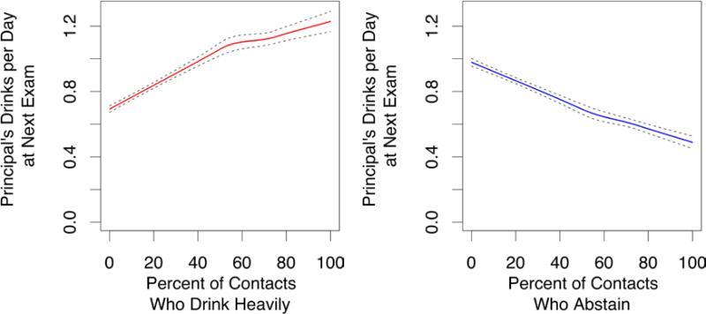
Social Network analyses…
Source: Rosenquist et al (2010). Annals Intern Med

Slide 4
12-step Mutual-help Organizations (MHO) one way to facilitate social network changes supportive of recovery
AA most commonly sought source of help for alcohol problems in the US
Given public health significance, Institute of Medicine (IOM, 1990) called for AA research.
State of science summarized and further research opportunities outlined (McCrady and Miller, 1993)
Past 20 yrs significant increase in scientific interest and rigor focused on AA and its mechanisms…

Slide 5
How might MHOs like AA reduce relapse risk and aid the recovery process? Do these mechanisms differ for different people?
Cue Induced
Stress Induced
RELAPSE
Social
Psych
Bio-Neuro
Drug Induced
MHO
Source: Kelly and Yeterian (2013) , Mutual-help Organizations, In McCrady and Epstein Addictions: A Comprehensive Guidebook, Oxford Univ Press

Slide 6
Do more and less severely alcohol dependent individuals benefit from AA in the same or different ways?
effect of AA on alcohol use for AC was explained by social factors but also by S/R and through negative affect (DDD only)
Majority of effect of AA on alcohol use for OP was explained by social factors
Source: Kelly, Hoeppner, Stout, Pagano (2012) , Determining the relative importance of the mechanisms of behavior change within Alcoholics Anonymous:
A multiple mediator analysis. Addiction 107(2):289-99

Slide 7
Figure 2. AA attendance and the percent change in both pro-abstinent and pro-drinking network ties from treatment intake to the 9-month follow-up in aftercare sample

Slide 8
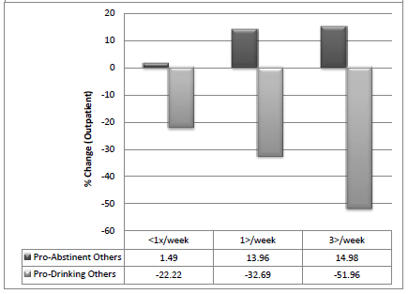
Figure 2. AA attendance and the percent change in both pro-abstinent and pro-drinking network ties from treatment intake to the 9-month follow-up in outpatient sample

Slide 9
What about young adults? A Life Course Perspective
A life course perspective:
has the advantage of recognizing developmental stages and social contexts as risk or protective factors that facilitate or inhibit change that differ across the life span (Hser & Anglin, 2008).
This transitional stage of human development confers high risk of substance use via peer influence, and waning but still influential parental influence. Implications for remission/recovery?

Slide 10
For young people seeking recovery from addiction: Depending on what age you begin recovery , sobriety conducive/supportive contexts will vary…
NSDUH Age Groups
100
Severity Category
90
80
No Alcohol or Drug Use
70
Light Alcohol Use Only
60
Any Infrequent Drug Use
50
40
Regular AOD Use
30
Abuse
20
10
Dependence
0
12-13
14-15
16-17
18-20
21-29
30-34
35-49
50-64
65+
NSDUH and Dennis & Scott
Notes:
This figure shows how the prevalence of these past year severity categories vary by age.
1- Substance use disorders typically on set during adolescents and young adult hood. In fact, 90% of all adults with dependence started using under the age of 18, half under the age of 15.
2- After several decades, the rates of abuse and dependence do decrease as people go into remission, incarceration or die. Epidemiological studies of people with lifetime substance dependence suggest that 58% eventually enter sustained recovery (i.e., no symptoms for the past year) -- a rate that is considerably better than the 39% average rate of recovery across psychiatric disorders (Kessler, 1994; see also Dawson, 1996; Robins & Regier, 1991).
3 – Notice how the rates of no use go up with age.
Thus substance use disorders on set early and last for many years, but do get better over time.

Slide 11
Given that for young adults sobriety conducive/supportive contexts may be at more of premium, MHOs may play a more important role… Objectives
To describe the composition of and changes to substance use in the social networks of young adults post-treatment.
To examine whether changes in substance use in young adults’ social networks was associated with 12-step attendance and furthermore, if it mediated the relationship between 12-step attendance and abstinence.

Slide 12
Sample
302 young adults (20.4±1.6 years, range 18-24) undergoing residential 12-step-oriented treatment in the United States enrolled in observational study of treatment process and outcome.
Mostly Caucasian (94.7%), male (73.8%) and single (100.0%); M LDQ =18.65 (8.7)
Assessments completed at intake, discharge, and 3-, 6-, and 12-months post-discharge.

Slide 13
Measures
Form 90
Percent days abstinent (PDA) from alcohol and other drugs and percent days heavy drinking (PDHD)
Social Support Questionnaire (SSQ)
Assessed up to 5 family members, friends, and others important people to whom they feel close; assessed their alc/drug use (“abstainer”, “infrequent user”, “regular user”, “possible abuser”, “abuser”)
Stages of Change Readiness and Treatment Eagerness Scale (SOCRATES)
Motivation to changes substance use
Commitment to Sobriety Scale (CSS)
Level of commitment to alcohol and drug abstinence
Multidimensional Mutual-Help Activity Scale
Mutual help attendance

Slide 14
Data Analysis
Classified family (parents, siblings) & friends’ substance use as high-risk (“regular users”, ”possible abuser/abusers”) vs. low-risk (“infrequent users” or “abstainers”).
Hierarchical linear models (HLM) analyzed changes from baseline to month 12 in number of high- and low-risk persons within each relationship category.
Test for mediation using cross-product of coefficients approach (MacKinnon et al, 2002) in a lagged, statistically controlled, model, to enhance causal inference (Kazdin and Nock, 2003).

Slide 15
Social network changes over time
During follow-up overall, average number of high-risk users decreased; average low-risk users increased in participants’ social networks (p<0.001).
Average number of high-risk friends, parents and other family members (excluding siblings) decreased (p<0.05), however there was no significant change in average number of high-risk siblings.
Average number of low-risk friends and parents increased (p<0.05), however there was no significant change in average number of high-risk siblings or other family members (excluding parents).

Slide 16
Temporally Lagged Mediation Analyses: Tested model
Number of High-Risk Friends (0m)
Number of High-Risk Friends (6m)
Number of Low-Risk Friends (0m)
Number of Low-Risk Friends (6m)
Baseline (0m) Covariates
12-Step Attendance
(3m)
Alcohol/Drug Use Outcome (12m):
Percent Days Abstinent (PDA)
Percent Days Heavy Drinking (PDHD)
*All models controlling for predictors of attrition (education), baseline levels of PDA/PDHD, baseline levels of the mediator, and predictors of PDA/PDHD (age, gender, commitment to sobriety, motivation, prior hospitalization for alcohol/drug problems and meeting with other mutual help group members outside of meetings at baseline)

Slide 17
Mediation Analysis
Path |  |  | PDA |  |  |  |  | PDHD
 |  |  | B | SE | t | p |  | B | SE | t | p
Direct effect: 12-step attendance predicting PDA/PDHD
 | 12-Step attendance → | PDA/PDHD | 0.009 | 0.004 | 2.44 | 0.015 |  | -0.002 | 0.001 | -1.99 | 0.048
Mediational path: 12-step attendance predicting mediators
 | 12-Step attendance → | Number of high-risk friends | -0.003 | 0.003 | -1.05 | 0.297 |  | -0.003 | 0.003 | -1.05 | 0.297
 | 12-Step attendance → | Number of low-risk friends | 0.006 | 0.004 | 1.58 | 0.116 |  | 0.006 | 0.004 | 1.58 | 0.116
Mediational path: mediators predicting PDA/PDHD
 | Number of high-risk friends → | PDA/PDHD | -0.344 | 0.080 | -4.32 | 0.000 |  | 0.059 | 0.018 | 3.33 | 0.001
 | Number of low-risk friends → | PDA/PDHD | 0.324 | 0.060 | 5.39 | 0.000 |  | -0.064 | 0.013 | -4.89 | 0.000
*All models controlling for predictors of attrition (education), baseline levels of PDA/PDHD, baseline levels of the mediator, and predictors of PDA/PDHD (age, gender, commitment to sobriety, motivation, prior hospitalization for alcohol/drug problems and meeting with other mutual help group members outside of meetings at baseline)

Slide 18
Mediation Analysis
Social network change is not a mediator of the relationship between 12-step participation and substance use outcomes
 |  | Sobel Test Statistic | p-value
Percent Days Abstinent
 | High-Risk Friends | 0.974 | 0.330
 | Low-Risk Friends | 1.445 | 0.148
Percent Days Heavy Drinking
 | High-Risk Friends | -0.956 | 0.339
 | Low-Risk Friends | 0.090 | 0.929

Slide 19
Mediation Analysis
12-step attendance (3m) significant predictor of subsequent (12m) PDA/PDHD in expected direction (p = .015 PDA and p = .048 PDHD).
number of high-risk friends and low-risk friends strong predictors of outcome, in expected direction, with p-values of .001 or less.
However, 12-step attendance was not found to significantly predict number of high/low-risk friends in this sample

Slide 20
Discussion and Conclusions
Social changes important in SUD. One pathway to achieving recovery supportive social changes in adults has been via AA/NA.
Treatment appears to have done a good job of helping young adults make recovery-beneficial changes in their social networks
Both recovery-supportive social changes AND 12-step MHO participation predicted better outcomes, yet, findings highlight a potentially important developmental difference regarding ways that young adults benefit from 12-step participation…
While 12-step MHO participation promotes social network changes, MHOs may be less able to provide social network change directly for young adults, perhaps because similar-aged peers are less common (comprising only about 13% of MHO members).
Findings highlight the importance of both social networks and 12-step MHOs, and raise further questions as to how young adults benefit from 12-step MHOs.

