Slide 1
Do Drug-Dependent Patients Attending Alcoholics Anonymous Rather than Narcotics Anonymous Do As Well? A Prospective, Lagged, Matching Analysis
John F. Kelly
Society for the Study of Addiction Annual Symposium 2014

Slide 2
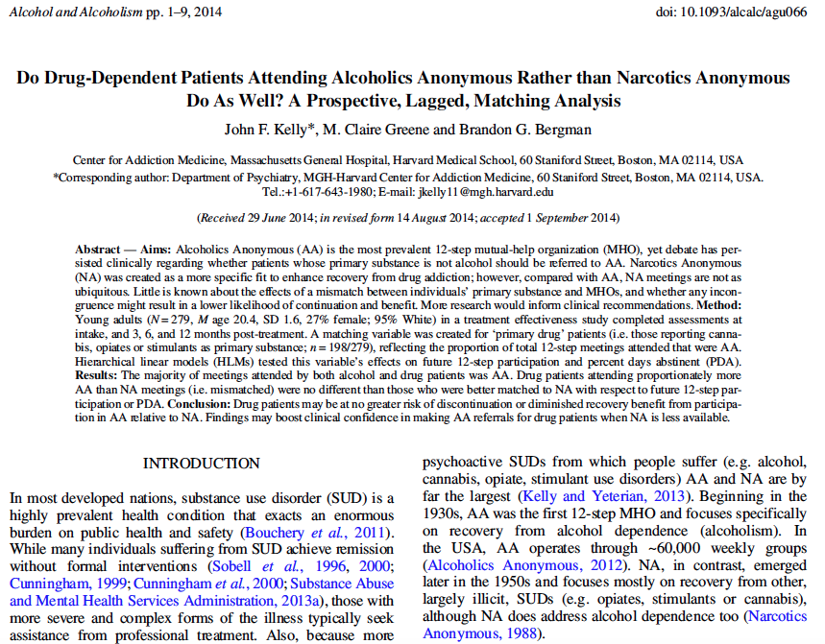
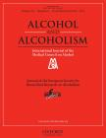

Slide 3
Background & Significance
High cost burden associated with long-term professional addiction recovery management
…and increasing health care incentives to use cost-efficient resources to sustain remission, has promoted clinical linkages to effective low-cost community mutual aid resources - become recent focus of UK treatment strategy (Hacker and Walker, 2013; Maust et al., 2013; Public Health England, 2013).
Therefore, many healthcare agencies encourage linkages to low-cost/freely available community mutual help organizations (MHOs)
Promising results have been found in regards to use of MHOs in addiction recovery
Higher rates of abstinence/SUD remission (Kelly, 2003; Moos & Moos, 2004; Kaskutas, 2009; Kelly & Yeterian, 2013)
Reductions in health care costs (Humphreys & Moos, 1996, 2001, 2007; Mundt et al., 2012)
Alcoholics Anonymous (AA) is the most prevalent 12-step MHO
AA focuses on recovery from alcohol addiction operates ~60,000 weekly groups in US (Alcoholics Anonymous, 2012).
NA, in contrast, emerged later in 1950s ; now ~20,000 weekly groups - focuses mostly on recovery from other, largely illicit, SUDs (e.g. opiates, stimulants, cannabis), although NA does address AUD too (Narcotics Anonymous, 1988)

Slide 4
Background & Significance
NA less available…
Because of the lower availability of NA compared with AA meetings, especially in suburban or rural communities, many with primary drug problems other than alcohol, may find it more difficult to access NA meetings, despite being potentially more relevant and closely matched to their specific addiction histories, experiences and recovery preferences.
Despite overlap in substance-specific comorbidities…
...of both organizational memberships (i.e. large proportion of AA members have other drug problems, and NA members, alcohol problems), in keeping with their names and original raison d’etre, there is a relative emphasis on recovery from specific substances, particularly in AA, regarding alcohol (AA’s ‘singleness of purpose’; Alcoholics Anonymous, 2001).
Substance-Specific Focus of AA…
Intended to promote greater therapeutic benefit via stronger identification resulting in tighter group cohesion and a deeper sense of universality. Also may foster efficient communication of recovery strategies that are intimately tied to distinctive characteristics associated with the use of and recovery from particular substance (e.g. its pharmacology, withdrawal, and post-acute withdrawal profiles) as well as its sub-cultural context (e.g. legality, cultural stigma, availability) (Alcoholics Anonymous, 1953).

Slide 5
Background & Significance
Lingering clinical question, therefore, is whether primary drug patients would attend, become engaged and derive as much benefit from 12-step MHOs if they attended more ubiquitous AA, rather than less available NA, meetings.
This question is particularly pertinent to young adults who comprise a substantial proportion of SUD treatment admissions (SAMHSA TEDS 2013) and, compared with older adults, are less likely to report alcohol as their primary substance (Substance Abuse and Mental Health Services Administration, 2013b).
Currently unclear whether any incongruence might result in more rapid discontinuation and less recovery benefit (perhaps via a lowered sense of universality, cohesion, and identification and reduced exposure to substance-specific recovery skills that many deem so helpful in their 12-step experience; Kelly et al., 2008, 2010a; Labbe et al., 2014).

Slide 6
Research Questions
Do young adults who report either alcohol, cannabis, opiates, or stimulants as their primary substance attend MHOs, and AA and NA specifically, at different rates in the year following residential treatment?
Among young adults who report either cannabis, opiates, or stimulants, as their primary substance (‘primary drug patients’), does proportionately greater attendance at AA rather than NA in the first 3 month post-treatment (a theoretical ‘mismatch’) result in subsequently lower rates of attendance and involvement at 6- and 12-month follow-ups?
Among primary drug patients does proportionately greater attendance at AA during the first 3 months post-discharge result in less subsequent recovery benefit (abstinent days) at 6- and 12-month follow-ups?

Slide 7
Study Population & Design
279 young adults undergoing residential treatment for a SUD
20.4+1.6 years old, 95% Caucasian, 73.4% male, 100% single
Study Design
Prospective cohort study
Follow-up
Assessments at 0m, 3m, 6m, 12m follow-ups
Measures
Form-90: substance use in the past 90 days
Multidimensional Mutual Help Activity Scale: 12-step attendance and involvement
Bio-assay (saliva) conducted: Abstinence confirmed in 99.6–100% who reported abstinence from all substances during assessment period prior to each follow-up.

Slide 8
Baseline Differences
There were demographic and clinical differences at baseline between primary substance groups
Opiate and stimulant patients had the most severe clinical profiles at baseline
65% of patients with a primary drug use disorder also met for DSM-IV alcohol abuse or dependence
All patients had used alcohol in the past 3 months at baseline

Slide 9
Do individuals with different primary substances attend 12-step meetings at different rates?
At baseline, the opiate group was attending more 12-step meetings, on average, relative to the cannabis group
At 6-months, the stimulant group was attending more 12-step meetings, on average, relative to the cannabis group

Slide 10
Do individuals with different primary substances attend AA at different rates?
At baseline, the opiate group attended more AA meetings on average relative to the cannabis group
No other between-group differences in number of AA meetings attended

Slide 11
Do individuals with different primary substances attend NA at different rates?
At baseline, the opiate group attended more NA meetings, on average, than the alcohol group
At 6 months, the opiate and stimulant groups attended more NA meetings, on average, than the alcohol group
At 12-months, the opiate group attended more NA meetings, on average, than the alcohol group

Slide 12
12-Step Attendance, Involvement and Percent Days Abstinent by Primary Substance
HLMs tested for differences between the four primary substance groups and
% days attending a 12-step meeting
12-step involvement
% days abstinent
During follow-up (3- to 12-months), attendance, involvement and abstinence declined over time (p<0.05)
The stimulant group had higher % days attending a 12-step meeting over the follow-up period relative to the alcohol group.
No other significant main effects of primary substance over the follow-up period (reference group=alcohol)

Slide 13
“Primary Drug Patients” vs. “Primary alcohol” patients
Patients who reported at treatment intake either cannabis, stimulants, or opiates as their primary substance were categorized as “Primary drug patients” (n=198/279)
Patients who reported alcohol as their primary substance on treatment entry were labeled “primary alcohol” patients (n=81)

Slide 14
“Mismatch”
The proportion of 12-step attendance that was theoretically mismatched
For a patient with a primary drug use disorder:
Degree of Mismatch = | # of AA meetings
 | (# of AA meetings + # of NA meetings)

Slide 15
Degree of Mismatch
Among primary drug patients, the proportion of meetings attended that were AA ranged from an average of 69.9-79.4%

Slide 16
Among primary drug patients does greater mismatch in the first 3 months post-treatment result in lowered rates of attendance and involvement at 6 months and/or 12 months? Controlling for for predictors of attrition (education); baseline levels of DV: (12-step attendance, 12-step involvement, PDA)
No effect of mismatch on future attendance or involvement

Slide 17
Among primary drug patients does greater mismatch during the first 3 months post-treatment result in less recovery benefit?
No effect of fellowship mismatch on percent days abstinent over the follow-up period (controlling for attendance/involvement)
Controlling for for predictors of attrition (education); baseline levels of DV: (12-step attendance, 12-step involvement, PDA)

Slide 18
Conclusions
Findings here suggest that, while primary drug patients may attend more NA meetings post-treatment compared to primary alcohol patients in absolute terms, they attend proportionately more AA meetings.
We did not find evidence that a greater match between an individual’s primary substance and fellowship type bears any influence on future 12-step participation or abstinence.
Contrary to expectation, young adults who identify cannabis, opiates or stimulants as their preferred substance may, in general, do as well in AA as NA.
This has significance in many communities where NA meetings may be less available or unavailable.

Slide 19
Acknowledgements
This research was supported by grant funding from the National Institute of Alcohol Abuse and Alcoholism (R21 AA018185-02) and by anonymous donations to the Hazelden Betty Ford Foundation.
Co-Authors:
Brandon G. Bergman, PhD
MGH-Harvard Center for Addiction Medicine
M. Claire Greene, MPH
Johns Hopkins Bloomberg School of Public Health

