Slide 1
Problem framing amongst harmful drinkers: effects on behaviour change and early recovery*
James Morris, PhD candidate, London South Bank University
*may contain DIY memes and Sopranos references

Slide 2
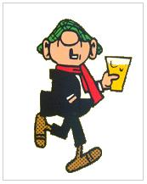
Problem framing?
Most harmful drinkers do not recognise their drinking as problematic:
‘Denial’? (Pickard, 2016)
Normative misperception (Shiner & Winstock 2015)
Fear of stigma/labelling (Schomerus et al., 2011)
Lack of an available language/framework to describe their drinking…?
Is this affected by problem framing? I.e. beliefs about what ‘alcohol problems’ are e.g.
“disease” – all or nothing? (binary framing)
“disorder” of severity (continuum framing)
Hypothesis: ‘disease model hinders problem recognition compared to continuum e.g. “I’m not an alcoholic” = nothing to see here!

Slide 3
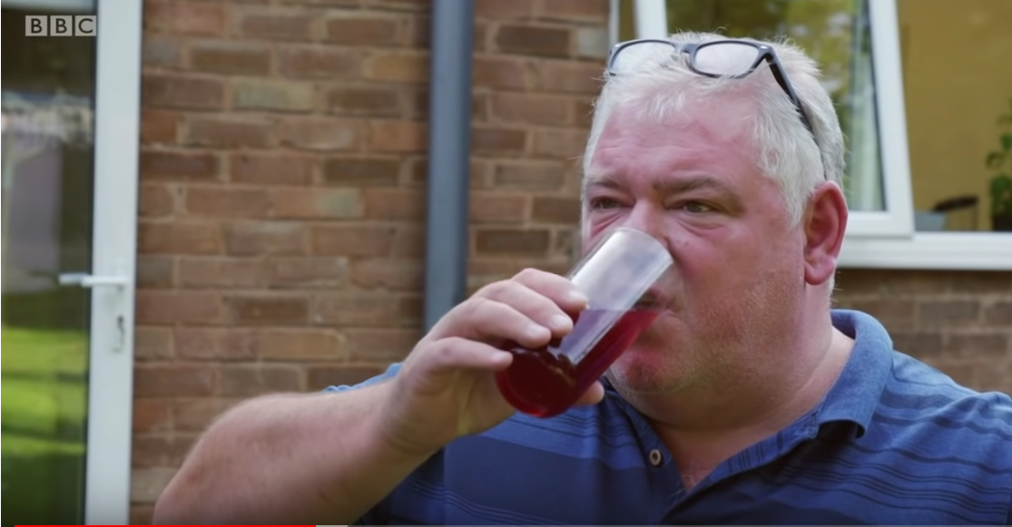
‘Drinkers like me’, Adrian Chiles, BBC Panorama 2018
“My name’s Adrian Chiles, and I’m not an alcoholic… at least, I don’t think I am...”
“It was only after I stopped drinking completely that I was able to see just how deeply ingrained my denial was …”
Adrian Chiles
“To a degree, we’re addicted to [alcohol], without being alcoholics”.
Mark

Slide 4
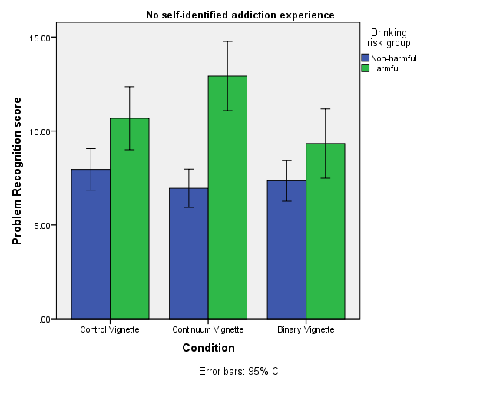
Study 1
Online experimental study (n597) with 3 conditions: Binary (disease model), continuum & control
Harmful drinkers with no self-identified addiction experience had higher problem recognition in the continuum condition versus control (p=.007) and binary (p<.001) conditions
Study 2: does self-stigma mediate this effect?

Slide 5
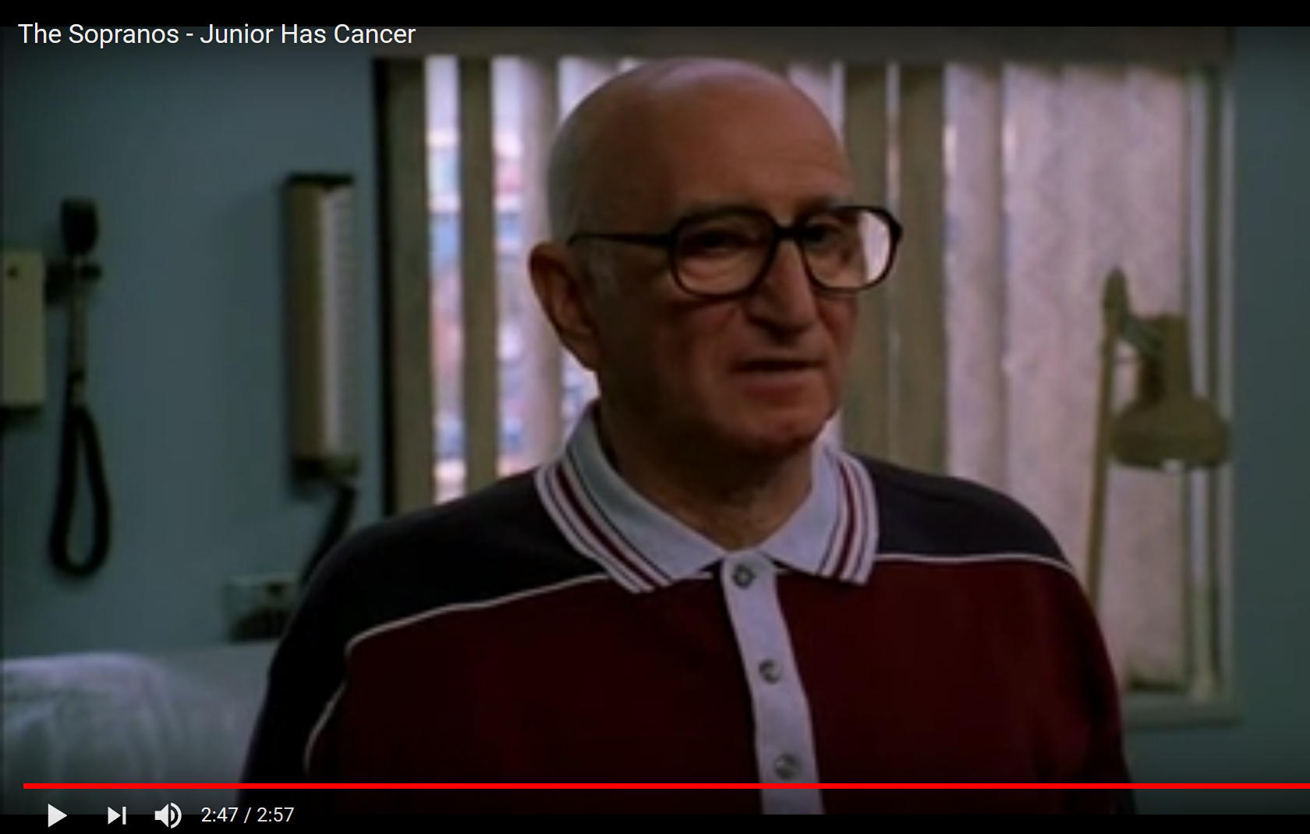
Stigma and disease
Junior Soprano: “I have cancer.”
Tony Soprano: “You have what?”
Junior Soprano: “Cancer. The big Casino..”
Tony Soprano : “Jesus Christ Uncle Jun…”
Junior Soprano:
“Promise me that you'll dummy up about this… You're sick, people look at you different, they treat you like a fuckin' non-entity. I'm not kidding. You can't talk about this with anybody.”
Tony: “yeah, yeah, of course.”
Next scene Tony calls his sister Janice:
Janice: “Hello?”
Tony: “Uncle Jun’s got cancer…”

Slide 6
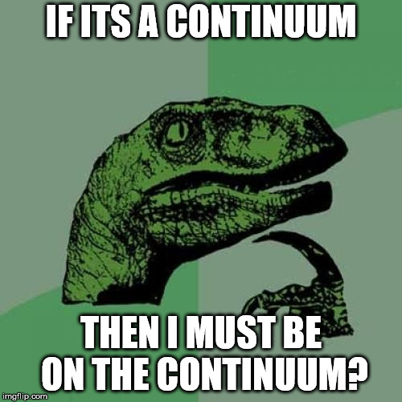
Effect of condition on problem recognition: implications?
Continuum beliefs (i.e ‘anyone can experience alcohol problems’) increased problem recognition…
Promoting continuum beliefs amongst harmful drinkers may be helpful for ‘early-recovery’ processes, as seen in mental health (Schomerus et al. 2013, Corrigan et al. 2016)

Slide 7
Contact
morrij17@lsbu.ac.uk
Twitter @jamesmorris24
With thanks to Alcohol Research UK and LSBU for support

