Slide 1

Listening to the service user voice: advantages for service delivery design
Magdalena Harris & Tim Rhodes
London School of Hygiene and Tropical Medicine
magdalena.harris@lshtm.ac.uk

Slide 2
Overview
LSHTM qualitative research: eliciting SU perspectives
Hepatitis C – the need for a new approach
HCV treatment provision: the role of flexibility
HCV prevention: the role of pragmatics
Tensions & limits: OST & vein care service provision
OST service user advocacy / innovations in harm reduction
From ‘risk’ to pragmatics: implications for interventions

Slide 3
The case of hepatitis C
Over 40% of PWID in the UK & over 60% in London HCV antibody positive
Current harm reduction interventions limited HCV prevention impact
Risk awareness insufficient to effect a change in injecting risk behaviour
PWID adherent to and interested in HCV treatment , yet uptake low
Changing HCV tx landscape: service delivery, eligibility & drug development
Time for a new approach: Learning from service user perspectives

Slide 4
Barriers & Facilitators study
Assessment of HCV treatment provision in D&A settings (2011)
2 sites (A&B)
  Partnerships between drug/alcohol and hepatology services (London)
Interviews with service users (n=35)
  29 male, 6 female
  32 receiving opioid substitution therapy
  Treatment: 13 not started; 6 ongoing; 4 interrupted; 12 completed (9 SVR)
Interviews with service providers (n=14)
  Hepatologists, blood-borne virus nurse specialists, psychiatrists, drug/alcohol service managers
Literature review
  Barriers & facilitators to HCV treatment access and uptake for PWID (Harris & Rhodes, 2013)

Slide 5
From hospital ....
  Multiple barriers associated with hospital–based HCV treatment
  (Complex referral & appointment systems, lengthy waiting times, rigid DNA & eligibility criteria, distance/unfamiliarity, stigma & discrimination)
  I wouldn’t have gone to hospital [for HCV treatment]... I was really badly treated and I know loads of people that have been treated abysmally down there, really blatant discrimination ... Just looking with clear disgust in the nurses’ faces, ‘You’re drug addicts, oh, so you got it through injecting, well you should know better’. (Len, Site B)
  As soon as I told the consultant what drugs, what medication I was on he was like, ‘Ooh’. He sort of like recoiled a bit ... [I am] much less vocal, yeah. Because I just feel like I’m lucky to be getting it [HCV treatment] ... damn lucky that someone is willing to treat us, do you know what I mean? ... There’s a personal judgment on you. (Davey, Site A)

Slide 6
... to community
Valuing service user perspectives ...
When we started treatment, [the hepatologist] went and he saw 3 or 4 patients. He [asked] ‘what do you think of the service, what could we do better’ and they really appreciated that, because it’s valuing their opinion and their input because they’re the ones who are using the service. (BBV Nurse, Site B)
I said to [hospital] it’s a good time for peer supporters to be involved, but we want something in return. So they’ve offered us any training that we want, anything to do with blood, which is cool (Len, Site B)
... to tailor/’tame’ the system:
Hospitals, it’s not that they won’t do it, they can’t do it. They can’t tailor the system to fit the client, they can’t have open access outpatients’ appointments where you just turn up when you want to, they can’t do that. You can’t run a hospital like that unfortunately. So that’s why our client group don’t fit that. (BBV nurse, Site A)

Slide 7
What works:
‘Taming the system’
Service provision that is:
Familiar ….
It [D&A service] was a familiar place to us and that’s what made us think, I’ll come back and I’ll try it [HCV treatment]. (Davey, site A)
… flexible
    Appointments
    Phlebotomy
    Eligibility / on-going substance use
  and responsive
    Health and social supports
    Multidisciplinary / a one-stop shop
It’s got everything in the one place...you’re in the building with like minded people and it’s easier. (Dillon, site B)
to service user needs

Slide 8
Negotiated flexibility: appointments
Open slots / sensitively timed appointments / No DNA policy
[Flexibility is important] because sometimes you don’t know how you are going to be feeling ... you get your ups and your downs, Its a tackle each day really. You’ve got bad drug habits, drink habits, depression. (James, Site A)
It’s probably our model of care which is the most effective, is about being flexible with patients and you set an appointment with a patient and if they don’t turn up, that they can still see us. (BBV nurse specialist, Site B)
If someone’s injecting heroin, 3 or 4 times a day, they’ve got to score in the morning, why give them a 9 o’clock appointment when you know they’re not going to make it. (BBV nurse, Site A)

Slide 9
health & social supports
Attention to pressing concerns: acute health issues/ benefits/ housing
We do primary healthcare, so that can range from leg ulcer dressings, sexual health testing ... any health problem that walks in the door. (BBV nurse, Site A)
We've had incidences of where people have been on Hep C treatment and there's been concerns of threats of eviction, so it's liaising with the housing worker just to say look, this person is on this treatment, it's really important that they have stable accommodation, it's important things like having a fridge to be able to store their interferon, things like that. Can we try and work out some way in which the person isn't evicted? (Nurse specialist, Site A)
[I] got a decent key worker who knew my housing situation and they managed to get me into a B&B and then from there, I got a flat. (Dillon, Site B)
They give me one to keep the [interferon in], a little fridge, yeah. (Fabio, Site A)

Slide 10
phlebotomy
Onsite phlebotomy / relaxed protocols / non-stigmatising / collaborative
I kept on saying to [hospital phlebotomist], ‘Look, you know, my veins are a nightmare, you know, let me do it’. [She said] ‘Oh you people, you think you know about your veins and all that, when you know nothing’. (Dillon, site A)
I listen to them because very often, they do know where the vein is because they use their veins to inject so they know which veins. (BBV nurse, site A)
You are only doing what is absolutely crucial. I’ve researched the minimum volumes for each test, so we have that information. (BBV nurse, site B)

Slide 11
Tensions and limits: OST
Power relations / supervised consumption / autonomy & trust
My key worker told me to [take the appointment]. It’s always been like that, it always will, the person who writes the [OST] script, they hold the power, you’re not going do anything to piss them off. (Dillon, Site B)
I’ve been on the [methadone] script for about 8 months now and they still supervise. I don’t know what they think I'm going to do ... I’m too angry with the system at the moment. I don’t really engage ... what pisses me off is why don’t they trust me? (Hakki, Site A)
I get it weekly, I’ve been trusted for a long time ... The hepatitis [treatment], the last thing you want is to run out to the chemist and get your medicine and come back. Knowing that it [methadone] was there, it was one more thing off your list that you had to do. So it is a great help having it there. (Jeff, site A)

Slide 12

Service user advocacy
Method:
Survey, with qualitative component.
Administered by 5 LSUC members
August 2013
40 participants. 70% male, 30% female.

Slide 13
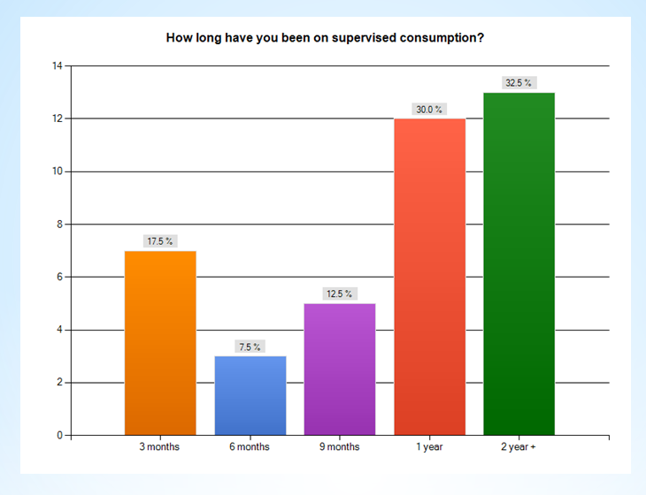
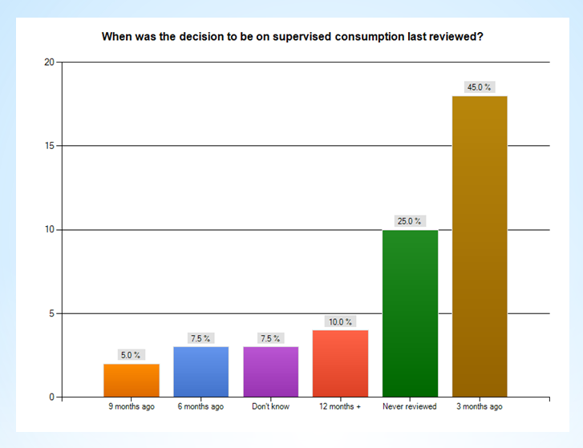
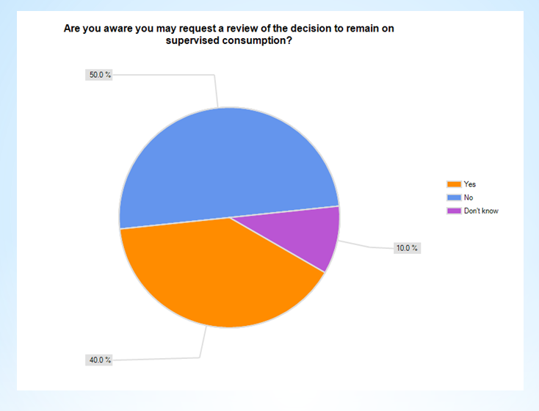
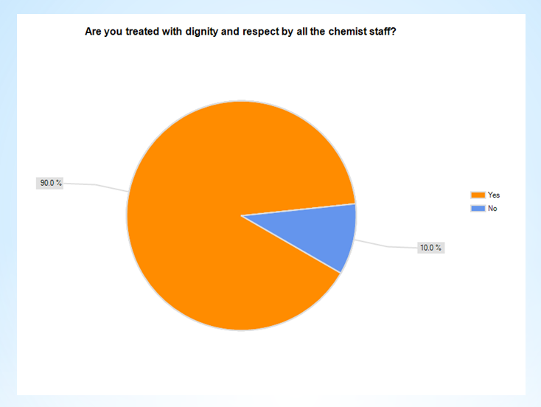

Slide 14
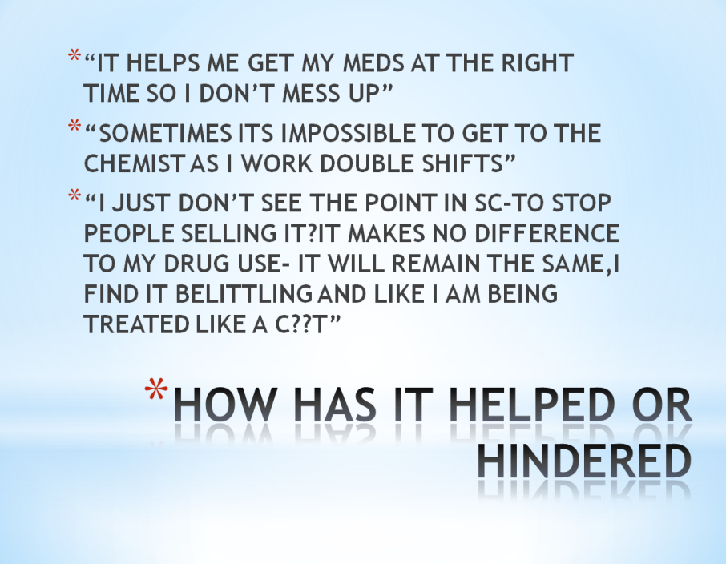
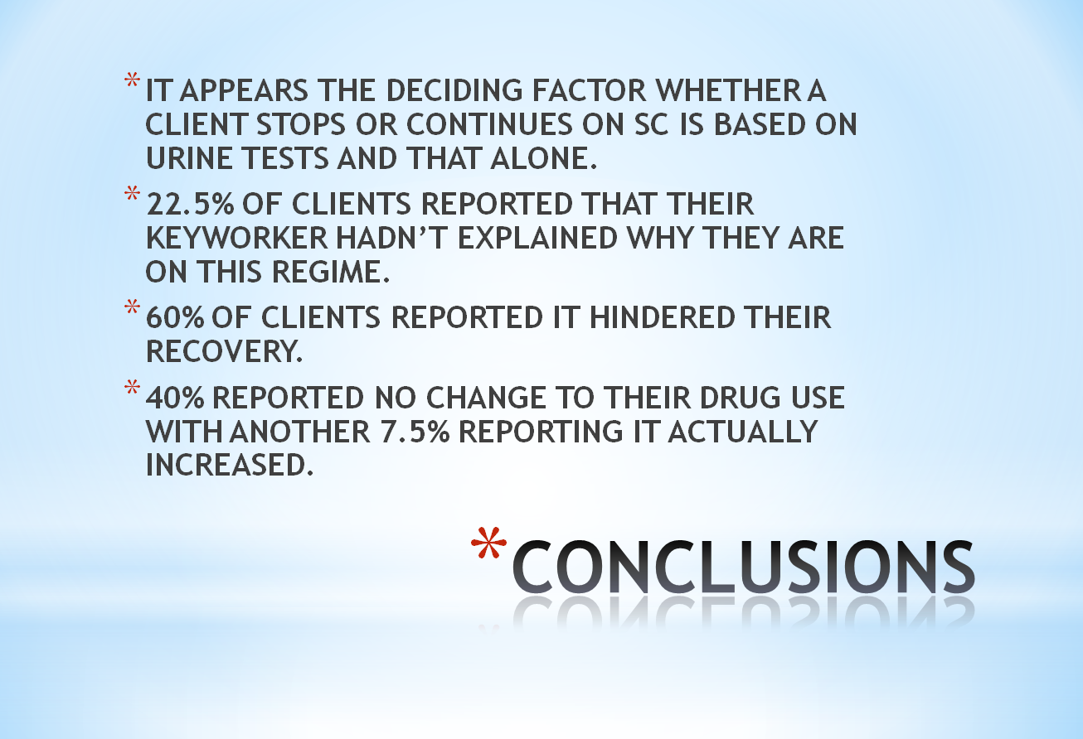
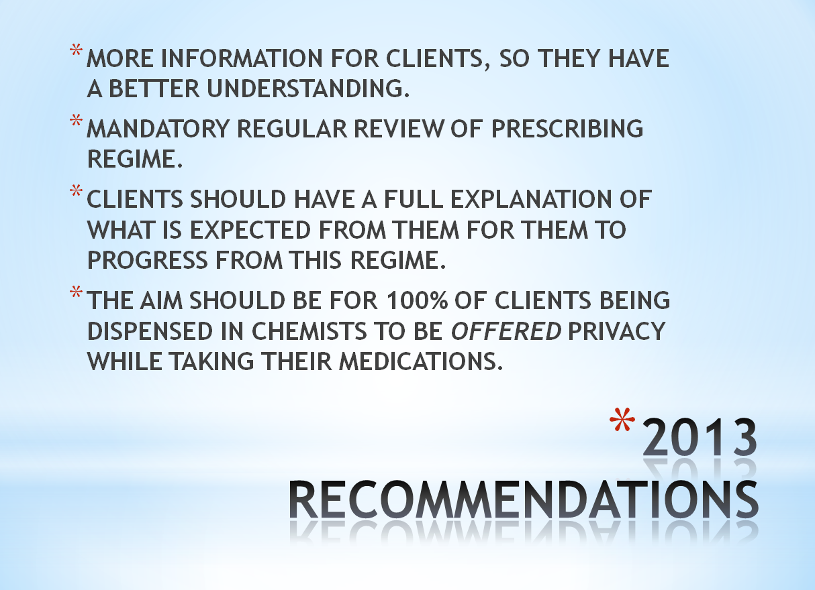

Slide 15
Listening to service users?
It wasn't very well received, it was criticised by some managers & staff for being the report writers opinion rather than the interviewees opinion. When we challenged them on this and asked them to point out what parts they talking about, they didn't give an answer.
One thing that surprised me when presenting the report was how ignorant some staff were regarding what supervised consumption entails, quite a few had no idea that the chemist can make you open your mouth 4-5 times during the 5-10mins it can take to dissolve the tablet.
As for it making a difference, there has been some changes. All consortium staff have mandatory prescribing regime training every 6 months with progression from supervised consumption being a big part of the training. Also the consortium managers have started to go through keyworkers caseloads to check for people that would be suitable to come off supervised consumption.
I would like to think these things are happening because of our report or because they don't want to put their clients through a very degrading process but I know that isn't the case. The reason these things are happening are because Lambeth budgets quite a large sum of money for enhanced payments to chemists for carrying out supervised consumption and for the last few years it has gone over budget ... so its because of money and not that consortium cares that its clients find it discriminatory and belittling. (Lambeth Service User Council)

Slide 16
Staying Safe: learning from the experts
Exploration of social practices of long-term viral avoidance
Multiple life history interviews with 37 London PWID (2010-2011)
  22 HCV-, 15 HCV + / 17 male, 10 female
  23 – 57 years old (average 40) / Injecting for 6-33 years (average 20)
Traditional HCV prevention research
  Event specific, risk focus
  Deficits in risk knowledge/concern: potentially alienating/stigmatising
A broader view
  De-prioritisation of HCV & ‘risk’ events
  Focus on protective individual, social and environmental factors

Slide 17
Protective practices
Using alone or in clearly demarcated using areas
Waiting to use until at home
Preparedness: drugs, money, N&S, equipment
Stockpiling/bulk: drugs, N&S, methadone
Separation &/or marking of N&S and equipment
Rules regarding not sharing N&S, filters, cinbins
Being in charge of mixing up/drug mix distribution
Temporary heroin smoking
Maintaining social networks / reciprocal relations
Carrying injecting ‘kit’ at all times / stashing N&S

Slide 18
The role of pragmatics
Vein care (not sharing or reusing N&S)
Privacy/pleasure (using alone/home, waiting, not sharing/reusing)
Withdrawal avoidance (preparedness, stockpiling, reciprocal relations)
Image management (using alone, waiting, smoking, not sharing)
Control of drugs (using alone, taking charge of mix)
Preventing dirty hits (not sharing/reusing, taking charge)
BBV prevention (not sharing, marking N&S, demarcation of using areas & equipment, smoking, preparedness)

Slide 19
Withdrawal avoidance:
OST sharing & stockpiling
I keep a stash of methadone up there, at my dad’s ... it’s there for emergencies. You know, emergencies. (Jeff)
Cause I don’t have to take it in front of the chemist, I can take what I want. I don’t have to take the full amount ... But if you take it in the chemist, you’ve got to do it all at once and you’re not allowed to save any, you have to drink it all. (Colin)
I had half a bottle of methadone I was able to give him ... it was nice to help him out because that bit of methadone will get him out of trouble (Ros)

Slide 20
Dirty hits & citric burns: taking charge
I’ll add a bit [citric] if I need to, but ain’t gonna put too much in ‘cos it burns ... That’s why I used to cook up my own hit, I never trusted anyone to do it … From when I had that citric, I was like “No mate, you ain’t fucking cooking my gear no more mate”, sod that. ‘Cos you’d end up with blotches everywhere, where it burnt everywhere. (Rebecca)
I’d had a dirty hit once before ... you get a great big pounding headache and you go all shivery and oh, it’s horrible, really horrible, so it was just from that I knew to keep my shit clean. (Abby)

Slide 21
Vein care: new works = sharp works
I’m not going to use a pin [needle] more than once, once its punctured my skin twice that pin is dead now because it’s blunt, therefore I can’t share anyone else’s because it’s blunt already, that was one of the reasons. That was the main reason. (Andy)
If you always use fresh needles you minimise any vein damage ... [I do it] to look after my veins to try and get more usage out of them (Jeff)
People would rather use clean works because they’re sharp for a start so, you know, they’re not going to be blunt. But does the message get through? Because hep C, you know: “yeah hep C, so what. I’m not going to drop down dead tomorrow. (Giles)

Slide 22
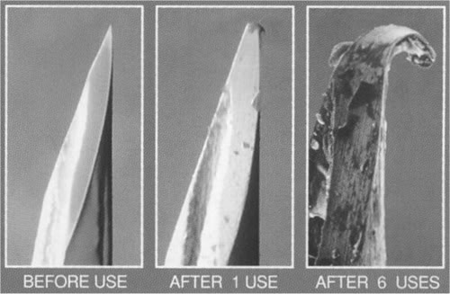
Track marks & stigma
Used works = blunt works
[I didn’t share] because I didn’t want scars to start off with and blunt needles give you scars … that was a massive thing to me ‘cause I didn’t want to go home and embarrass my family. (Lisa, Sydney)
[Needles] getting blunt mainly and just leaves scars. Also that picture in the clinics . Once, twice, three, five times used and you see it wear down.
(Phil, Sydney)
I like new stuff and, you know, it’s good to have those new ones there … And it doesn’t leave as big a mark as it does I think with the blunt ones. (Evan, Sydney)

Slide 23
Missed intervention opportunities
Q: Will they help you to find veins in other places?
No, for you to ask, no, because they will immediately go, oh well, try smoking. And you know, they don’t get it. Fucking hell, you know, smoking ! (Tony)
Sometimes I just can’t get [the femoral vein] look, I got two fingers here, can you tell me where the best place is to go? (Helene)
At one place, only because it was attached to the hospital, it was like a big poster of a man and he showed all his veins and his arteries, like red and blue, and it’s the closest I’ve ever seen to someone telling me. Even like when you’re banging-up, they say in the groin, I know it’s two fingers to the left, to the right, but I don’t know if it’s the left or the right, do you what I mean? … I wouldn’t know whether it’s left, right, up or down. (Fred)

Slide 24
Hepatitis C: a relative situated concern
HCV as ‘ubiquitous’, ‘normalised’, an ‘occupational hazard’, accommodated, of limited seriousness (Davis & Rhodes 2004; Wozniak et al., 2007; Harris & Rhodes, 2012)
[I first heard of HCV] just a few years ago. My mate said: “you’re bound to get it. Everyone who injects has got hep C”... And I thought, you can’t die from it, can you. It didn’t really bother me. (Ros)
The withdrawal makes you want to use other people’s needles ... if you’re ill and you’ve got no clean pins and the chemist is ten miles away, you ain’t going to fucking go to the chemist, bollocks, just give me a pin, I’ll use it! I have to get better, thank you. (Reuben)
My philosophy is if you’re going to get something, you’re going to get it you know, that’s my philosophy, it’s true, if you’re going to get something, you’re going to get something. (Leeroy)

Slide 25

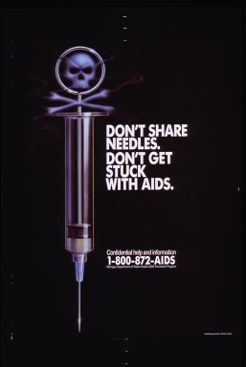

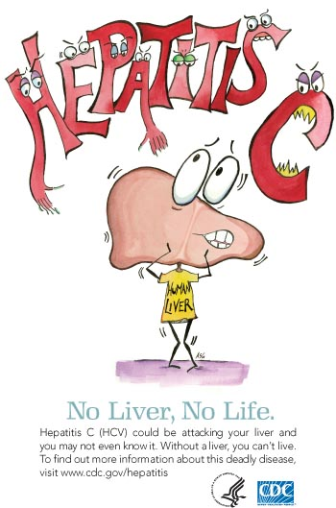

From risk ...

Slide 26
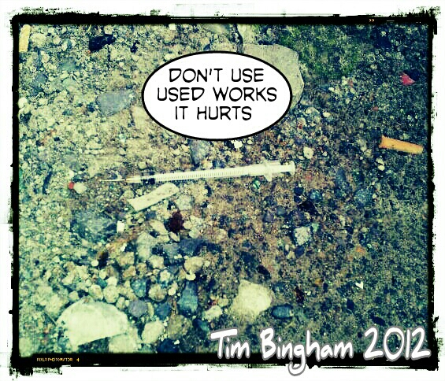
... to pragmatics

Slide 27
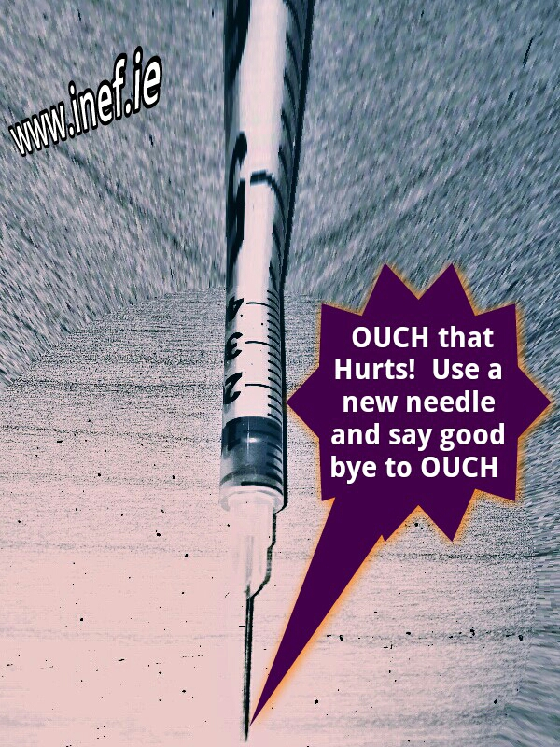
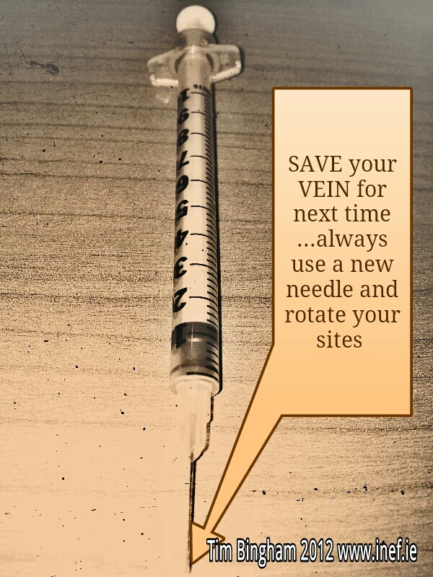

Slide 28
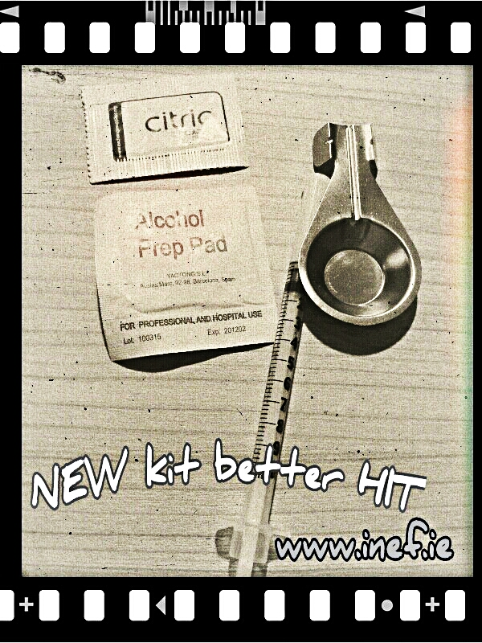
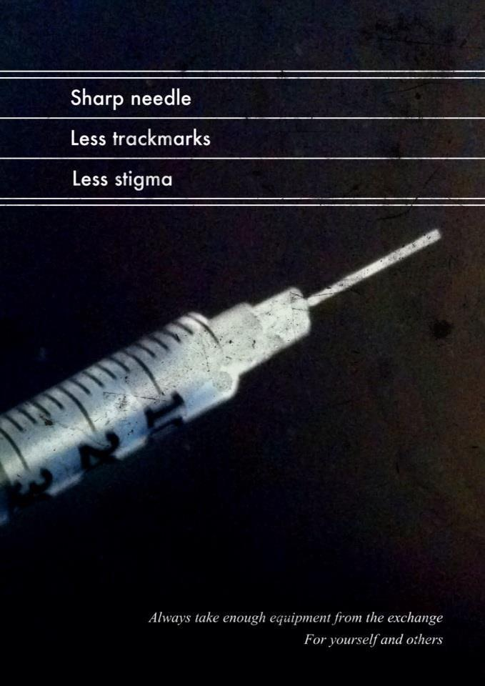

Slide 29
Implications for interventions?
Listening to & involving SU Meaningful & innovative service delivery
The case of HCV prevention:
  HCV avoidance often an indirect effect of short term concerns
  A movement from risk to pragmatics reengagement potential
The case of HCV treatment:
Enabling environment interventions
  Flexibility & attention to structural barriers increased engagement
Tensions & limits
OST supervised consumption / Vein care service delivery

Slide 30
Concluding thoughts
The service user voice?
Accessing SU perspectives: power relations & qualitative research
Meaningful interventions: re-assessing the role of risk?
Constraining contexts: budget cuts & PBR
Utilising the expertise of peers
A place for drug use pleasures and pragmatics in the ‘recovery’ agenda?
I like taking drugs you know. ... And I’m not hurting no-one so I’m going to continue to take them until I die. (Malcolm)

Slide 31




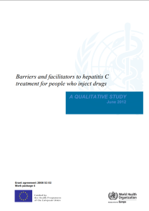
Harris, M. & Rhodes, T. (2012). Venous access and care: Harnessing pragmatics in harm reduction for people who inject drugs. Addiction, 107, 1090–1096
Harris, M., Rhodes, T. & Martin, A. (2013). Taming systems to create enabling environments for HCV treatment: Negotiating trust in the drug and alcohol setting. Social Science and Medicine, 83, 19-26.
Harris, M. & Rhodes, T. (2012). Methadone diversion as a protective strategy: The harm reduction potential of ‘generous constraints’. International Journal of Drug Policy
Harris, M. & Rhodes, T. (2013). Hepatitis C treatment access and uptake for people who inject drugs: A review mapping the role of social factors. Harm Reduction Journal 10:7
WHO Regional Office for Europe (2012). Barriers and facilitators to hepatitis C treatment for people who inject drugs: A qualitative study. Copenhagen: WHO Regional Office for Europe.

Slide 32
Acknowledgements
LSHTM study participants
Fieldworkers Greg Holloway & Anthea Martin
Lambeth Service User Council
Research partners/sites: Lorraine Hewitt House, Ceders Road Hostel, Islington Primary Care Practice, ELFT Specialist Addiction Unit, Royal London Hospital, Kings College Hospital.
Research Funders: The Economic and Social Research Council, National Institute of Health Research, WHO Regional Office for Europe, European Commission Directorate of Health and Consumers

