Slide 1
Using Transient Elastography to identify undetected but significant liver disease in patients attending community alcohol misuse services
Nottingham Digestive Diseases Biomedical Research Unit
David J Harman, Vasudevan Krishnan, Emilie A Wilkes, Stephen D Ryder, Martin W James, Guruprasad P Aithal, Karen Fisher, Tanzeel R Ansari, Indra Neil Guha

Slide 2
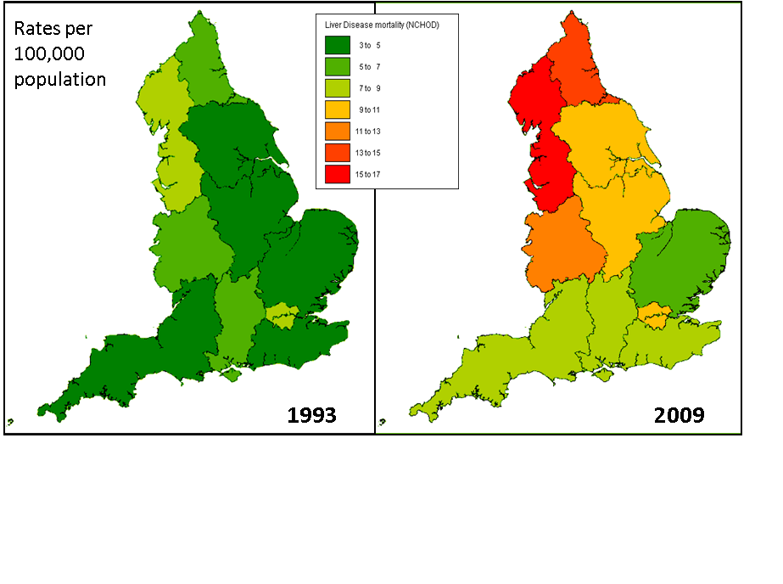
Bhala et al, BMJ , 2013

Slide 3
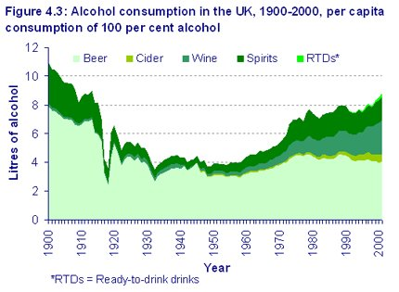
Academy of Medical Sciences. Calling time. The nation’s drinking as a major health issue; 2004

Slide 4
Natural History of Chronic Liver
Disease
Risk Factors
Alcohol
Diabetes
Obesity
Viral hepatitis
Scarring
Severe Scarring (Cirrhosis)
Symptoms
Death
5-20 yrs 10%/ yr

Slide 5
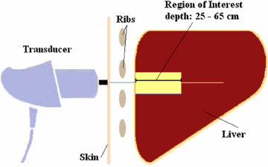
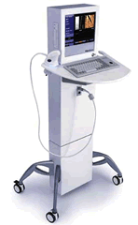

Slide 6
Nottingham Community Study Rationale
1/ Are non-invasive liver fibrosis biomarkers feasible use in a non-hospital setting?
2/ Can Transient Elastography (TE) identify silent but significant liver disease in patients with liver fibrosis risk factors?

Slide 7
Nottingham Community Study
Consecutive patients triaged for review by Oxford Corner Substance Misuse team in Nottingham invited for an additional liver scan appointment
Study period April 2012 to March 2014
  TE examination performed at Oxford Corner by trained nurses
  Liver stiffness threshold of ≥8 kilopascals* prompted review in the community by visiting consultant hepatologist
  Longitudinal follow-up of hospital/Oxford Corner notes – cross-sectional analysis of alcohol intake at 6 months after Fibroscan
*Roulot et al, Gut, 2011

Slide 8
Patient Flowchart
156 patients invited for TE appointment
69 patients refused or did not attend
87 patients attended TE appointment
1 unsuccessful scan
86 patients with successful liver stiffness acquisition

Slide 9
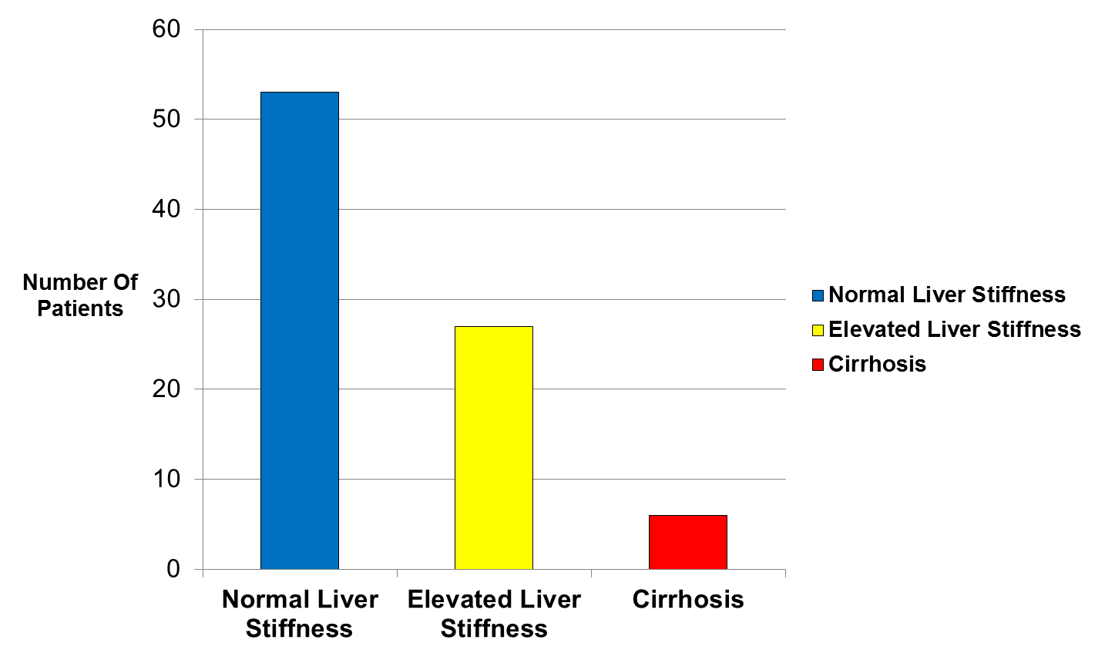
Liver Stiffness Results

Slide 10
Liver Function Test
Performance
Table 1. Serum alanine aminotransferase (ALT) levels of patients with successful liver stiffness acquisition
Liver Stratification | Normal ALT (local lab cutoffs) | Raised ALT (local lab cutoffs)
Normal Liver Stiffness (n=53) | 23 (43.4%) | 30 (56.6%)
Elevated Liver Stiffness* (n=32) | 8 (25%) | 24 (75%)
Cirrhosis (n=6) | 2 (33.3%) | 4 (66.7%)

Slide 11
Liver Function Test
Performance
Table 2. Serum gamma-glutamyl transferase (GGT) ) levels of patients with successful liver stiffness acquisition
Liver Stratification | Normal GGT (local lab cutoffs) | Raised GGT (local lab cutoffs)
Normal Liver Stiffness* (n=34) | 5 (14.7%) | 29 (85.3%)
Elevated Liver Stiffness* (n=25) | 1 (4%) | 24 (96%)

Slide 12
Table 3. Alcohol consumption of 86 patients successfully undergoing Transient Elastography
Variable | Normal Liver Stiffness (n=53) | Raised Liver Stiffness (n=33) | P Value
Alcohol units/week (pre-scan) | 138.7 (85.3) | 159.3 (86.1) | 0.334
Alcohol Abstinence (6 months post-scan) | 19.0% | 26.9% | 0.526
Reduction in Alcohol Intake | 65.0% | 64.0% | 0.944
Increase in Alcohol Intake | 20.8% | 3.0% | 0.04
Mean Change in Alcohol Intake (Units/week) | -44.7 (94.8) | -80.7 (103.0) | 0.235

Slide 13
Summary
Transient Elastography is a feasible tool to stratify clinically significant liver disease in community alcohol misuse services
Using TE identifies a significant yield of chronic liver disease which would be missed with standard investigation algorithms
The use of TE as an adjunct to alcohol reduction/abstinence warrants further study with a randomised controlled trial.

Slide 14
Any Questions?

