Slide 1
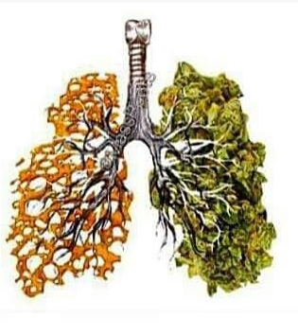
Developing the evidence base for an intervention to address tobacco and cannabis use
Hannah Walsh RMN
PhD student
King’s College London
SSA phD symposium 2018

Slide 2
TOBACCO
CANNABIS
…EXCEPT for people living with mental health problems, substance use disorder, manual workers, low SES …
use
Use
Use
T
H
C
Demand for tx
CO-USE
co-administration
concurrent
Demand for tx

Slide 3
Aims
To describe topographies of co-smokers, co-quitters and trying-to-quitters
To build up the evidence and background theory to support an intervention
To develop the logic model for intervention which addresses both tobacco and cannabis

Slide 4
Who to target?
General population
What age range?
Where?
Treatment seekers
Cannabis treatment
Tobacco treatment

Slide 5
MRC complex intervention framework & COM-B
1. To carry out a systematic review of interventions which address both substances
Findings:
RCTs needed; cannabis cessation more likely than tobacco cessation; inconsistent measurement
2. To carry out a review of existing literature to develop a theoretical basis for a simultaneous or sequential intervention
3. To carry out a questionnaire survey to ascertain patterns of co-smoking, motivation to quit, history of quit attempts, interest in intervention and interest in type of intervention (i.e. digital or face to face, or group)
4. To carry out qualitative interviews with co-smokers, to further explore similar questions as above
5. Develop a logic model which could form the basis of intervention development (post PhD)

Slide 6
Thank you for listening
Hannah.walsh@kcl.ac.uk
@hannaheawalsh

