Slide 1
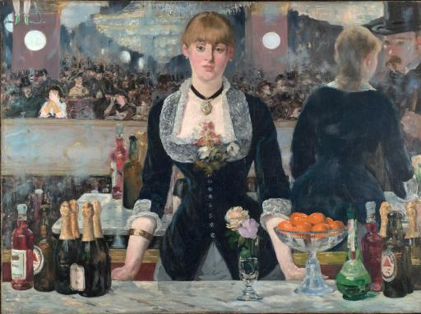
Selling Ideas of Respectable Drinking: Alcohol Producers in Late Victorian Britain
Thora Hands
University of Strathclyde
Email: thora.hands@strath.ac.uk

Slide 2
The expansion of the alcohol industry

Slide 3
The ‘spectre of the drunkard’

Slide 4
Case studies
Bass & Co. – brewers based in Burton-upon-Trent
James Buchanan & Co. – Scotch whisky manufacturers
W&A Gilbey – one of the leading wine and spirit merchants in Britain

Slide 5
Bass Brewery Burton-upon-Trent

Slide 6
Bass Branding

Slide 7
Bass Advertising

Slide 8
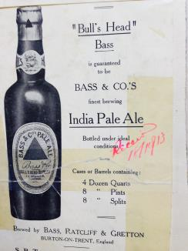
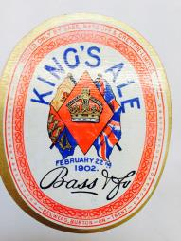
Culture & Imperialism

Slide 9
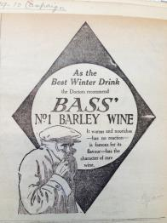
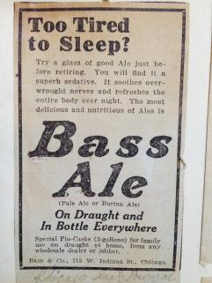
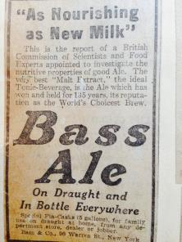
Health

Slide 10
Buchanan’s whisky

Slide 11
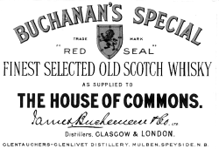
House of Commons Brand

Slide 12
The Whisky Test
The label states
‘At the British and Foreign Spirits Select Committee appointed by the government in 1890, under the presidency of Lord Playfair, Dr. Bell, CB, the chief analytical chemist of the government spoke in terms of high appreciation of a sample of our Scotch whisky saying “From the general fine character of the sample there is reason to believe that it has been warehoused for many years etc.

Slide 13
The drink of the elites

Slide 14
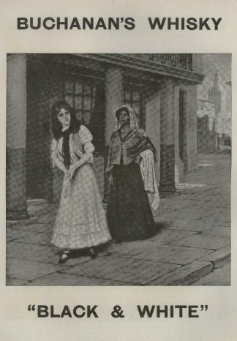
Black & White

Slide 15
W & A Gilbey
‘There are indeed many people who want to buy limited quantities of the best brandy than of the best champagne, as it is looked upon somewhat as a medicine that must be kept in the house, and it is just as difficult to get them to believe this can be obtained without the brand of Hennessey or Moet, as the finest champagne can be obtained under W&A Gilbey’s Castle 4a or Castle 5a. We shall therefore, make just as large a profit on any goods we sell under these brands as if we sold them under the brand of W&A Gilbey …’

Slide 16
The illusion of the brand
‘If during the last few years we have increased our reputation for selling pure but cheap wine, we have also considerably increased our commercial reputation and the public are disposed to place unbounded confidence in us when we state that Croft’s Port and Gonzales Sherry are the finest, but are very loathe to believe us when we endeavor to crack open our own goods such as Castle J Port and Castle A Sherry, no matter what the quality may be’

Slide 17
Conclusions
Elevating the commodity value of alcohol involved the creation and propagation of particular ideas about the substance. Bass and Buchanan did this very effectively through the use of branding and advertising.
If particular brands were associated with ideas about wealth, status, health or even British imperialism then people were more inclined to conspicuously consume these products.
This created a distinction between ‘good’ brands and cheaper alcoholic drinks – a distinction that prevails.

