Slide 1
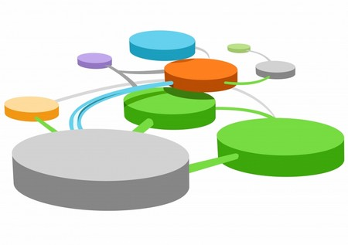



AN AUDIT OF COMPLEXITY IN A COMMUNITY ADDICTION CASELOAD
Logo
Here
Authors Dr David M Greenwell, Dr David Johnson
1. INTRODUCTION
2 DEVELOPING AN INSTRUMENT TO MEASURE PATIENT COMPLEXITY
Staff working in a small community addiction service in the West of Scotland felt that the case load carried by the service had a substantial number of patients with highly complex presentations
Staff reported that the number of service users with complex presentations resulted in a substantially higher workload which has not necessarily been mirrored in other teams working in other parts of the same Health Service area
The aim of the audit was therefore to assess patient complexity in the addiction service (Service A) and to compare this to another service in a different part of the same Health Service area (Service B) which operated in a similar way
A search of online database using the search terms “complex and addiction and measurement” did not identify an instrument for measuring complexity in addiction team caseloads. It was therefore necessary to develop an instrument the purpose of which was to measure patient complexity in a community addiction caseload.
The tool was developed on the basis of the following assumptions:
Patients with more risk factors in their lives would require more input from the addiction team in developing and implementing risk management plans
Patient with higher levels of problem severity would require more input from the addiction team than those with lower levels of problem severity
Patients with a higher frequency of contact with services have a greater impact on an addiction team workload than those with a lower frequency of contact
Patients who are attending several different services in addition to the addiction service, e.g. criminal justice services, child protection services, mental health services, can increase the addiction team’s workload. This is because of the requirement for inter agency communication and the requirement to produce reports for and to attend multi-professional / multi agency case conferences.
The instrument comprised the following:
The patient’s Level 1 Sainsbury Risk Assessment score
Measures of the severity of patients problems with alcohol, drugs, physical health, mental health and other, e.g. criminal justice or child protection, problems. Severity was measured using a six point scale of 0,1, 2, 3, 4 or 5 with 0 indicating no problem and 5 indicating the highest level of problem severity
The frequency of the patients’ contact with the addiction service. This was weighted in favour of patients with a high frequency of contact because of the disproportionate impact this can have on the services workload. Therefore a contact frequency: once weekly or more than once weekly scored 8, once every two weeks scored 4, once every three weeks scored 2 and once every four weeks or less frequently than this scored 1.
One point was scored for each different agency or professional the patient was attending
The sum of these individual scores yielded a total complexity score
A COMPLEX PATIENT JOURNEY?
3. METHODS
4. DATA ANALYSIS
Data were collected by interviewing the caseload holders at Services A and B with reference to patients case records. Data was not recorded in respect of new patients who had not completed the assessment process as their data were incomplete at the time data were collected. Data were collected for 44 patients at service A and 98 patients at Service B. Service B covers a larger area than Service A and has a larger staff team . Service B has three full time nursing and social work staff whereas Service A has one full time and two part time nursing and social work staff.
Patients were placed into one of three categories according to their total complexity scores. Individuals with scores of between 0 and 12 were classified as presenting with low complexity, individuals with sores of between 13 and 24 were classified as presenting with moderate complexity while patients with scores of 25 and higher were classified as presenting with high complexity. The number of individuals on each caseload who came within each of the complexity categories were then summed. This enable the identification of the number of people within each category of complexity in each caseload. The percentages of patients in each category at each service were then calculated to facilitate comparison between the two services.
HIGH
Fig 1. COMPARNG PATIENT COMPLEXITY IN SERVICE A AND SERVICE B
LOW
MODERATE
5 RESULTS
While the caseload in in Service B was more than double the size of that in Service A only15% of the patients in Service B came within the highly complex category as illustrated in Fig. 1.. In contrast 27 % of the patients attending Service A came within this category. The smaller staff team in Service A would seem to be dealing with a proportionality greater level of complexity than those in Service B. Conversely the staff team in Service B rare dealing with a greater proportion of service users of low complexity (35%) as compared to those in Service B (14%). Both caseloads demonstrated greater similarity in respect of service users presenting with moderate levels of complexity.
6. DISCUSSION AND CONCLUSIONS
The audit met its aim in identifying the different levels of complexity in the caseloads of the two services. The results support the statements made by staff working in Service A that this area has a caseload with high levels of complexity. This would suggest that complexity is an important factor in determining the workload of community addiction teams. Measures of complexity should therefore be taken into account when undertaking workforce planning. This audit was limited by the use of a draft instrument to measure patient complexity in an addiction team. Further work is required to establish the validity and reliability of this instrument.

