Slide 1

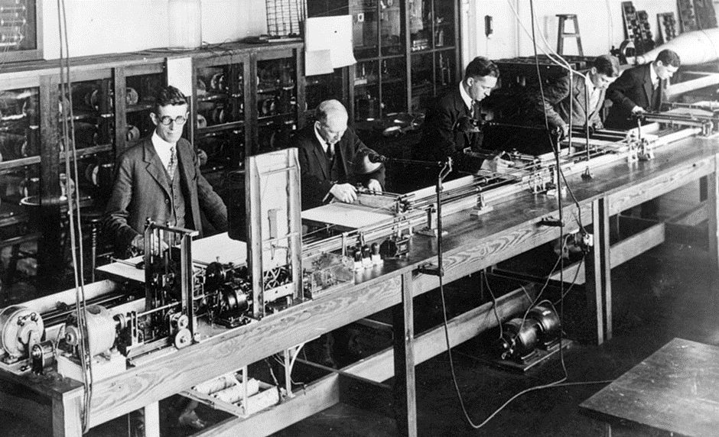

SALIS Internet Archive Digitization Project
The SALIS Collection Unveiled:
Building an Alcohol, Tobacco and other Drugs (ATOD) Digital Archive
Christine Goodair, St George’s, University of London & Sheila Lacroix, SALIS (Substance Abuse Librarians & Information Specialists)
Society for the Study of Addiction Annual Symposium, York, UK 11-12th Nov 2016
Picture: Getty Images

Slide 2
SALIS Internet Archive Digitization Project
SALIS – Who? Impetus?
Who - Substance Abuse Librarians & Information Specialists(SALIS) international association of individuals & organizations with special interests in the exchange and dissemination of alcohol, tobacco, and other drug (ATOD) information.
Impetus - Changes within ATOD Information Sector – loss of access to collections research resources.

Slide 3
SALIS Internet Archive Digitization Project
Why Are We Doing This?
To preserve key texts -history making
Scholarship – past present and future
To provide a memory for the ATOD sector
A tool for learning – about policy, treatments, successes & failures
Enable public access to texts, books, reports etc.

Slide 4




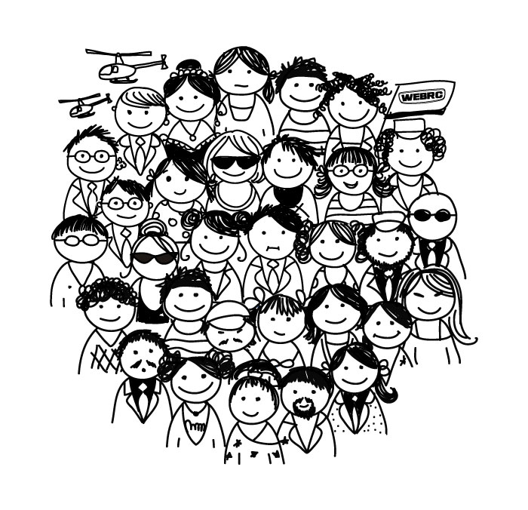
SALIS Internet Archive Digitization Project
Through…..
Partnerships
With the
Internet Archive
Libraries, documentation centres
SALIS members and individuals

Slide 5
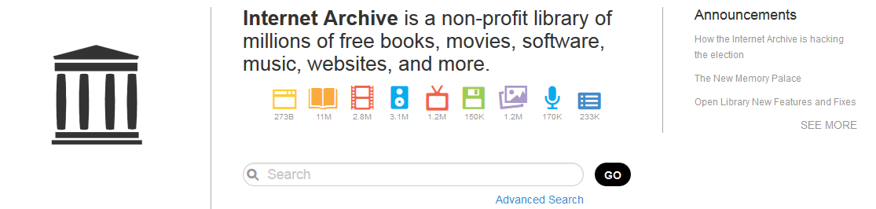
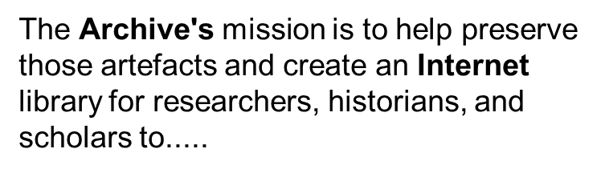
SALIS Internet Archive Digitization Project
https://archive.org/about/

Slide 6











Build Libraries Together
SALIS Internet Archive Digitization Project
The SALIS Collection is Unique, in that our collection is actually being built by a number of SALIS libraries.
https://archive.org/about/

Slide 7
SALIS Internet Archive Digitization Project
A Brief History
2008 SALIS & its then European sister met to express concerns about loss of valuable ATOD collections
SALIS established an international advocacy group to work on raising concerns & to consider how to develop a digital SALIS Collection
2012 SALIS editorial in Addiction recommending Digital Archive to preserve ATOD information
Andrea Mitchell, SALIS Exec. Director attended a seminar about the Internet Archive and began to explore options
2013 SALIS Conference in Berkeley --a tour to visit the Internet Archive – convinced advocacy group of potential, and a test collection was set up
2014 - SALIS formally a Partner with the Internet Archive--2014 -contract was signed with the IA to start digitization, and set up The SALIS Collection
2015 aim of 500 texts achieved…………… and now has over 900… and continues to grow

Slide 8
SALIS Internet Archive Digitization Project
Raised funds and continue to do so
Identified texts and collections at risk
SALIS Collection
created and grows
24 libraries/individuals contributing
Working with other bodies – NIAAA to include their publications
Let’s take a look………….

Slide 9
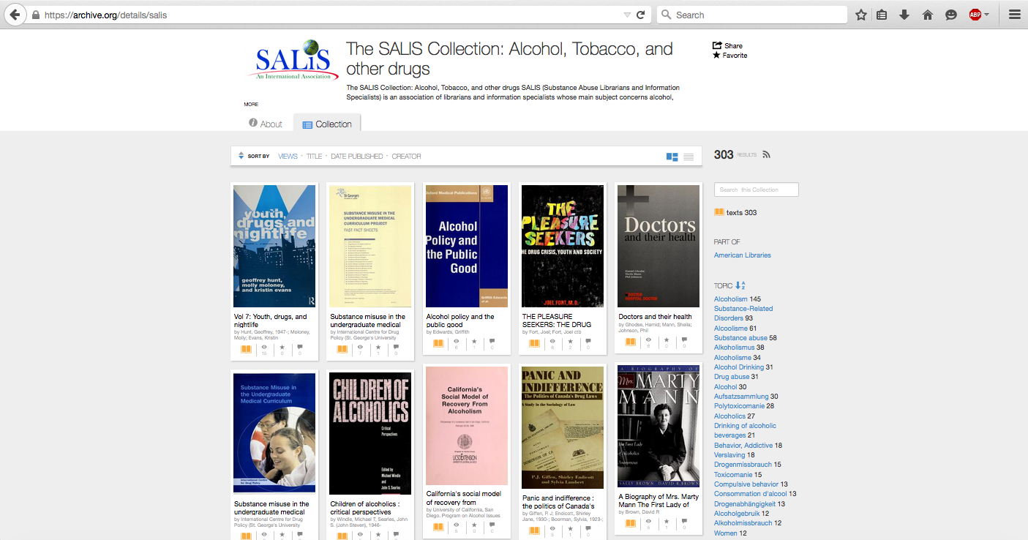
SALIS Internet Archive Digitization Project

Slide 10
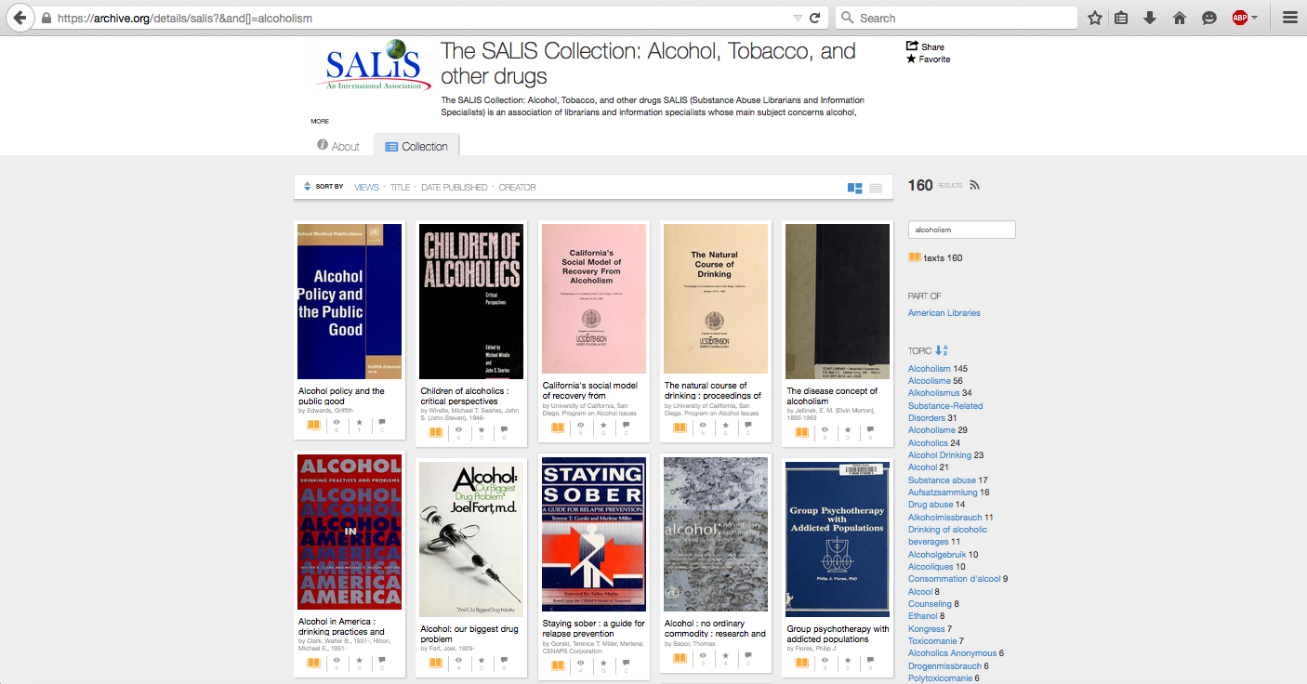
SALIS Internet Archive Digitization Project

Slide 11
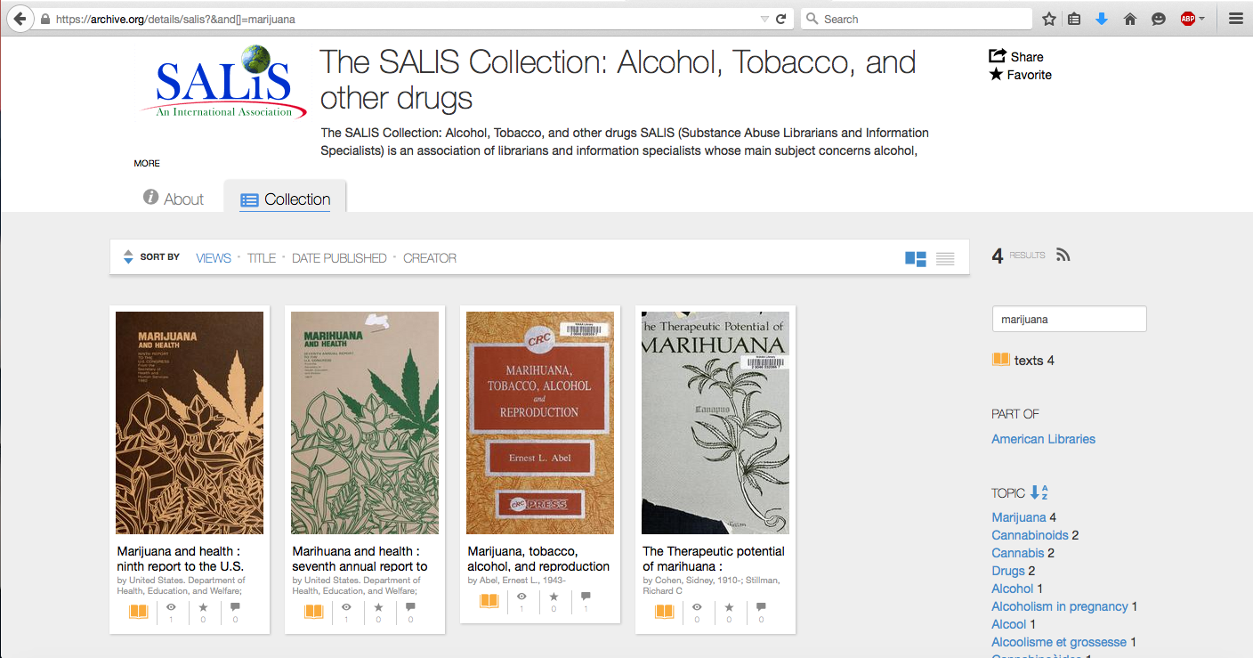
SALIS Internet Archive Digitization Project

Slide 12

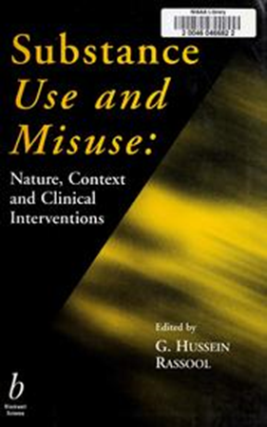
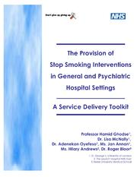
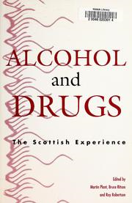

SALIS Internet Archive Digitization Project
UK texts in SALIS collection

Slide 13

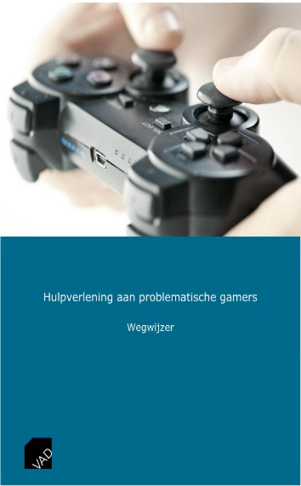
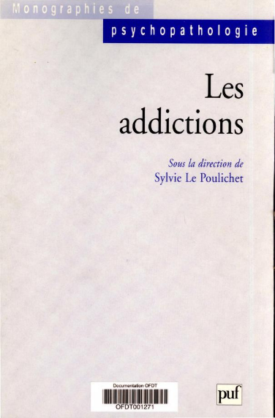
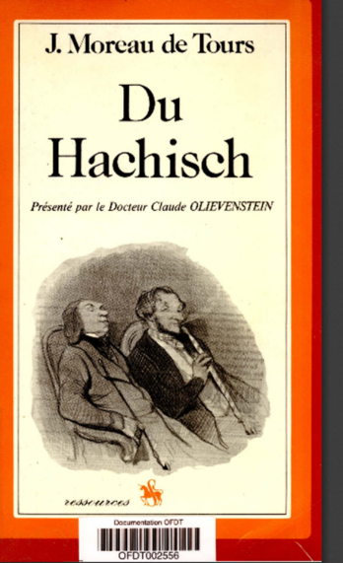
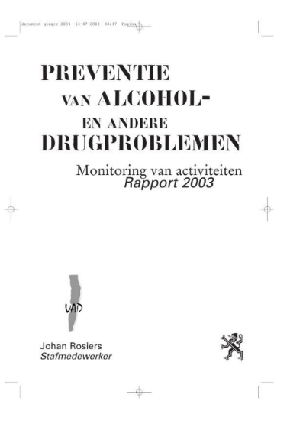
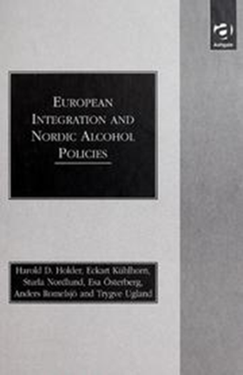
SALIS Internet Archive Digitization Project
European texts in SALIS collection: France, Belgium, Italy & Norway

Slide 14
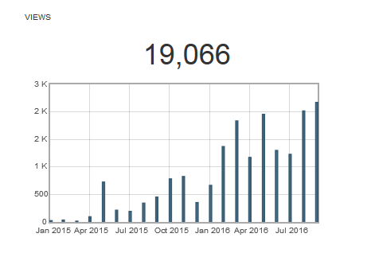
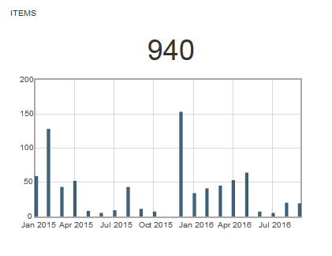
SALIS Internet Archive Digitization Project

Slide 15
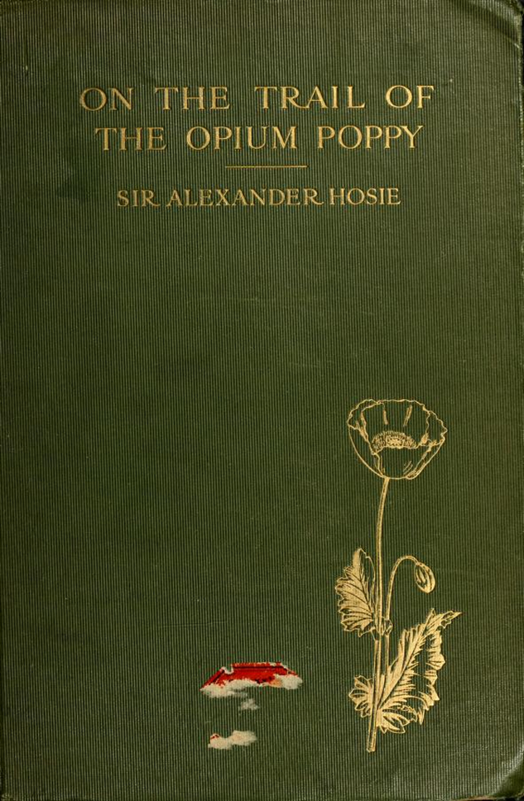
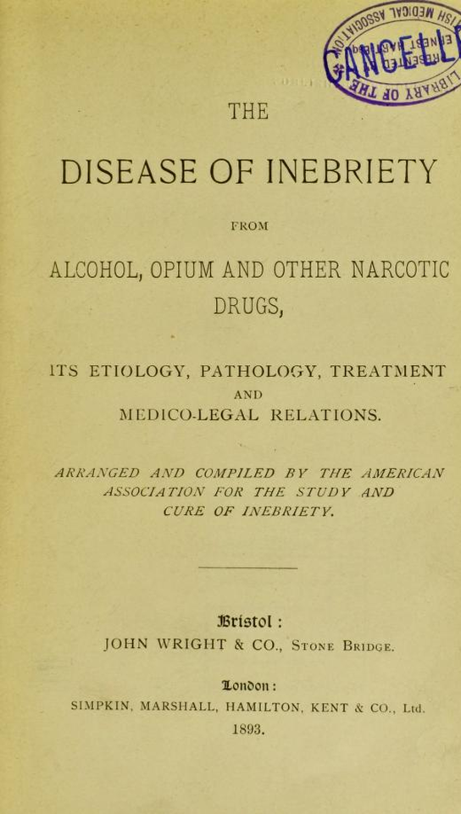
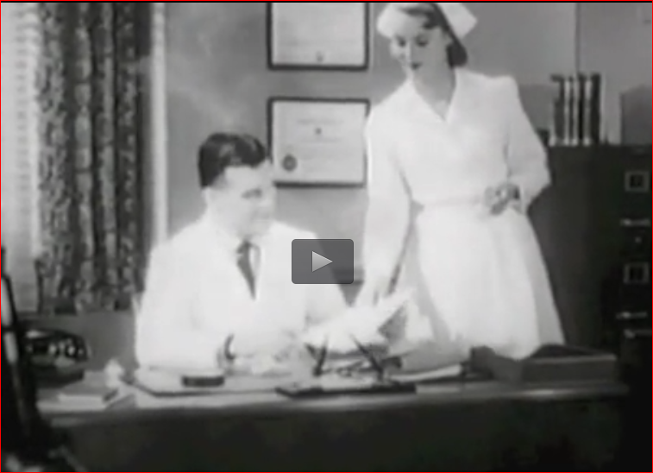
SALIS Internet Archive Digitization Project
Linking with other Collections ….SALIS
The Tobacco Institute "Passing Clouds" Thames TV Code on Channel 1/NTSC
http://www.williamwhitepapers.com

Slide 16
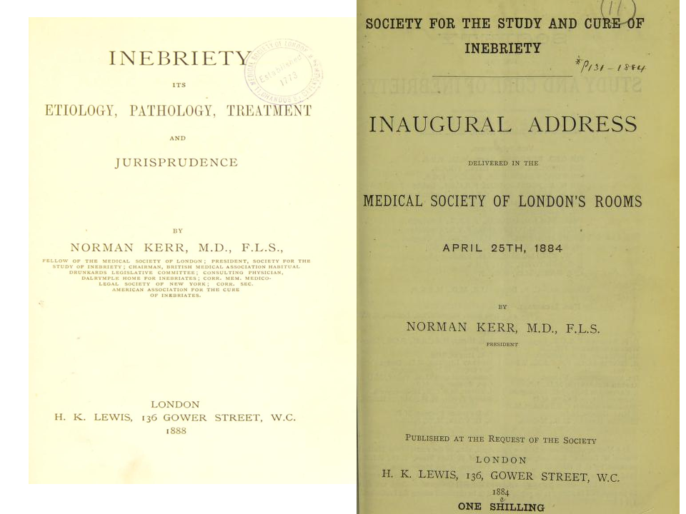

SALIS Internet Archive DigitizationProject
UK
Major contributors include

Slide 17

A case study: contributor and partnership developer for the SALIS Collection
SALIS Internet Archive Digitization Project

Slide 18

The SALIS Collection
The CAMH Library
Sheila Lacroix
Investigating partnerships & possibilites.
ARF Collections
Partnership with University of Toronto Libraries
CAMH Archives
Cornell University Library

Slide 19
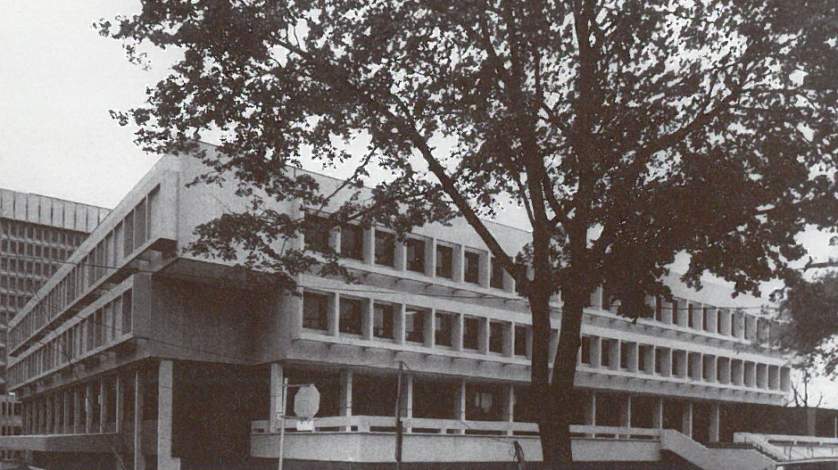
Addiction Research Foundation:
1949 - 1998
The Library Collections
Historical Collections with many donations & special collections: laws, gov. documents, reports, books, etc.
Publications by ARF staff and researchers
ARF Publications (ARF was a publisher of books, curricula, videos, etc.)

Slide 20
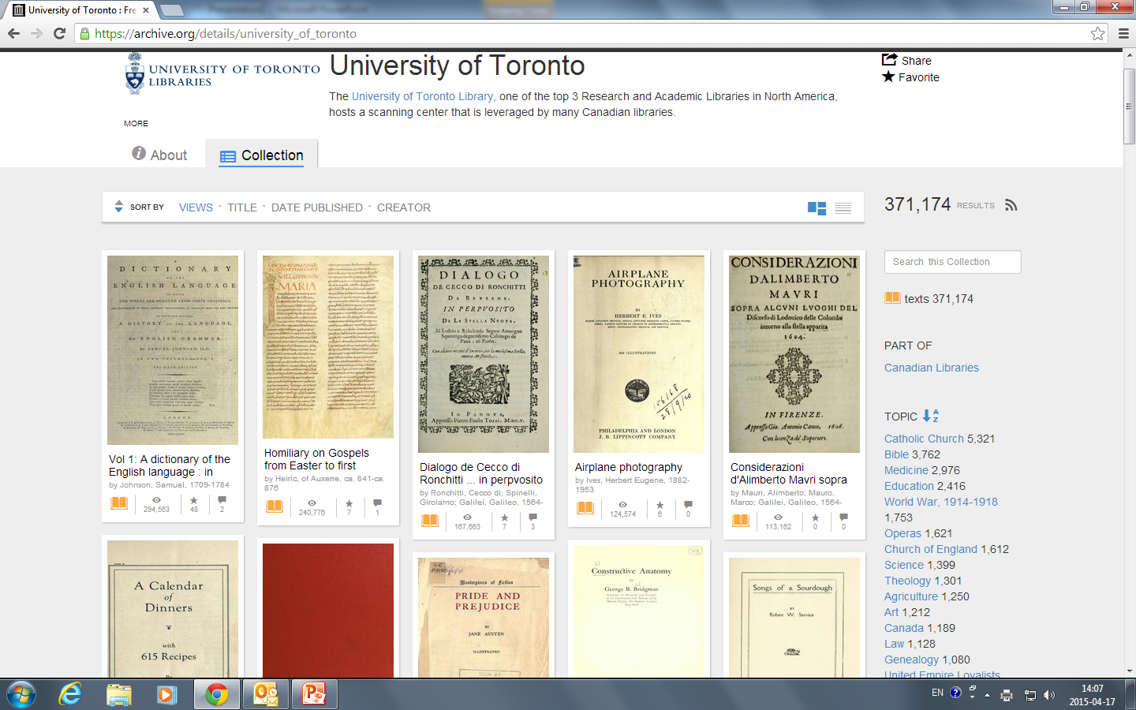
IA: University of Toronto

Slide 21
University of Toronto Libraries: Partnership
Question:
Can CAMH Library books be digitized @ UofT?
Discovered:
There is an IA scanning centre at UofT.
UofT pays IA for items to be scanned. Not free!
Primarily older books, copyright free.
Agreed to scan and cover cost of Addiction Research Foundation books if:
  They are held in UofT Library Collections
  CAMH provides copyright clearance.

Slide 22
CAMH “Friends of the Archives”
Offers Hewton and Griffin Bursaries for Archival Research
Awarded a small amount in 2016 for digitizing ARF publications.
Because of Uof T Libraries arrangement, choosing books by ARF authors but not published by ARF.
Enough to digitize approx. 8 books.
Choosing books from the Brookside Monograph Series. Brookside was the first location of the Alcoholism Research Foundation.
Baby steps but every donation counts!

Slide 23
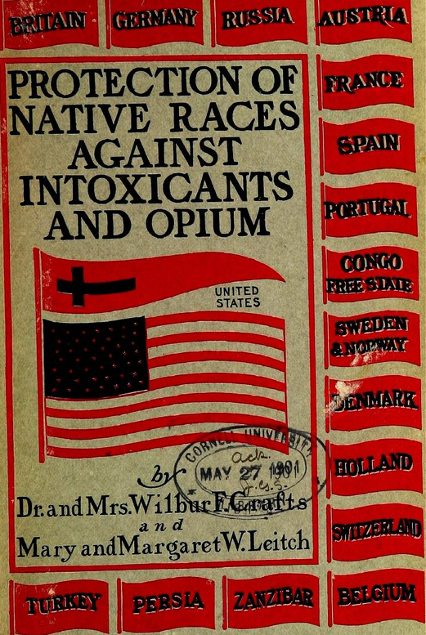
Sharing with other IA Collections
The CAMH Library
Based on testimony of 100 missionaries and travellers. 1900.
Many Historical Texts, including: Royal Commission on Opium Reports (Great Britain) from turn of last century.
Examples of books held in the Cornell University IA collection that can be ‘shared’.

Slide 24

How you can Help!
We need the support of the broader addiction community to sustain and build this unique collection.
You can help by:
Using the The SALIS Collection & promoting it to your colleagues.
Bookmarking the url https://archive.org/details/salis
Letting us know of any collections at risk.
Offering suggested resources at any time. No need to send a physical resource. In most cases, SALIS will be able to track it down. If not, we will contact you.
Supporting our Fundraising efforts. Let us know of opportunities for grants.
salis@salis.org

Slide 25
SALIS Internet Archive Digitization Project
References
Campbell, N. D. (2013), Remembering ‘Collective amnesia: reversing the global epidemic of addiction library closures’. Addiction, 108: 434. doi:10.1111/add.12021
Corkery, J. M. (2013), Loss of materials and resources for addiction researchers: comment on Mitchell et al. (2012). Addiction, 108: 432–433. doi:10.1111/add.12021
Mitchell A., Lacroix S., Weiner B., Imholtz C., Goodair C. (2012) Collective amnesia reversing the global epidemic of addiction library closures. Addiction,107: 1367–1368. http://onlinelibrary.wiley.com/doi/10.1111/j.1360-0443.2012.03813.x/full
Mitchell, A. L., Lacroix, S., Weiner, B. S., Imholtz, C. and Goodair, C. (2013), Further Reflections. Addiction, 108: 438–439. doi:10.1111/add.12083
Reinarman C. Librarians and other subversives: truth can be a casualty of drug wars too. Int J Drug Policy 2005; 16: 1–4. http://www.ijdp.org/article/S0955-3959%2804%2900133-1/fulltext?mobileUi=0
Reinarman, C. (2013), The tragedy of lost libraries. Addiction, 108: 437–438. doi:10.1111/add.12026
Templeman, D. and Shelling, J. (2013), Addiction libraries in Australia: collective amnesia threat. Addiction, 108: 436. doi:10.1111/add.12029

