Slide 1





Quality of life among heroin dependent poly-drug users receiving treatment with extended-release naltrexone or
buprenorphine-naloxone
Zhanna Gaulen, M.Phil
Department of Addiction Medicine, Haukeland University Hospital
PhD candidate, The Faculty of Medicine, University of Bergen

Slide 2
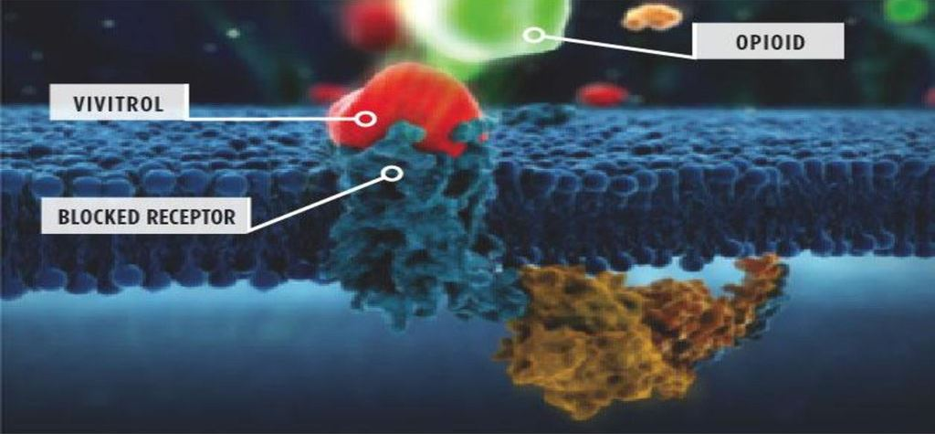
Extended-release naltrexone = Vivitrol
18 years or older
in medically assisted rehabilitation
not actively psychotic or suicidal
no organ failure
not pregnant or breastfeeding

Slide 3
Materials and methods
Study design
12-week open-label RCT
36-week follow-up
Instruments
Europ-ASI
SCL-25
TSLS present

Slide 4
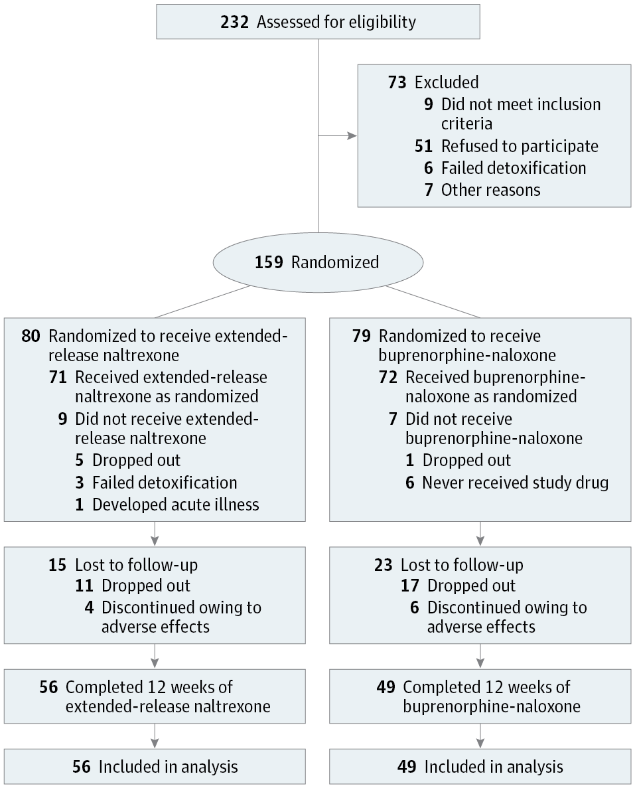

Slide 5
Treatment intervention
Buprenorphine (BUP)
BUP-to-NTX group
12 weeks
NTX
36 weeks
Naltrexone (NTX)
NTX group
Our objectives:
Impact life satisfaction
«I would change nothing about my current life»
«I have the important things I want right now»
Associations with quality of life
Drug use, physical and mental health
Social relations, work
Depression and anxiety

Slide 6


THANK YOU
References
Rudd, R. A., Seth, P., David, F., & Scholl, L. (2016). Increases in drug and opioid-involved overdose deaths - United States, 2010-2015. MMWR Morbidity and Mortality Weekly Report(65), 1445-1452.
Florence, C. S., Zhou, C., Luo, F., & Xu, L. (2016). The Economic Burden of Prescription Opioid Overdose, Abuse, and Dependence in the United States, 2013. Med Care, 54(10), 901-906.
Tanum, L., et al. (2017). "Effectiveness of injectable extended-release naltrexone vs daily buprenorphine-naloxone for opioid dependence: A randomized clinical noninferiority trial." JAMA Psychiatry 74(12): 1197-1205.
Acknowledgements
Supervisors Lars Tanum, Research Professor and Lars Thore Fadnes, Associate Professor
Department of Addiction Medicine, Haukeland University Hospital
The Faculty of Medicine, University of Bergen
Contact
zhanna.gaulen@helse-bergen.no
zhanna.gaulen@uib.no
+47 416 35 221

