Slide 1
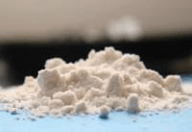

Complex Management of Gamma Hydroxyl Butyrate Withdrawal
Zelda Summers & K M Gangineni

Slide 2
Introduction
GHB is a naturally occurring short chain fatty acid related to gamma amino butyric acid found in peripheral organs including heart, liver, brain, kidney, cardiac and skeletal muscles.
GHB is rapidly absorbed from GI tract
Peak plasma levels in 40 -60 minutes after ingestion.
Plasma levels are negligible 6hours after a single 4.5gramdose
GHB is sold as clear odorless liquid with slightly salty taste (powder less common).

Slide 3
People at Risk
Bodybuilders/other athletes, sex workers using GHB for a sleep or workout aid or weight loss tool--the largest group.
Business professionals who travel frequently and were introduced to GHB as a “safe” sleep aid.
The elderly, who have been told that GHB is an anti-aging compound.
People with prior depression, who have been told that GHB is an anti-depressant. Intoxicating effects of GHB may make it seem, initially, to have this effect, but it later turns on many of them.
People subject to drug testing programs who use GHB as an alcohol substitute and to bypass testing.
Website managers, especially those selling GHB and other sports/dietary supplements, and computer programmers.

Slide 4
Case report
29yr old single man
H/o poly substance misuse (many years including alcohol)
GHB use in last 1 year
Usage every 2-3 hours
Up to 300ml and half the dose at night time to aid sleep
Diagnosed with GHB dependence
C/o Mood swings
Latter denied (mentioned in order to get Olanzapine) (recommended in internet sites)

Slide 5
Management
Investigations
  Routine blood investigations
  ECG
Treatment
  Planned inpatient detox (psychiatric unit) for atleast 2 weeks
  Withdrawal rating scales (CIWA-AR) every half hourly
  Monitoring of physical signs half hourly

Slide 6
Pharmacological treatment
No withdrawal noted
GABA B agonist such as baclofen 40mg qds.
Acamprosate 999mg tds
Needed minimal benzodiazepines which has
most evidence
Baclofen was gradually reduced over 2 weeks to 30mgqds
Sodium valproate 500mg bd
Acts on GABA transaminase and increases GABA levels
Nalterxone 25mgod,increased to 50mgod.
Baclofen was gradually reduced over 3 months
Continued on other medication
Continued..

Slide 7
Pharmacological treatment
lapsed twice during the reduction (baclofen reduction continued)
During relapse presented to A&E with confusion
Presented with depressive symptoms
Started on mirtazapine, shown good improvement

Slide 8
Psychological Treatment
Relapse prevention therapy
Active participation of family
Currently abstinent
Started working
Continued engagement with CDAT

Slide 9
Pathophysiology
The most important activity GHB possesses with regards to withdrawal syndrome is close metabolite relationship with GABA.
GHB modulates both GABA a and GABA b receptors (predominant) and that explains the similarity of withdrawal syndrome with benzodiazepines and alcohol
GABA b is important mediator of GHB psychotropic effects (Hechler et al., 1997)
Cross tolerance has been demonstrated between GHB and alcohol in rats, and GHB has been used to suppress the alcohol withdrawal syndrome
GHB withdrawal state might involve loss of inhibitory tone from GABA (B more effected than A) and GHB receptors (Dyer et al, 2001)

Slide 10
Management of GHB Withdrawal
Symptomatic and supportive care in addition to sedation is required in medical setting to prevent injury, hyperthermia and rhabdomyolysis
Medications
  Benzodiazepines
  Barbiturates
  GABA B agonists such as Baclofen
  Acamprosate
  Anti-psychotics
  Anti-convulsants
  Anti-hypertensives such as beta blockers

Slide 11
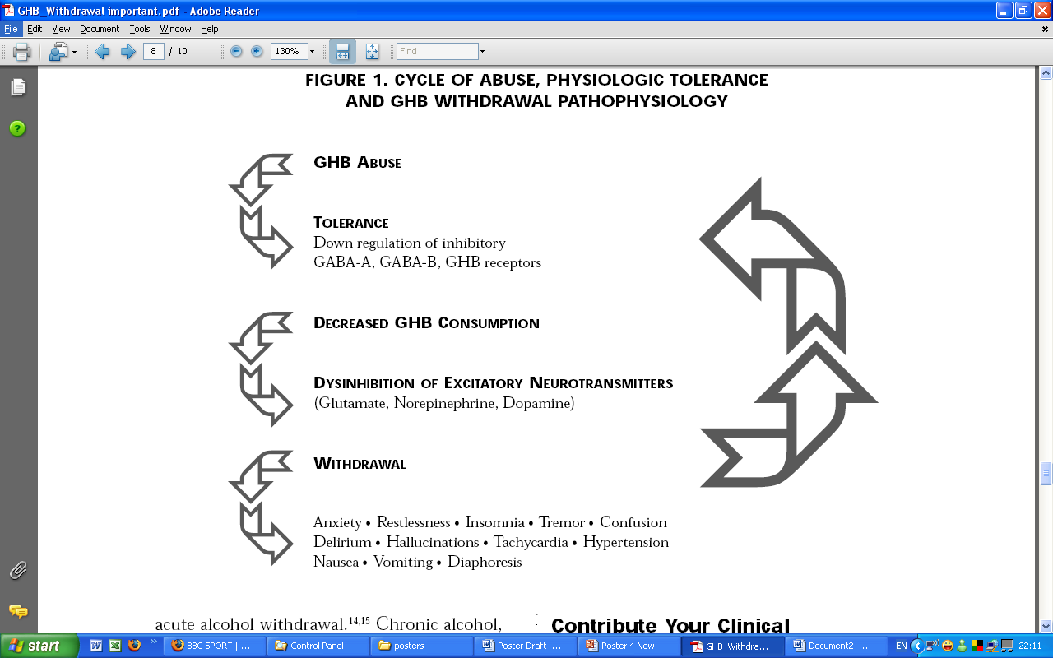
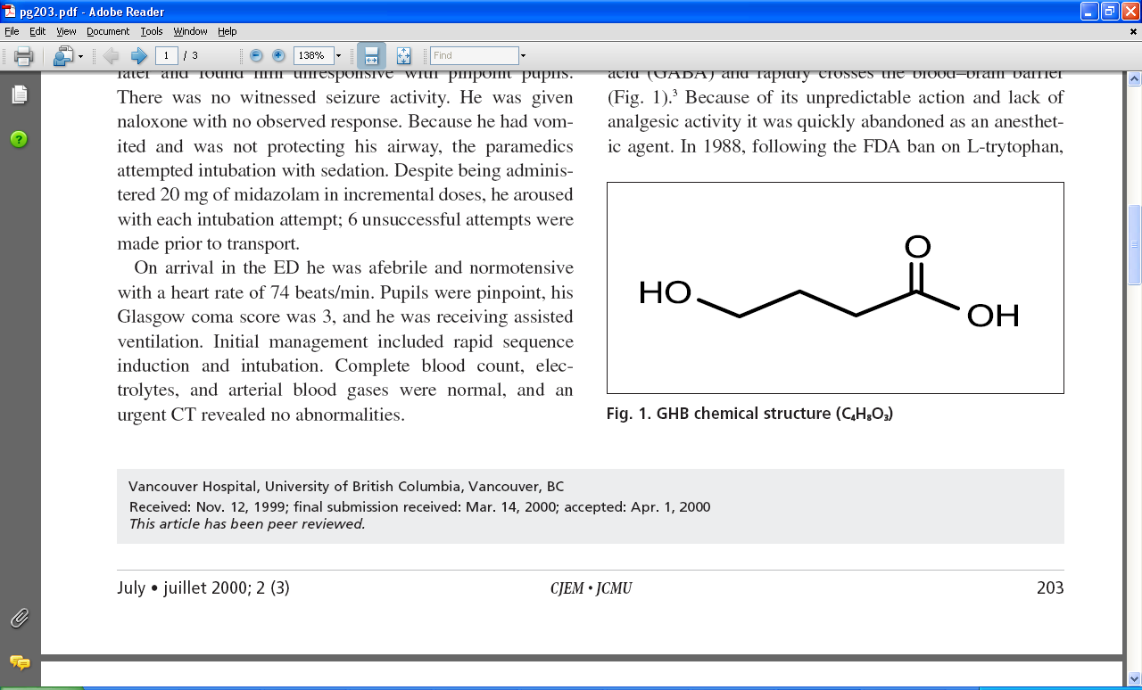
GHB chemical structure (C4H8O3)
CYCLE OF ABUSE, PHYSIOLOGIC TOLERANCE
AND GHB WITHDRAWAL PATHOPHYSIOLOGY

Slide 12
TEMPORAL PATTERN OF THE SYMPTOMS OF GHB WITHDRAWAL
SYMPTOMS: | Early (1-24 hours) | Progressive (1-6 days) | Episodic when waning (7-14 days)
Anxiety/Restlessness | ++ | +++ | ++
Insomnia | +++ | +++ | ++
Tremor | + | ++ | +
Confusion | ++ | +++ | ++
Delirium | ++ | +++ | +++
Auditory, tactile, and visual hallucinations | + | +++ | ++
Intermittent Tachycardia | +++ | +++ | ++
Hypertension | + | ++ | +
Nausea | ++ | + | +
Vomiting | ++ | + | 0
Diaphoresis | + | ++ | +
Key: Mild = +, Moderate = ++, Severe = +++

Slide 13
Management of GHB Withdrawal
Milder forms of withdrawal may be successfully treated with benzodiazepines on an out patient basis. (Addolorato et al 1999c; Galloway et al.1997)
Severe withdrawal states require medical support, high doses of benzodiazepines and capacity for physical restraint to prevent the patient from harming self or others during bouts of psychotic agitation (Dyer et al.2001; Miotto and Roth 2001)
Craig and Colleagues reported a case of a patient who needed 507 mg of lorazepam plus 120 mg of diazepam over 90 hours to control agitation.
Other drugs used in the management are Barbiturates (Benzodiazepine Resistant cases), antipsychotic, chloral hydrate, anticonvulsants.
Continued..

Slide 14
Management of GHB Withdrawal
In the above described patient we used drugs which share same pharmacological action such as Baclofen (acts on GABA B receptors) and drugs like acamprosate, sodiumvalproate (acts on GABA transaminase and slow down degradation of GABA).
Symptomatic and supportive care in addition to sedation is required in medical setting to prevent injury, hyperthermia and rhabdomyolysis (cause of mortality)

Slide 15
Baclofen
Advantages
  Needed minimal use of benzodiazepines
  Less risk of respiratory depression
  No marked withdrawal due to similar pharmacological action
  Easy to administer
Disadvantages
  Not commonly prescribed
  Risk of dependence in very short time
  Risk of severe withdrawal (same as GHB)

Slide 16
Benzodiazepines
Advantages
  Commonly prescribed
  Most of published evidence recommends
Disadvantages
  Risk of respiratory depression
  Needed very high doses compared to alcohol withdrawal
  Difficulty in managing resistant cases

Slide 17
Other Medications
Anti-psychotics are not efficient and could cause effects such as dystonic reactions and neuroleptic malignant syndrome.
Anti-hypertensives could be used only in milder cases but could cause paradoxical vasospasm in severe withdrawal.
It was reported that anti-hypertensives could treat milder symptoms (autonomic instability) but sometimes lead to major withdrawal
Phenobarbital (unlike other barbiturates) can directly open GABA-A and voltage gated chloride channels (Sivilotti et al.,2001) and therefore less dependent on GABA availability.
This might explain the response of benzodiazepine resistant GHB withdrawal symptoms to phenobarbital.

Slide 18
FACTS
Treatment for at least 2 weeks in hospital setting
Transfer to psychiatric unit once neuropsychiatric symptoms are controlled.
Monitoring of physical state is very important during treatment of withdrawal
Close monitoring after discharge and very gradual reduction of sedatives prescribed
Follow up to six months due to risk of severe depressive and anxiety symptoms which could trigger relapse

Slide 19
Myths about GHB use and Treatment
Non dangerous, non addictive and could easily stopped
Could be stopped with alcohol usage
Olanzapine could be used to self detoxify

Slide 20
Recommendations
GHB should be suspected in cases of coma, seizures or withdrawal when no other aetiology can be found; urine drug test negative for other drugs and demographic factors point towards this type are young adults with history of substance misuse and body builders.
Detailed information should be obtained about usage and frequency to ascertain the risk of severe withdrawal.
GHB severe withdrawal should be considered as medical emergency and ideally should be treated in hospital setting for at least 2 weeks due to high rates of mortality
GHB usage and frequency of use should be enquired as routine measure while obtaining psychiatric history

Slide 21
Conclusion
GHB is emerging drug of abuse which has sedating and anesthetic properties
Even though emerging medical information provides new insights into GHB dependence and withdrawal, research on treatment is an important area to be developed.
Psychiatric, emergency and critical care professionals need to be aware of GHB withdrawal signs and should coordinate their care to provide safe management of these patients.

Slide 22
Thank You

