Slide 1
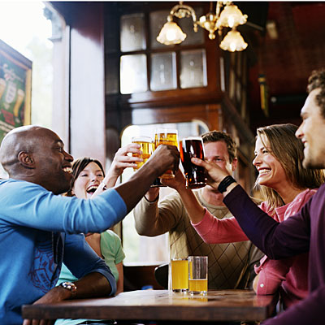
The influence of groups and alcohol on risk-taking behaviour
Marianne Erskine-Shaw
PhD Candidate

Slide 2
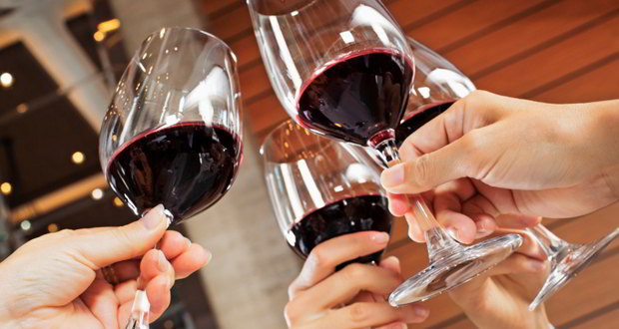
Content
The issue
The research
The issue
The study

Slide 3
The Issue
Excessive alcohol consumption is one of the top five risk factors for disease, disability and mortality globally (WHO, 2014)
Binge drinking associated with risky behaviours and subsequent injuries/harm (Corte & Sommers, 2005)
Campaigns – NHS know your limits
Nek Nominations – the social aspect?
Understanding drinking behaviour at a group-level – how do groups influence alcohol-related behaviours?
(BBC, 2014)

Slide 4
The Research
Influence of groups and alcohol independently
Risk-Taking – behaviours which carry a probability of negative consequences (Lane et al., 2004)
Alcohol and risk-taking behaviour – well documented in the psychological literature.
Alcohol consumption → increased risk-taking (Lane et al., 2004; Rose et al., 2014)
Group influences of risk-taking – Majority of research in adolescence.
Social contexts → increased risk-taking (Gardner & Steinberg, 2005)
Social contexts → increase positive alcohol expectancies (Monk & Heim, 2013)
Diminutive experimental research exploring the combined influences of alcohol and groups on risk-taking behaviour

Slide 5
The Research
Groups increase alcohol-induced risk-taking behaviour
Sayette and colleagues (2012; 2004)
Groups of 3 consumed alcohol, soft drink or placebo
Decision (as individuals or as group of 3) - 30min Q’s / coin toss = no Q’s or 60mins Q’s
Findings: Groups more risky when believed they had alcohol (alcohol and placebo). No differences when choice was made individually.
Groups compensate for alcohol-induced risk-taking behaviour
Abrams et al. (2006)
Individual or groups of 4 consumed alcohol or placebo
Risk attraction task
Findings – individuals found risky choices more attractive after alcohol.
Groups showed no difference

Slide 6
The Research
So what is the problem?
Procedural differences
Sayette et al. (2012) Drink in groups → make decision in isolation or collective as a group
Abrams et al. (2006) Drink in isolation or in groups → make decision in isolation or collective as a group
Group influence on individual behaviour or group decision?
Individual characteristics may influence individuals to voice their ideas more or be more persuasive within the group (c.f. Oreg & Sverdlik, 2013)
Many risky behaviours are not preceded by group discussion e.g. impulsive risky behaviour

Slide 7
The Study
Aims & Hypotheses
To examine the independent and combined influences of alcohol and group contexts on individual, impulsive risk-taking behaviour
What can we hypothesise from what we have learnt?
Alcohol consumption will increase risk-taking behaviour in individuals
Group contexts will increase individual risk-taking behaviour
The combined influence of group context and alcohol consumption will further increase individual risk-taking behaviour

Slide 8
The Study
Demographics & Materials
Participants 99 social drinkers (62 female). Age 20.71(±4.34) with AUDIT 11.04(±4.84)
Conditions: Isolated Alcohol (N=23) x Isolated Placebo (N=25) x Group Alcohol (N=27) x Group Placebo (N=24)
Self reports and risk-taking tasks
0.5-6g/kg of alcohol or placebo
Self reports and risk-taking tasks
AUDIT (Saunders et al., 1993), RT-18 (de Haan et al., 2011)
Subjective intoxication Scale,
Balloon Analogue Risk Task (BART; Lejuez et al., 2002) and Stoplight Task (SLT; Chein et al., 2011)
Tested in isolation or with two friends
*all measures taken individually

Slide 9
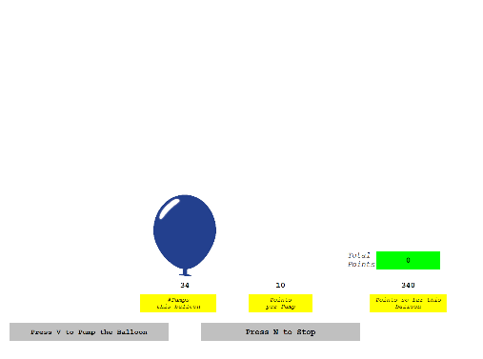
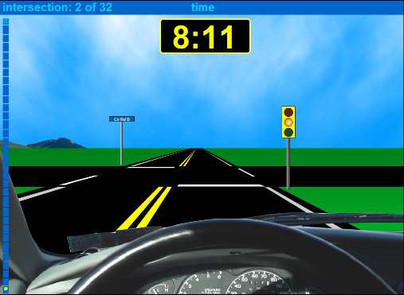
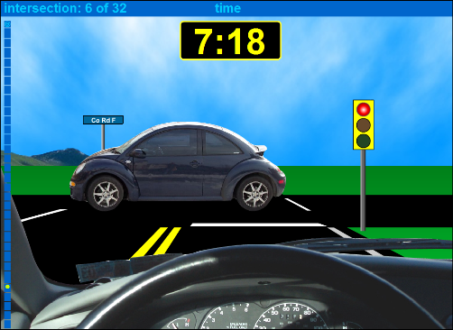
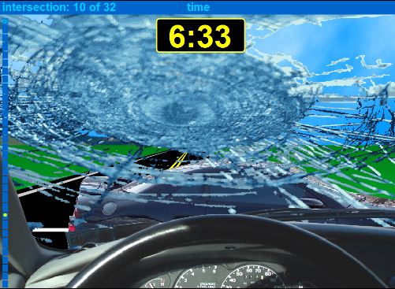
The Study
Risk-Taking Tasks
BART; Lejuez et al., 2002
SLT; Chein et al., 2011

Slide 10
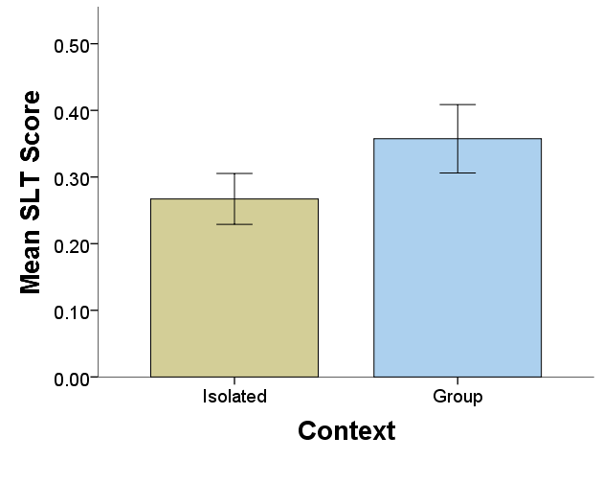
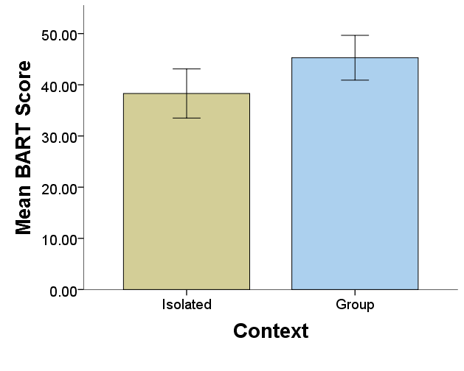
The Study
Results
Mixed ANOVA controlling for alcohol consumption behaviour and trait risk taking (AUDIT and RT18) Beverage - Alcohol did not influence risk-taking behaviour. However, those who consumed placebo were significantly less risky on the SLT F(1,93) = 22.96, p < .001, η² = .20
Context - Participants who were tested within groups were significantly more risk-taking compared those tested in isolation, on both the BART F(1,93) = 3.94, p = .05, η² = .04, and the SLT F(1,93) = 7.69, p < .01, η² = .08
Interactions - No significant interactions were found for context and beverage on risk-taking behaviour.

Slide 11
The Study
Results Summary
Alcohol does not have a significant effect on risk-taking behaviour regardless of the social context
However… the expectancy of alcohol (placebo) decreases risky driving behaviour – compensate behaviour?
Group contexts increase an individuals risk-taking behaviour
An individuals impulsive risky behaviour appears to be influenced by group contexts to a greater extent than alcohol consumption

Slide 12
The Issue
Conclusions
Targeting the influence of group contexts in combination with alcohol consumption may aid in practices reducing risky behaviours in drinking environments
…
However, it is important to consider the type of risk-taking targeted – impulsive/premeditated, general/specific
Still an under-researched area
More research within naturalistic drinking environments in addition to manipulating a social context?

Slide 13
Acknowledgements
Funding and research contribution
Research Contribution
Supervisory Team - Professor Derek Heim, Dr Rebecca Monk and Dr Adam Qureshi, Edge Hill University
Funding Contribution
Alcohol Research UK
Psychology Postgraduate Affairs Group

Slide 14
Thank you!
Marianne Erskine-Shaw
Department of Psychology
Edge Hill University
erskinem@edgehill.ac.uk

