Slide 1
Not so responsible? The impact of others’ drinking behaviours Students in Southern England
Briony Enser, Oxford Brookes University
Presentation to the SSA Annual Symposium 2016
York 10-11 November 2015

Slide 2
Alcohol-Related Collateral harm
This study uses the acronym “ARC harm” for this multi-faceted phenomenon and as a metaphor for the circle around the drinkers where these ARC harms occur.

Slide 3
Please Drink Responsibly?
The Health of the Nation (DH, 1992) effectively medicalised public health interventions for alcohol.
The conception of alcohol and the ‘drink problem’ for society has become subsumed into the prevention of lifestyle diseases for the individual drinker.
The DH message “Please drink responsibly” appears on alcohol labels next to the UK CMOs’ advisory low risk number of units and it is widely understood in terms of personal alcohol consumption only.

Slide 4
The unseen dimension of alcohol-related harm
Harms that drinkers do to themselves are well recognised.
Preventive public health messages target drinkers.
ARC harm is uncharacterised and largely unacknowledged .
Yet perceptions of alcohol-related harm as an issue began when mass drunkenness and the concomitant social disorder were seen to impact at the societal level.
Historically, Government intervention was not about harms to the individual drinker, but to address the harms that drinkers caused to others in society.

Slide 5
“English monarchs from Henry VII onwards enacted licensing legislation to promote public order”
Harrison, B. (1994) Drink and the Victorians,
Keel University Press, ISBN 1 85331 046 8

Slide 6
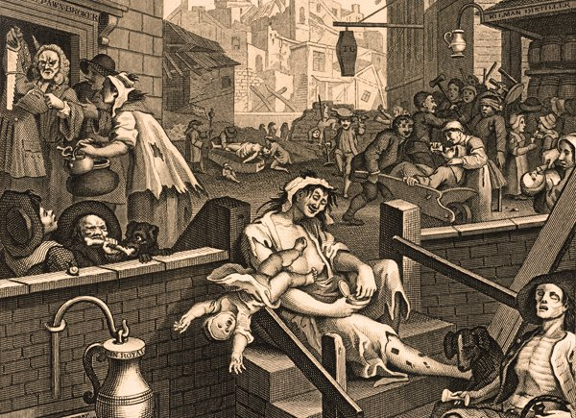
William Hogarth (1697-1764) “Gin Lane”

Slide 7
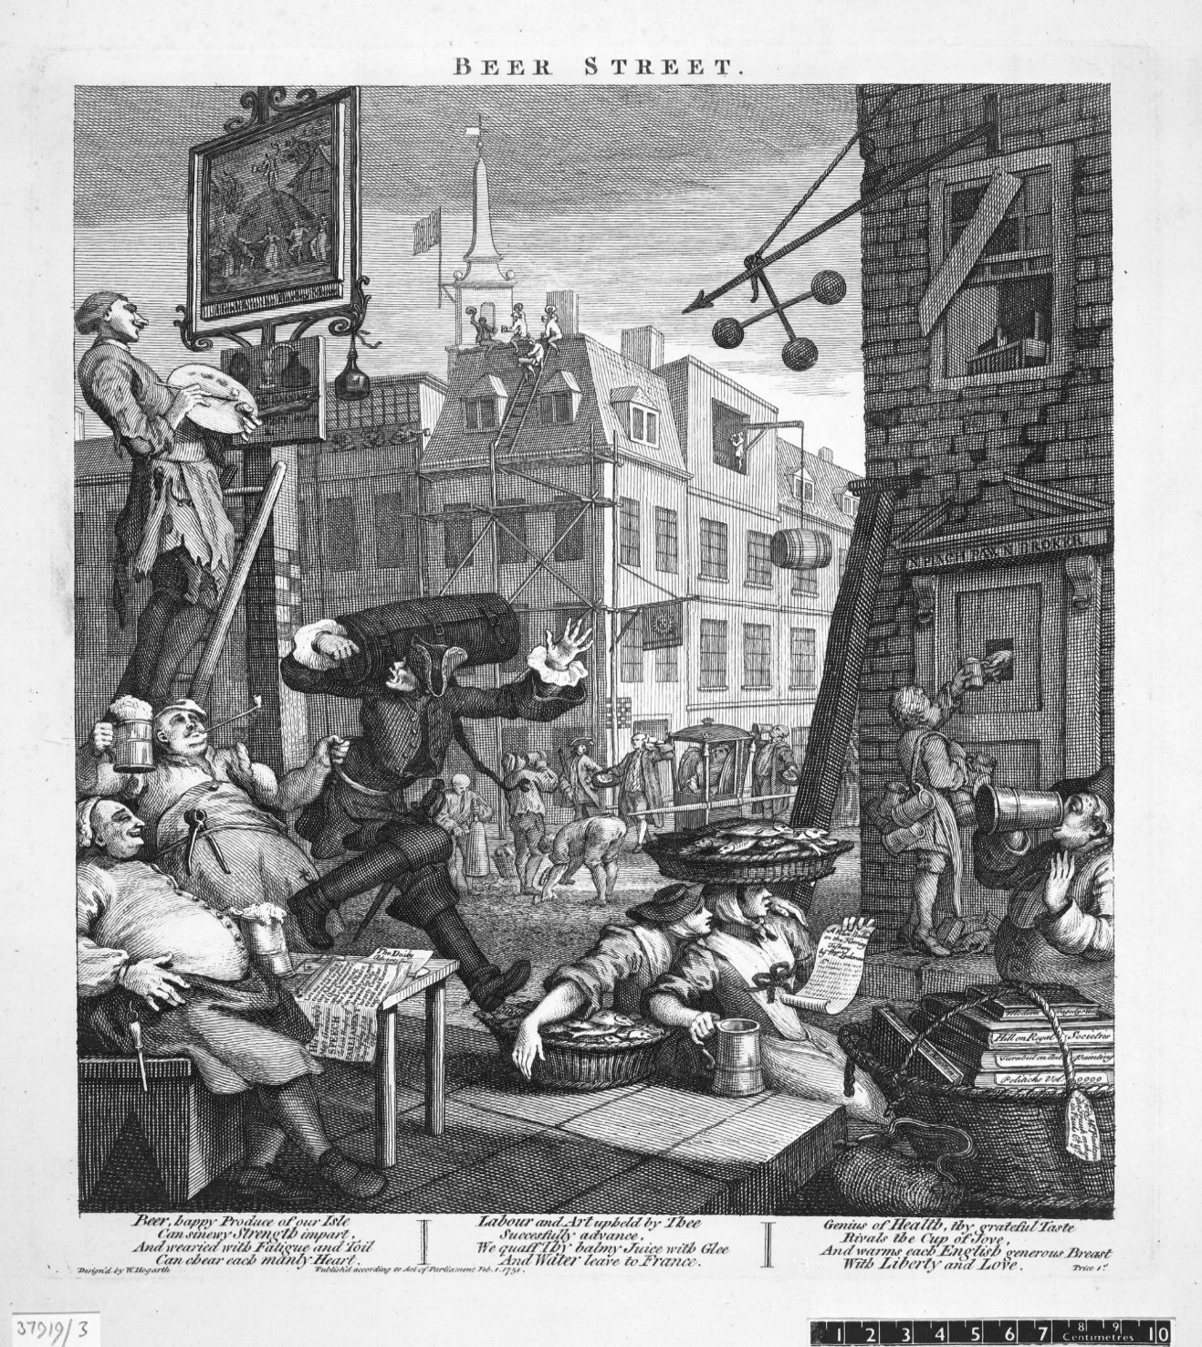
William Hogarth (1697-1764) “Beer Street”
©Trustees of the British Museum.

Slide 8
Victorian Liberalism and the Temperance movement
“It used to be the fashion to look at drunkenness as a vice which was the concern only of the person who fell into it, so long as it did not lead him to commit an assault on his neibours. No thoughtful man any longer looks at it this way. We know that, no matter how decently carried on, the excessive drinking of one man means injury to others”
Green T.H. (1888), Liberal Legislation and Freedom of Contract 383-384

Slide 9
Today ARC harms are hidden in plain sight. Today ARC harms are hidden in plain sight. Today ARC harms are hidden in plain sight. Today ARC harms are hidden in plain sight. Today ARC harms are hidden in plain sight. Today ARC harms are hidden in plain sight. Today ARC harms are hidden in plain sight. Today ARC ha..

Slide 10
Alcohol-Related Collateral harm, the unseen dimension?
Mixed methods
Phase I: On-line survey of college and university students aged 16 -24. Quantitative data collected on ARC harm. Qualitative data collected on the types of ARC harm experienced.
450 responses analysed.
Phase II: 25 semi-structured interviews with a sample of survey participants who reported at least one experience of ARC Harm.
Thematic Analysis of ARC harm from 445 pages of transcripts.

Slide 11
Do well-educated young adults experience very much ARC harm?
64% of participants reported that their health or safety put at risk by other peoples’ drinking and/or they had been affected adversely in another way (69% young women, 53% young men).
Including 50% of the non-drinkers.

Slide 12
Factors hypothesised to be associated with ARC harm Multivariate logistic regression
Variable | Experience of ARC harm (N= 450).
 |  | 95% C.I
 | OR | Lower | Upper
A. Gender (Female: Male) | 1.621 | 1.005 | 2.615
B. Aged under 19 years of age? (16-18) (No: Yes) | 2.612 | 1.572 | 4.337
C. Student at college or university? (Univ.: Coll.) | .738 | .332 | 1.640
D. Living in the parental home? (No: Yes) | 1.144 | .590 | 2.221
E. Do you drink alcohol at all currently? (Yes: No) | 1.482 | .790 | 2.780
F. Units of alcohol consumed within guidelines? (No: Yes) | 1.196 | .549 | 2.606
G. Do close family members drink alcohol at all? (Yes: No) | .994 | .497 | 1.988
H. Close family members drink alcohol every day? (Yes: No) | 2.646 | 1.492 | 4.693
I. Do the drinking habits of friends or family affect your decision to have a drink or not to drink? (Yes: No) | 2.026 | 1.324 | 3.101
Constant | .272

Slide 13
Four main drivers for ARC harm
Variable | Experience of ARC harm (N= 450).
 |  | 95% C. I.
 | OR | Lower | Upper
A. Gender (Female: Male) | 1.618 | 1.040 | 2.516
B. Aged under 19 years of age? (16-18) (No: Yes) | 2.362 | 1.549 | 3.602
H. Close family members drink alcohol every day? (Yes: No) | 2.622 | 1.502 | 4.577
I. Do the drinking habits of friends or family affect your decision to have a drink or not to drink? (Yes: No) | 2.051 | 1.354 | 3.107
Constant | .414

Slide 14
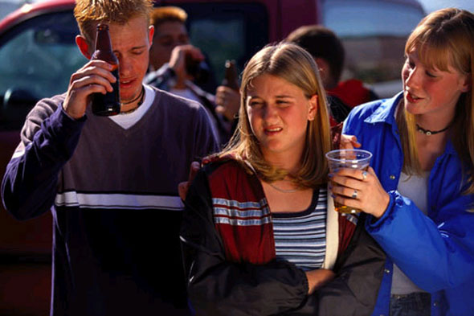

Slide 15
Themes that categorise ARC harm
NUISANCE (Disturbance by and exasperation with irresponsible/careless/selfish behaviours of drinkers. Lost sleep, lost study, lost opportunities).
TOLERANCE/ACCOMMODATION (Coping with unacceptable behaviour from drinkers by accepting it and adjusting one’s own life to accommodate it).
PRESSURE (Pressure from drinkers to conform to perceived group norms, peer pressure to drink heavily, drink-related sexual pressure).
UNSOUGHT RESPONSIBILITY (To care for/clean up after drunk friends and family, to rescue drunk friends from arguments and fights, to take them to A&E, to parent drunk parents).
PSYCHOLOGICAL HARM (Stress directly by drinker’s damaging behaviour, worry about drinker’s health, bereavement caused by alcohol).
ACUTE INJURY/ACUTE RISK (Deliberate or ‘accidental’ injury caused by a drinker - aggression, attacks, fights, drink driving and drink spiking incidents.
RELATIONSHIP HARM (Conflict, degradation or severance in relationship with friend, family or partner caused by their injurious behaviour when drinking).
.

Slide 16
NUISANCE
Disturbance
ACUTE INJURY
Aggression
Drink driving
Iceberg of
ARC Harm
Rescue drunk friends from fights
Bereavement
Impact on study
Accommodation
TOLERANCE
Exclusion
Avoidance
Lost sleep
UNSOUGHT RESPONSIBILITY
PRESSURE Caring for drunk friends
Peer pressure to drink heavily
PSYCHOLOGICAL HARM
Parenting parents Stress Sexual pressure by drunks
Pressure to conform to norms
Pressure university
RELATIONSHIP HARM
Conflict
Degradation
Severance
Lost opportunities

Slide 17
Risk factor themes for ARC harm
INDIVIDUATION (Vulnerability at point of developmental transition: coming of age, new domicile and entering higher education). Fear of exclusion/being left out, confronted by drinkers who are careless and absolve selves of responsibility.
UNIVERSITY MILIEU (Self-fulfilling expectations of excess drinking alcohol culture, university life and normative cultural pressure).
PERCEPTIONS OF ALCOHOL (Drinking alcohol as a joke or game, as epitome of ‘cool’ adult, as excuse for inappropriate/irresponsible behaviours without owning the consequences, viz Agentic State).
LEGITIMATING ENVIRONMENTS (Absence of censure for ARC harm. Absence of alternative social activities, certain settings: university halls of residence, nightclubs, family home).

Slide 18
Nuisance and tolerance
“There was two of us in our flat that were having exams and the other three weren’t and two of them they’d go out quite a lot and so be coming in at three or four, drunk, making loads of noise, didn’t really care, and obviously that was like exhausting, and then we had to get up in the morning.” (Vivienne, aged 18).
“It won’t be direct, I mean it can be that you, might not just get invited even to something because people think you’re not going to drink. I didn’t get invited to things. I was thinking well, you know, I could have quite easily gone… You don’t have to have a lot to drink. I don’t see that, it’s bizarre, it’s absolutely bizarre. I don’t see why you have to have eight pints, you know.” (Carl, aged 21)
“One of them has told me very horrible things to me when he was drunk about like me and how he wanted me to die.”
(Edward, aged 22)

Slide 19
Pressure
“It’s actually quite difficult to be the person who’s not drinking and to still go out” (Annie , aged 21)
“There was quite a pressure to drink…and, obviously I’d never really had like this kind of initiation or like this kind of drinking habit or behaviour before. I didn’t see the reason behind it. Yeah, at the point I was like eighteen, I wasn’t willing to argue.”
(Peter, aged 20)
“I had sex with someone, that I never met before and that was completely out of character for me and I regretted it and it was purely because I’d drunk that much… like even when I would go out and boys would be quite touchy-feely, I’d be like “no!” I know people do it, but that’s just not me, and I just hated the fact that I’d done it.” (Vivienne, aged 18)

Slide 20
Unsought responsibility
“And when you have to look after friends you want to do what’s best for them, but it can be stressful as well. You can’t pretend it’s what you want to be doing because it’s not what you want to be doing.” (Kristie, aged 18)
“I think being sober when everyone else is sort of out of it, it can… In a way, it is good because you’re sort of… you can look after them and stuff and you’re like “don’t do this! Don’t do that!” But then you can end up just being like “why have I come out?” (Stella, aged 19)
“Quite a few nights …she was too drunk to actually to be looking after us as children. Our parents split up when I was five so it was me and my sisters, like five and seven year olds in the house and she’d be, you know, quite drunk.” (Annie, aged 21)

Slide 21
Physical harm
“My dad.. took me up to the park once, when he was having a drink and I broke my nose because he was on a seesaw and he went down too hard and I went over the seesaw”
(Edward, aged 22)
“The driver was drunk, they were all drunk, they came in too fast and crashed and one of the … My friend, who was the only one wearing a seatbelt, she died and then there was another three of them seriously injured, like in hospital. One was in a coma, the other one I think lost his hand. […] The driver was fine, but he’s in prison now for manslaughter and he’s on suicide watch in prison.” (Betsy, aged 23).

Slide 22
Psychological harm
“He was just forty I think when he died, but he was ill for the past six/seven years, kind of in and out of hospital and my mother and I would go and clean the house when it would have like you know… when it was really bad there’d be kind of like, you know, throwing up blood and things like that in the toilets, the whole bathroom was a complete mess. It was really hard going to see him and seeing him like that.”
(Annie, 21)
“I didn’t know my dad if he wasn’t drunk…in my entire time that I knew my dad, I’ve only ever had one conversation with him when he was sober.”
(Edward, aged 22)

Slide 23
Relationship harm
“If I’m at home and my dad’s drunk…then I’ll just stay in my room… I do like to have a talk with my dad, but when he is really drunk, it is hard to have a conversation, so I will stay in my room. This is what I used to do when I was younger, obviously I prefer not to… yeah, I don’t like seeing him drunk all the time.”
(Yvonne, aged 19)
“I did not want to go anywhere near my father when he was drunk, so, obviously it affected me in that sort of respect…. I wasn’t really afraid of him….more, more just being uncomfortable being like anywhere near him”
(Nathan, aged 19)

Slide 24
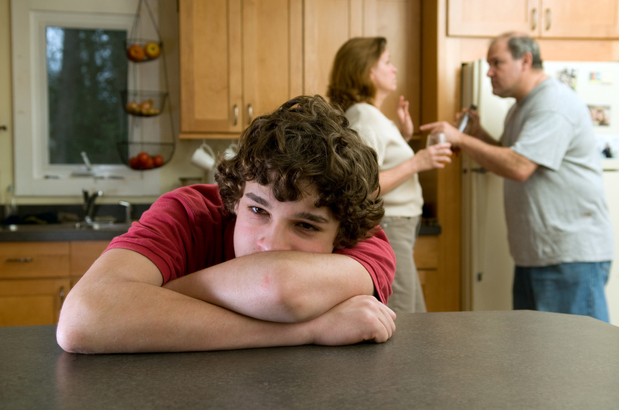

Slide 25
University milieu
“At first at university that’s how people kind of get to know each other a little bit, and they feel like they’re bonding by getting really drunk and crying in the toilets together”.
(Annie, aged 21)
“With student life, you never really know what to do and you want to be accepted, so you kind of go along with it”
(Isabelle, aged 24)
I’ve had water and drunk it out of a straw so people don’t think I’m stopping drinking because I don’t want them to think I’m a bit pathetic…so I just pretend it’s alcohol. Sometimes people are like “ah, why are you stopping drinking, it’s only like one in the morning” and like “ah, you’re so boring”.
(Ursula, aged 19)

Slide 26
Perceptions of alcohol
“You know, you don’t go to parties in order to meet people… My course mates, they’re saying they go in order to get drunk, and if they didn’t get drunk, then they see the party as a failure…” (Dan, aged 22)
“It’s apparently, not really the thing to do to ask someone ‘can you buy me a lemonade’ Doesn’t sound as well as ‘can you buy me a wine’ People would have wine or cocktail or beer or something, not a lemonade…if you’re grown up and can drink alcohol”
(Rosa, aged 18).
“It’s normal for our age bracket, you know. Between eighteen and twenty-five you’re expected to drink, right. People expect you to. And if you don’t you’re kind of … um….”
(Annie, aged 21).

Slide 27
Legitimating environments
“It seems to me a sort of accepted thing now in night clubs to be sort of groped and touched… and I just sort of find it really sort of sickening, but…. Like if you’re just walking down the street they’d never do it, but in a night club it seems to be a normal thing to happen. Like, if I go out on a night out, I definitely wouldn’t expect to come home without somebody trying something. (Betsy, aged 23).
“I’ve sort of seen him drinking always, and it’s like on a daily basis. It never like never occurred to me before I was older that this is like, this is not normal. So that’s the way I learnt to treat my problems. Like, if I’m sad or stuff like that I drink to make myself feel more relaxed or better, so I think that came from home.” (Lara, aged 22)

Slide 28
Please Drink Responsibly ?
Thank you for listening
Briony Enser, Oxford Brookes University, 12097441@brookes.ac.uk
DRINK
RESPONSIBLY

