Slide 1
Alcohol-Related Collateral Harm: the unseen dimension?
Young adults experience in their family and social circle
Briony Enser, Oxford Brookes University
Presentation at the SSA Annual Symposium 2015
York 5-6 November 2015

Slide 2
Alcohol-Related Collateral harm
Harms that drinkers do to themselves are well recognised and preventive public health messages target drinkers.
Harms that people who drink do to the others around them are poorly conceptualised and poorly recognised.
This study uses the term “ARC harm” to provide an acronym for this multi-faceted phenomenon and as a metaphor for the circle around the drinker where these ARC harms occur.

Slide 3


Slide 4
Why “Young Adults” ?
(aged 16 to 24) and why an educated group of young adults?
Policy focus on harms to the drinker side-lines the young adult population group since most alcohol-related harms to drinkers manifest in later life.
Focus on harms to the underprivileged suggests alcohol is not a societal issue.
Media lampoons young adults’ drinking or dismisses it as a rite of passage.
And yet:
Young adults comprise the population group most likely to binge-drink.
Alcohol is the most acute area of lifestyle risk for young adults.
Alcohol causes almost 25% of all Young Adult deaths in the UK.
Alcohol-related accidents are the leading cause of death for young adults.

Slide 5
Aims
Collect and analyse data on young adults’ experiences of the alcohol-related collateral harms (ARC harms) that people who misuse alcohol cause to the other people around them.
Examine how young adults themselves characterise the issue of ARC harm and the extent of its impact on their lives.
Explore associations with the experiences of ARC harm identified, categorise the types of harm, reflect on any insights into their causes and draw out themes.

Slide 6
Phase I: Health & Wellbeing Survey
Phase II: In-depth Interviews
Mixed methods
Phase I: On-line survey of college and university students aged 16 -24. Quantitative data collected on ARC harm in the context of the key risk areas for Public Health: Smoking, Drinking, Diet & Exercise. Qualitative data collected on the types of ARC harm experienced.
450 sixth form & university students’ responses analysed.
Phase II: 25 semi-structured interviews collected qualitative data for thematic analysis from a purposive sample of survey participants who reported at least one experience of ARC Harm.

Slide 7
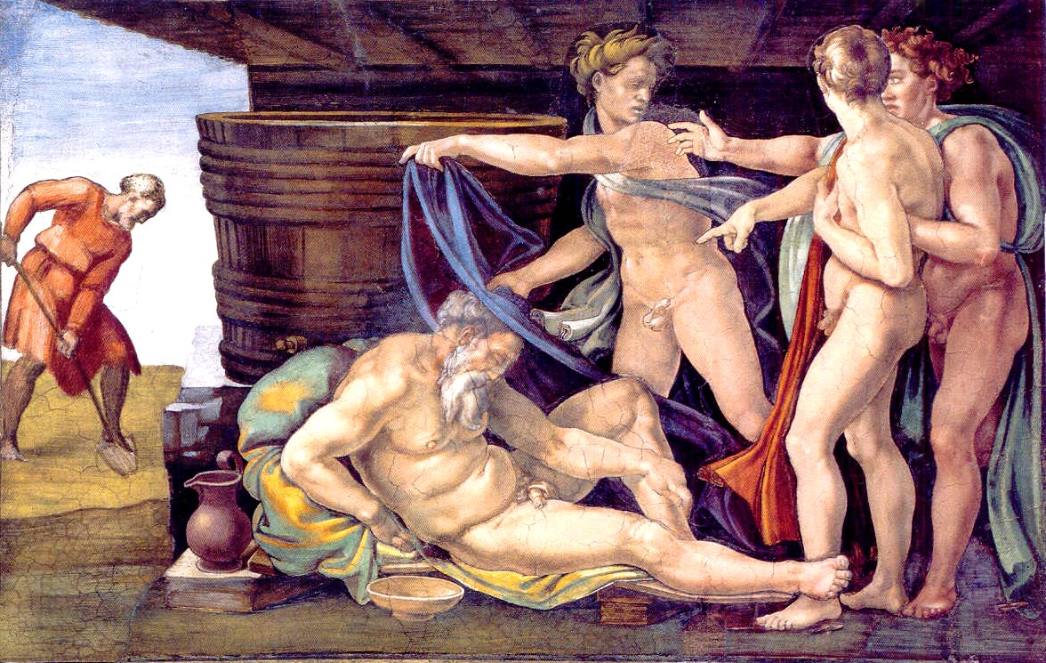

Slide 8
Few recorded data
Alcohol-Related Collateral Harm
Macroeconomic significance:
Estimated costs to the NHS £2.7 billion
Estimated costs to the economy £21 billion.
Home & Community significance:
Estimated 1.3 million children affected
Almost half of all violent incident offenders
Some 110,000 cases of domestic abuse per year
Most common non-genetic cause of learning disability

Slide 9
Characteristics of survey sample
85% of survey participants drank alcohol
79% stated that alcohol played a role in their lives.
94% had close family members who drank alcohol
89% had close friends who drank alcohol.
Males reported a weekly average of 7.8 UK units of alcohol, Females 9.1 units.
Adjusted: Males 11.6 units and females 13.6 units weekly
(National comparator Young Adult age group: 14.1 units men, 8.2 women) (NHS Information Centre).

Slide 10
ARC harm awareness
83% of the survey sample had heard of alcohol-related harms caused by other peoples’ drinking (91% had heard of second-hand smoke).
91% thought drinking alcohol when pregnant was not acceptable.
88% believed that parents’ drinking alcohol put children at risk of harm.
ARC harm experience
64% of participants had had their health or safety put at risk by others’ drinking and/or been affected adversely affected in another adverse way.
47% had experienced ARC harm which affected their health or safety alone.
47% had experienced ARC harm which only affected them in another adverse way.
60% of participants said that friends and/or family affected their decision to drink.

Slide 11
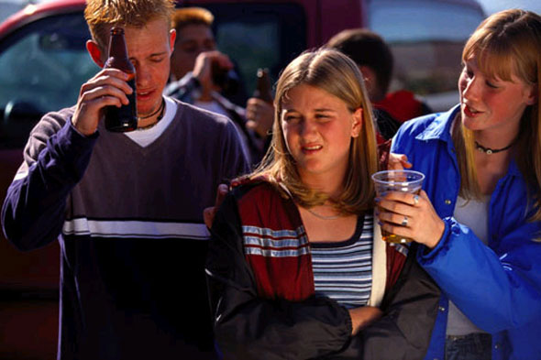

Slide 12
Survey statistical analyses of ARC harm – Key associations
Young adult women were significantly more likely to have experienced ARC harms than young men (69% to 53%, χ2 =10.05, p= 0.001 ).
ARC harm did not only affect drinkers - Both drinking and non-drinking participants reported personal experience of ARC harm (66% of drinkers, 50% of non-drinkers, χ2 =6.58, p>= 0.010).
Experience of ARC harm affecting participants’ health or safety was predictive of ARCH also having affected participants in another adverse way. (χ2 = 45.38, p = <0.001)
Experience of ARC harm was predictive of another person having affected participants’ own decisions to have an alcoholic drink or not to drink alcohol. (χ2 = 20.93, p = <0.001).
Experience of ARC harm was not associated with the amount of alcohol participants consumed per week - Neither drinking 21 units of alcohol or fewer, nor drinking 28 units or more per week was predictive of having experienced ARC harm.
Participants’ parents’ drinking alcohol was not predictive of participants reporting a personal experience of ARC harm. BUT participants’ parents’ drinking alcohol every day was predictive of the participants reporting a personal experience of ARC harm. (χ2 = 12.79, p = <0.001).

Slide 13
Eight initial clusters of ARC harm from young adults experiences
Avoidance: Avoidance/exclusion from social experiences where people get drunk.
Nuisance: e.g. Disturbed sleep/study from noisy drunken friends & neighbours (Mild to severe depending on nature & frequency).
Pressure: e.g. to conform - Peers encourage drinking alcohol as ‘normal’. Mild to severe, extending to complete exclusion. Threatening pressure: e.g. unwelcome attention/sexual behaviour by drinkers. (Mild to severe, verbal abuse/harassment to life threatening situations).
Unsought responsibility: From reciprocal caring for drunken friends, to taking them to A&E, parenting older generation, coping with variants of others’ irresponsibility.
Psychological harm: Embarrassment/distress/bereavement/loss from behaviour of a heavy-drinking friend/family member or stranger.
Relationship harm: Negative effect on relationships, arguments and rifts caused by friends’ or family’s alcohol consumption.
Physical harm: e.g. an unsolicited attack by a drunk or a car accident with a drunk driver. (Mild to severe, minor scars to life threatening injury).
Undisclosed harm: Details of harm declined. Shame / concealment.

Slide 14
ARC harm by age
Alcohol-Related Collateral harm takes off at age 18.

Slide 15
Semi-structured interviews
Revisited ARC questions in survey & participant’ s own responses to them.
Leeway given to participants to dictate pace & direction.
Taxonomy of categories of ARC experiences drawn from all survey presented to participants as cross check/prompt.

Slide 16
Risk factors for ARCH
Coming of age (legal age for pubs & clubs)
Away from home first time
Expectations of university life
Alcohol as a joke or game
Alcohol as “cool” v “sad” non drinkers
Fear of being left out / need for instant friendships
Absence of alternative activities
Absence of censure or other messages

Slide 17
DESCRIPTIVE CODES
WHO?
(ARC harm perpetrators mentioned by survey participants)
Stranger, acquaintance, friend, boyfriend/girlfriend, parent, sibling, cousin, uncle/aunt, grandparent.
(Perpetrator has consumed alcohol in all cases, and may be drunk when the ARC harm occurs, but may not be an habitual heavy drinker, nor an alcoholic
WHAT?
(Type of ARC harm experienced)
Nuisance, pressure, responsibility, physical harm, psychological harm, relationship harm, loss (time) loss (opportunity cost), loss (severed relationship/bereavement), undisclosed harm (embarrassment, shame, guilt).

Slide 18
WHEN?
(Timing of ARC harm instances reported - frequency of risk)
24/7, clusters: early evening (pre-drinks around 18.00-22.00), late night/early morning (night-time economy around 22.00- 04.00), weekends (Fri, Sat, Sun), cheap club nights (Mon & Weds).
WHERE?
(Setting where ARC harm occurs)
Family home, friend’s home, university (hall of residence), university (private or shared home), nightclub, public place/street.
(Context in which ARC harm occurs)
Story of harm event in the setting

Slide 19
WHY?
AGENTIC STATE
(Carelessness/irresponsibility on part of drinker)
Drinker absolves self from his/her actions or failure to act appropriately.
Does not own the consequences. (Milgram 1974)
ENVIRONMENTAL CONTEXT
(Permissive, legitimating)
Drinker and quarry conform to legitimating environment.
Club environment endorses social and sexual harassment for perpetrator, expectation on quarry to tolerate.
(French & Raven 1957)

Slide 20
SOCIAL CONTEXT
(Normative pressure)
Drinker and quarry both conform to social norms.
(Kelly 1952, Lewin 1947)
REINFORCING ENVIRONMENT
(Reward power)
Drinker and quarry are rewarded for accepting new norms by incentives offered - Freshers’ week freebies, cheap student club nights, absence of alternative, recreational activities.
(Moscovici 1976).

Slide 21
Responsible drinking?
“No person ought to be punished simply for being drunk; but […] when […] there is definite damage, or a definite risk of damage, either to an individual or to the public, the case is taken out of the province of liberty and placed in that of morality or law.”
Mill, J.S. (1859) On Liberty.

Slide 22
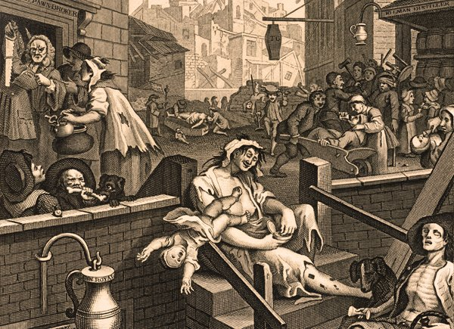
Thank you for listening
Briony Enser, Oxford Brookes University, 12097441@brookes.ac.uk

