Slide 1
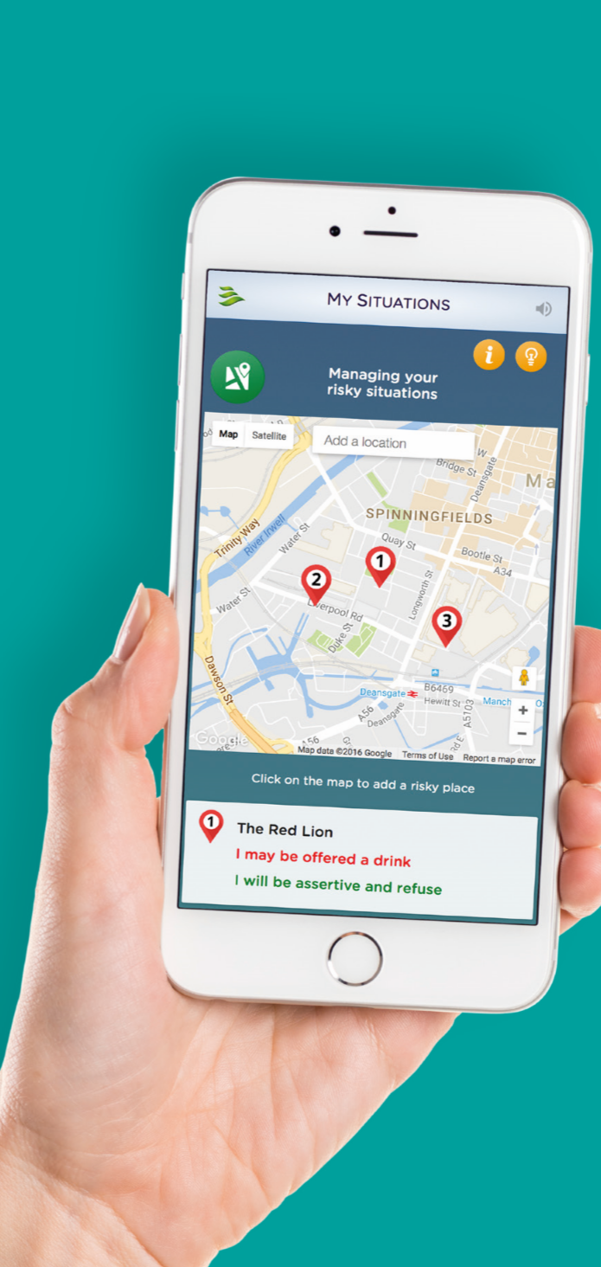
Challenging the ‘hierarchy of evidence’:
Using the Medical Research Council (MRC) framework to evidence Breaking Free Online
Dr Sarah Elison - Breaking Free Online

Slide 2
Content
Introduction
Methods
Findings
Conclusions
Digital treatment for substance misuse:
Breaking Free Online (BFO)
The Medical Research Council (MRC) framework
Key findings from BFO research programme
And implications

Slide 3
Introduction: Technology and treatment
Computer-assisted therapy (CAT) widens access to evidence-based treatment
Based primarily on cognitive-behavioural therapy (CBT) principles
Reduces waiting times
Overcome stigma
Improves treatment fidelity
Also cost-effective
Can be used as CAT or self-help for range of mental health-related conditions
Literature demonstrates approach clinically effective

Slide 4
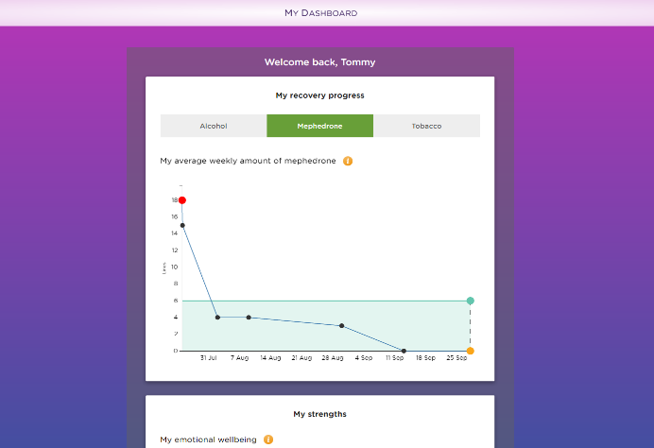
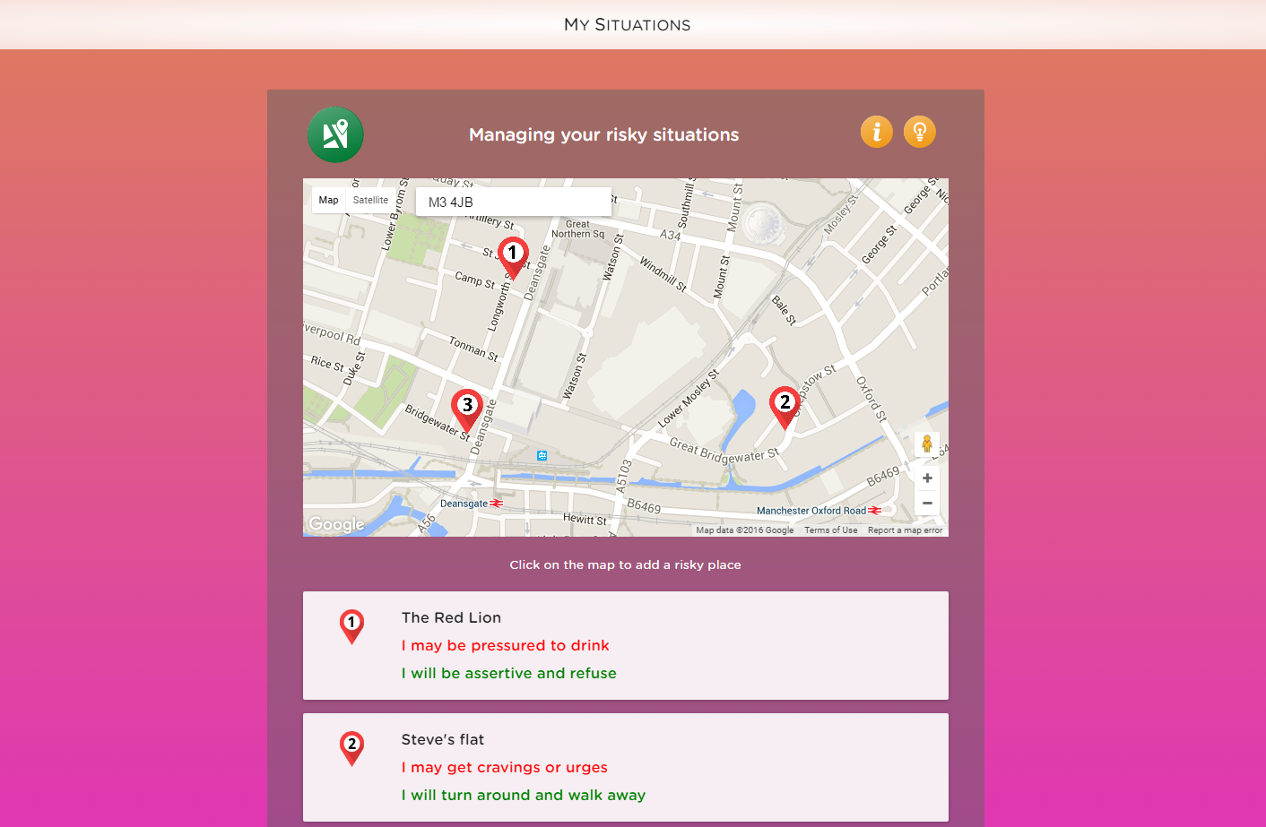
Introduction: Breaking Free Online
Psychological treatment programme for substance misuse
Accessible 24/7 across all devices via a secure cloud-based web application
Integrates CBT, mindfulness, relapse prevention and motivational enhancement therapy
Delivers personalised treatment with consistency and fidelity
Research programme underway demonstrating clinical effectiveness and implementation

Slide 5
Methods: MRC framework
Effectiveness evaluated via mixed-method research programme
Based on Medical Research Council (MRC) guidelines
For complex multi-component interventions
Implementation and change mechanisms as important as outcomes
Encourages continual process of research and development
Multiple methodologies, i.e. both qualitative and quantitative approaches
Results in data spanning the ‘hierarchy of evidence’

Slide 6
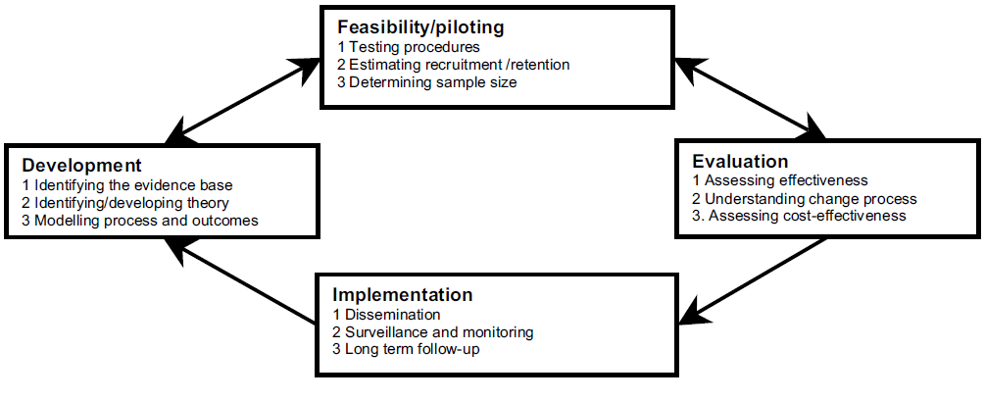
Methods: MRC framework
Medical Research Council 2008
www.mrc.ac.uk/complexinterventionsguidance

Slide 7
Methods: Hierarchy of evidence
Decreasing ‘value’ amongst medical model focussed scientific community, however MRC Framework describes the importance of ‘lower level’ evidence in the design of complex interventions and achievement of ‘gold standard’ evidence (RCTs, meta-analyses)
Systematic Reviews
Randomised Controlled Trials
Pilot Outcome Evaluations
value
Qualitative Interviews/ Focus Groups
Case Studies

Slide 8
Findings: Findings from BFO research programme
Development:
Conceptualising clinical content using BCT taxonomy
Feasibility/piloting:
Real-world outcomes from an eTherapy service
Implementation:
Qualitative exploration of barriers and facilitators
Evaluation:
Understanding mechanisms of action of clinical content
Spectrum of methods and evidence within MRC framework

Slide 9
Findings: Findings from BFO research programme
Development:
Conceptualising clinical content using BCT taxonomy
Feasibility/piloting:
Real-world outcomes from an eTherapy service
Implementation:
Qualitative exploration of barriers and facilitators
Evaluation:
Understanding mechanisms of action of clinical content
Spectrum of methods and evidence within MRC framework

Slide 10
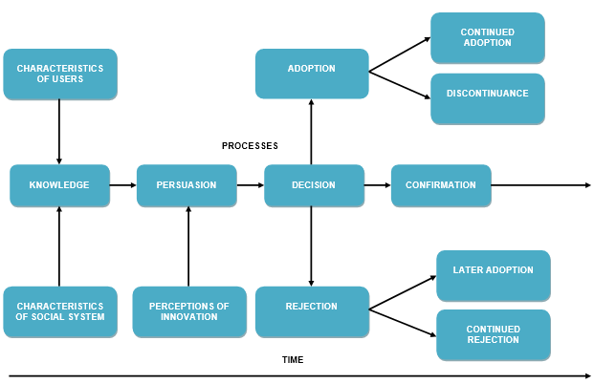
Implementation: Qualitative exploration
Introducing a novel digital innovation into existing healthcare system can be seen as ‘disruptive’
This may affect adoption and uptake of the innovation.
Qualitative studies to explore barriers and facilitators of this process at Change, Grow, Live (n = 61)
Behavioural science theory used to conceptualise findings:
Diffusion of innovations theory
Normalisation process theory
Transtheoretical model

Slide 11
Implementation: Qualitative exploration
Initial difficulties with IT infrastructure and trepidation about digital format initially acted as barriers to diffusion
Eventually staff and services users started to see benefits, e.g. caseload management, 24/7 access outside of normal service opening hours
Diffusion achieved via a nationwide licence, some barriers to normalisation of BFO as standard treatment offering, e.g. preferences for traditional interventions
But as innovative ways of delivering BFO were devised staff and service users began to find a ‘place’ for BFO amongst other treatments available
Peer mentor delivery was found to be a particularly effective means of delivery, as it provided recovery community with ‘ownership’ of BFO
And peer mentors reported that by supporting service users to use BFO and practice strategies in it, this helped their own recovery maintenance

Slide 12
Findings: Findings from BFO research programme
Development:
Conceptualising clinical content using BCT taxonomy
Feasibility/piloting:
Real-world outcomes from an eTherapy service
Implementation:
Qualitative exploration of barriers and facilitators
Evaluation:
Understanding mechanisms of action of clinical content
Spectrum of methods and evidence within MRC framework

Slide 13
Findings: Findings from BFO research programme
Development:
Conceptualising clinical content using BCT taxonomy
Feasibility/piloting:
Real-world outcomes from an eTherapy service
Implementation:
Qualitative exploration of barriers and facilitators
Evaluation:
Understanding mechanisms of action of clinical content
Spectrum of methods and evidence within MRC framework

Slide 14
Development: Conceptualising clinical content
Field of health psychology has made significant progress in advancing and standardising the science of behaviour change
Major part of this is development of the Behaviour Change Technique Taxonomy v1 (BCTTv1) (Michie et al., 2013)
Provides a means of describing the active components contained within complex interventions
However, the BCTTv1 has not been widely used to describe content of interventions for substance misuse
So, this study used the clinical content of BFO to demonstrate how the BCTTv1 could be used to conceptualise the content of a substance misuse intervention

Slide 15
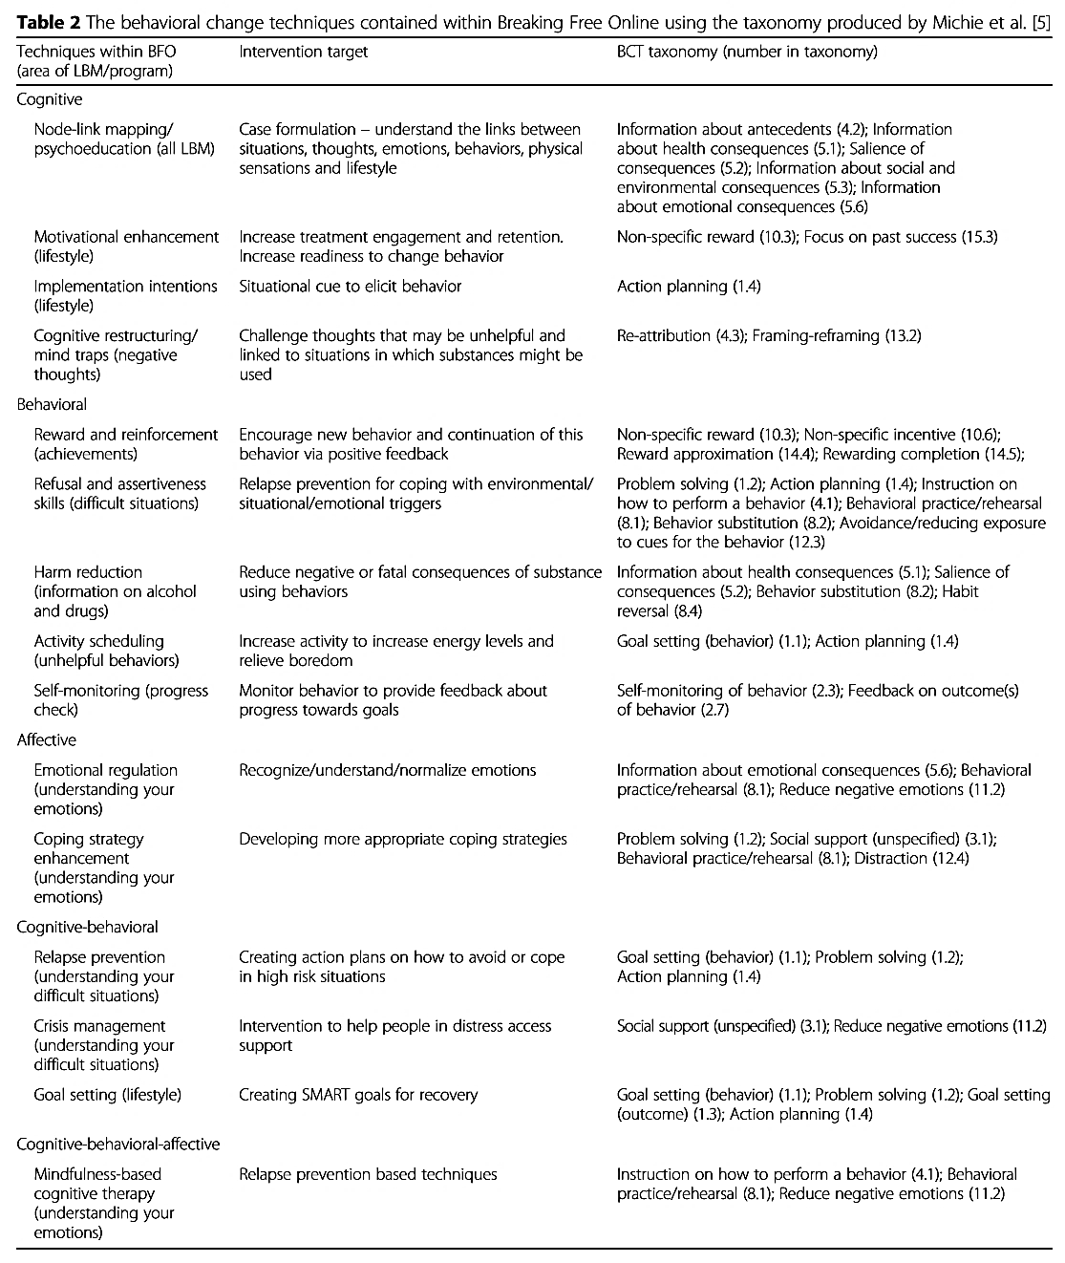
Development: Conceptualising clinical content
Total of 26 / 93 BCTs identified in BFO
At least one BCT identified in 12 / 16 BCT grouping categories in the BCTTv1
Specific BCT categories included:
Goal setting and planning
Psychoeducation
Repetition and substitution
Reward
Regulation
Alcohol misuse
£3.5 billion
Table from: Dugdale et al. (2016) Substance Abuse Treatment, Prevention and Policy

Slide 16
Findings: Findings from BFO research programme
Development:
Conceptualising clinical content using BCT taxonomy
Feasibility/piloting:
Real-world outcomes from an eTherapy service
Implementation:
Qualitative exploration of barriers and facilitators
Evaluation:
Understanding mechanisms of action of clinical content
Spectrum of methods and evidence within MRC framework

Slide 17
Findings: Findings from BFO research programme
Development:
Conceptualising clinical content using BCT taxonomy
Feasibility/piloting:
Real-world outcomes from an eTherapy service
Implementation:
Qualitative exploration of barriers and facilitators
Evaluation:
Understanding mechanisms of action of clinical content
Spectrum of methods and evidence within MRC framework

Slide 18
Feasibility: Outcomes from eTherapy service
Research demonstrated CAT for substance misuse effective, though much of these data from research settings, not real-world services
Therefore, clinical outcomes examined from a dedicated eTherapy Increasing Access to Psychological Therapies (IAPT) mental health service ‘Self-Help Services’
Quantitative study with 1068 service users triaged into one of three CAT programmes:
Breaking Free Online (BFO)
Sleepio (insomnia)
Living Life to the Full (LLttF - low mood and stress)
Aims: examine outcomes for the three groups, and determine if CAT has potential as a treatment modality for range of mental health related conditions

Slide 19
Feasibility: Outcomes from eTherapy service
Outcomes measured using IAPT Minimum data Set:
Patient Health Questionnaire-9; General Anxiety Disorder scale-7; Work and Social Adjustment Scale
At baseline, BFO users significantly higher scores for depression and anxiety than Sleepio and LLttF users
Significant within group changes in scores from baseline to post-treatment
Within each group, percentages of service users reaching clinical threshold scores for depression and anxiety significantly reduced over the treatment period
No significant differences between groups in degree of change in scores
Findings demonstrate that CAT modality has potential as additional treatment offering in IAPT service, implications for case-load management

Slide 20
Findings: Findings from BFO research programme
Development:
Conceptualising clinical content using BCT taxonomy
Feasibility/piloting:
Real-world outcomes from an eTherapy service
Implementation:
Qualitative exploration of barriers and facilitators
Evaluation:
Understanding mechanisms of action of clinical content
Spectrum of methods and evidence within MRC framework

Slide 21
Findings: Findings from BFO research programme
Development:
Conceptualising clinical content using BCT taxonomy
Feasibility/piloting:
Real-world outcomes from an eTherapy service
Implementation:
Qualitative exploration of barriers and facilitators
Evaluation:
Understanding mechanisms of action of clinical content
Spectrum of methods and evidence within MRC framework

Slide 22
Evaluation: Mechanisms of action
BFO clinical content structured via six-domain biopsychosocial model, the Lifestyle Balance Model (LBM)
Also, corresponding psychometric assessment, Recovery Progression Measure (RPM)
Measures changes in functioning in six domains in LBM
Data from RPM at baseline populates LBM to provide tailoring advice to users, shows domains of most significant impairment (traffic lights)
Directs users to clinical techniques that will be of most benefit to them
But, do users follow tailoring advice and more frequently complete techniques corresponding to their most impaired domains of functioning?
Also, does completion of specific clinical techniques result in specific clinical outcomes (mechanisms of action of BFO)?

Slide 23
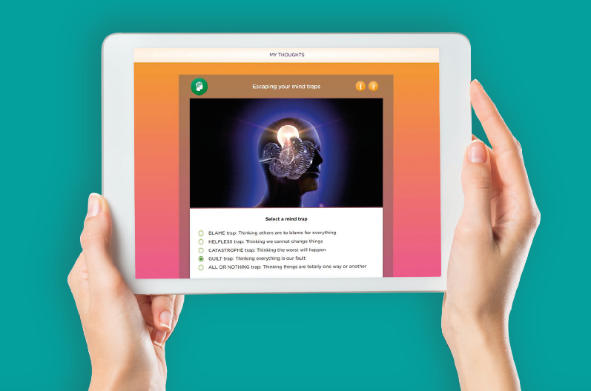
Evaluation: Mechanisms of action
Data from 2311 BFO users analysed to examine association between tailoring advice, clinical techniques completion, and clinical outcomes
Outcomes showed that users did follow tailoring advice
Frequency of completion of clinical techniques significantly associated with level of impairment (red, amber, green) in individual LBM domains
Mechanism of action analyses revealed primacy of techniques in BFO related to cognitive restructuring (located on ‘negative thoughts’ LBM domain)
Surprising finding, but makes sense theoretically
BFO is a cognitive-behavioural programme
Cognitive behavioural theory demonstrates cognitions underpin behaviours
And therefore, cognitive change underpins behavioural change

Slide 24
Conclusions and implications
MRC framework demonstrates that establishing clinical effectiveness of complex interventions just one aspect of development and evaluation process
Examining implementation and outcomes in real-world treatment settings important in facilitating translation into standard practice
Especially important in relation to ‘disruptive’ digital interventions
Also, understanding how clinical content of complex interventions exert their effects, important in guiding continual updated and refinements
Particularly important for digital interventions which may be continually updated in order to keep pace with evolving digital technologies
Though RCTs and other clinical trial methodologies are important in evaluating complex interventions, other complementary approaches can be used

Slide 25
Contact details
Dr Sarah Elison
Research Director
Email: selison@breakingfreegroup.com
Office: 0161 834 4647
Mobile: 07814 048483
Websites: www.breakingfreegroup.com
www.breakingfreeonline.com

