Slide 1

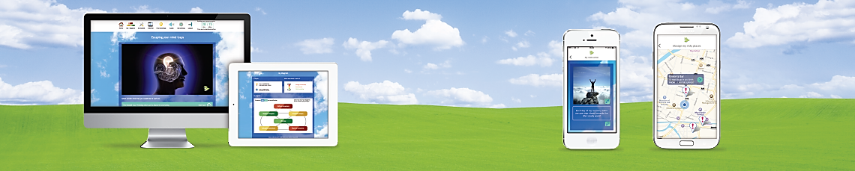
Mixed-methods evaluation of the Breaking Free Online (Health and Justice) treatment and recovery programme for substance misuse in prisons
Dr Sarah Elison
Head of Research, Breaking Free Group
© 2014 Breaking Free Online Limited. All rights reserved.
www.BreakingFreeGroup.com

Slide 2

Breaking Free Online (Health and Justice)
Computer-assisted therapy for drug and alcohol addiction:
  Widens access to evidence-based treatment
  Reduces waiting times
  Overcomes stigma and other barriers to treatment
  Cost-effective solution
Growing evidence base published in UK and US peer reviewed journals:
  Research based on MRC framework (Craig et al., 2008)
  Qualitative studies focused on implementation (Elison et al., 2014)
  Quantitative studies in range of populations (Elison et al., 2012, 2013, 2014, 2015a,b)

Slide 3



Breaking Free Online (Health and Justice)
  Approved by UK Ministry of Justice
    Delivered via Virtual Campus
    Secure, web-based learning environment in prisons
First healthcare intervention to be included on VC
  Provides continuity of care between all prisons in England and Wales
    And following release back to the community
  NHS England ‘Through the Gate’ initiative to address addiction in offenders:
    Aims to improve rehabilitation and reduce reoffending
    Increasing access to support in prison and the community

Slide 4
Overview of evidence-based psychosocial interventions in Breaking Free Online
Strategies in Breaking Free Online | Interventions | Therapeutic approaches
Assessment Progress check | Structured assessment Self-monitoring | Extended brief intervention (EBI) Standardised measures
Lifestyle balance model | Generic formulation Idiosyncratic formulation | Node-link mapping Cognitive-behavioural therapy (CBT)
Understanding your difficult situations | Psycho-education on problematic situations | Psycho-education Extended brief intervention (EBI)
Managing your difficult situations: Recognise-avoid cope | Recognise-avoid-cope Seemingly irrelevant decisions (SIDs) | Relapse prevention Overdose awareness; Preparation for release
Understanding your negative thoughts | Psycho-education on negative thinking patterns | Psycho-education Extended brief intervention (EBI)
Escaping your mind traps | Mind traps Cognitive restructuring | International Treatment Effectiveness Programme (ITEP) Cognitive-behavioural therapy (CBT)
Understanding your emotions | Psycho-education on emotional regulation | Psycho-education Extended brief intervention (EBI)
Shifting your focus | Attention narrowing/attention switching Emotional regulation | Coping strategy enhancement (CSE) Mindfulness-based cognitive therapy
Understanding your physical sensations | Psycho-education on cravings and urges | Psycho-education Extended brief intervention (EBI)
Surfing your cravings and urges | Urge surfing | Mindfulness-based cognitive therapy
Understanding your unhelpful behaviours | Psycho-education on behavioural control | Psycho-education Extended brief intervention (EBI)
Planning your time positively | Activity scheduling Behavioural activation | Cognitive-behavioural therapy (CBT)
Understanding your lifestyle | Psycho-education on association of lifestyle and substance use | Psycho-education Extended brief intervention (EBI)
Achieving your life goals | Goal-setting | Motivational enhancement therapy (MET) Implementation intentions
Guidance for supporters | Psycho-education for practitioners, peer mentors and members of social networks | Psycho-education Family therapy (FT)

Slide 5

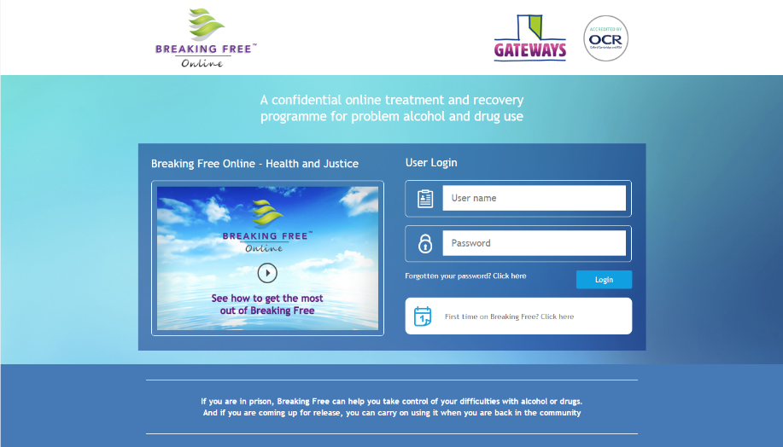
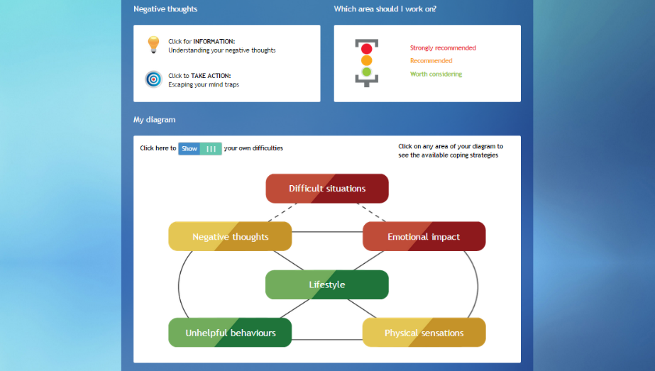
Breaking Free Online (Health and Justice)

Slide 6
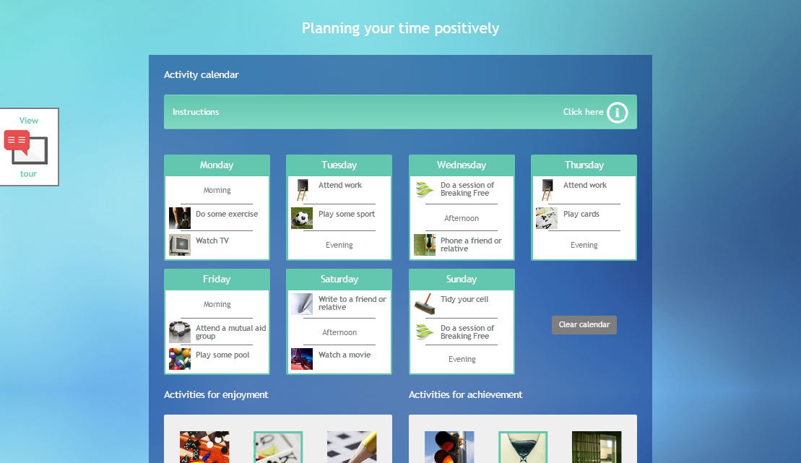
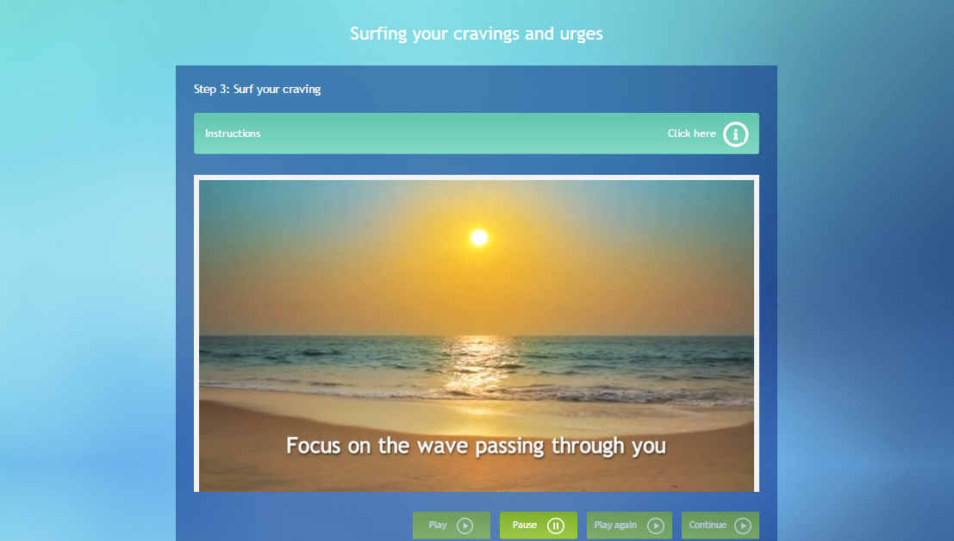
Breaking Free Online (Health and Justice)

Slide 7
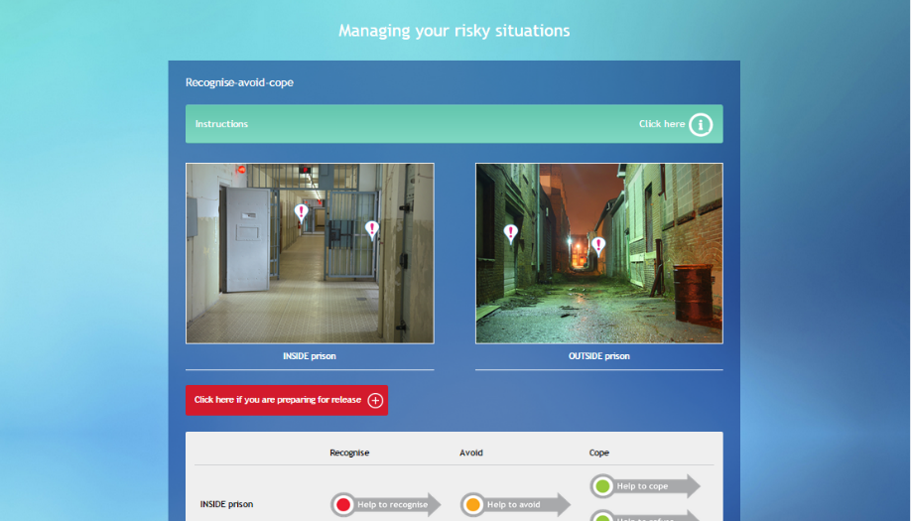
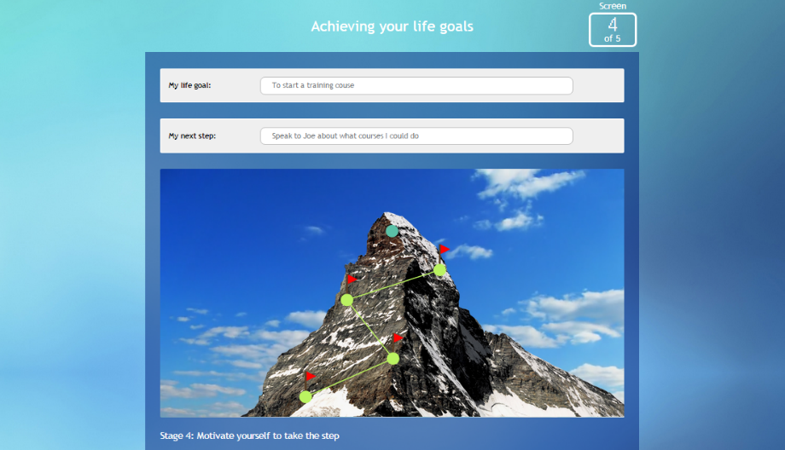
Breaking Free Online (Health and Justice)

Slide 8
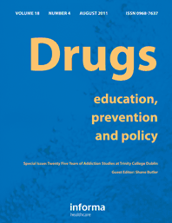
Evaluation using the MRC framework
Accepted for publication in Drugs: Education, Prevention and Policy
All offenders male; mean age 35 years (range 21-50 years)
  Range of substances including opiates (36%) and alcohol (18%)
Quantitative outcomes from 85 offenders
    Self-reported substance use
    Severity of dependence (SDS; Gossop et el., 1995)
    Quality of life (WHOQoL-BREF; Skevington et al., 2004)
    Recovery progression (RPM; Davies et al., 2015; Elison et al., under review)
  Exploratory qualitative study with 16 offenders

Slide 9
Quantitative findings
Measure | P-value | Effect size
Quality of life | < .0001 | .38
Recovery progression | .415 | .01
Severity of alcohol dependence | .013 | .57
Alcohol consumption | < .0001 | .74
Severity of drug dependence | < .0001 | .36
Drug consumption | < .0001 | .74
Simple pre-test/post-test study
Based on offender self-reports
Statistically significant improvements in quality of life, substance dependence and substance use but not recovery progression

Slide 10
Recovery progression
Aspect of functioning | P-value | Effect size
Thoughts | .002 | .34
Emotions | .004 | .31
Unhelpful behaviours | .646 | .05
Physical sensations | .014 | .27
Difficult situations | .025 | .24
Lifestyle | .645 | .04
No significant change on total RPM score
But when individual aspects of functioning examined:
  Improvements in thoughts, emotions, physical sensations, difficult situations
  But no change in unhelpful behaviours and lifestyle – is the ability of offenders to utilise interventions constrained by prison environment and regime?

Slide 11
Qualitative findings
“I'm not really good on computers […] it was a bit hard to get into at first.”
Initially some concerns about digital skills…
…but benefits of digital format also reported
And therapeutic benefits also identified…
Interviewer: What was it that made you think you might like to have a go at it?
Participant: 'Cause it's working on a computer instead of a group.
Interviewer: You're not into groups?
Participant: Not really, no.
“I thought it was really helpful […] I had no idea how many units of alcohol I was drinking, and how harmful it was […] finding out that I was drinking over 50 units of alcohol a day.”

Slide 12
Qualitative findings
“What I liked about it, I didn't want to just come in here, then go out there with absolutely nothing […] So, yeah, it is a good tool, and I understand why you've done it.”
Offenders reported it equipped them with ‘tools’ to sustain their recovery…
…and that they intended to continue accessing
the programme when back in the community
There were anecdotal reports some already were
“When I get home, I'll go on it from time to time, just to re-boost myself.”
“People who are coming up to their release and started it, in here with a few weeks […] have said they've used it when they've got out.”

Slide 13
Conclusions
Even in challenging prison environment, offenders can make significant progress in their recovery from drug and alcohol addiction
Despite security and digital inclusion barriers, it was possible to implement computer-assisted therapy in prison settings and support offenders in using it
Data suggest positive outcomes
  Reduced substance dependence and substance use
  Improvements to quality of life and aspects of recovery progression
Recovery progression findings interesting as they reveal which aspects of functioning might be more amenable to positive change in a prison setting
  Further investigation needed to look at longer-term outcomes in the community

Slide 14
Next steps
Randomised controlled trial (RCT) has been given approval by MoJ and NOMS
Follow-up study being conducted in community to assess how recovery progresses following release
  Also looking at other aspects of rehabilitation including education, employment etc.
Approvals currently being sought for data linkage study
  Intention to track reoffending using the MoJ Data Justice Lab

Slide 15
References
Craig, P., Dieppe, P., Macintyre, S., Michie, S., Nazareth, I., & Petticrew, M. (2008). Developing and evaluating complex interventions: the new Medical Research Council guidance. British Medical Journal, 337(Sep29_1), a1655-a1655.
Davies, G., Elison, S., Ward, J., & Laudet, A. (2015). The role of lifestyle in perpetuating substance dependence: A new explanatory model, The Lifestyle Balance Model. Substance Abuse Treatment, Prevention and Policy, 10(2).
Elison, S., Davies, G., & Ward, J. (2015a). An outcomes evaluation of computerised treatment for problem drinking using Breaking Free Online. Alcoholism Treatment Quarterly, 33(2), 185-196.
Elison, S., Davies, G., & Ward, J. (2015b). Sub-group analyses of a heterogeneous sample of service users accessing computer-assisted therapy (CAT) for substance dependence using Breaking Free Online. Journal of Medical Internet Research, 2(2), e13.
Elison, S., Davies, G., & Ward, J. (under review). Initial development and psychometric properties of a new measure of substance misuse ‘recovery progression’: The Recovery Progression Measure (RPM). Substance Use and Misuse.
Elison, S., Humphreys, L., Ward, J., & Davies, G. (2013). A Pilot Outcomes Evaluation for Computer Assisted Therapy for Substance Misuse- An Evaluation of Breaking Free Online. Journal of Substance Use, 19(4), 1-6.
Elison, S., Ward, J., Davies, G., Lidbetter, N., Dagley, M., & Hulme, D. (2014). An outcomes study of eTherapy for dual diagnosis using Breaking Free Online. Advances in Dual Diagnosis, 7(2), 52-62.
Elison, S., Ward, J., Davies, G., & Moody, M. (2014). Implementation of computer-assisted therapy for substance misuse: a qualitative study of Breaking Free Online using Roger's diffusion of innovation theory. Drugs and Alcohol Today, 14(4), 207-218.
Gossop, M., Darke, S., Griffiths, P., Hando, J., Powis, B., Hall, W., & Strang, J. (1995). The Severity of Dependence Scale (SDS): psychometric properties of the SDS in English and Australian samples of heroin, cocaine and amphetamine users. Addiction, 90(5), 607-614.
Skevington, S. M., Lotfy, M., & O'Connell, K. A. (2004). The World Health Organization's WHOQOL-BREF quality of life assessment: psychometric properties and results of the international field trial. A report from the WHOQOL group. Quality of Life Research, 13(2), 299-310.

Slide 16
Contact details
Dr Sarah Elison (Head of Research)
Email: selison@breakingfreegroup.com
Phone: +44 (0) 161 834 4647
Website: www.breakingfreegroup.com

