Slide 1


Using the Transtheoretical Model to conceptualise peer mentors’ recovery from substance use.
Stephanie Dugdale
Research Associate, Breaking Free Group
© 2014 Breaking Free Online Limited. All rights reserved.
www.BreakingFreeGroup.com

Slide 2


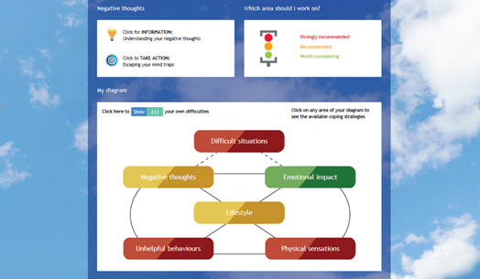
Breaking Free Online
Online treatment and recovery programme for substance use difficulties
Growing evidence base (Elison et al., 2013, 2014a, 2014b, 2015a, 2015b)
Centred on the Lifestyle Balance Model
(Davies et al., 2015)
Notes:
Delivered as cat or self help – talk about cat and pms
LBM as below
Techs including mind traps and activity scheduling, and body scan meditations from mindfulness
Growing ev base of both quantitative and qualitative studies suggesting the efficacy of the programme in significantly improving substance dependence, mental health and quality of life outcomes. The programme is currently being delivered to service users throughout some of the major health and addiction services in the UK.

Slide 3
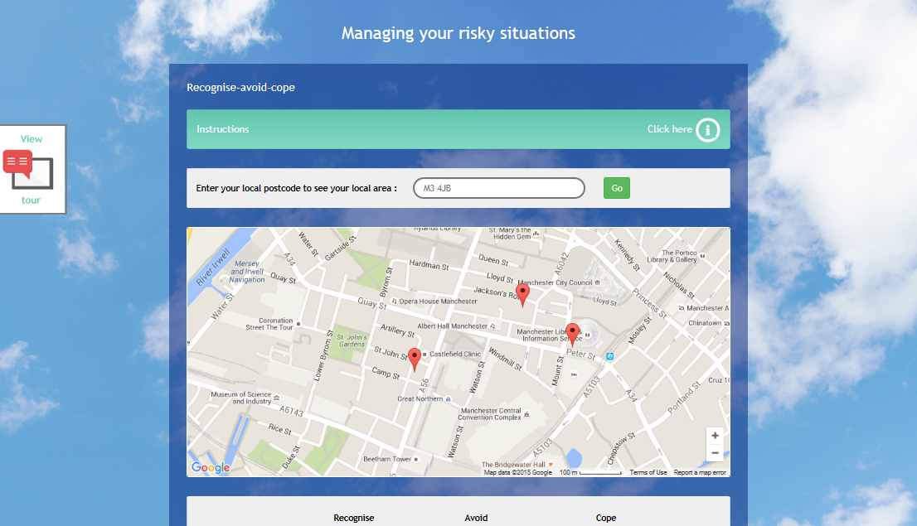
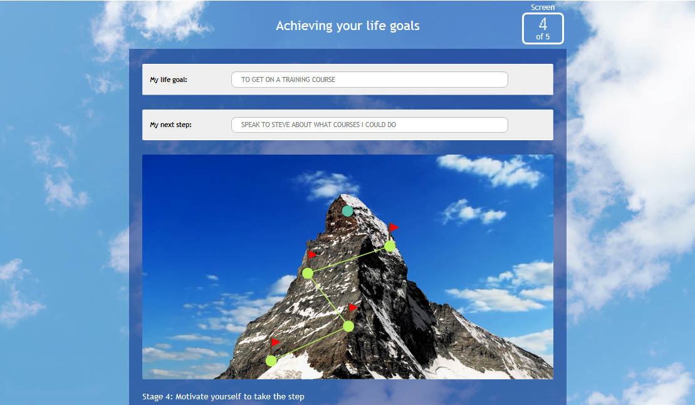
Community
Notes:
Difficult situations and lifestyle

Slide 4


General questions
Peer mentors from Crime Reduction Initiatives (CRI) are used to deliver Breaking Free Online
  - How important is this role in the sector?
  - How does the introduction of Breaking Free Online affect peer mentors?
Notes:
Interested in the qualitative strand of research and wanted to look further at the implementation process of Breaking free within services –
Looking at cri, many use pms to deliver intervention as cat
Peer mentors are able to identify with service users through a shared understanding of experiences, however they are currently maintaining their recovery and have to demonstrate stability before being recruited.
Wanted to know more about the impact of peer mentors in this sector and in the implementation process of BFO, and what the effects on peer mentors were

Slide 5
Background
Peer mentoring is increasingly utilised in healthcare due to the benefits for service users:
- increased likelihood of completing a substance use intervention (Mangrum, 2009)
- reduced risk of relapse (Boisvert et al., 2008)
Peer mentors may develop practical skills (Skovholt, 1974)
However, the therapeutic benefit of this role to peer mentors is often unrecorded
- suggestions that the role increases the probability of relapse (ColÓn et al., 2010; Tober
et al., 2013)
Notes:
Looking at the background peer mentoring is incredibly useful, research has suggested that it benefits the service users…
Also may benefit the peer mentor devel practical skills such as increased competence, learning opportunities and social approval
But paucity of evidence surrounding therapeutic benefit of the role. With evidence suggesting that peer mentoring could lead to relapse, it is important to investigate the effects of this role on recovery

Slide 6
Transtheoretical Model
The Transtheoretical Model (Prochaska et al., 1992) can be used to understand the role of peer mentoring on the process of recovery maintenance
Precontemplation
Contemplation
Recovery
Preparation
Relapse
Action
Maintenance
Termination
Notes:
one way to conceptualise the effects of the role on recovery is by using the TTM, which is widely applied in addictions research

Slide 7
Transtheoretical Model
The Transtheoretical Model (Prochaska et al., 1992) can be used to understand the role of peer mentoring on the process of recovery maintenance
Precontemplation
Contemplation
Recovery
Preparation
Relapse
Action
Maintenance
Termination
Notes:
Of particular importance is the maintenance stage and how the peer mentoring role may affect transition throughout the model causing relapse or sustaining recovery

Slide 8
Design
A total of 18 peer mentors (female = 7) from CRI attended semi-structured interviews.
- Average age of participants was 39 years old (range = 26-56 years)
Thematic analysis was used to analyse the interview transcripts.
- Analysis was guided by the Transtheoretical Model to investigate recovery
maintenance.
Notes:
Add icons from Emma’s poster

Slide 9
Results – ‘Changing paths’
Participants initially thought they could
control their substance use…
… often leading to relapse.
Accepting their difficulty with substances was typically
brought about by a turning point, presenting participants
with two options:
“It was always a case of me deciding I was gonna give up […] I didn't really consider that I had a problem, I thought I could handle it ”
“I just drank probably every day for about three weeks […] I stopped for a couple of months, and then started again.”
“Either do something about it or just carry on the way I was going and probably end up dead”
Notes:
In order to understand maintenance of recovery, it is important to understand peer mentors’ progression to this stage

Slide 10
Results – ‘Perceptions of peer mentoring’
Participants perceived the peer mentoring role as
beneficial to themselves and their recovery.
Participants also noted the benefits of this role to others.
“It's given me a reason to get up every morning. It's given me a purpose”
“The help the peer mentors gave me when I was giving up full blown addiction, I just wanted to...yeah, I wanted to do what they do, I want to help people.”
Notes:
Once peer mentors had progressed through recovery into a more stable state, they began to contemplate becoming a peer mentor
Provides purpose and structure
Help other people and give back to services

Slide 11
Results – ‘The peer mentoring “self”’
There was initial trepidation surrounding participants’
new roles as peer mentors…
however, through their new role, participants were able to develop into
a ‘self’ distinct from their previous substance using behaviours
…and peer mentors felt empowered
to make this change.
“I wasn't sure, 'cause it was a big step, 'cause I'd just come out of service.”
“I was putting distance between how I was”
“The life I had and the life I've got now... they're completely different”
“We chose to pursue that addictive behaviour. So, if we chose to pursue that then we can choose to change it.”
Notes:
Regain control

Slide 12
Results – ‘Sustaining role’
Through helping others, participants were able to maintain their recovery.
The process of recovery maintenance seems ongoing for most peer mentors, as they were aware that relapse is still possible at this stage
…however one participant considered themselves to be ‘recovered’.
“It's keeping me in touch with recovery”
“If you give up on whatever you give up, it is pretty easy, but it's hard to maintain it. So, being a peer mentor really helps me stay focused, and push through”
“I don't consider myself in recovery, I consider myself to be recovered”

Slide 13
Results – ‘Sustaining role’
BFO
Hobbies
Family
Recovery capital
Training courses
Peers
Mutual aid
Notes:
Apart from that one peer mentor – for the most maintenance is key.
The role of PMs actually helped to facilitate maintenance by creating opportunities to build recovery capital
Bfo, family, peers, mutual aid, training courses, hobbies

Slide 14
Results – ‘Sustaining role’
“Reminding me what reverting back to old thinking could lead back to”
BFO
Recovery capital
“I think it's a really useful tool […] if I'm having a bad day, I can just go online and just do some work on Breaking Free for a few hours, and I feel better afterwards. As I said, it's one of the things that keeps me in recovery.”
Notes:
One of the questions I was initially interested in before starting the study was how does the implementation of BFO affect peer mentors
Suggests that they use the programme for themselves or use the techniques as a reminder to maintain recovery

Slide 15
Conclusions
Peer mentoring helped participants regain control over their addiction and maintain their recovery
- reflect on own experiences and the impact of relapse on service users
- plan for the future and seeking support from others who were in recovery
Peer mentoring provided participants with access to a wide range of resources, both related to and not related to recovery. Engaging in these resources supported maintained recovery.
Future research may want to compare findings to those in longer-term recovery, to contribute to the literature on the ‘termination’ stage in substance use recovery.

Slide 16
References
Boisvert, R. A., Martin, L. M., Grosek, M., & Clarie, A. J. (2008). Effectiveness of a peer-support community in addiction recovery:
Participation as intervention. Occupational Therapy International, 15(4), 205-220.
ColÓn, R. M., Deren, S., Guarino, H., Mino, M., & Kang, S.-Y. (2010). Challenges in recruiting and training drug treatment
patients as peer outreach workers: a perspective from the field. Substance Use & Misuse, 45(12), 1892-1908.
Davies, G., Elison, S., Ward, J., & Laudet, A. (2015). The role of lifestyle in perpetuating substance use disorder: The Lifestyle
Balance Model. Substance Abuse Treatment Prevention Policy, 10, 2.
Elison, S., Davies, G., & Ward, J. (2015a). An outcomes evaluation of computerised treatment for problem drinking using
Breaking Free Online Alcoholism Treatment Quarterly, 33(2), 185-196.
Elison, S., Davies, G., & Ward, J. (2015b). Sub-group analyses of a heterogeneous sample of service users accessing computer-
assisted therapy (CAT) for substance dependence using Breaking Free Online. Journal of Medical Internet Research, 2(2), e13.
Elison, S., Humphreys, L., Ward, J., & Davies, G. (2013). A pilot outcomes evaluation for computer assisted therapy for
substance misuse- An evaluation of Breaking Free Online. Journal of Substance Use, 19(4), 1-6.
Elison, S., Ward, J., Davies, G., Lidbetter, N., Dagley, M., & Hulme, D. (2014). An outcomes study of eTherapy for dual diagnosis
using Breaking Free Online. Advances in Dual Diagnosis, 7(2), 52-62.
Elison S, Ward J, Davies G, Moody M. (2014b). Implementation of computer-assisted therapy for substance misuse: A qualitative
study of Breaking Free Online using Roger's diffusion of innovation theory. Drugs and Alcohol Today, 14(4), 207-218.
Mangrum, L. F. (2009). Client and service characteristics associated with addiction treatment completion of clients with co-
occurring disorders. Addictive Behaviors, 34(10), 898-904.
Skovholt, T. M. (1974). The client as helper: A means to promote psychological growth. The Counseling Psychologist, 13, 58-64.
Prochaska, J. O., DiClemente, C. C., & Norcross, J. C. (1992). In search of how people change: applications to addictive
behaviors. American Psychologist, 47(9), 1102-1114.
Tober, G., Raistrick, D., Fiona Crosby, H., Sweetman, J., Unsworth, S., Suna, L., & Copello, A. (2013). Co-producing addiction
aftercare. Drugs and Alcohol Today, 13(4), 225-233.

Slide 17
Contact details
Stephanie Dugdale
Research Associate
Email: sdugdale@breakingfreegroup.com
Phone: +44 (0) 161 834 4647
Website: www.breakingfreegroup.com

