Slide 1

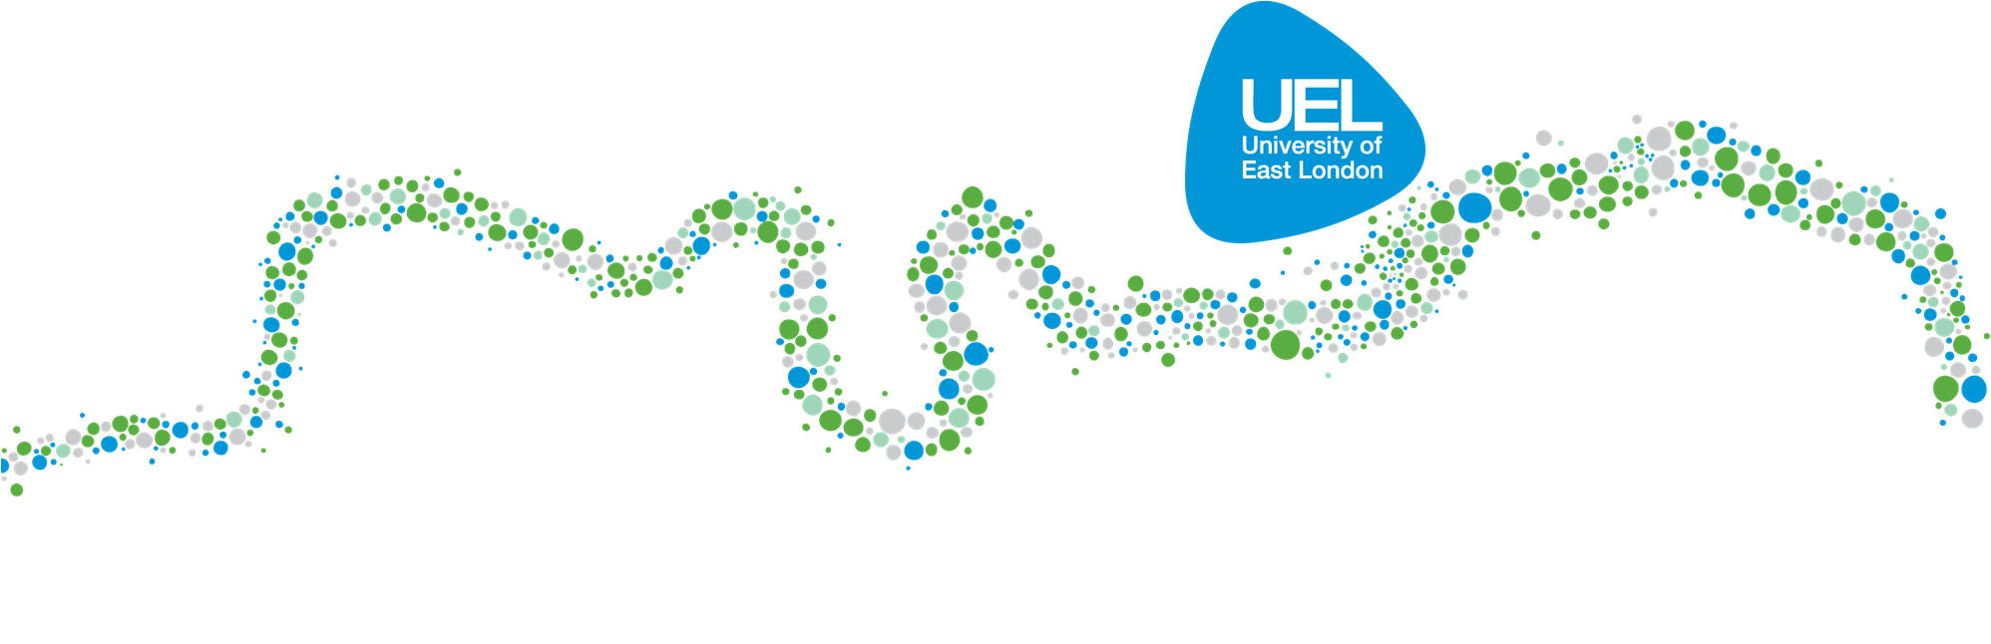
The Role of Gamma-Aminobutyric Acid B Receptors in Alcohol Related Behaviours in Drosophila Models of Ethanol Tolerance and
Daniel Ranson BSc MRes
PhD Student- Medicines Research Group
University of East London
d.ranson@uel.ac.uk @mrdanielranson

Slide 2
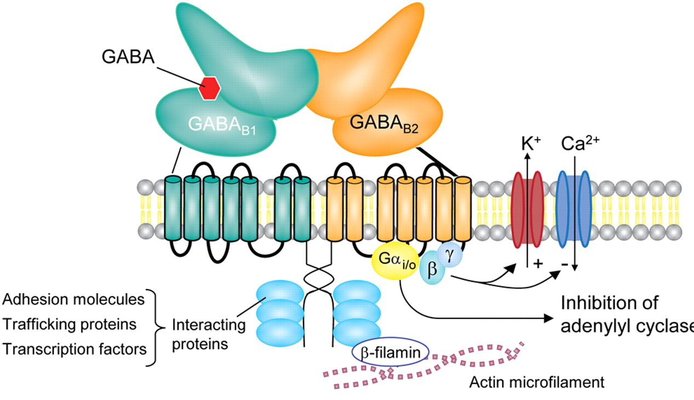
GABA B Receptor
Heterodimer structure:
  2 Subunits: B1 & B2
Class C GPCR:
  Ca²⁺ and K⁺ channels and elicit both pre/post synaptic inhibitions.
Binding modulates change in G Proteins.
d.ranson@uel.ac.uk @mrdanielranson

Slide 3
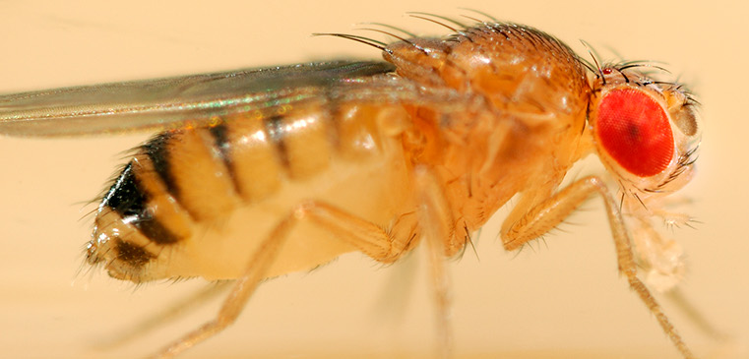
Drosophila melanogaster
Drosophila melanogaster is one of the most genetically accessible animal models.
Behavioural similarities shared between mammals and the fruit fly when exposed to ethanol:
  Both exhibit locomotor stimulation
  Both exhibit sedation
  Both exhibit preference
In addition, flies exhibit preference for ethanol in a number of ways, in their natural behaviours:
  Females prefer to lay eggs on ethanol containing food.
  Larvae spend more time on ethanol containing food.
  Flies prefer to eat ethanol containing food.

Slide 4
Tolerance Development and Sensitivity Reduction to Ethanol Vapour
d.ranson@uel.ac.uk @mrdanielranson
Agonist Administration: Sensitivity to Ethanol Increases
Antagonist Administration: Sensitivity to Ethanol Decreases

Slide 5
Project Objectives and Findings to Date
✓
Develop further the Drosophila melanogaster as a model to study the effects of addiction like behaviours.
Investigate GABA_{B} gene behaves differently in response to alcohol.
Investigate if GABA_{B} receptor drugs can effect addiction like behaviours.
Determine if tolerance to ethanol can be reversed by the administration of a GABA_{B} receptor drugs.
Determine if tolerance to ethanol can be prevented with the administration of GABA_{B} receptor drugs before ethanol exposure.
✓
✓
✓
✓
d.ranson@uel.ac.uk @mrdanielranson

Slide 6
Thank you for listening!
Daniel Ranson BSc MRes
University of East London| Stratford Campus
d.ranson@uel.ac.uk @mrdanielranson linkedin.com/in/danielranson

