Slide 1
Science & politics – synergy or conflict
The drive to time-limit OST – is it austerity or ideology ? Is it good science and good practice ?
Annette Dale-Perera

Slide 2
Declaration of interests & conflicts
2015 Independent consultancy company: contracts with Home Office, CRI, Labour Party, Responsible Gambling Trust, Inspire Education, etc. Director Choices Consortium CIC; Trustee Adfam and Build on Belief
Member of Advisory Council of the Misuse of Drugs (ACMD) & co-chair of Recovery Committee
Previously
Director of NHS Addiction and Offender Health Services, Director of Quality National Treatment Agency for Substance Misuse; UKDPC; DrugScope, Research Fellow at Centre for Research on Drugs and Health behaviour, etc
Speaking in independent capacity
Yes, I am often conflicted about many things !

Slide 3
Time-limit OST: OST ‘cure to curse’
2001-2009 rapid expansion of drug treatment in England
Pre 2008: OST seen as positive, excellent drug treatment coverage
2007/8: ‘Broken Britain’ & ‘Addicted Britain’ Tory think tank
Growing user/ ex-user lobby for healthier & more fulfilling lives;
Some academics highlight poor quality drug treatment and an ‘ill’ marginalised population on OST
2010: new Government, new Drug Strategy. RECOVERY at its heart is POSITIVE but drive is for ABSTINENCE. OST seen as negative.
Coalition government ‘special advisors’

Slide 4
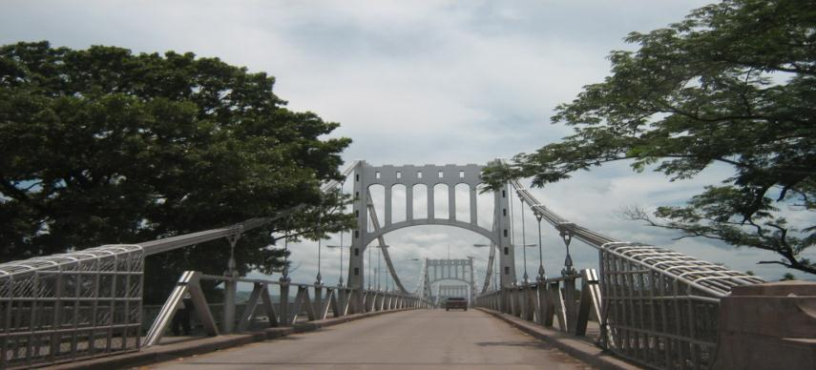
Policy shift on OST – an analogy
Choluteca Bridge: Honduras
OST as a strong bridge to recovery

Slide 5

Choluteca Bridge
Honduras after Hurricane Mitch
OST stranding people in ill health isolation and unemployment

Slide 6
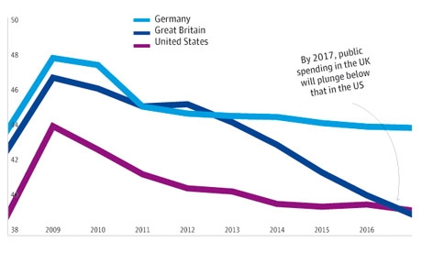
A Perfect Drug Policy Hurricane: austerity, Politics, ideology, competitive treatment market
New Political ideology
Government ideology is to reduce state dependence
Heroin users in OST typify dependence on the state
Conflict in Drug Treatment
Recovery revolution: like a ‘class war’- some user groups
Tensions harm reduction, social asset building approach, & ‘medical management’
Evidence is we need ALL for recovery-orientated treatment
Austerity
Real risks to more expensive treatments, staff, and quality due to reduced budgets
International Monetary Fund Public spending projections: UK below USA by 2017
Competitive market & re-procurement in England: An(other) English disease

Slide 7
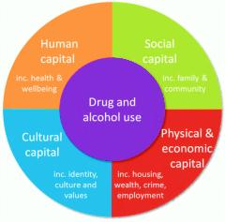

Fuelled by competing voices in our field
‘The only True Recovery is abstinence’
Full Recovery (Abstinence) is the only recovery we will accept
Reduction of harm alone is not an acceptable outcome
Recovery is an individual process involving: overcoming dependence; maximising health and wellbeing and people being participating members of society
Medical management of substance addiction without asset building leads to people being parked on methadone
Recovery is social revolution for drug users who suffer health inequalities
The drive for recovery was positive but fell into BLAME CULTURE around types of treatment and recovery interventions and services users. Stories vs research

Slide 8
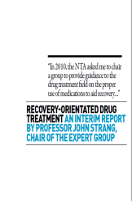

Managing the politics of recovery
Inter-ministerial Group on Drugs: IMG 2009-2014 Coalition government politics plus departmental interests. Challenge - lack of ambition, “poor outcomes” & OST system failure
ACMD Recovery Committee created to provide evidence-based advice to ministers due to ‘conflicting voices’ about Recovery
NTA changed key performance indicators to treatment completion without re-presentation
Drug Advisors from USA including Keith Humphries & Thom McLellan
Professor John Strang recovery - -orientated expert group reports
(SOME) MINISTERS CONTINUED TO BE UNHAPPY ABOUT OST

Slide 9
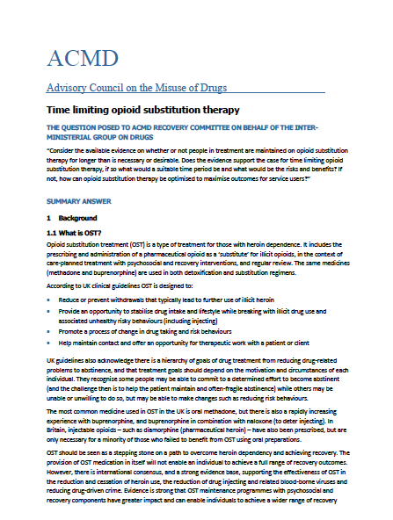
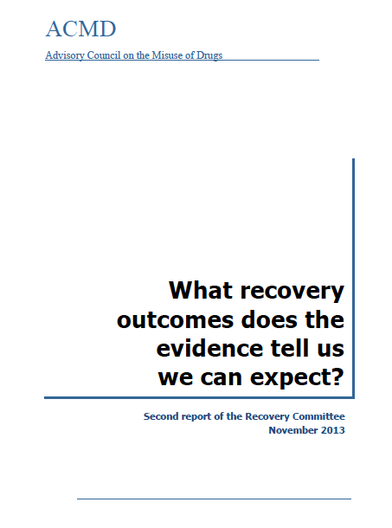
ACMD RC was given the question ……
Does evidence supports the case for time-limiting opioid substitution therapy (OST); and if so, what would be a suitable time period and what would the risks and benefits be? Part 1
Additionally, if this is not the case how can continuing opioid substitution therapy be optimised in order to maximise service user outcomes ? Part 2
Part 1 delivered Nov 2014
Part 2 delivered June 2015
and Oct 2015

Slide 10
Answer to time-limiting OST: Part 1
Evidence does not support a blanket policy to time-limit OST
The likely result would be relapse with significant unintended consequences including:
  Increased crime (drug Tx = 25-33% of fall in acquisitive crime),
  increase in BBV and drug-related death.
  Medico-legal challenges may make it un-implementable
Most are not ‘parked’. Most have episodic use of OST. 10-15% have been in OST 5 yrs or more. 40% retained less than 6 months, median stay is around 300 days, 69% in OST under 2 yrs
BUT: there are significant issues around variable quality drug treatment and recovery systems.

Slide 11

REACTION

Slide 12
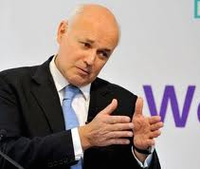
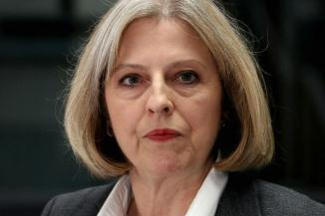
IMG reactions to Part 1
Chair: Norman Baker LibDem had just resigned over Tory’s non evidence-based approach to drug policy
Most departments accepted the report, some reluctantly
Some did NOT accept the report
Ian Duncan Smith DWP complained about ACMD and wrote personal letter to Daily Telegraph … we must now fight the Methadone Industry that keeps addicts hooked…
The Home Office control the drug strategy
MORE QUESTIONS FOR OST PART 2

Slide 13
Part 2: Optimising OST key messages
We cannot tell who will ‘get better’ except broad predictors
Protect the investment – it is at risk
Strive for stability in drug treatment so stop frequent re-procurement which has a negative impact on recovery outcomes
National improvement programme for OST to ensure evidence-based practice is implemented. Set clear minimum standards
Ensure enough abstinence pathways & ongoing recovery support
Tackle discrimination and stigmatising of those in medication assisted recovery by health services; employers and communities
More research to build UK evidence on recovery

Slide 14
Conclusions
DRUG TREATMENT in UK is always driven by ideology
New drug strategy is due
There has been a fundamental shift in belief about ‘what works’
Resource cuts and drive for cheapest is mitigating against evidence-based practice and ‘expensive staff’/interventions.
WE NEED TO KEEP DELIVERING EVIDENCE-BASED ADVICE
WE NEED MORE EVIDENCE TO TRACK IMPACT OF TRENDS IN COMMISSIONING, CHANGES IN PROVISION & RESOURCE CUTS ON RECOVERY OUTCOMES
A ROLE FOR SSA AND RESEARCH. PLEASE HELP. Don’t leave it to ACMD volunteers with no budget and ‘official statistics’

