Slide 1
SSA Annual Symposium 2015
Developing the Addiction Therapist Rating Scale (ATRS): a tool for evaluating treatment delivery
Helen F. Crosby
PhD Student
Academic Unit of Psychiatry and Behavioural Sciences
Leeds Institute of Health Sciences
School of Medicine
University of Leeds

Slide 2
Acknowledgements
Supervisors and co-applicants: Gillian Tober (Leeds Addiction Unit),
Gary Latchford (LIHS), and Bridgette Bewick (LIHS).
Leeds Addiction Unit

Slide 3
What is my research about?
The ATRS will have utility in routine practice
Supporting routine clinical supervision
Evaluating training of addiction therapists
How did the project come about?
Previous work evaluating treatment fidelity (AESOPS & ADAPTA)
Talking to therapists
Aim
To develop the Addiction Therapist Rating Scale (ATRS): a rating scale for evaluating therapist delivery of psychological interventions used in routine practice for drug and alcohol use problems

Slide 4
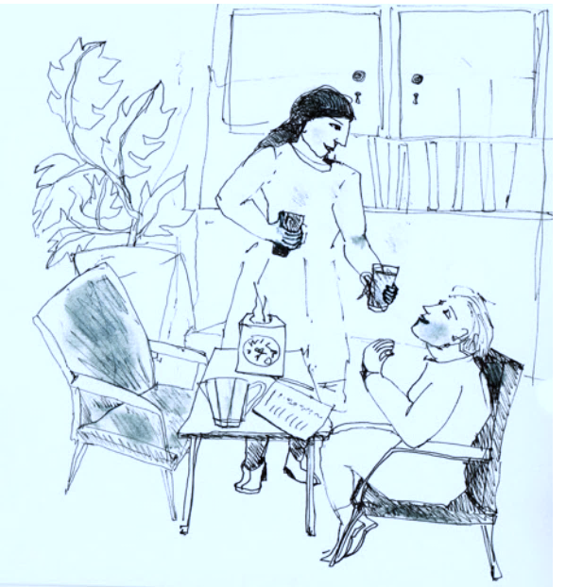
What is my research about?
Treatment fidelity measures in the addiction field
Yale Adherence and Competence Scale (YACS)
Motivational Interviewing Supervision Training Scale (MISTS)
Fidelity measures in routine practice
Measured indirectly during supervision
Relies on self-reports
Use of video recordings
ATRS
A validated scale for use in routine practice
Transtheoretical focusing on therapist competence

Slide 5
What am I going to do?
Development and Validation
Implementation
Item selection
Identify existing fidelity measures
Generate items
Scale content
Delphi exercise
Content validity
Scale piloting
Face validity
Validity
Construct
Concurrent
Reliability
Inter-rater
Test re-test
Clinical team
Training
What works?
Barriers to implementation

Slide 6
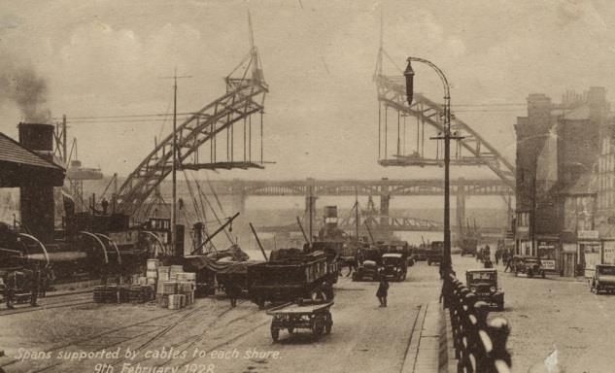
Where am I up to?
Study approvals
Identifying existing fidelity measures
58 papers, from which 35 scales have been identified
What can be seen so far?
Research vs. clinical use

Slide 7
UKATT Process Rating Scale
Tober et al. 2008
SBNT & MET
26 items, e.g. homework, empathy, and eliciting optimism for change
Items rated on two 5-point scales:
Therapist frequency:
To what extent did the therapist…?
Not at all | A little | Somewhat | Considerably | Extensively
0 | 1 | 2 | 3 | 4
Therapist quality:
How well did the therapist perform the behaviour within each item?
Not at all well |  |  |  | Very well
0 | 1 | 2 | 3 | 4

Slide 8
Cognitive Therapy Scale – Revised
Blackburn et al. 2000
12 items, e.g. homework setting, pace and efficient use of time
Items rated on a 7-point scale
Incompetent Novice Advanced beginner Competent Proficient Expert | 0 |  | Absence of feature, or highly inappropriate performance
 | 1 |  | Inappropriate performance, with major problems evident
 | 2 |  | Evidence of competence, but numerous problems & lack of consistency
 | 3 |  | Competent, but some problems and/or inconsistencies
 | 4 |  | Good features, but minor problems and/or inconsistencies
 | 5 |  | Very good features, minimal problems and/or inconsistencies
 | 6 |  | Excellent performance, even in the face of patient difficulties

Slide 9
Where am I up to?
Study approvals
Identifying existing fidelity measures
58 papers, from which 35 scales have been identified
What can be seen so far?
Research vs. clinical use
Routine practice data collection
Site 1: 18 therapy sessions recorded
Site 2: Recruitment started

Slide 10
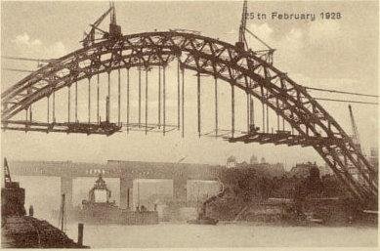
What’s next?
Focus on developing the ATRS
Short list items from the literature review for potential inclusion
Conduct the Delphi exercise
Facilitating a consensus on the scale content
Identify around 15 professionals
Invitation to take part…
Preparing for Study 2: Scale validation
routine practice data collection

Slide 11
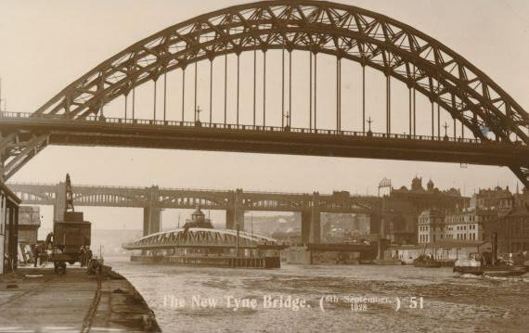
And finally… Thank you
Any questions?
Three years later…

Slide 12
Picture acknowledgements
Images of the fossil, rating scale, and Tyne Bridge have been drawn from the following sources:
Kimler, W.C. The Implications of Fossils [Online]. Accessed 1 November 2015. Available from: http://www4.ncsu.edu/~kimler/hi322/fossils.html
Lentz, M. 2005. Wine-Girl.net Rating Scale [Online]. Accessed 1 November 2015. Available from: http://www.wine-girl.net/winegirlnet-rating-scale.html
Williamson, A. 2004. The Tyne Bridge Under Construction as seen in old postcards and photographs [Online]. Accessed 1 November 2015. Available from: http://picturesofgateshead.co.uk/postcards_tyne_bridge_uc/index.html

