Slide 1

Impact of Alcohol Related Problems on Families
H Collinson, K Warburton, C Eyles, N Sheron & J Sinclair
Notes:
Good morning. My name’s Helen Collinson, I’m a final year medical student from the University of Southampton. Today I’m going to talk about the study that myself and another medical student conducted over the past 2 years, entitled “Impact of alcohol related problems on families”.

Slide 2
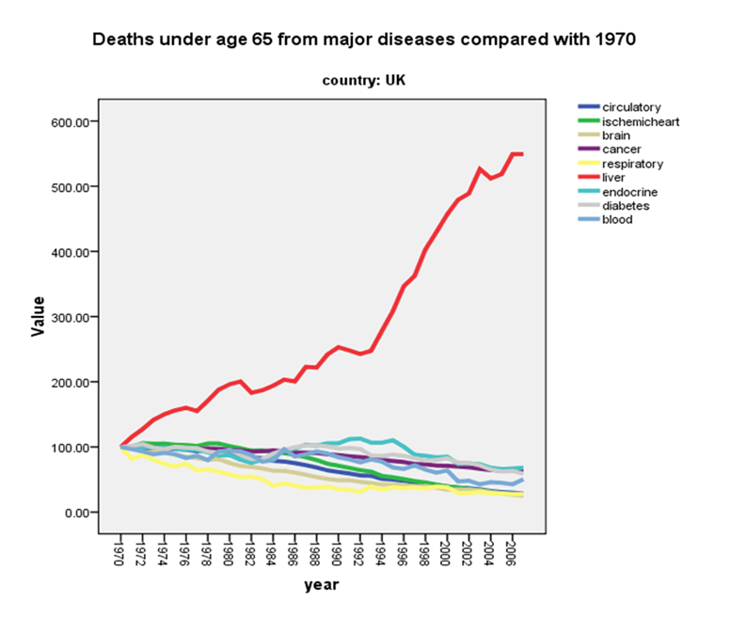
Liver disease and alcohol statistics
Health and social care information centre. 2012.
Notes:
Now I know you all have an extensive knowledge on recent alcohol statistics but I want to draw your attention to the significant impact of alcoholic liver disease.
As we can see from the graph on the right, while the number of under 65s dying from major diseases have decreased dramatically, you can see that deaths from liver disease are exponentially rising.
Also looking at the graph on the left shows that of all alcohol related deaths ALD deaths constitutes nearly 2/3s. This is a phenomenal percentage demonstrating the devastating impact of this disease.

Slide 3
Severity of alcohol dependency in patients with ALD v patients undergoing alcohol detox
Smith et al. (2006).
Notes:
Finally we are also aware of the differences between patients undergoing detoxification of alcohol and those being treated in hospital for ALD. A recent study in Southampton showed that nearly 2/3 of ALD patients have none or mild alcohol dependence as measured by the SADQ. In comparison 76% of patients detoxing at a residential centre having severe dependency.
This shows that patients with ALD are different from those undergoing alcohol withdrawal, in respect to their drinking habits and their health complications. There is no doubt that these patients are affected physically, psychologically and socially but it is also important to consider the effect on the patient’s families who are commonly their support network.
Graph showing the large proportion of those with ALD don’t have alcohol dependence
58% of ALD pt scored none/mild on SADQ
32% score moderate
9% score severe
76% AD patients scored severe

Slide 4
What do we already know about the impact of Alcoholic Liver Disease (ALD) on families?
ALD
Liver disease
Alcohol dependency
Chronic disease
Notes:
So what do we already know about the impact of ALD on families?
As yet no literature has been published. However, despite a lack of specific literature, there is plenty of relevant literature which offers a flavour of the current understanding in this field.

Slide 5
Summary of current literature
Impact of alcohol dependency on families¹
Children, females; domestic violence and decreased marital satisfaction, health, coping methods, support.
Impact of chronic disease on families^{2,3}
Psychological impact; depression, anxiety, PTSD.
Impact of liver disease (CLD, cirrhosis and transplantation) on families^{4,5} Psychological impact and caregiver burden.
ALD
References:
Orford et al. (2010).
Holmes et al. (2003).
Hickman et al. (2010).
Bolden et al. (2010).
Bajaj et al. (2011).
Notes:
The literature regarding the impact of AD, chronic disease and liver disease on families is summarised.

Slide 6
Aims
To explore how having a relative suffering from ALD impacts on families.
To explore any differences between patient groups (ALD v. AD).
Notes:
So to fill in the gap in our understanding, the aim of my study was to explore how having a relative suffering from ALD impacts on families.
To explore any differences between patient groups (ALD v. AD).

Slide 7
Methods
Notes:
In keeping with the explorative nature of this study I used qualitative phenomenological approach to data collection and analysis. I conducted face to face semi structured interviews ranging from 15mins-2hours.
The family members invited to be interviewed were purposefully sampled from separate locations. They were family members of in-patients with ALD being treated at Southampton General Hospital and family members of out-patients being treated for alcohol dependency at community alcohol services in Southampton and Winchester.
The interview transcriptions were then coded to form emerging themes that reflected similar phenomena experienced by family members and the key issues that they face.
During this process it became apparent that the emerging themes reflected the views and issues of both families with ALD and AD patients. Hence it was deemed appropriate to pool the results instead of considering the carer groups separately.

Slide 8
Results
16 interviews
15 female participants
1 male participant
9 carers of Alcoholic Liver Disease patients
7 carers of Alcohol Dependency patients
Notes:
Read out slide
9 themes emerged from the data however, none mutually exclusive instead they influenced or interlinked with others at different levels as I will hope to demonstrate.

Slide 9
Threat to home life
Concern/worry
“like Jekyll and Hyde”
Emotional distress/rollercoaster
Carer Isolation
Lack of understanding of alcohol addiction
Support
Who cares for the carer?
Coping mechanisms
Notes:
9 themes emerged from the data however, none mutually exclusive instead they influenced or interlinked with others at different levels as I will hope to demonstrate.
-Like Jekyll and Hyde
The theme title Like Jekyll and hyde is an in-vivo quote from two participants. It reflects patient’s split personality when heavily intoxicated. Many were described to lack responsibility, especially with money, be compulsive liars and highly secretive about their alcohol use. They’re behaviour was reported to be unpredictable, aggressive, abusive and risk taking.
“he did grab hold of my son and that was it, I said “you go now”. He didn’t actually physically hit but I could see the fear in my son’s eyes.” AD 14
-Emotional distress/rollercoaster
The turmoil of the patient’s behaviour has severe consequences for their family members. They reported a myriad of emotions, in particular: Embarrassment, frustration, being frightened to being angry and frequently very sad, yet one third of the participants still described feelings of hope. Ultimately they’ve experienced a rollercoaster of emotions.
“we’ve had highs and real lows with no in-between at all” ALD 2
-Support
-Carer isolation
-Lack of understanding of alcohol addiction
-Who carers for the carer
Another topic continually discussed in the interviews was support, or the lack of it
“I feel that people don’t want to talk about his drinking problem. They’ll talk about the medical side of things…it’s just that they’re not specialised in the alcohol field as in giving support to family members.” ALD 1
which gave rise to another theme, carer isolation. Other family members being unhelpful, causing friction or allowing one relative to take sole responsibility enhanced this feeling of isolation. Looking at these concepts in more detail it became apparent that a lack of understanding of alcohol addiction by other family members, children, professionals and the public is to some extent fuelling this lack of support.
“I had to go in because I was really worried and the doctor was in my face ...“what you doing here I can’t speak to you about Mr P he’s a grown up”. And I said I’m here because he won’t tell you everything that’s really going on. I mean he had me in tears... he actually turned to me and said “Give him a break” CSS 5
However, patients themselves were also reported to be oblivious to the impact of alcohol addiction, especially on others, and were in a state of denial regarding their excessive alcohol use.
“He was rushed into intensive care. It was 60:40 not in his favour… He said “Ah I picked up a virus mum” CSS 5
Once again this is reflected by their poor attitude and behaviour as described in ‘like jekyll and hyde’.
So going back to the theme carer isolation, it is not only due to a lack of support but also the time consuming nature of the family member’s caring role, which was reported to negatively impact on their social life and opportunities for spontaneity.
“You’re left feeling quite abandoned.” ALD 1
“They end up taking over your life.” AD11
This concept of self-neglect interlinks with a similar theme “who cares for the carer?” The carers desperately want to help, mothering, defending and protecting their ill relative, taking responsibility that the patient lacks and in many cases becoming financially supportive. And in return who looks after them? They are having to adapt to a changed relationship, have been affected physically and mentally and have suffered the emotional trauma of witnessing the patients physical lows and experiencing near loss situations.
“It doesn’t just kill them, it kills the people looking after them.” AD 3
“I’ve got my own issues…I’ve got liver damage, I’ve got hepatitis, I’m HIV positive.” AD 12
-Normalisation and coping- link to theory
So how do the relatives cope with this stress and strain? In this study there was huge variation in methods, by individuals when they felt that one strategy wasn’t working and between different family members.
Broadly speaking the three most common strategies were:
Engaging
Withdrawing
Tolerating
However of those that tolerated, some did so readily- accepting it, while others normalised, justified or defended the patient’s behaviour.
“he was never the stereotypical alcoholic, he doesn’t hide bottles, he doesn’t drink anything that’s in the house. He was solely a bitter or larger drinker”. ALD 2
This shows that to each coping method there are slight variations which comply with John Orfords theory that coping methods are not mutually exclusive but actually form part of spectrum.
Umbrella themes:
All the themes described so far can ultimately be overarched by two final themes. The first of these is concern/worry.
-Concern/worry
The family members were predominantly worried for the patients, their physical health and their future. In many cases this is the fundamental reason that they have continued to offer support.
“I’ve obviously got major concerns about dads health, the long-term prospect.” ALD 2
“it got so bad that I did try getting her admitted to the DOP because she was completely off her head” ALD 9
Those with children involved also expressed their concern about the impact it was having on them.
“when he’s had enough to drink he doesn’t talk to them anymore he shouts at them. The littlest ones get so frightened they wet themselves.”
-Threat to home life
Concern about the impact on children relates to the final overarching theme of the study, “threat to home life”. This theme is built on codes already discussed which are included in other domains. Most importantly: the 24hr caring required, the financial impact to families, arguments and conflict at home and relationship issues between the relative and the patient or other family members.
“You’ve got to keep money aside for his addiction because he will go and borrow off other family members and then you’re put in to more debt paying it all back.” ALD 3
“There’s no light at the end of the tunnel when you have a relationship with an alcoholic.” ALD 7
Ultimately, the themes of concern and threat to home life unite the 7 smaller themes.
So as we can see from the results the impact of alcohol related problems on families is vast and complex, for both ALD and AD relatives.
Despite the relatively small number of participants and the female predominance to the results, I feel that they still give a true representation of the experiences and feelings of affected family members, as similar codes continued to emerge throughout all 16 interviews. However, in the future more studies focusing on the impact on male relatives is required.

Slide 10
What messages does this study have for us?
Notes:
So what messages does this study have for us?
How can these family members be helped?
Well ultimately the problems stem from the patients alcohol use so improving for patient care for those affected and decreasing alcohol use at a national level could go some way to easing the burden for families. However that is far beyond the realms of this study and some family members have been so affected by their relatives drinking that even if they now stopped the negative impact has already occurred (on themselves and their children).
These families need support and although community alcohol services should be offering this, those that present to hospital with ALD patients miss out. Whether this support is adequate needs to be further assessed but at the very least the same level of care should be accessible no matter which domain of healthcare services these family members are involved in. Hence my recommendations…..

Slide 11
Recommendations
Carer burden could be significantly reduced by improving patient care and offering families appropriate support.
Families of ALD in-patients should have access to the same level of support that is offered to families of patients under specialist community alcohol services.
Notes:
Well ultimately the problems stem from the patients alcohol use so improving for patient care for those affected and decreasing alcohol use at a national level could go some way to easing the burden for families. However that is far beyond the realms of this study and some family members have been so affected by their relatives drinking that even if they now stopped the negative impact has already occurred (on themselves and their children).
These families need support and although community alcohol services should be offering this, those that present to hospital with ALD patients miss out. Whether this support is adequate needs to be further assessed but at the very least the same level of care should be accessible no matter which domain of healthcare services these family members are involved in. Hence my recommendations…..

Slide 12
Acknowledgments
Dr Julia Sinclair (Honorary Consultant Addiction Psychiatrist)
Dr Nick Sheron (Consultant Hepatologist, SGH)
Dr Caroline Eyles (Research Fellow, UoS)
Debbie Duffy (Alcohol Specialist Nurse, SGH)
Claire Appleby and the team at New Road Centre Southampton (a community substance misuse service)

Slide 13
Thank you for listening
Any questions?

