Slide 1
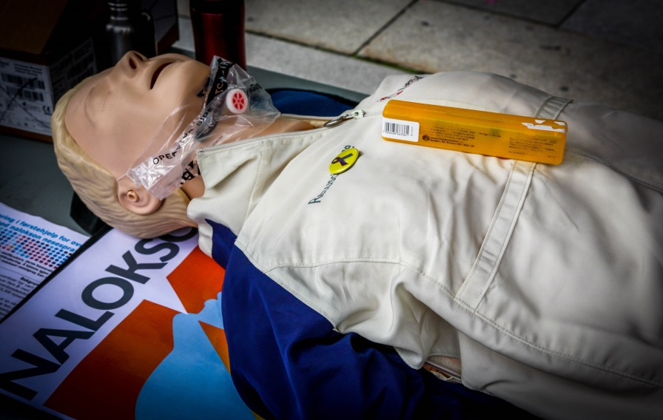
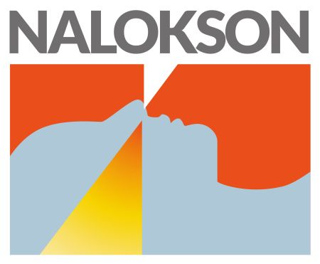
Naloxone nasal spray in Norway
Thomas Clausen
Professor (Dr. med)
thomas.clausen@medisin.uio.no
5. November 2015

Slide 2
Conflicts of interest
None
Thomas Clausen is a full-time employee at the Norwegian Centre for Addiction Research, University of Oslo, Norway

Slide 3
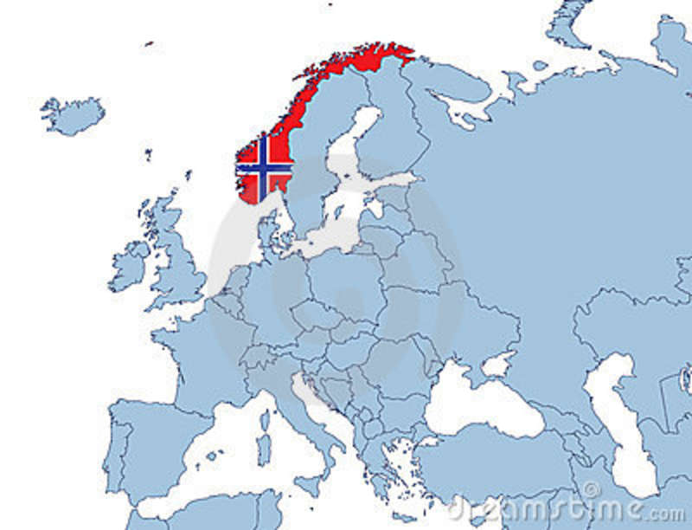
Norway
Population: 5 mill
+/- 10.000 opioid
drug users
90% inject
Heroin & polydrug
7400+ in OMT
Universal health
care system
Free access to treatment

Slide 4
Background
Norway has high rates and numbers of fatal overdoses (ODs)
OMT coverage +/- 60%
Increasing evidence: Take-home-Naloxone may reduce fatal ODs

Slide 5
National Strategy
Minister of Health; launched national overdose prevention strategy (2014)
5-year overdose prevention strategy
0-vision for ODs in the long-term
Includes multiple sub-strategies as well as funding
Nasal naloxone distribution
Accompanied by research/evaluation funds
http://www.helsedirektoratet.no/publikasjoner/nasjonal-overdosestrategi-20142017/Sider/default.aspx

Slide 6
Fatal opioid OD rates by nasal naloxone introduction rates
Naloxone coverage per 100K
Opioid overdose death rate
27% reduction
46% reduction
Walley et al. BMJ 2013; 346: f174.

Slide 7
Prior to distribution
No available nasal naloxone in Norway
NOMA approved Nasal naloxone (June 2014)
Based on EU-MA medication (injectable, for peer-admin.)
New route of administration
2mg/2ml – 5 dose - Prefilled syringe + Nasal adapter (MAD300) > No needles
No individual prescription

Slide 8
Nasal application Considerations
Increasing clinical/epidemiological evidence from US
Lower risk for 3.party injury
Expected lower barrier to use
No history of failure from clinical practice
Perceived overall positive Benefit/Harm ratio
Above supported rapid implementation
Lack of formal PK-data
Project (partial) implementation

Slide 9
Nasal naloxone: Project-structure
Implementation in 2 largest cities (1/3 of ODs)
2-year pilot period
Formal evaluation of project
Is distribution feasible and does it work?
Recommendations for future, based on local and international evidence

Slide 10
Overdose Prevention Training A public health approach
Training existing staff with 2-hour sessions
500+ staff
Multiple sites-
Housing facilities
Drop-in day centres
Services “on-wheels”
Police
Family members/Relatives
Prisons
Detox
OMT
Rescue breathing
Call ambulance
Use Naloxone

Slide 11
Status October 2015
1500 naloxone kits distributed
400+ returns for refills
60% used in OD situation
Of 215 feedback forms (July 15):
1 died, and 11 unknown outcome
Aim to distribute at least 100 kits/100.000 in the two cities (annual ODs +/- 80)
Aim; minimum 900 sprays (within one year)

Slide 12
Success factors
Governmental support & funding
Part of national strategy
NOMA approved nasal medication
Local pharma company
No individual prescriptions
Relying on existing healthcare facilities
Involvement of user-groups

Slide 13
…and obstacles
Getting general approval for a new route (nasal) of administration of Naloxone
New kits to come, seem to be one-dose only with relatively high concentration
Cost; price per kit; 50$

Slide 14
Feedback from client
[Upon her 3rd refill]
“It’s worked every time. I see he’s blue, and then within a few minutes he’s up standing! Should have had it sooner. I’ve seen too many of these [overdoses].”
- Client, drop-in center Bergen

Slide 15
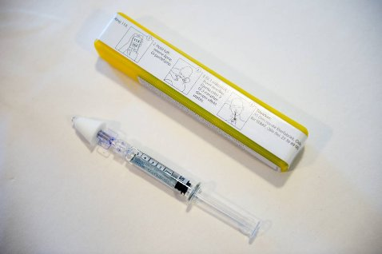
Norwegian nasal naloxone
5 doses of 0,4mg Naloxone
Notes:
Here are some pictures

Slide 16
Naloxone Nasal Spray in Norway
thomas.clausen@medisin.uio.no
www.stoppoverdose.no
Contact

