Slide 1
Prof J. Chick and Dr J. Gill
J C is Medical Director at Castle Craig Hospital, Scotland

Slide 2
The Research Team Acknowledgements
Prof. Jonathan Chick
Dr Jan Gill
Fiona O’May
Robert Rush
Prof Barbara McPake
Heather Black
Cheryl Rees
Jane Doogan
Christine Galloway
Lucie Michalova
NHS Lothian Endowments Fund. SMHRN

Slide 3
Original study design
6 months | 12 months | 18 months | 24 months
Data collection Time-point 1 | Time-point 2 | Time-point 3 | Time-point 4
MUP
MUP
Supplemented with Qualitative interviews
Cohort study; n=639 (females = 181, males = 458) heavy drinkers, ‘harmed by alcohol’, recruited in Edinburgh, and Glasgow.
Data to be presented were collected at Time-point 1.

Slide 4
Participant inclusion criteria:
Attending an alcohol problems service out-patient appointment
or
being admitted to hospital, and having a diagnosis of an alcohol-related condition (whether or not another diagnosis has also been made)
Measures:
Detailed record of drinks consumed in ‘last’ or ‘typical’ week, type, volume, price paid, location of purchase.
(Self-reported health conditions.
ARPQ – 11 item questionnaire, physical and mental health(6), domestic (3), police (1), work-related problems (1). )

Slide 5
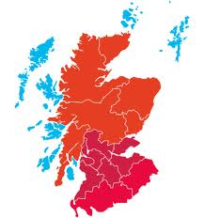
Glasgow
N=345
Recruited during 2012
75.7% male
Edinburgh
N= 294
Recruited during 2012
67% male

Slide 6
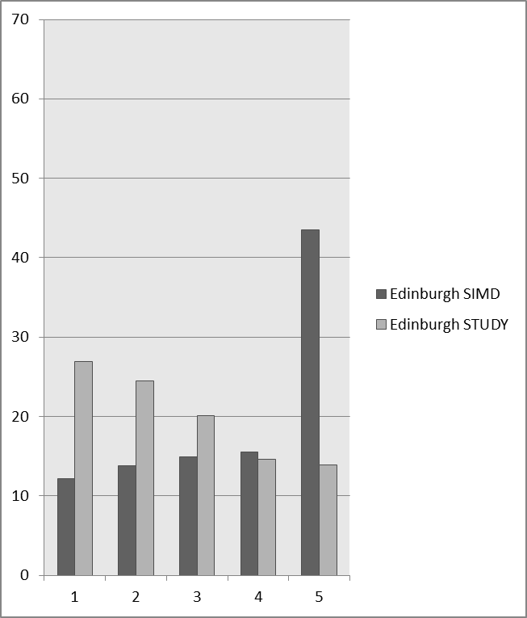
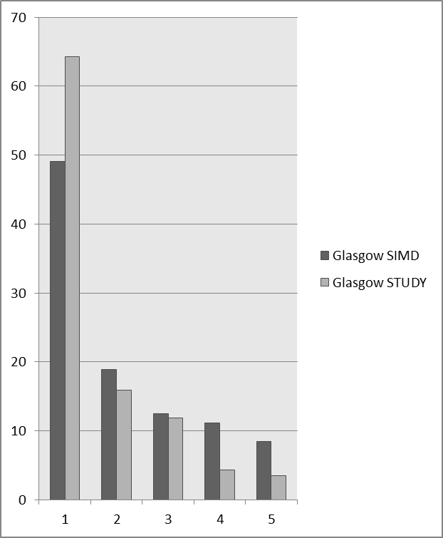
EDINBURGH
GLASGOW

Slide 7
Participant demographics and alcohol consumption (N = 639).
% male | 71.7
Mean Age (years) (95% CI) | 45.6 (44.8-46.5)
Median (IQR) Consumption (typical or last week) UK units | 184.8 (161.3)
Mean pence per unit for all purchased units (all outlets) | 39.7
% of all units purchased as OFF Sales | 95.0
% of all units reported as stolen | 0.49%
Median Expenditure (IQR) in recorded week (£) | 70.00 (62.02)

Slide 8
Drink type choices split by gender
% of all units consumed as different drink types: comparison of female and male participants

Slide 9
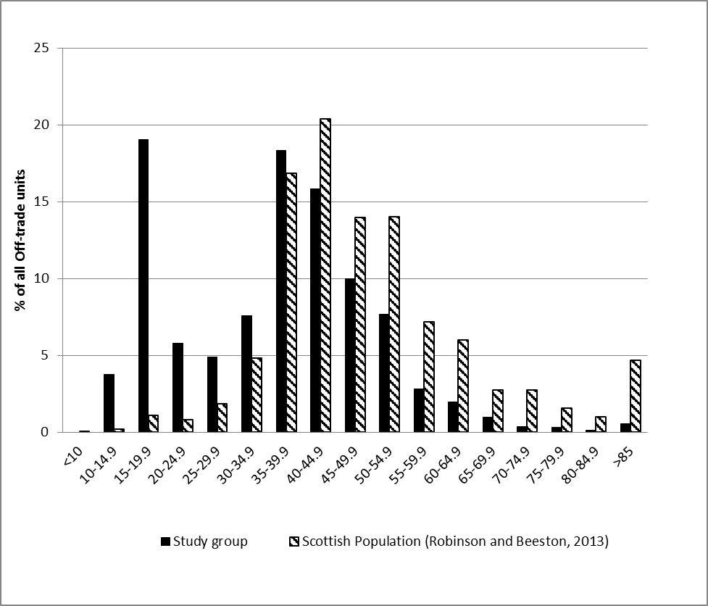
Off sales purchases
by price band:
patients v. Scottish Population
Price band (ppu)
Price distribution (%) of all drinks purchased as ‘Off sale’ by study group (data collected 2012). For comparison, population data from Robinson and Beeston (2013) (MESAS), produced from the Nielsen off-trade dataset (excluding discount retailers) are shown (% of all off-trade alcohol (L pure alcohol)) and sold in Scotland during 2012.

Slide 11
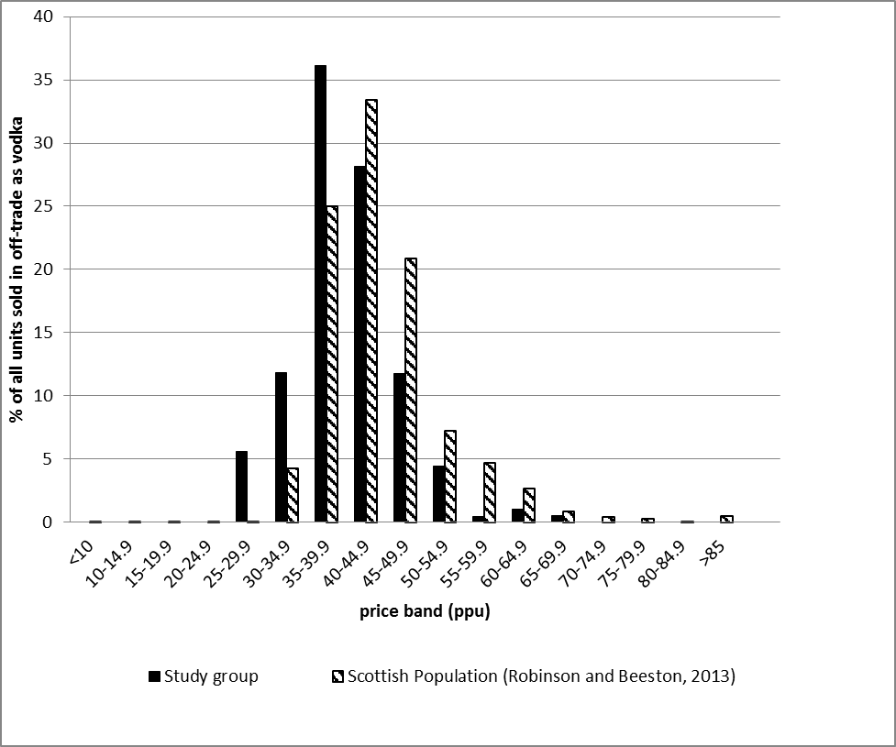
VODKA
Price distribution of units purchased off trade as vodka by study group (data collected 2012). For comparison, data from Robinson and Beeston (2013) produced from the Nielsen off-trade dataset (excluding discount retailers) are shown (% of all off-trade vodka (L pure alcohol)) and sold in Scotland during 2012.

Slide 12
VODKA
54% purchased below 40 ppu.
(wider population 29%)
97% from Off-sales.
(37% from supermarkets)
No difference in mean price paid between corner shops and supermarkets.
Price distribution of units purchased off trade as vodka by study group (data collected 2012). For comparison, data from Robinson and Beeston (2013) produced from the Nielsen off-trade dataset (excluding discount retailers) are shown (% of all off-trade vodka (L pure alcohol)) and sold in Scotland during 2012.

Slide 13
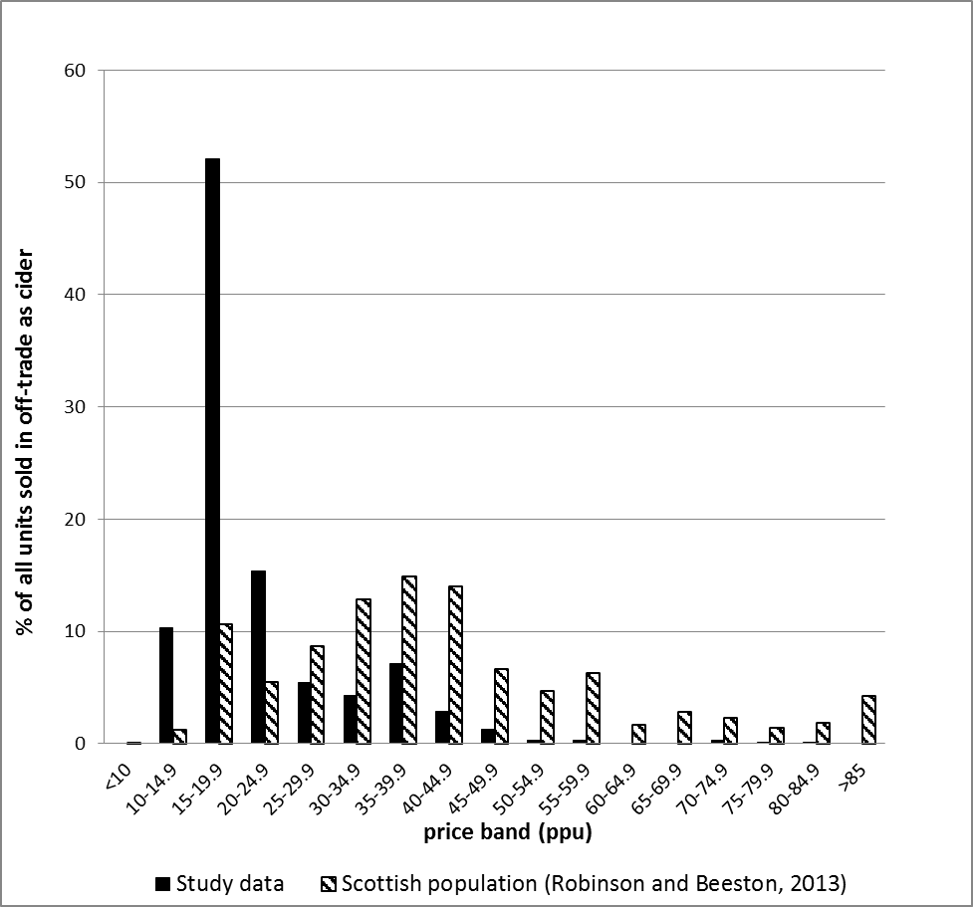
Cider
Price distribution of units purchased off trade as cider (white, amber and pear ciders) by study group. For comparison data from Robinson and Beeston (2013) produced from the Nielsen off-trade dataset (excluding discount retailers) are shown (% of all off-trade cider (L pure alcohol)) and sold in Scotland during 2012.

Slide 14
Cider
White Cider:
70% of all cider sales.
= 97% of sales <20 ppu .
100% as Off-sales.
73.1% sales from corner shops despite being cheaper in supermarkets.
Price distribution of units purchased off trade as cider (white, amber and pear ciders) by study group. For comparison data from Robinson and Beeston (2013) produced from the Nielsen off-trade dataset (excluding discount retailers) are shown (% of all off-trade cider (L pure alcohol)) and sold in Scotland during 2012.

Slide 15
White cider and harm
WC drinkers drank significantly more in index week than other drinkers (p<0.001)
Patients accounts concur with Literature anecdotes of GI harm.
Sample chemical analysis revealed compounds with health relevance (e.g. methanol, higher chain alcohols) were below toxicological thresholds).
Acetaldehyde – possibly a factor in cirrhosis and cancer.
Acetaldehyde intake from cider by our drinkers (0.866 mg/kg bw/day) far exceeds average acetaldehyde intake in the EU from all alcoholic beverages (0.112 mg/kg bw/day)
82% WC drinkers smoked - predicts harms

Slide 16
Trading down when affordability decreases: Comparison between 2008 and 2012 consumption
Overall affordability of alcohol was observed to have fallen by 4.7% between 2008/9 and 2012 (Beeston et al, 2013).
2008 and 2012 patients average weekly consumption same
BUT, the proportion of units purchased as white cider had increased to 22.67% in 2012 compared with 15.93% in 2008.
Thus in times of falling affordability drinkers ‘trade down’ to maintain their intake. (They can do that because very cheap alcohol (i.e. white cider) continues to be available (having increased only from median 14p/unit to median 17p/unit during that period.)

Slide 17
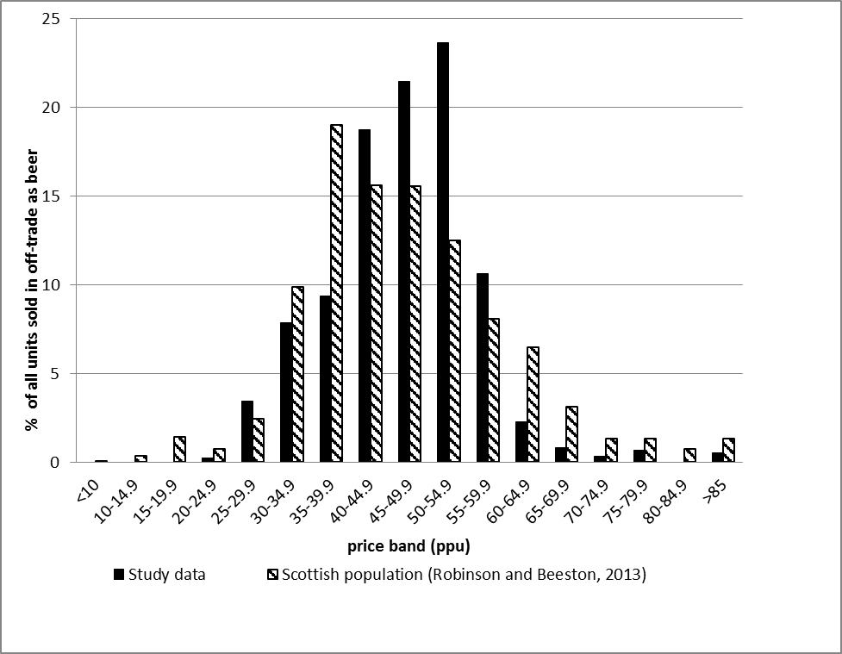
Beer
Price distribution of units purchased off trade as beer. For comparison, data from Robinson and Beeston (2013) produced from the Nielsen off-trade dataset (excluding discount retailers) are shown (% of all off-trade beer (L pure alcohol)) and sold in Scotland during 2012.

Slide 18
Beer
82.4% from Off-sales.
54.5% of Off-sales = corner shops.
Low strength beer (<5%abv) median price in supermarkets less than corner shops.
? multibuys.
Price distribution of units purchased off trade as beer. For comparison, data from Robinson and Beeston (2013) produced from the Nielsen off-trade dataset (excluding discount retailers) are shown (% of all off-trade beer (L pure alcohol)) and sold in Scotland during 2012.

Slide 19
Aspects of female consumption

Slide 20
Findings; Consumption
Women: n = 181
Median (IQR) consumption = 157.6 (159.8) UK units in the index week.
(180 grams ethanol/day)
98.9% as Off sales.
Current UK definition of harmful consumption by women = 35+ UK units/week,
WHO (2000) defines high risk and very high risk drinking as 41-60g/day and 61+ g/day

Slide 21
Women’s (n=181) self-reported consumption in the index week expressed in multiples of the UK definition of harmful consumption (35 UK units per week).

Slide 22
Percentage of units consumed by type with associated mean unit price. (RTD = ‘Ready to drink’ alcopops etc.)
Notes:
3 drinks; vodka, white wine, white cider accounted for 74.3% of all units consumed.

Slide 23
‘Aye, contraband and that….. I would never dream of going near that, even though it’s dirt cheap, you know what I mean. I’m too worried about my health [laughs]’.
‘Fake alcohol : It’s far too dangerous. I’m a bit of a wuss.’
‘Em, I just.. I know it sounds funny but, em, I’m scared of what I put in my body. I know if it’s on sale in a supermarket, then it’s relatively safe. I wouldn’t know what I’d be buying, and I wouldn’t know what was in it, and that would scare me.’

Slide 24
Harm associated with alcohol : women
ARPQ
11 item, self-completed problems score past 6 months
physical health, mental health, social problems including police/court.

Slide 25
Multivariable regression model: Predictors of harm (as operationalised by ARPQ score).
Factor | B (95% CI)
Age of patient in years | -0.067*** (-0.095, -0.038) | younger
Total units consumed in the week - all drinks | 0.006*** (0.003, 0.008) | Drinking more
Living in Glasgow | 1.328*** (0.719, 1.937) | Living in Glasgow
N | 178
Adjusted R square | 0.32
* P<0.05, **P<0.01,***P<0.001
Notes:
Several factors were found to be univariably associated with ARPQ score, namely; age, cigarettes smoked per day, unit price, total units consumed in the index week, white cider percentage consumed, expenditure, time, any drug use, city and SIMD two categories (most deprived versus other SIMD quintiles) (see table 2). A multivariable regression model was developed with those univariably significant factors. This indicated a significant independent negative association with ARPQ for age (-0.067, 95%CI:-0.095, -0.038) and a positive association for consumption in the index week (0.006, 95%CI: 0.003, 0.008) and residing in Glasgow compared to Edinburgh (1.328, 95%CI 0.719, 1.937) (see table 3). The model accounts for around 32% of the variation in ARPQ score.

Slide 26
SUMMARY
Drink choice: price and availability are important –gender influence.
White cider has a ‘buffering’ role when affordability declines.
Acetaldehyde intake from cider by our drinkers (0.866 mg/kg bw/day) far exceeds average acetaldehyde intake in the EU from all alcoholic beverages (0.112 mg/kg bw/day)
Corner shops important sources of drink purchases.
Some beer (and wine) heavy drinkers may be little impacted by MUP set at 50 ppu.

Slide 27
references
Black, H.,Michalova, L, Gill,J. et al (2014) White cider consumption and heavy drinkers: a low-cost option but an unknown price. Alcohol & Alcoholism 49(6) 675-680.
Gill,J et al (2015) Alcohol purchasing by ill heavy drinkers; cheap alcohol is no single commodity. Public Health http://dx.doi.org/10.1016/j.puhe.2015.08.013
Lachenmeier,D.W., Gill,J., Chick,J. and Rehm,J. (2015) The total margin of exposure of ethanol and acetaldehyde for heavy drinkers consuming cider or vodka. Food and Chemical Toxicology 83 210-214.
Robinson and Beeston (2013) Monitoring and Evaluating Scotland’s Alcohol Strategy. Annual Update of alcohol sales and price band analysis. August 2013. Edinburgh: NHS Health Scotland;2013.

Slide 28
Thank you

